Slide 1

BotGods
FLIQ
Financial Language Intelligence Quotient
From 'What is fixed deposit?' to 'Mera paisa kitna badhega?'
Finnovate Hackathon
Kyndryl

Slide 2
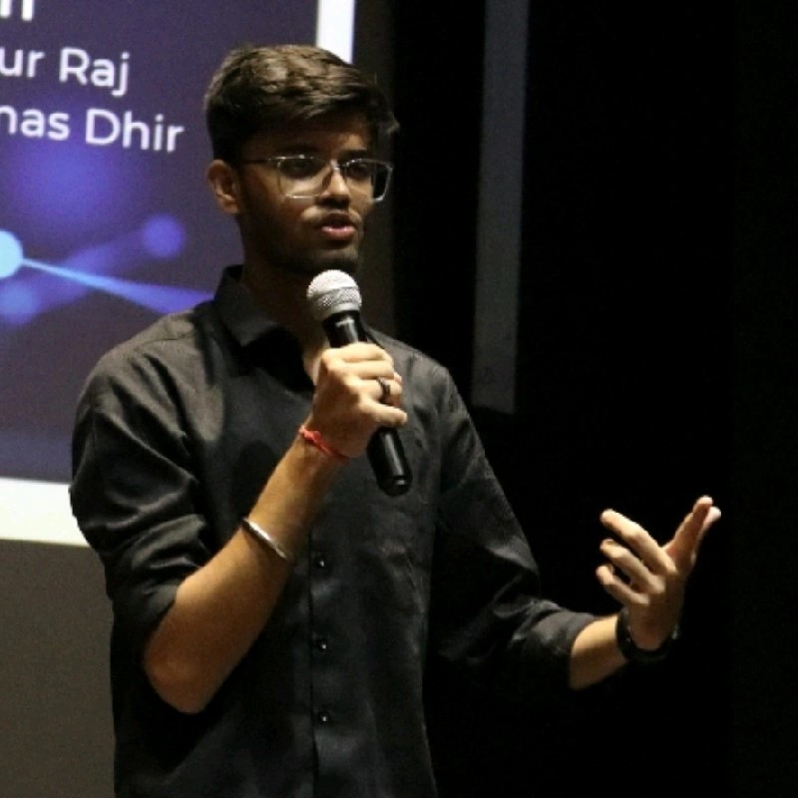

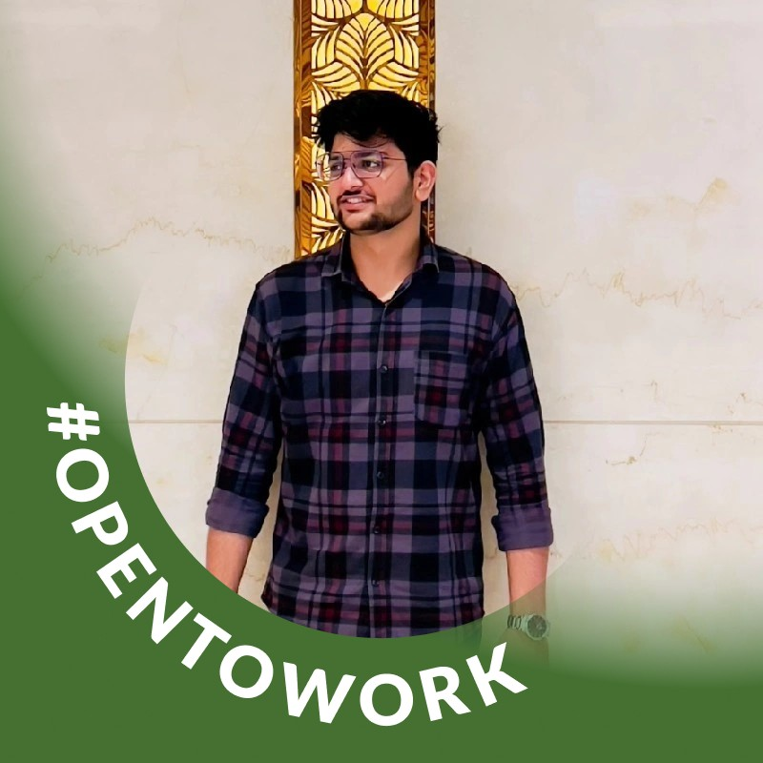
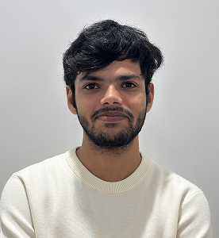
BotGods
FLIQ
Financial Language Intelligence Quotient
Team Members
Akshat Saraswat
Gen AI Dev
ML \ DS
Divyanshu Kasherwal
GEN AI
Cloud Engineer
Kritish Jaitely
GenAI Development
System Architecture
Sushant Kumar
Frontend Developer
Backend Developer
Finnovate Hackathon
Kyndryl

Slide 3
BotGods
FLIQ
Financial Language Intelligence Quotient
Demo link: AI Chat App
GitlHub link: Sushant0753/Kyndryl: Kyndryl x Bhasini Finnovative
Finnovate Hackathon
Kyndryl

Slide 4








BotGods
FLIQ
Financial Language Intelligence Quotient
Agentic AI:Table of Content
Problem Statement
Tech Stack
Solution Overview
MVP Scope
System Architecture
Innovation & Feasibility
UI Overview
Impact Metrics
Finnovate Hackathon
Kyndryl

Slide 5



BotGods
FLIQ
Financial Language Intelligence Quotient
Agentic AI: Problem Statement
Overview:
With over 120 local languages in India, most digital assistants give very general answers and don't understand banking terms or processes, leaving people confused about account details, product features, and financial rules.
This makes digital banking harder to use, especially when customers need clear and simple guidance.
High call abandonment in banking is linked to long waits and confusing IVR; simpler, multilingual self-service reduces drop-offs
Challenges:
Language barriers make it difficult for many rural and semi-urban people in India to use banking services in English - 87.5% of financial executives confirm that language barriers limit FinTech benefits.
Current chatbots sound robotic and lack empathy, contributing to 200% increase in call abandonment since 2019, leading to poor customer experience, low trust, and financial exclusion for millions.
Finnovate Hackathon
Kyndryl
Notes:
Source: https://www.jsr.org/hs/index.php/path/article/view/3198

Slide 6




BotGods
FLIQ
Financial Language Intelligence Quotient
Agentic AI: Solution Overview
Introducing FLIQ (Financial Services LLM)
Banking Intelligence That Speaks Your Language
Domain-Specific Intelligence:
Purpose-built FS-LLM trained on banking terminology, regulations, and procedures
Understands financial context - transforms "annual percentage yield" into "yearly earnings on your savings
Multilingual & Human-Centered:
Communicates in 10+ Indian languages (Hindi, Punjabi, Tamil, Bengali, etc.)
Sentiment-aware conversations that feel natural and empathetic, not robotic
Omnichannel Integration:
Seamlessly plugs into all customer touchpoints - kiosks, mobile apps, chatbots, IVR, social media
Real-time translation and contextual responses across all banking channels
Finnovate Hackathon
Kyndryl

Slide 7
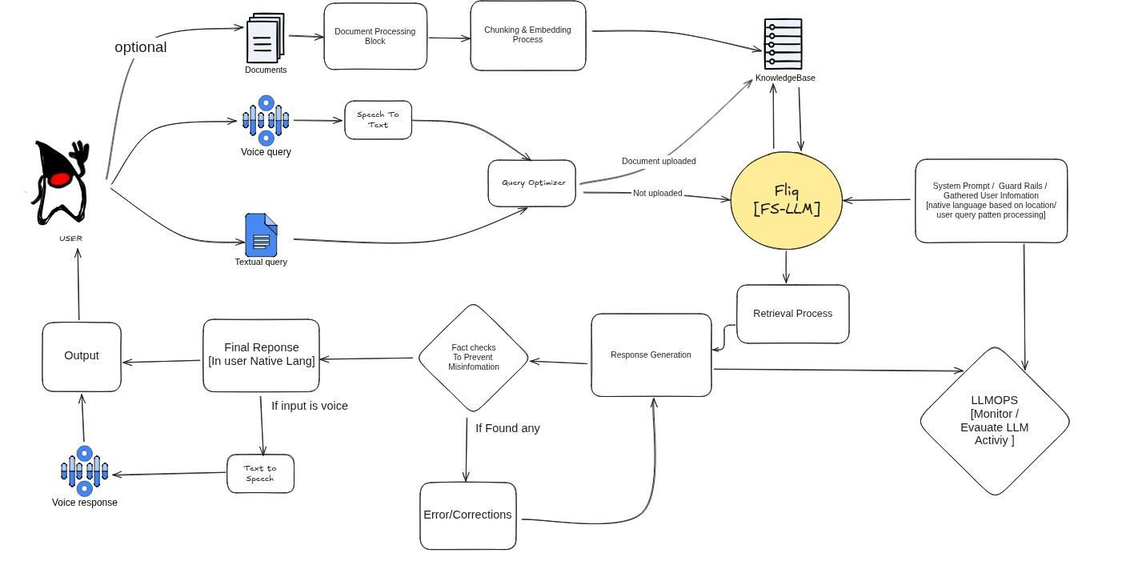
BotGods
FLIQ
Financial Language Intelligence Quotient
Agentic AI: Architect Diagram
Finnovate Hackathon
Kyndryl

Slide 8
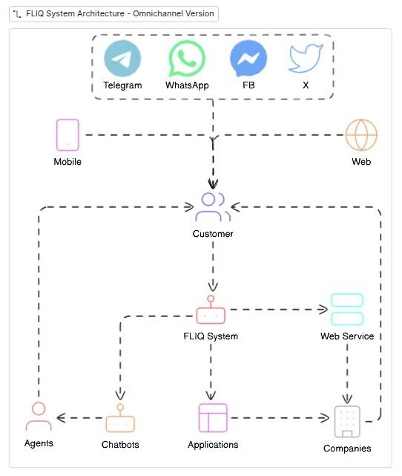
BotGods
FLIQ
Financial Language Intelligence Quotient
Agentic AI: Architect Diagram
Finnovate Hackathon
Kyndryl

Slide 9
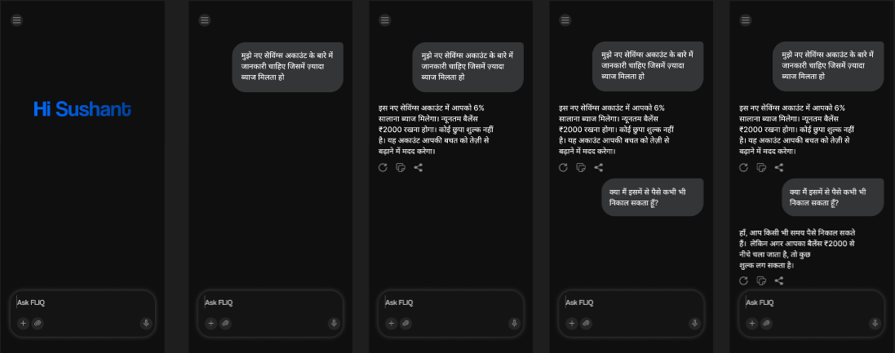
BotGods
FLIQ
Financial Language Intelligence Quotient
Agentic AI: UI Overview
Finnovate Hackathon
Kyndryl

Slide 10
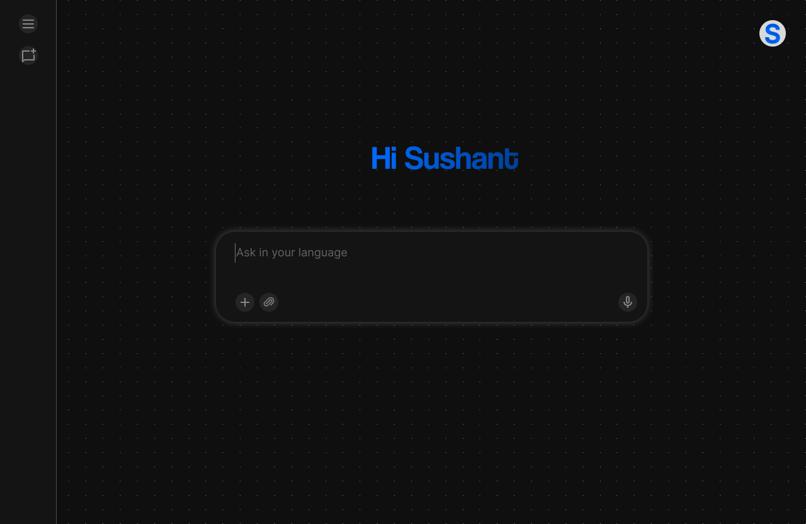
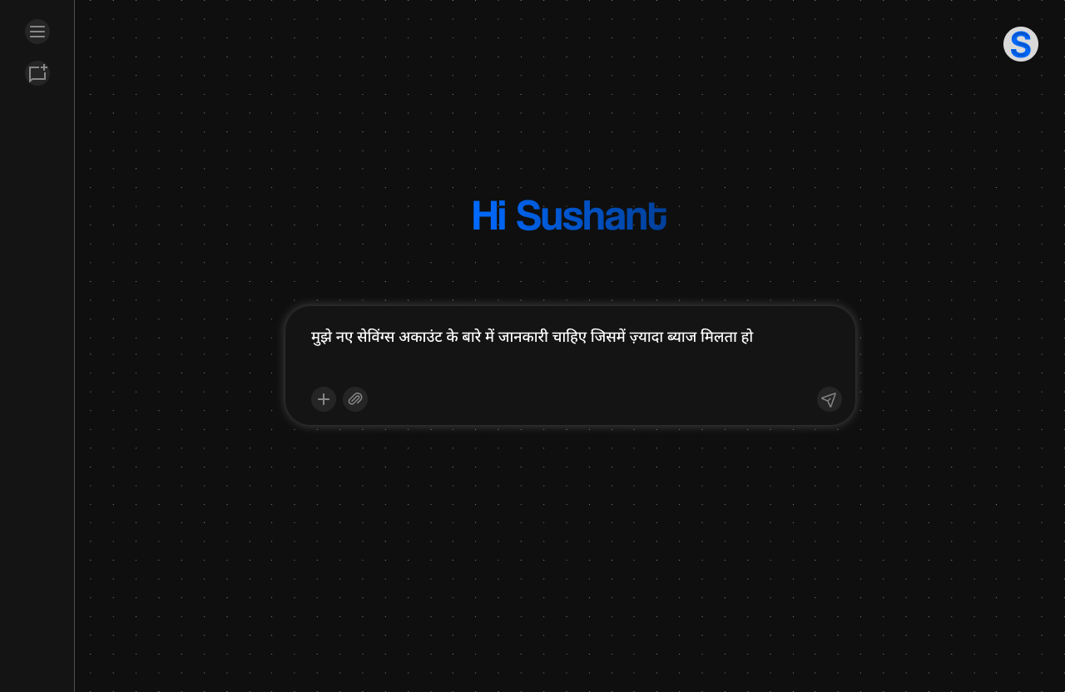
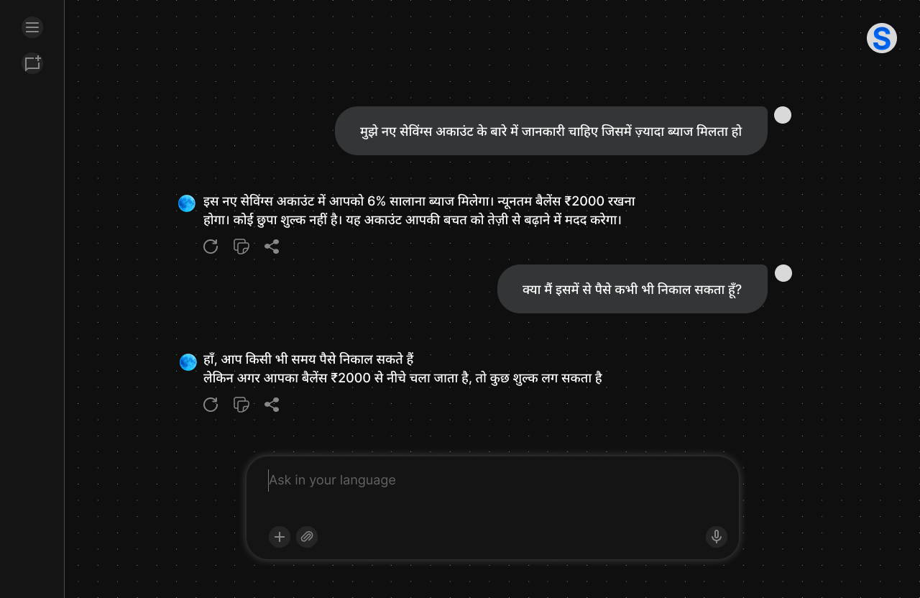
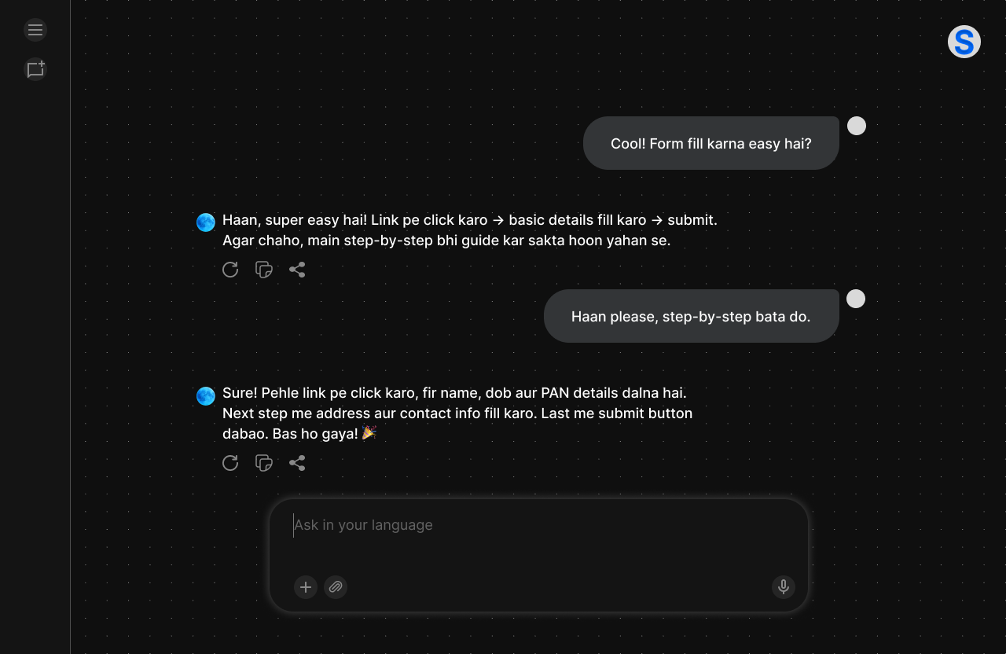
BotGods
FLIQ
Financial Language Intelligence Quotient
Agentic AI: UI Overview
Finnovate Hackathon
Kyndryl

Slide 11


BotGods
FLIQ
Financial Language Intelligence Quotient
Agentic AI: Tech Stack
Layer | Tools / Technologies Used
User Interface | Next.js, Tailwind CSS, HTML/CSS, JavaScript, Figma
AI Language Model | Context Aware LLM (GPT-4o)
Knowledge Retrieval (RAG) | Qdrant (vector DB) + OpenAI text-embedding-3-large
Language Processing | Bhasini API Key for Translation and Language Detection
Memory & Context | MongoDB + Conversation history + LangChain
Voice Layer | ElevenLabs(Text to Speech) + SpeechRecognition ( Speech to Text)
Cloud Infrastructure | FastAPI (APIs), Docker (deployment), Vercel, Azure
Finnovate Hackathon
Kyndryl

Slide 12


BotGods
FLIQ
Financial Language Intelligence Quotient
Agentic AI: MVP Scope
Domain-Specific Intelligence
Understands banking better than ChatGPT ---- with strong context awareness financial terminology, regulations, and institutional procedures
Converts complex terms like "compound interest" into simple explanations: "extra money you earn on money you already earned"
Multilingual Coverage
Covers rural/vernacular users with 10+ Indian languages (Hindi, Punjabi, Tamil, Bengali, Gujarati, Marathi, etc.)
Cultural context awareness - understands regional banking preferences and local financial habits
Omnichannel Integration
One model, many touchpoints - seamlessly works across kiosks, mobile apps, chatbots, IVR, social media
Consistent experience whether customer types, speaks, or visits branch
Finnovate Hackathon
Kyndryl

Slide 13


BotGods
FLIQ
Financial Language Intelligence Quotient
Agentic AI: MVP Scope
Sentiment-Aware Responses
Empathetic, not robotic - detects customer frustration, confusion, or satisfaction
Adjusts tone and explanation depth based on customer's emotional state and literacy level
Enterprise Scalable
New banks/languages can be added easily through modular architecture
Cloud-native design supports multiple financial institutions simultaneously
Finnovate Hackathon
Kyndryl

Slide 14



BotGods
FLIQ
Financial Language Intelligence Quotient
Agentic AI: Innovation & Feasibility
For Customers:
Native Language Banking
Access banking in their own language - no more confusion with English-only interfaces
80% of Indians are more comfortable in their native language than English
Clear Understanding
Clear, jargon-free explanations - transforms "APR" into "yearly interest you pay"
53% improvement in loan completion rates when explained in regional languages
Enhanced Trust & Comfort
More trust and comfort with digital channels - banking feels familiar, not foreign
28% increase in customer satisfaction among non-English/Hindi speakers
Finnovate Hackathon
Kyndryl
Notes:
Source: https://www.gnani.ai/resources/blogs/the-rise-of-multilingual-banking-serving-indias-next-billion/

Slide 15



BotGods
FLIQ
Financial Language Intelligence Quotient
Agentic AI: Innovation & Feasibility
For Banks:
Customer Excellence
Increased customer satisfaction and retention - happier customers stay longer
47% expansion in customer reach in previously underserved regions
Cost Optimization
Reduced support center load → cost savings - fewer calls, more self-service
22% decrease in operating costs through automated multilingual services
Market Expansion
Wider financial inclusion, especially in rural/semi-urban India
31% reduction in branch footfall as voice banking adoption increases
Finnovate Hackathon
Kyndryl

Slide 16


BotGods
FLIQ
Financial Language Intelligence Quotient
Agentic AI: Impact Metrics
For Customers:
Language Empowerment
Clear, personalized banking in their own language
68% of Indians prefer financial transactions in their native language
Enhanced Understanding
Jargon-free explanations - "APR" becomes "yearly interest rate"
53% improvement in loan completion rates when explained in regional languages
Finnovate Hackathon
Kyndryl
Notes:
68% → https://www.gnani.ai/resources/blogs/the-rise-of-multilingual-banking-serving-indias-next-billion
53% → https://www.gnani.ai/resources/blogs/the-rise-of-multilingual-banking-serving-indias-next-billion

Slide 17

BotGods
FLIQ
Financial Language Intelligence Quotient
Agentic AI: Impact Metrics
For Banks:
Business Growth
Reduced churn, stronger trust, better cross-selling
47% expansion in customer reach in previously underserved regions
28% increase in customer satisfaction among non-English speakers
Cost Efficiency
31% reduction in branch footfall as digital adoption increases
22% decrease in operating costs through automated multilingual services
Finnovate Hackathon
Kyndryl
Notes:
47%, 28%, 31%, 22% → https://www.gnani.ai/resources/blogs/the-rise-of-multilingual-banking-serving-indias-next-billion/

Slide 18


BotGods
FLIQ
Financial Language Intelligence Quotient
Agentic AI: Impact Metrics
For Society:
Financial Inclusion Revolution
Financial inclusion for rural & semi-urban India
Only 36% of rural Indians feel comfortable with English banking - FLIQ serves the remaining 64%
Democratizing financial services for India's next billion customers
National Impact
Supports India's $990 billion fintech growth target by 2032
Bridges the digital language divide that limits true financial adoption
Finnovate Hackathon
Kyndryl
Notes:
Current article states: $990Billion by 2032 → https://www.globenewswire.com/news-release/2025/05/09/3077984/28124/en/India-s-Fintech-Market-to-Reach-990-Billion-by-2032-at-30-2-CAGR-Fintech-Firms-Eye-Untapped-Indian-Digital-Payments-Market-with-Secure-Low-Cost-Digital-Financial-Solutions.html
India's fintech market valued at $110 billion in 2024 → possible to cross 150B in 2025 → https://socialchamps.com/indian-fintech-market-outlook-2025-trends-opportunities-and-marketing-strategies/
Growth rate in 2025→ 15%

Slide 19
BotGods
FLIQ
Financial Language Intelligence Quotient
Thank you
Banking. Simplified. For Everyone
Finnovate Hackathon
Kyndryl

