Slide 1
The effectiveness of caching for content delivery within vehicle to vehicle networks.
William Beeton
B919555

Slide 2
Background
Vehicular Ad-Hoc Networks (VANETs) are spontaneously created wireless networks of vehicles and roadside infrastructure.
VANETs further existing research into mobile ad-hoc networks (MANETs), but differ in the areas of topology, mobility, and the available resources.
VANETs are evolving into an “Internet of Vehicles”, and will likely continue to evolve into an “Internet of Autonomous Vehicles”.

Slide 3
MANETs Vs VANETs
MANETs
- Random movement
- Small internal storage
- Need for power efficiency (batteries)
- Lack of computing power
VANETs
- Predictable movement
- “Infinite” internal storage
- Constant supply of power from the vehicles engine
- Superior computing power

Slide 4
When to use caching?
Safety applications such as collision detection and avoidance are time critical so data is not stored for any significant period of time.
Applications that transmit a large amount of data, such as video streaming, will have dedicated protocols for data transfer
Applications likely to benefit most are those that often exchange medium amounts of non critical data.

Slide 5
Experiment
I Implemented vehicle to vehicle content delivery within a network of vehicles, then I added caching to the content distribution network. Finally I analysed the effects in three different scenarios: rural, urban, and highway.
Outline:
- Vehicles have up to 16 unique content items within their storage
- Each vehicle requests one of these 16 items every 5 seconds
- The vehicle attempts to answer its query using its own cache and/or storage servers
- If it cannot, a request is broadcast to the other vehicles
- Vehicles who receive requests attempt to reply with the requested item
(more in the demo)

Slide 6
Simulators
SUMO (Simulation of Urban Mobility)
“An open source, highly portable, microscopic and continuous multi-modal traffic simulation package designed to handle large networks.”
OMNeT++ (Objective Modular Network Testbed in C++)
“An extensible, modular, component-based C++ simulation library and framework, primarily for building network simulators.”
Veins (Vehicle in Network in simulator)
“An open source framework for running vehicular network simulations.“
Bidirectionally couples SUMO and OMNeT++ using a TCP socket and the TraCI (Traffic Control Interface Protocol)

Slide 7
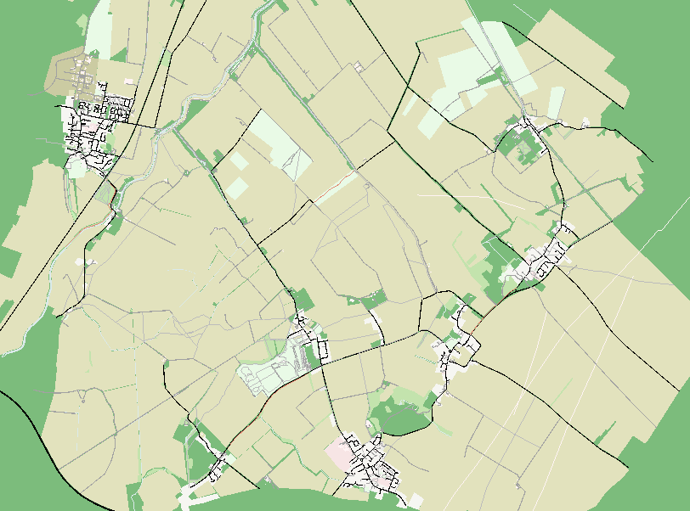
Rural
The area surrounding the villages of Bottisham, Lode, Swaffham Bulbeck, Swaffham Prior and Reach in Cambridgeshire, UK.
Road Network stats:
- 4125 edges
- 1967 junctions

Slide 8
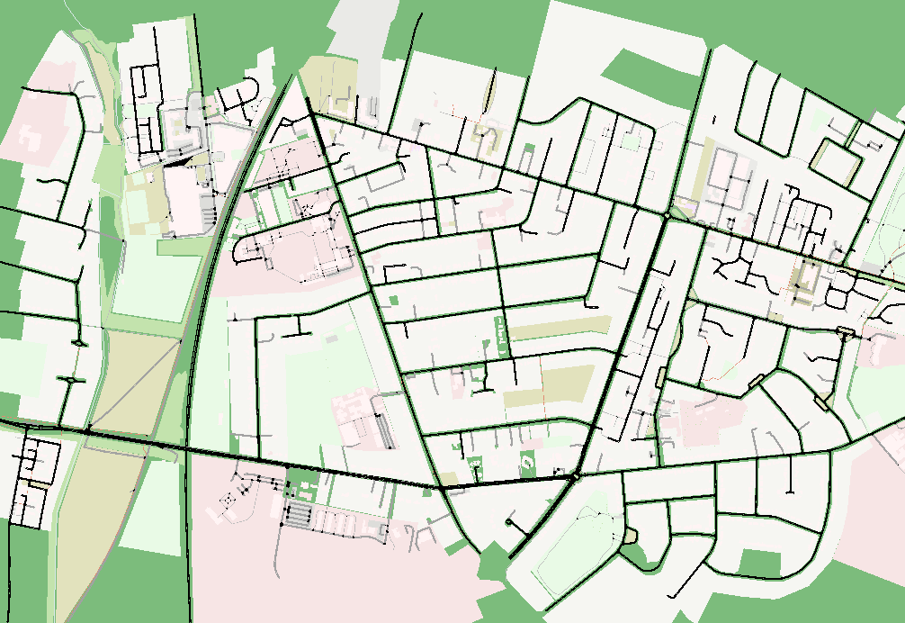
Urban
The area south of Cambridge Railway station where Hills Road meets Cherry Hinton Road in the north and Long Road in the south.
Road network stats:
- 3220 edges
- 1227 junctions

Slide 9
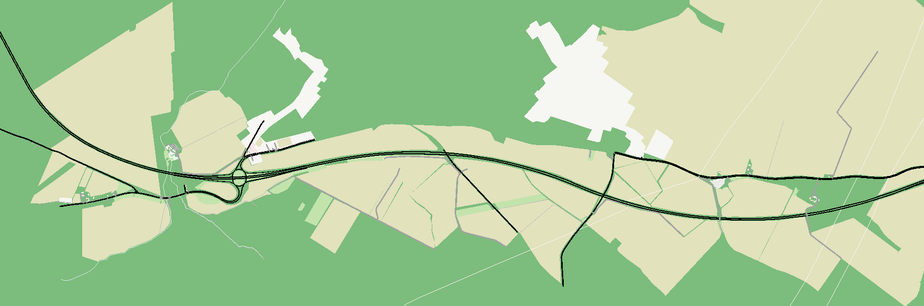
Highway
The area that was chosen for the Highway simulation is the area between junctions 35 and 36 on the A14. 289 edges and 160 junctions.

Slide 10
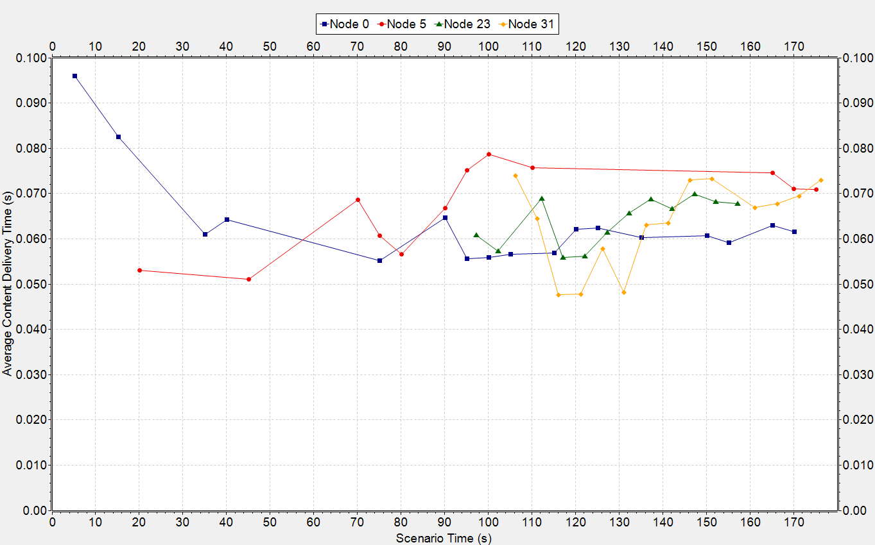
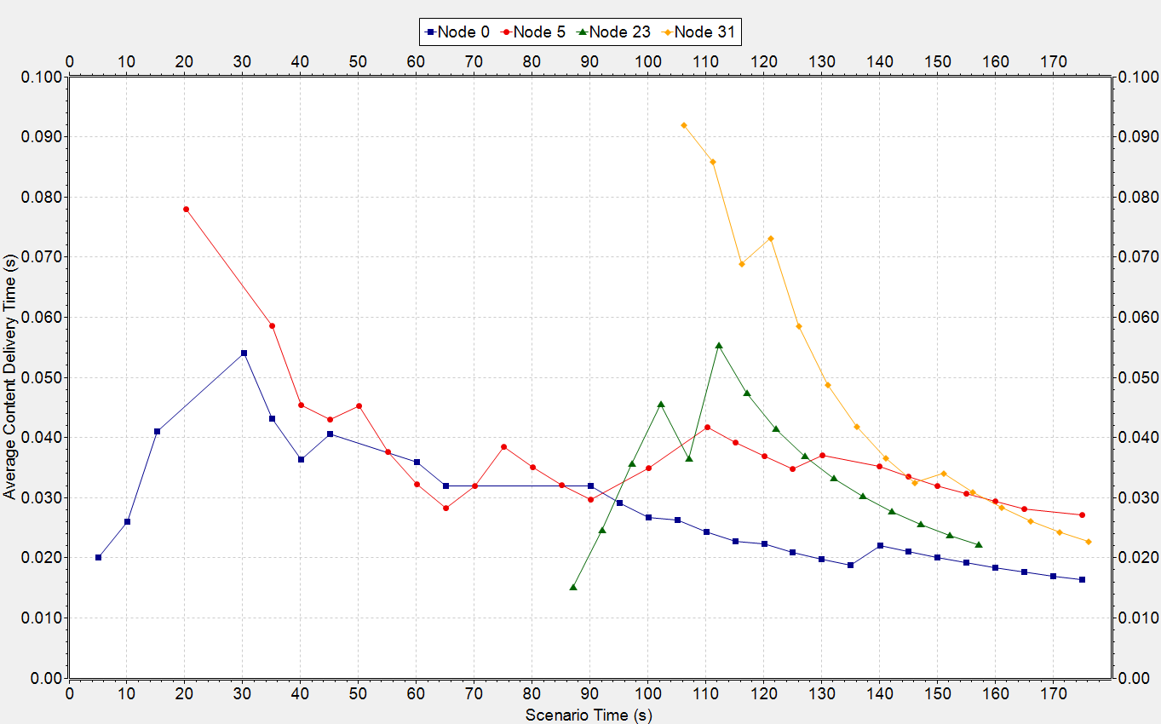
Rural – Average Request Time

Slide 11
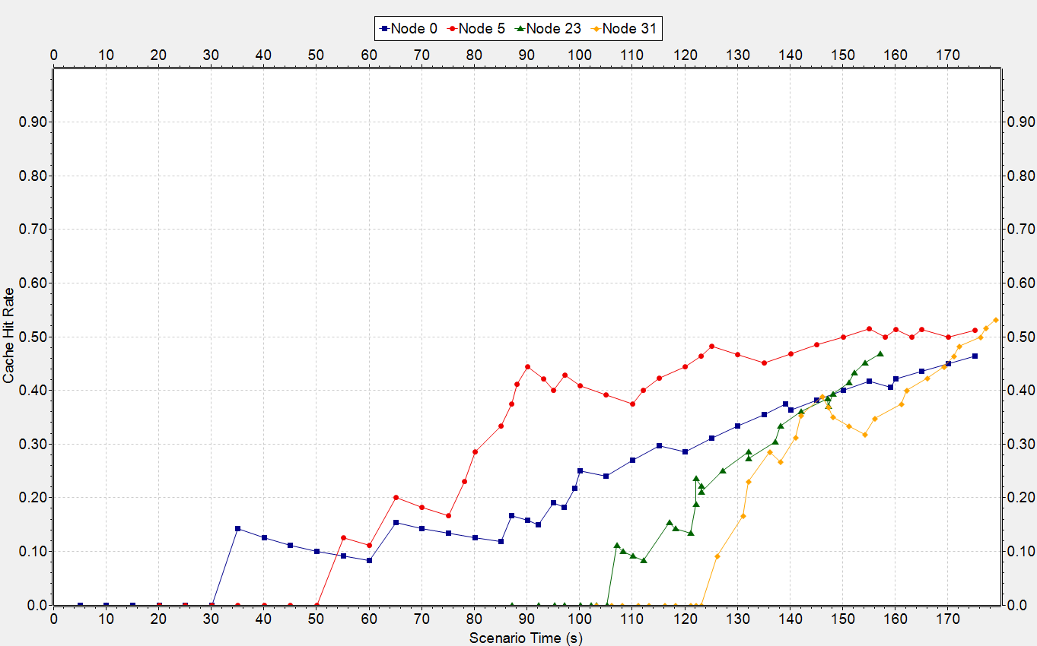
Rural – Cache Hit Rate

Slide 12
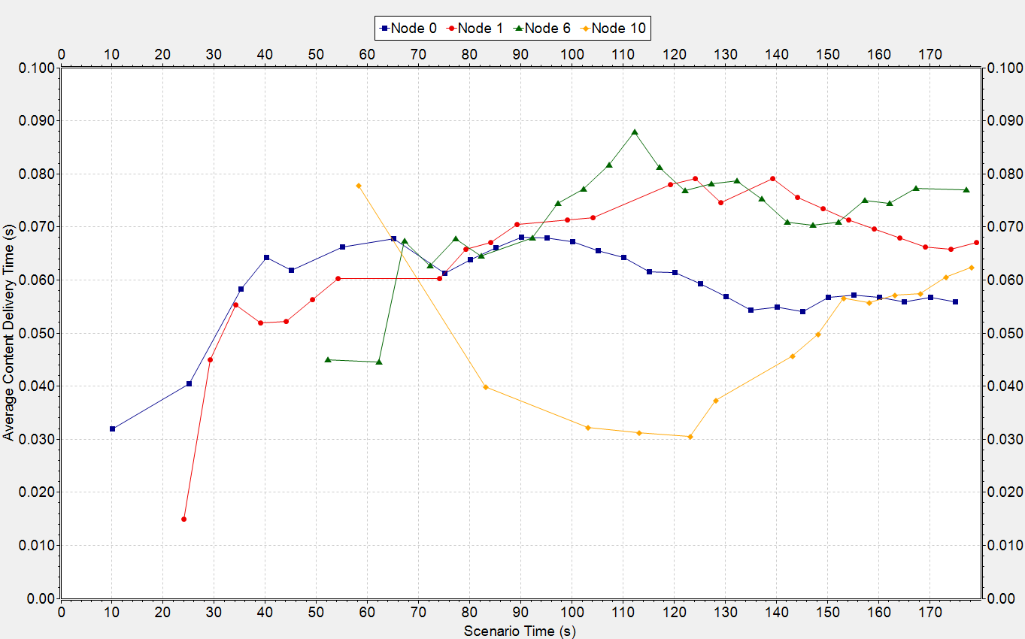
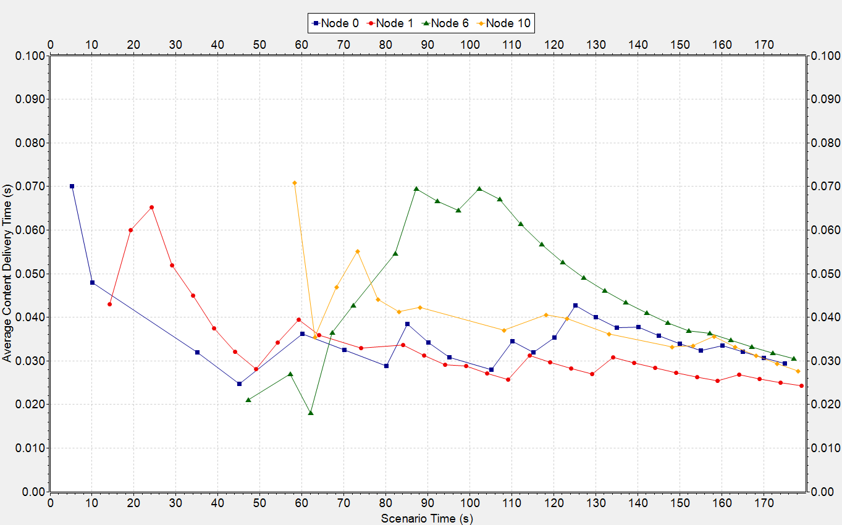
Urban – Average Request Time

Slide 13
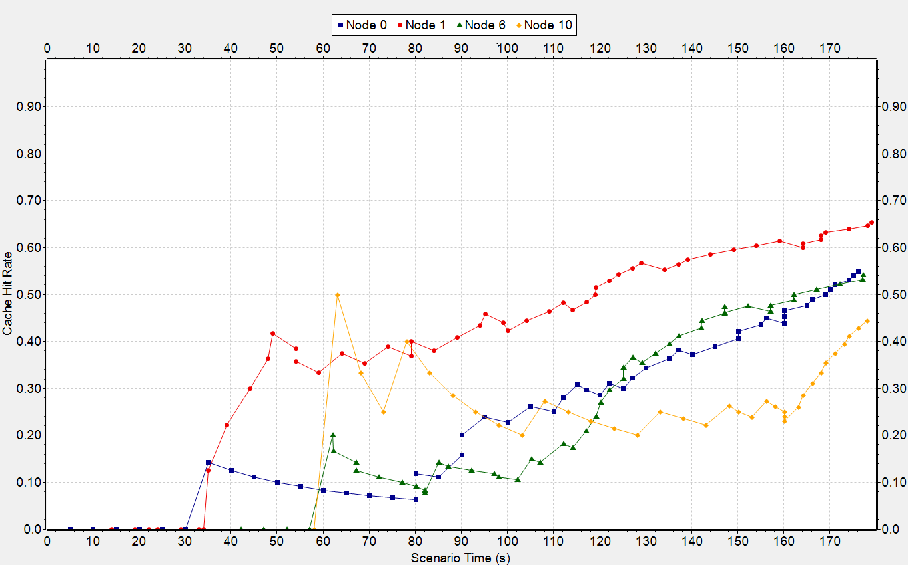
Urban – Cache Hit Rate

Slide 14
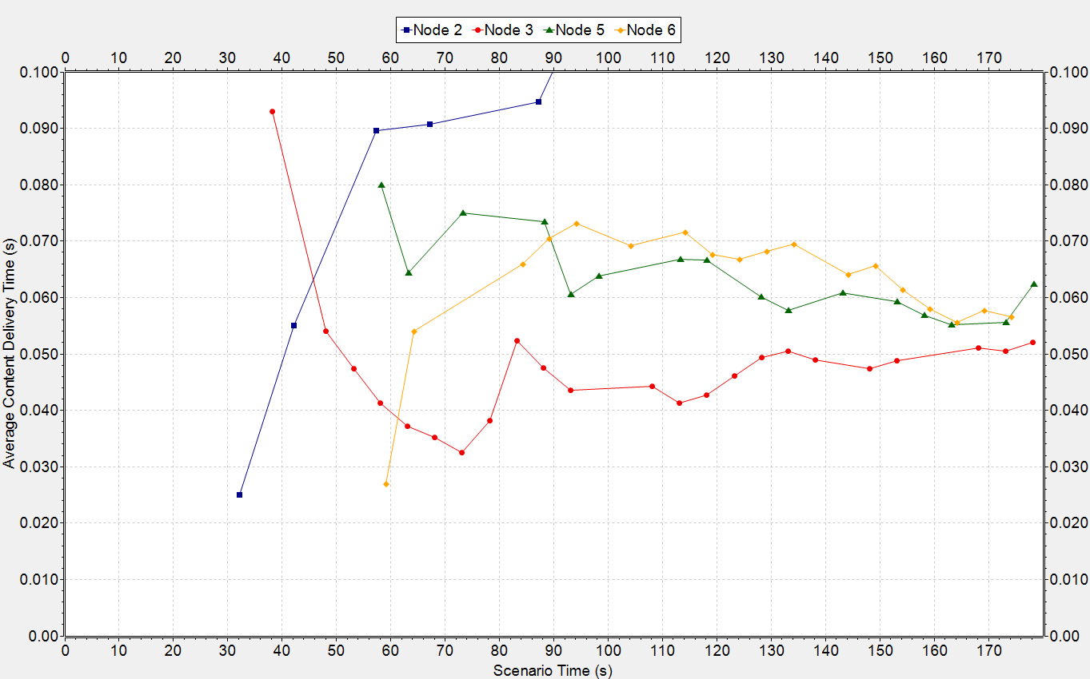
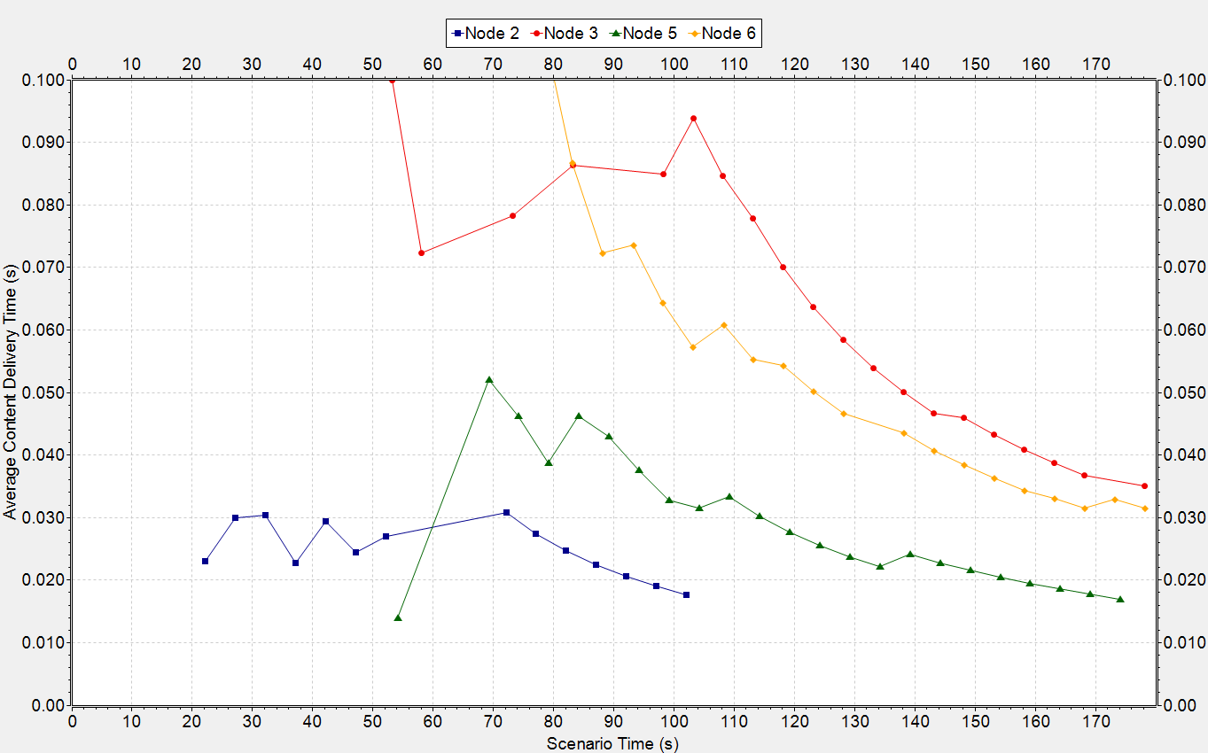
Highway – Average Request Time

Slide 15
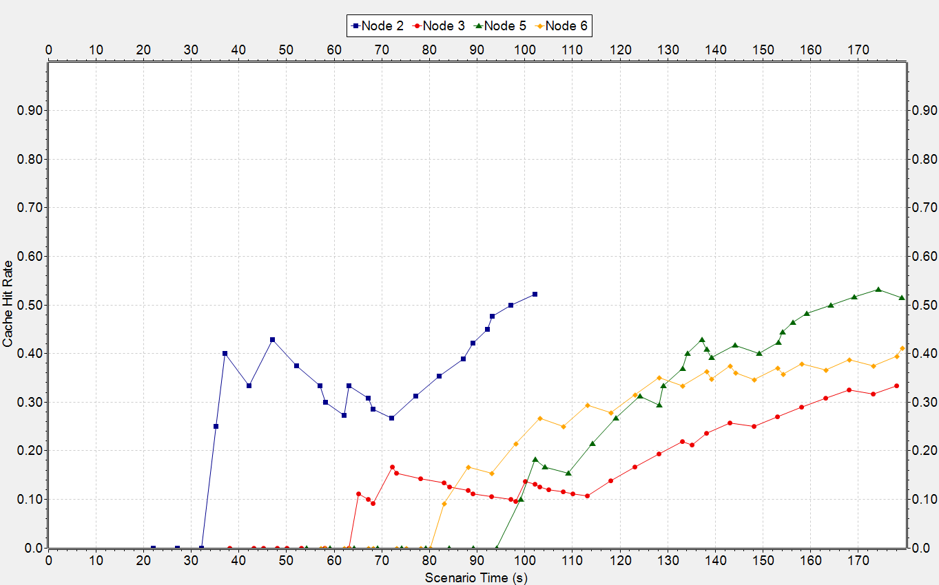
Highway – Cache Hit Rate

Slide 16
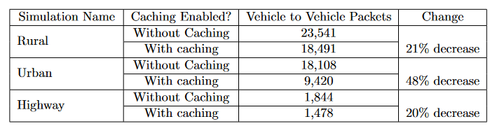
Vehicle to Vehicle packets

Slide 17
Conclusion
Given that a network lasts for enough time for caching to make a significant difference:
- Caching reduces the average content delivery time in all cases by around 50%
- Cache Hit Rate increases up to around 40 - 70% before a vehicle leaves the network. Higher in cases when vehicles remain connected for longer such as in urban scenarios
- Requests within the network fall by 20 - 50% depending on the density of the network.

Slide 18
Future Work
- Specialised highway protocols for propagating messages along highway networks that take advantage of caching as well as the consistent speed and direction of vehicles.
- Investigation into the effects of different caching algorithms, such as using an artificial intelligence to decide what to cache.
- Expand communication from V2V to V2X, taking advantage of the widespread use of IoT devices.
- Investigation into the effects of stationary and slow moving, taking advantage of the predictable movement.

