Slide 1
WRF-Var Background Error Generation
Dr. Dale M. Barker
MMM Division, NCAR,
PO Box 3000, Boulder, Colorado,
80307-3000, USA
http://www.mmm.ucar.edu/people/barker/

Slide 2
Outline of Talk
Use of Background Errors in WRF-Var.
WRF-Var Background Error Covariance Generation (gen_be).

Slide 3
Use of Background Errors in WRF-Var

Slide 4
WRF-Var in the WRF Modeling System
x^{lbc}
Background
Preprocessing
(SI, real)
x^{b}
Cold-Start Mode
Cycling Mode
Observation
Preprocessing
(3DVAR_OBSPROC)
yº
WRF-Var
xª
Update
Lateral BCs
(WRF_BC)
Forecast
(WRF)
Background
Error
(gen_be)
B₀
Blue = Supported by WRF-Var Team

Slide 5
Background Error (BE) Estimation in WRF-Var
The number 1 question from WRF-Var users is
“What background error covariances are best for my application?”.
Procedure:
Use default statistics files supplied with code (MM5, GFS-based).
Create you own, once you have run your system for ~a few weeks.
Implement, tune, and iterate.
A new utility gen_be has been developed at NCAR to calculate BEs.

Slide 6
Incremental WRF-Var J_{b} Preconditioning
Define preconditioned control variable v space transform
where U transform CAREFULLY chosen to satisfy B_{o} = UU^{T} .
Choose (at least assume) control variable components with uncorrelated errors:
where n~number pieces of independent information.

Slide 7
Model-Based Estimation of Climatological Background Errors
Assume background error covariance estimated by model perturbations x’ :
Two ways of defining x’:
The NMC-method (Parrish and Derber 1992):
where e.g. t2=24hr, t1=12hr forecasts…
…or ensemble perturbations (Fisher 2003):
Tuning via innovation vector statistics and/or variational methods.

Slide 8
Analysis Sensitivity to Background Error Model
(Lee, Barker, and Kuo 2006)
GSI (Global NMC, RFs)
WRF-Var (Local NMC, EOFs)
WRF-Var (Local Ensemble1)
WRF-Var (Local Ensemble2)
T increments : T Observation (1 Deg , 0.001 error around 850 hPa)
Notes:
This slide shows vertical cross section of T increment according to T observations.
We can see several things.
Default CV3 has strong vertical autocorrelation than CV5
ENSo shows smaller influence range than CV5-NMC and CV3
ENSb shows similar affected range to NMC. But vertical propagation by the observation was increased.
Finding.
1. CV3-T : 연직 상관이 크다.
SNMC & ENSo : 연직상관이 작다 .
2. Scale Length → Enso 는 약 50 % 작다.
3. ENSb는 연직상관이 커지고, Scale length는 NMC 수준

Slide 9
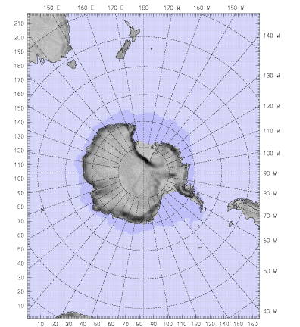
Sensitivity to Forecast Error Covariances in Antarctica
(Rizvi et al 2006)
60km Verification (vs. radiosondes)
60km Domain 1
_{T+24hr Temperature}
_{GFS-based errors}
20km Domain2
_{WRF-based errors}

Slide 10
2. WRF-Var Background Error Covariance Generation (gen_be)

Slide 11
Background Error (BE) Estimation in WRF-Var
A new utility gen_be has been developed at NCAR to calculate BEs. The new
gen_be code is split into a number of stages:
Stage0: Convert model-specific data to “standard fields”.
Stage1: Remove time-domain mean from fields.
Stage2: Calculate regression coefficients, and use them to define “unbalanced”
control variables.
Stage3: Calculate vertical error covariances (eigenvectors and eigenvalues) for
control variables.
Stage 4: Calculate horizontal error correlations: lengthscales (in regional domains),
and “power spectra” in global domains.

Slide 12
BE Generation: gen_be_stage0
KMA
MM5
WRF
NFS
Other…
Standard Fields
Perturbations
(e.g. ψ’)
Metadata
(e.g. z, φ)
Stage0 is the only stage that is model specific (e.g. gen_be_stage0_nfs).
Perturbed fields are either forecast differences (NMC-Method) or ensemble perturbations (ensemble method).
Standard fields are perturbations of streamfunction, velocity potential, temperature, relative humidity, and surface pressure.

Slide 13
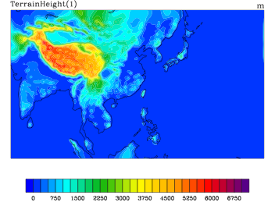
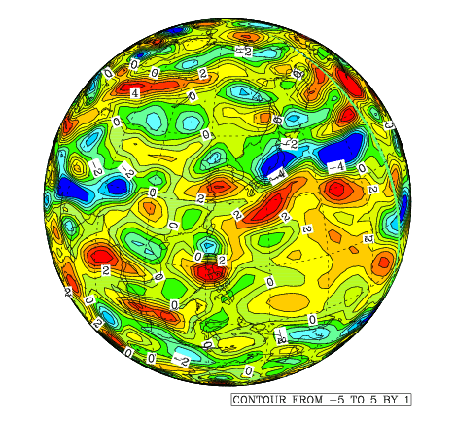
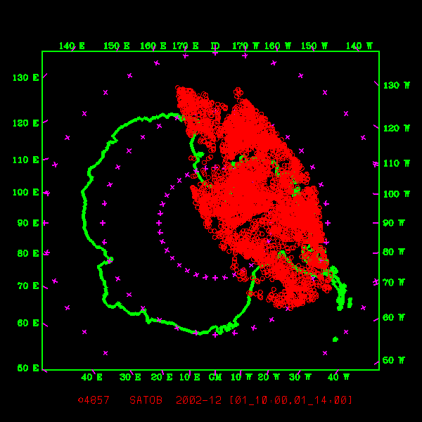
Background Error (BE) Estimation for different domains/models/times
In the following results, we apply gen_be stages 1-4 to a variety of models to
see robustness of results:
CWB 45km WRF
Korean T213 Global:
AMPS 30km WRF

Slide 14
Background Error (BE) Estimation in WRF-Var
A new utility gen_be has been developed at NCAR to calculate BEs. The new
gen_be code is split into a number of stages:
Stage0: Convert model-specific data to “standard fields”.
Stage1: Remove time-domain mean from fields.
Stage2: Calculate regression coefficients, and use them to define “unbalanced”
control variables.
Stage3: Calculate vertical error covariances (eigenvectors and eigenvalues) for
control variables.
Stage 4: Calculate horizontal error correlations: lengthscales (in regional domains),
and “power spectra” in global domains.

Slide 15
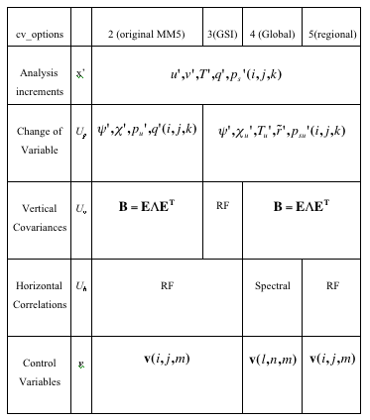
WRF-Var Background Error Modeling
Define control variables:

Slide 16
3D-Var Statistical Balance Constraints
Define statistical balance after Wu et al (2002):

Slide 17
3D-Var Statistical Balance Constraints
Regression Coefficeints
Define statistical balance after Wu et al (2002):

Slide 18
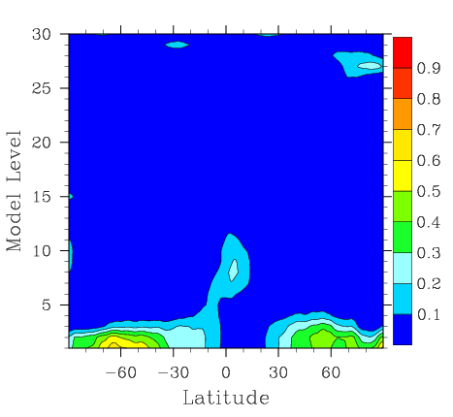
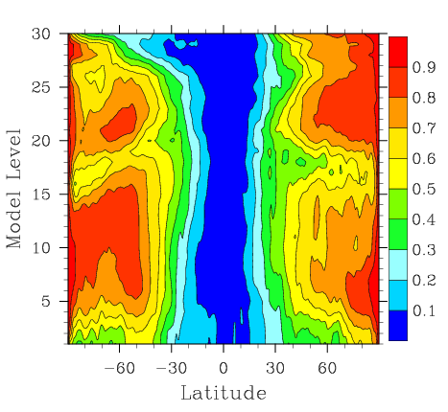
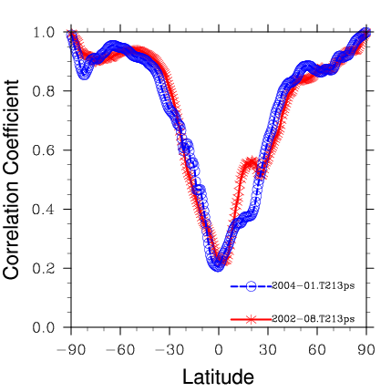
3D-Var Statistical Balance Constraints
Define statistical balance after Wu et al (2002):
How good are these balance constraints? Test on KMA global model data. Plot correlation between “Full” and balanced components of field:

Slide 19
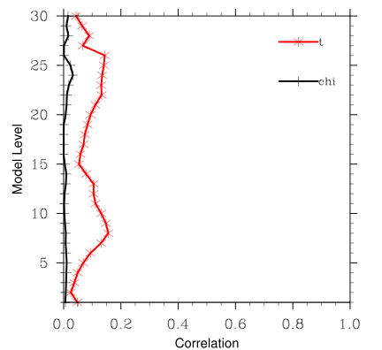
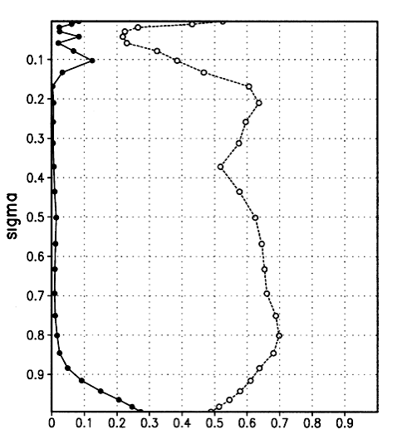
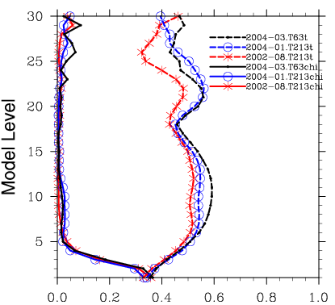
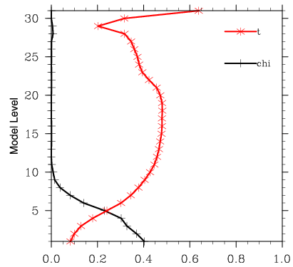
Stage2: CWB/KMA/AMPS Comparison
CWB 45km WRF:
Calculate domain averaged correlations:
For a variety of models using NMC-method.
NCEP (Wu et al 2002):
Korean T213 Global:
AMPS 30km WRF:

Slide 20
Background Error (BE) Estimation in WRF-Var
A new utility gen_be has been developed at NCAR to calculate BEs. The new
gen_be code is split into a number of stages:
Stage0: Convert model-specific data to “standard fields”.
Stage1: Remove time-domain mean from fields.
Stage2: Calculate regression coefficients, and use them to define “unbalanced”
control variables.
Stage3: Calculate vertical error covariances (eigenvectors and eigenvalues) for
control variables.
Stage 4: Calculate horizontal error correlations: lengthscales (in regional domains),
and “power spectra” in global domains.

Slide 21
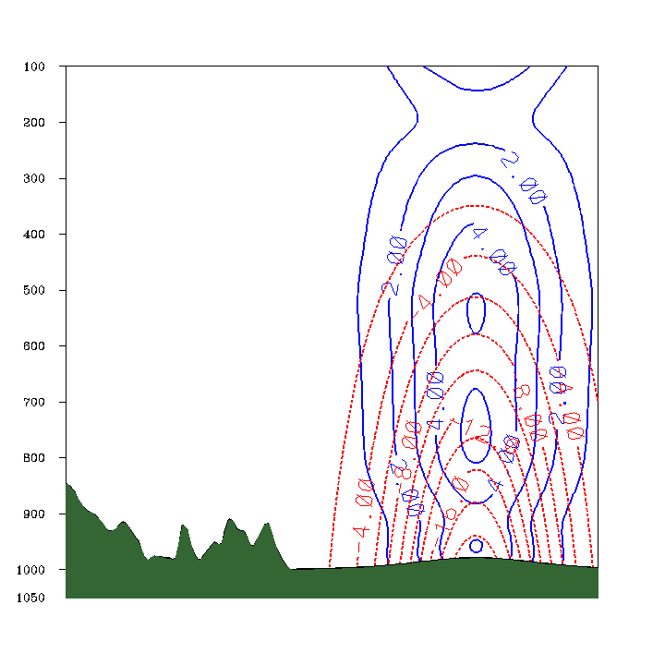
WRF-Var Background Error Modeling

Slide 22
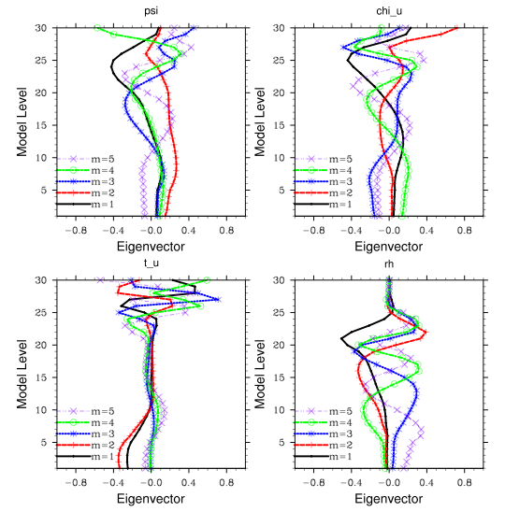
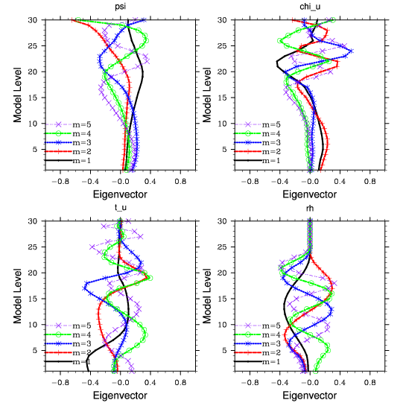
Comparison of Domain-Averaged Eigenvectors
CWB 45km WRF:
Korean T213 Global:
Conclusion: Significant differences in regional/global models (as one might expect), so it is is important to calculate domain-specific background error
correlations.

Slide 23
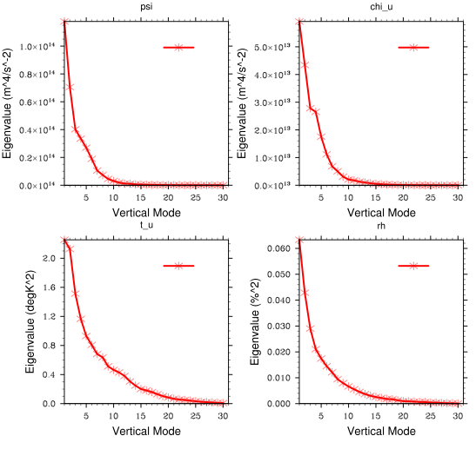
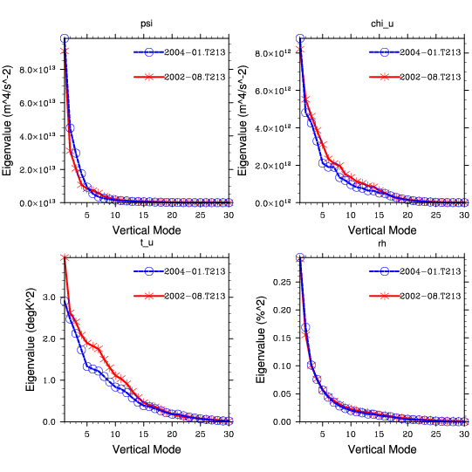
Comparison of Domain-Averaged Eigenvalues
CWB 45km WRF:
Korean T213 Global:
Conclusion: Significant differences in regional/global models (as one might expect), so it is is important to calculate domain-specific background error
variances.

Slide 24
Background Error (BE) Estimation in WRF-Var
A new utility gen_be has been developed at NCAR to calculate BEs. The new
gen_be code is split into a number of stages:
Stage0: Convert model-specific data to “standard fields”.
Stage1: Remove time-domain mean from fields.
Stage2: Calculate regression coefficients, and use them to define “unbalanced”
control variables.
Stage3: Calculate vertical error covariances (eigenvectors and eigenvalues) for
control variables.
Stage 4: Calculate horizontal error correlations: lengthscales (in regional
domains), and “power spectra” in global domains.

Slide 25
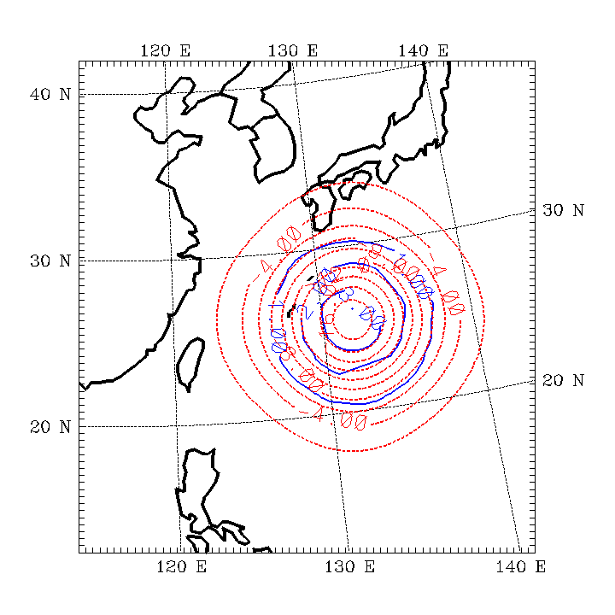
WRF-Var Background Error Modeling

Slide 26
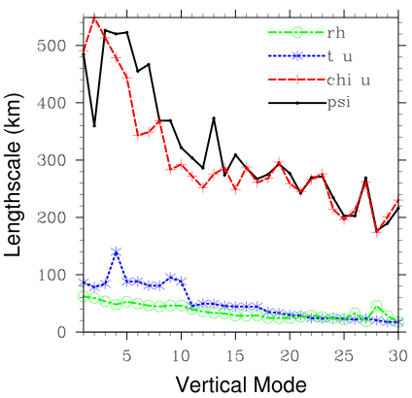
Stage4: Regional model (CWB Sept. 2003) data
Horizontal error correlation
lengthscales are produced as
follows:
Bin each 2D perturbation
field as a function of
gridpoint separation.
Calculate correlation matrix
for all data.
Fit Gaussian curve to data to
estimate horizontal error
correlation lengthscales.

Slide 27
Conclusions
Background Error Statistics are a crucial input to 3/4D-Var systems.
BE estimation methods are somewhat ad-hoc, and require significant efforts to accumulate the necessary forecast input data (e.g. 1 month 24hr forecasts)
A new utility gen_be has been written to calculate BEs for WRF-Var applications (for a variety of models, and techniques).
The output of gen_be must be further tuned to optimize WRF-Var performance. A number of additional utilities are available to perform this work.

Slide 28
Components of Global Background Error Statistics
Regression Coefficients (used to derive “balanced” components of fields) after Wu et al (2002) (output from stage2):
Eigenvectors/eigenvalues of vertical component of background error (output from stage3):
Domain/time averaged “global” values -
Longitude/time averaged “local” values -
Power spectra (model horizontal error correlations for each vertical mode - output from stage4_global):

Slide 29
Components of Regional Background Error Statistics
Regression Coefficients (used to derive “balanced” components of fields) after Wu et al (2002) (output from stage2):
Eigenvectors/eigenvalues of vertical component of background error (output from stage3):
Domain/time averaged “global” values -
Longitude/time averaged “local” values -
Lengthscales (model horizontal error correlations s for each vertical mode - output from stage4_regional):

