Slide 1
WRF-Var Software
(Version 2.1)
John Bray
July 26, 2006

Slide 2
Outline:
Introduction
Software Overview
Data Structures
Registry
Example

Slide 3
Introduction:
Intended audience for this tutorial session:
  Primarily scientific users and others who wish to:
    Work with the code
    Extend/modify the code to enable their work/research
    Address problems as they arise
    Adapt the code to take advantage of local computing resources
  Also: developers, computer scientists and software engineers, computer vendors
    Developing new functionality (e.g. new observations, new minimization package)
    Porting and benchmarking new platforms

Slide 4
Supported Platforms:
IBM (AIX)
HP (OSF1)
MAC (OS X)
PC (Linux)
SGI (IRIX)
CRAY (X1)

Slide 5
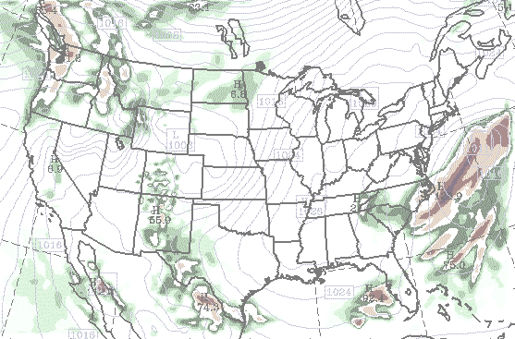
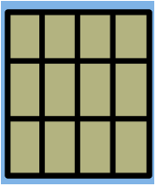
Parallelism in WRF-Var: MPI Decomposition
Each Patch has Only one Tile
Logical domain
Single version of code for efficient execution on:
  Distributed-memory
  Vector and microprocessors
Inter-processor communication
Model domain is decomposed for parallelism
  Patch: section of model domain allocated to a distributed memory node
  Tile: same as patch in WRF-Var

Slide 6
Distributed Memory Communications
Halo updates
Periodic boundary updates
(only needed for global 3dvar)

Slide 7
Distributed Memory Communications
Halo updates
Periodic boundary updates
Parallel transposes
“nproc_x = 1”
(For global option)
all y on
patch
all z on
patch
all x on
patch

Slide 8
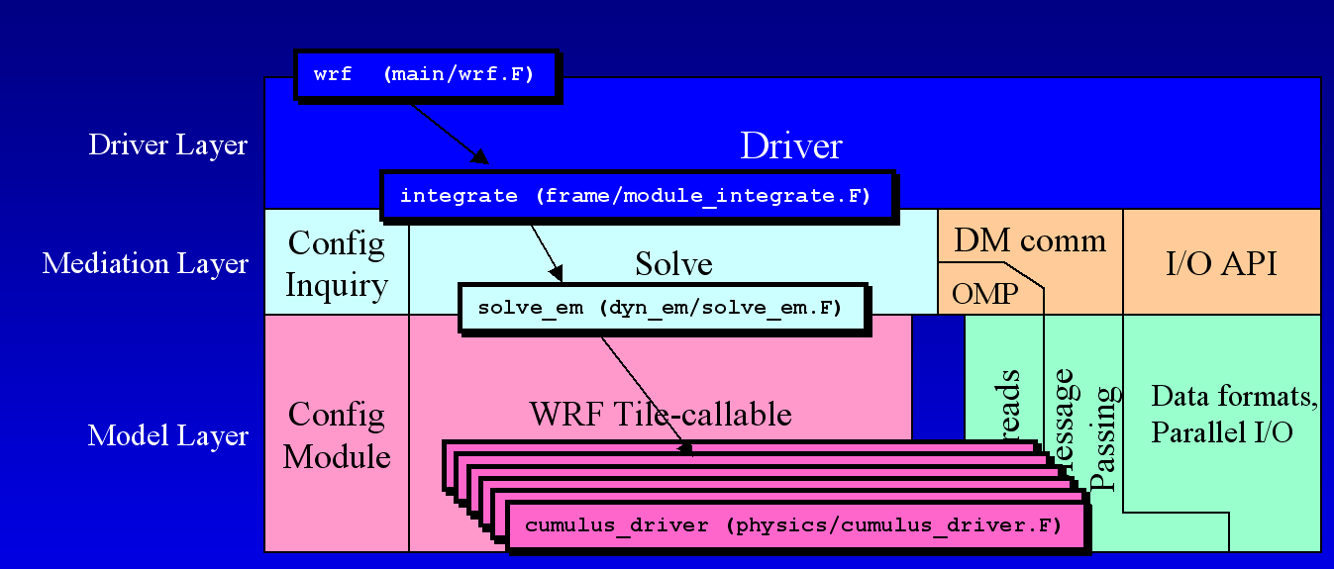
Directory Structure
WRF WRF-Var
Integrate wrf_3dvar_interface
Solve_em da_solve_v3d
Cumulus_driver obs. (DA_Ships) or DA_Minimisation etc.

Slide 9
WRF-VAR Observations
May be single level or multiple levels
Ob_type or y_type:
    ob%obs_type(:)%field_type%[inv/qc/error]
Innovation, quality flag, error
Obs field (u,v,t,etc.)
Ob_type and length
Obs. structure

Slide 10
Example
Radiosonde observation appears as:
ob% sound(n)% u(lvl)% inc
ob% sound(n)% v(lvl)% qc
ob% sound(n)% v(lvl)% error
Radiosonde residual appears as:
re% sound(n)% u(lvl)
re% sound(n)% v(lvl)

Slide 11
Observation Storage
Observations are stored in heap
  Completely self-contained and private
  Set once (Read in from disk file)
  No exchange between processors/processes

Slide 12
Observation in Distributed Memory
Halo Region Observation
For global option obs. on East & West boundaries are duplicated
*
Obs. on one processor’s halo
Obs. on neighboring processor

Slide 13
Grid Representation in Arrays
Increasing indices in WRF-Var arrays run
  West to East (X, or I-dimension)
  South to North (Y, or J-dimension)
  Bottom to Top (Z, or K-dimension)
Storage order in WRF-Var is IJK, but this is a WRF-Var convention, not a restriction of the WRF Software Framework
WRF-Var grid data are all converted to mass-grid point

Slide 14
WRF-Var Registry
"Active data-dictionary” for managing WRF-Var data structures
  Database describing attributes of model state, intermediate, and configuration data
    Dimensionality, number of time levels, staggering
    Association with physics
    I/O classification (history, initial, restart, boundary)
    Communication points and patterns
    Configuration lists (e.g. namelists)
  Program for auto-generating sections of WRF from database:
    Argument lists for driver layer/mediation layer interfaces
    Interprocessor communications: Halo and periodic boundary updates, transposes
    Code for defining and managing run-time configuration information
Automates time consuming, repetitive, error-prone programming
Insulates programmers and code from package dependencies
Allow rapid development
Documents the data

Slide 15
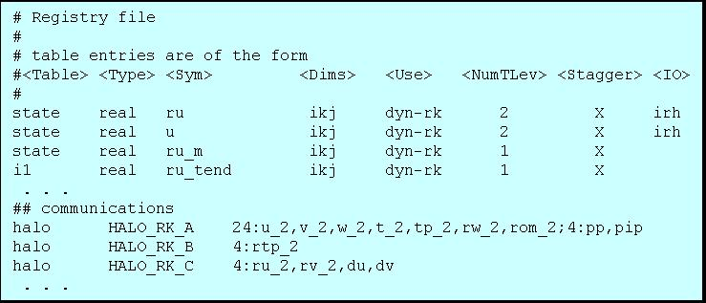
Registry Mechanics
%compile var
Registry/Registry
registry program:
tools/registry
CPP
____________
Fortran90
inc/*.inc
WRF-VAR source
*/*.F
wrfvar.exe

Slide 16
Registry Data Base
Currently implemented as a text file: Registry/Registry.3dvar
Types of entry:
  State – Describes state variables and arrays in the domain structure
  Dimspec – Describes dimensions that are used to define arrays in the model
  Typedef – Describes derived types that are subtypes of the domain structure
  Rconfig – Describes a configuration (e.g. namelist) variable or array
  Halo – Describes halo update interprocessor communications
  Xpose – Describes communications for parallel matrix transposes

Slide 17
State entry:
Elements
  Entry: The keyword “state”
  Type: The type of the state variable or array (real, double, integer, logical, character, or derived)
  Sym: The symbolic name of the variable or array
  Dims: A string denoting the dimensionality of the array or a hyphen (-)
  Use: A string denoting association with a solver or 4D scalar array, or a hyphen
  NumTLev: An integer indicating the number of time levels (for arrays) or hyphen (for variables)
  Stagger: String indicating staggered dimensions of variable (X, Y, Z, or hyphen)
  IO: String indicating whether and how the variable is subject to I/O and Nesting
  DName: Metadata name for the variable
  Units: Metadata units of the variable
  Descrip: Metadata description of the variable
Example
# Type Sym Dims Use Tlev Stag IO Dname Descrip
# definition of a 3D, two-time level, staggered state array
state real u ijk dyn_em 2 X irh "U" "X WIND COMPONENT“
…
typedef xb_type real u ijk - 1 - -
…
state xb_type xb - -

Slide 18
Comm entries: halo
Elements
  Entry: keywords “halo”
  Commname: name of comm operation
  Description: defines the halo operation
    For halo: npts:f1,f2,...[;npts:f1,f2,...]*
Example
halo HALO_XA dyn_em 24:xa%u,xa%v,xa%q,xa%p,xa%t,xa%rho,xa%rh,xa%psfc,xa%qcw,xa%qrn,xa%qt
halo HALO_XB dyn_em 24:xb%u,xb%v,xb%w,xb%wh,xb%q,xb%p,xb%t,xb%rho,xb%rh,xb%psfc,xb%slp

Slide 19
WRF-Var I/O
Uses same WRF I/O API features

Slide 20
Procedure for adding new Observations
Edit DA_Define_Structure.F to add new data type
Make new observation sub-directory under “src”
Develop desired programs like getting innovation vector, forward observation operator, tangent linear & its adjoint, gradient & cost function etc. in this new sub-directory.
Input observation (update DA_Obs)
Sometimes it might be needed to add certain grid arrays in Registry
Link into minimization package (DA_Minimisation)

