Slide 1
WRFDA
Background Error Estimation
Syed RH Rizvi
National Center For Atmospheric Research
NCAR/ESSL/MMM, Boulder, CO-80307, USA
rizvi@ucar.edu
July, 2013 WRFDA Tutorial WRFDA BE Syed RH Rizvi

Slide 2
Talk overview
What is Background Error (BE) ?
Some properties of BE
Role of BE in WRFDA
Various components of BE
Impact of BE on minimization and forecasts
How to compute (“gen_be” utility)?
Single Observation Test
Upcoming new features
Introduction to Practice Session
July, 2013 WRFDA Tutorial WRFDA BE Syed RH Rizvi

Slide 3
What is BE?
The BE covariance matrix describes the probability distribution function (PDF) of forecast errors, assumed Gaussian
BE is the covariance of (forecast - truth) in analysis control variable space
BE = <(x-x^{t}), (x-x^{t})^{T}>
Since truth (x^{t}) is not known, it needs to be estimated
Common methods for estimating BE
  Innovation Method
  NMC Method: (x-x^{t}) ≈ (x^{t1} - x^{t2})
  (Forecast differences valid for the same time)
  Ensemble Method: (x-x^{t}) ≈ (x^{ens} - <x^{ens}>)
  = (Ensemble - Ensemble mean)
July, 2013 WRFDA Tutorial WRFDA BE Syed RH Rizvi

Slide 4
Some properties of BE
B matrix is square and symmetric. Thus, its eigenvalues are all real and eigenvectors are mutually orthogonal
It is positive semi-definite. Thus, its eigenvalues are all non-negative. It is a very important property because without this the minimum of the cost function may not exist
It consists of correlation (C)and variance (∑) parts, B = ∑C∑
If V is an orthogonal matrix (V^{T}V = I) transforming vector X to U (U = VX), then the background error for X (B) and of U (B^{u}) will be related as B^{u} = V^{T} B V
A special representation of B is the eigen-representation, where B^{u} is diagonalized. Eigenvectors of B form the columns of V and the eigenvalues of B are the diagonal elements of B^{u}
July, 2013 WRFDA Tutorial WRFDA BE Syed RH Rizvi

Slide 5
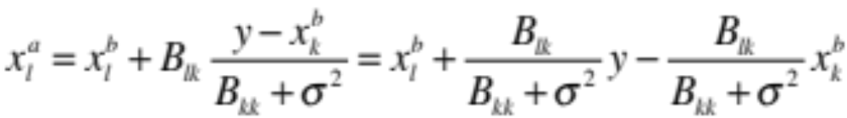
Role of BE
B spreads information, both vertically & horizontally with proper weights to observations and FG. This effect may be understood by introducing a single observation of one (kth) element of x in the analysis equation
xª = x^{b} + BH^{T}(HBH^{T} + R)⁻¹[yº-H(x^{b})]
In this case H or H is a row vector with all elements zero except the kth, which is = 1 and yº = y ; R = σ² . Thus the analysis equation gives
Thus non-zero off-diagonal terms for B lead to analysis increment for lth element
In data assimilation, this is not the only mechanism of spreading information. Observation operators (H & H) also do this job
If σ² << B_{kk} ; x_{k}ª ≈ y and if σ² >> B_{kk} ; x_{k}ª ≈ x_{k}^{b}
Thus if BE is very large compared to observation error, the analysis is closer to the observation. Otherwise it is closer to FG
July, 2013 WRFDA Tutorial WRFDA BE Syed RH Rizvi

Slide 6
Role of BE Contd.
B matrix spreads information between variables and imposes balance
Since B is the last operator in the analysis equation, the analysis increments lies in the subspace of B.
B provides a means by which observations can act in synergy. B _x0016_ allows observations to reinforce each other in a way that improves the analysis to a degree that is greater than their individual contributions.
B is used for preconditioning the analysis equation.
July, 2013 WRFDA Tutorial WRFDA BE Syed RH Rizvi

Slide 7
How BE is represented in WRFDA?
It is represented with a suitable choice of U as follows
B = U^{T} U with U = U_{p}U_{v}U_{h}
U_{h} Horizontal Transform
U_{v} Vertical Transform
U_{p} Physical Transform
Horizontal transformation (U_{h}) is via
Regional ----- Recursive filters
Global ----- Power spectrum
Vertical transformation (U_{v}) is via EOF’s
Physical transformation (U_{p}) depends upon the choice of the analysis control variable
July, 2013 WRFDA Tutorial WRFDA BE Syed RH Rizvi

Slide 8
How BE is represented? Contd.
Size of B is typically of the order of 10⁷x10⁷
It is reduced by designing the analysis control variables in such a way that cross covariance between these variables are minimum
Currently, analysis control variables for WRFDA are the amplitudes of EOF’s of
stream function (ψ)
Unbalanced part of velocity potential (χ_{u})
Unbalanced part of temperature (T_{u})
Relative Humidity (q)
Unbalanced part of surface pressure (p_{s_u})
With this choice of analysis control variables off-diagonal elements of BE is very small and thus its size typically reduces to the order of 10⁷
July, 2013 WRFDA Tutorial WRFDA BE Syed RH Rizvi

Slide 9
How BE is represented? Contd.
U_{p}
B
U_{v}
B = U_{h}^{T}U_{v}^{T}U_{p}^{T}U_{p}U_{v}U_{h}
U_{h}
.
.
.
.
July, 2013 WRFDA Tutorial WRFDA BE Syed RH Rizvi

Slide 10
Components of BE
Regression Coefficient for balanced part of Velocity potential, Temperature and Surface pressure
Eigen vectors and Eigen values for stream function, unbalanced velocity potential, unbalanced temperature and moisture field
Horizontal length-scales of control variables for regional option
Power spectrum of control variables for global option
July, 2013 WRFDA Tutorial WRFDA BE Syed RH Rizvi

Slide 11
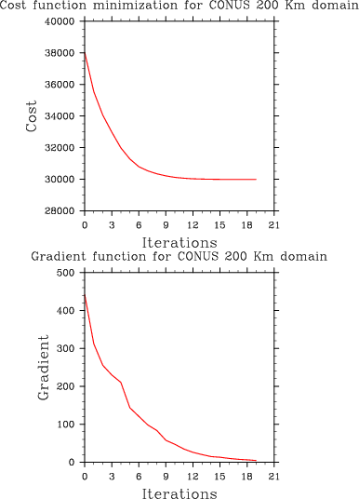
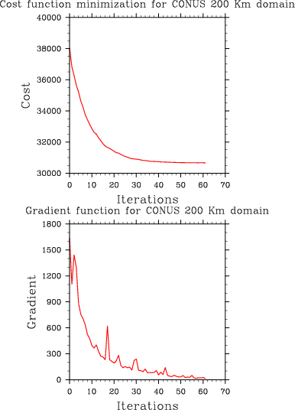
Impact of BE on Minimization
Good BE
Bad BE
July, 2013 WRFDA Tutorial WRFDA BE Syed RH Rizvi

Slide 12
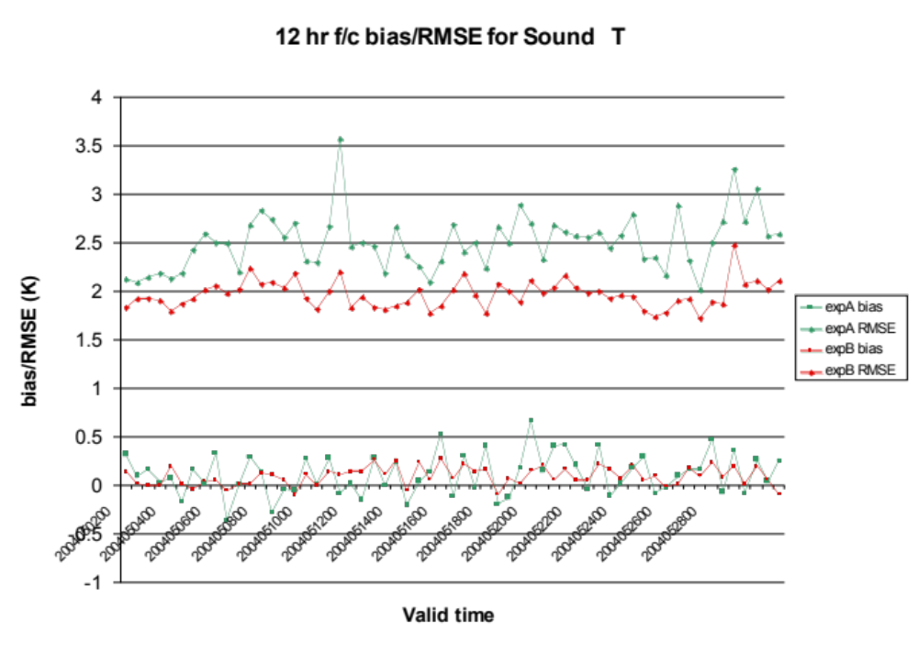
Impact of BE on Temperature forecast
Exp A: 6 Hr cycling with old BE
Exp B: 6 Hr cycling with new BE
July, 2013 WRFDA Tutorial WRFDA BE Syed RH Rizvi

Slide 13
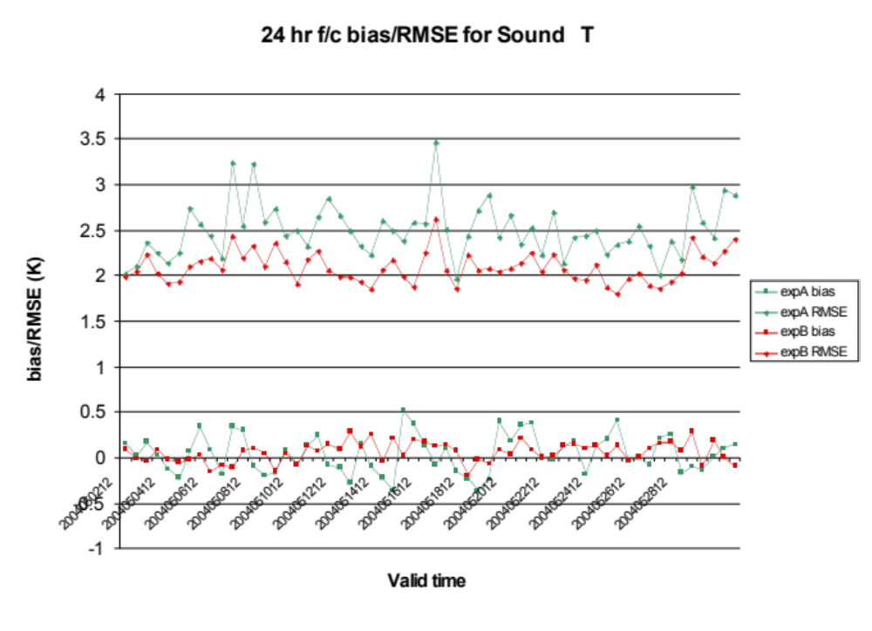
Impact of BE on Temperature forecast
Exp A: 6 Hr cycling with old BE
Exp B: 6 Hr cycling with new BE
July, 2013 WRFDA Tutorial WRFDA BE Syed RH Rizvi

Slide 14
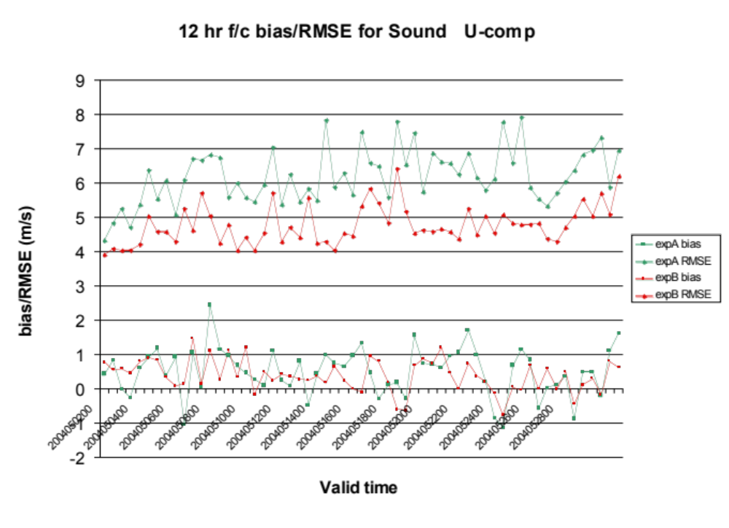
Impact of BE on Wind (U Comp.) forecast
Exp A: 6 Hr cycling with old BE
Exp B: 6 Hr cycling with new BE
July, 2013 WRFDA Tutorial WRFDA BE Syed RH Rizvi

Slide 15
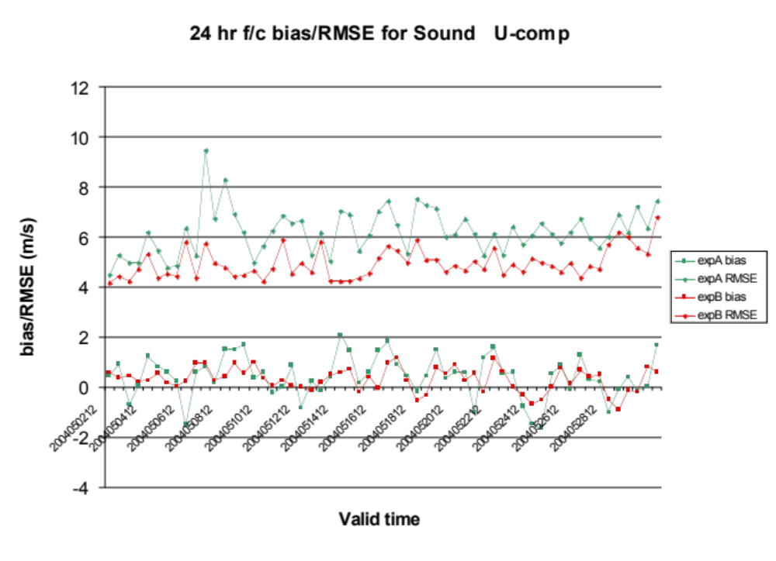
Impact of BE on Wind (U Comp.) forecast
Exp A: 6 Hr cycling with old BE
Exp B: 6 Hr cycling with new BE
July, 2013 WRFDA Tutorial WRFDA BE Syed RH Rizvi

Slide 16
WRFDA “gen_be” utility:
It resides in WRFDA under the “var” directory
Computes various components of BE statistics
Designed both for NMC and Ensemble methods (“BE_METHOD”)
It consists of five stages
Basic goal is to estimate the error covariance in analysis control variable space (Coefficients of the EOF’s for ψ, χ_{u}, T_{u}, rh and p_{s_u}) with input from model space (U, V, T, q & P_{s})
July, 2013 WRFDA Tutorial WRFDA BE Syed RH Rizvi

Slide 17
“gen_be” - Stage0
Computes (ψ , χ) from (u,v)
Forms desired differences for the following fields
ψ - Stream Function
χ - Velocity potential
T - Temperature
q - Relative Humidity
p_{s} - Surface Pressure
July, 2013 WRFDA Tutorial WRFDA BE Syed RH Rizvi

Slide 18
“gen_be” - Stage1
Reads “gen_be_stage1” namelist
Fixes “bins” for computing BE statistics
Computes “mean” of the differences formed in stage0
Removes respective “mean” and forms perturbations for
Stream Function (ψ´)
Velocity potential (χ´)
Temperature (T´)
Relative Humidity (q´)
Surface Pressure (p_{s}´)
July, 2013 WRFDA Tutorial WRFDA BE Syed RH Rizvi

Slide 19
“gen_be” - Stage2 & 2a
Reads “gen_be_stage2” namelist
Reads field written in stage1 and computes covariance of the respective fields
Computes regression coefficient & balanced part of χ, T & p_{s}
χ_{b} = C ψ´
T_{b}(k) = ∑_{l}G(k,l) ψ´(l)
p_{s_b} = ∑_{l} W(k) ψ´(k)
Computes unbalanced part
χ_{u}´ = χ´ - χ_{b}
T_{u}´ = T´ - T_{b}
p_{s_u}´ = p_{s}´ - p_{s_b}
July, 2013 WRFDA Tutorial WRFDA BE Syed RH Rizvi

Slide 20



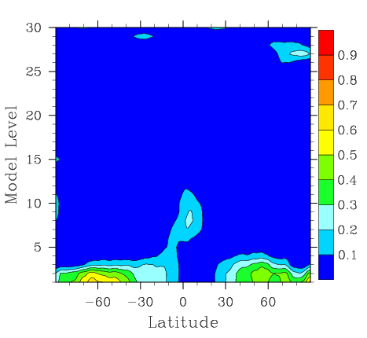
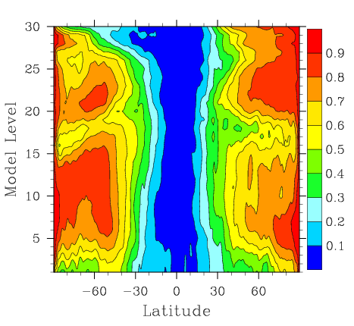
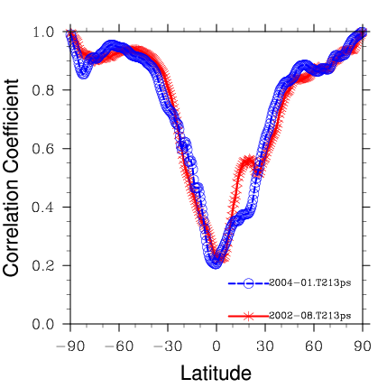
WRFDA Balance constraints
WRFDA imposes statistical balanced constraints between
Stream Function & Velocity potential
Stream Function & Temperature
Stream Function & Surface Pressure
How good are these balanced constraints?
Computed based on KMA global model
July, 2013 WRFDA Tutorial WRFDA BE Syed RH Rizvi

Slide 21
“gen_be” - Stage3
Reads “gen_be_stage3” namelist
Removes mean for χ_{u}´, T_{u}´ & p_{s_u}´
Computes eigenvectors and eigen values for vertical error covariance matrix of ψ´ , χ_{u}´, T_{u}´ & q
Computes variance of p_{s_u}´
Computes eigen decomposition of ψ´ , χ_{u}´, T_{u}´ & q
July, 2013 WRFDA Tutorial WRFDA BE Syed RH Rizvi

Slide 22

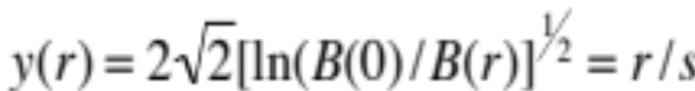
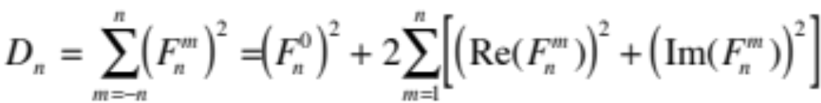
“gen_be” - Stage4
Reads “gen_be_stage4” namelist
For each variable & each eigen mode, for regional option computes “lengthscale (s)”
For global option, computes “power spectrum (D_{n})”
July, 2013 WRFDA Tutorial WRFDA BE Syed RH Rizvi

Slide 23
Single observation test
Through single observation test, one can understand
  structure of BE
  It identifies the “shortfalls” of BE
  It gives a broad guidelines for tuning BE
Basic concept:
Analysis equation: xª = x^{b} + BH^{T}(HBH^{T} + R)⁻¹[yº-H(x^{b})]
Set single observation (U,V,T etc. ) as follows:
[yº-H(x^{b})] = 1.0 ; R = I
Thus,
xª - x^{b} = B * constant delta vector
July, 2013 WRFDA Tutorial WRFDA BE Syed RH Rizvi

Slide 24
How to activate Single obs test (PSOT)?
“single obs utility” or “psot” may be activated by setting the following namelist parameters
num_pseudo = 1
pseudo_var =“ Variable name” like ”U”, “T”, “P”, etc.
pseudo_x = “X-coordinate of the observation”
pseudo_y = “Y-coordinate of the observation”
pseudo_z = “Z-coordinate of the observation”
pseudo_val = “Observation innovation”, departure from FG”
pseudo_err = “Observation error”
July, 2013 WRFDA Tutorial WRFDA BE Syed RH Rizvi

Slide 25
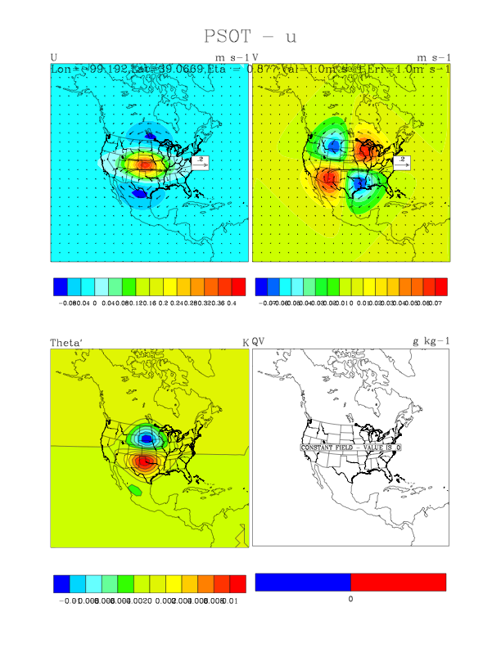
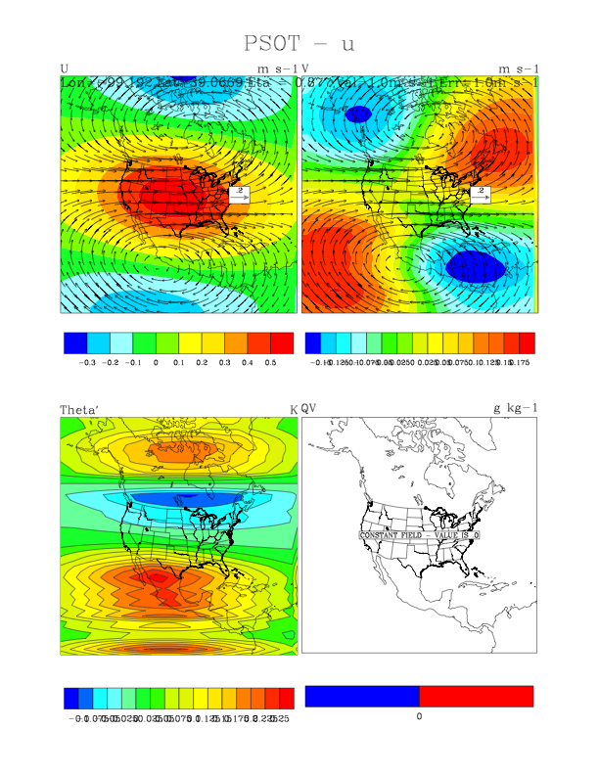
Single Obs (U) test with different BE
July, 2013 WRFDA Tutorial WRFDA BE Syed RH Rizvi

Slide 26
How to perform tuning of BE?
Horizontal component of BE can be tuned with following namelist parameters
LEN_SCALING1 - 5 (Length scaling parameters)
VAR_SCALING1 - 5 (Variance scaling parameters)
Vertical component of BE can be tuned with following namelist parameter
MAX_VERT_VAR1 - 5 (Vertical variance parameters)
July, 2013 WRFDA Tutorial WRFDA BE Syed RH Rizvi

Slide 27
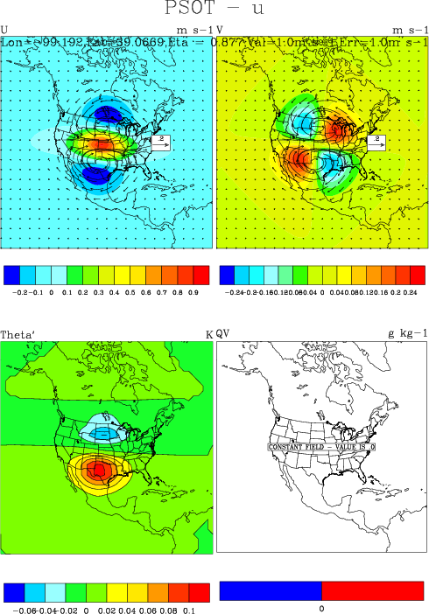
Results with BE Tuning
No tuning
Len_scaling1 & 2 =0.25
July, 2013 WRFDA Tutorial WRFDA BE Syed RH Rizvi

Slide 28

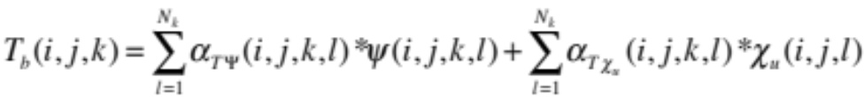
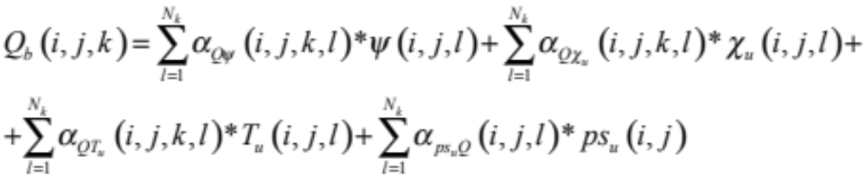
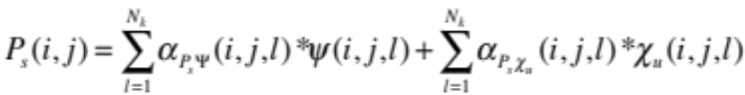
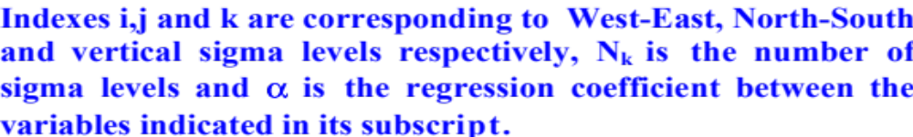
Multivariate formulation of BE
New set of analysis control variables (cv_options=6) have been designed
July, 2013 WRFDA Tutorial WRFDA BE Syed RH Rizvi

Slide 29
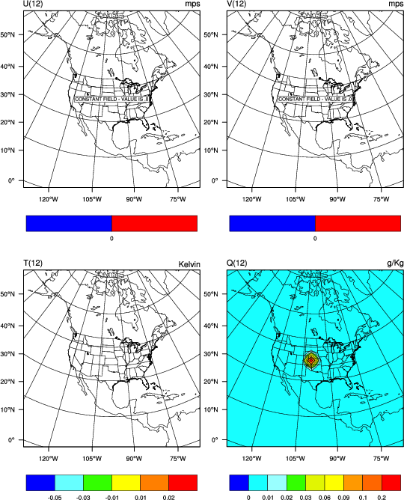
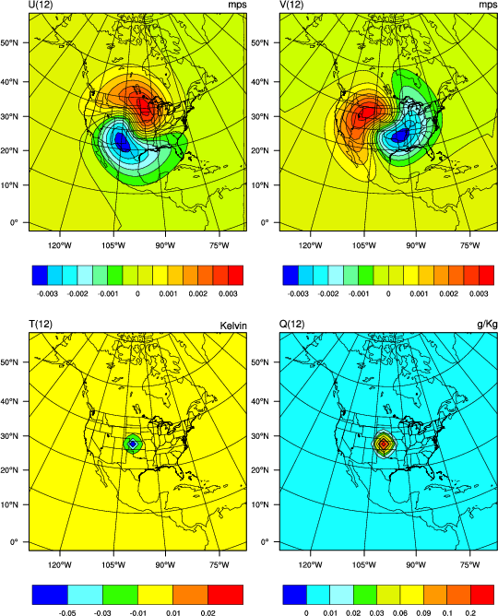
Single Obs (Moisture) test
cv_options=5, BE
Cv_optins=6, BE
July, 2013 WRFDA Tutorial WRFDA BE Syed RH Rizvi

Slide 30
Upcoming new features
Some filtering options at various stages
Background error for cloud hydrometeors like cloud water vapor, ice, snow and rain
Introduction of new “bin_type=7” for four types of “rain” categories
Additional diagnostics to study the frequency distribution of background error statistics
Implementation of Holm (2002) type background error
Stand alone branch of “gen_be”
July, 2013 WRFDA Tutorial WRFDA BE Syed RH Rizvi

Slide 31
Advanced Practice Session – “gen_be”
Compilation of “gen_be” utility
Generation of BE statistics
Familiarization with various graphical utilities to display “gen_be” diagnostics
Running single observation tests to understand the structure of BE
BE error tuning
July, 2013 WRFDA Tutorial WRFDA BE Syed RH Rizvi

Slide 32
Generation of BE
“gen_be_wrapper.ksh” script for generating BE for “CONUS” at 200 Km domain with:
Grid Size : 45 x 45 x 28
BE Method : NMC Method
Data Input : January, 2007 forecasts, both from 00 & 12 UTC IC
Basic environment variables that needs to be set are:
Gen_be executables location (WRFVAR_DIR)
Forecast input data (FC_DIR)
Run directory (BE_DIR)
Data Range (START_DATE, END_DATE)
“gen_be” wrapper script basically executes “var/scripts/gen_be/gen_be.ksh” script
July, 2013 WRFDA Tutorial WRFDA BE Syed RH Rizvi

Slide 33
Gen_be diagnostics
“gen_be” creates various diagnostic files which may be used to display various components of BE statistics.
Important files are:
Eigen vectors: fort.174, fort.178, fort.182, fort.186
Eigen values: fort.175, fort.179, fort.183, fort.187
scalelength: fort.194, fort.179, fort.183, fort.187
Correlation between χ_{u} & χ_{b} (chi_u.chi.dat)
Correlation between T_{u} & T_{b} (T_u.T.dat)
Correlation between p_{s_u} & (ps_u.ps.dat)
Important Strings that need to be defined in the wrapper script
“var/script/gen_be/gen_be_plot_wrapper.ksh”
BE_DIR --- gen_be Run directory
July, 2013 WRFDA Tutorial WRFDA BE Syed RH Rizvi

Slide 34
How to run Single Observation Test ?
Familiarization with single observation “wrapper” script (“da_run_suite_wrapper_con200.ksh”) to run Single Observation test
Key parameters are
Type of observation (pseudo_var)
Obs co-ordinates (pseudo_x, pseudo_y & pseudo_z)
Observation value (pseudo_val)
Observation error (pseudo_err)
Display analysis increments to understand BE structure
July, 2013 WRFDA Tutorial WRFDA BE Syed RH Rizvi

Slide 35
BE tuning
Understand the role of BE-tuning parameters through namelist options
LEN_SCALING1 - 5 (Length scaling parameters)
VAR_SCALING1 - 5 (Variance scaling parameters)
MAX_VERT_VAR1 - 5 (Vertical variance parameters)
Note: If BE is available for the same domain configuration then its tuning is not required
July, 2013 WRFDA Tutorial WRFDA BE Syed RH Rizvi

