Slide 1
WRFDA Tools
Analysis/Forecast Verification
Syed RH Rizvi
National Center For Atmospheric Research
NCAR/ESSL/MMM, Boulder, CO-80307, USA
rizvi@ucar.edu
July, 2013 WRFDA Tutorial WRFDA Tools Syed RH Rizvi

Slide 2
Talk overview
WRFDA verification package
What are its advantages/disadvantages?
How to run WRFDA verification package
Expected graphics
Upcoming new feature - AFWA Go-Index
WRFDA scripts and graphic tools
Obs error tuning (Desroziers method)
(QJRMS (2001), Vol. 127, pp. 1433-1452)
Obs error tuning Hollingsworth method)
(Tellus (1986), Vol. 38, pp. 111-161, Part I & II)
July, 2013 WRFDA Tutorial WRFDA Tools Syed RH Rizvi

Slide 3
How to Verify Analysis/Forecast?
Two ways:
- Against Observations
- Against any analysis available in grid space
(Control Analysis)
Verification scores:
- Root Mean Square Error (RMSE)
- Mean bias (BIAS)
- Absolute Mean bias (ABIAS)
July, 2013 WRFDA Tutorial WRFDA Tools Syed RH Rizvi

Slide 4
Observation based Verification
Analysis/Forecast
(FG)
WRFDA Innovations
( Y = Yº - FG )
Verification
Package
Observations
(Yº)
Verification code is under
var/da/da_verif_obs
compile all_wrfvar creates the desired executable
da_verif_obs.exe
July, 2013 WRFDA Tutorial WRFDA Tools Syed RH Rizvi

Slide 5
Analysis based Verification
Control Analysis
(X^{c})
Error
( y = X^{c} - X^{f} )
Verification
Package
Analysis/Forecast
(X^{f})
Code resides under “var/da/da_verif_anal” directory
“compile all_wrfvar” creates the desired executable
(da_verif_anal.exe)
July, 2013 WRFDA Tutorial WRFDA Tools Syed RH Rizvi

Slide 6
Advantages/disadvantages
Consistent with WRFDA QC
Consistent with WRF model topography
It makes use of built-in WRFDA observation operators
In principle, verification is possible against any
- Observation type individually or collectively
- Verification analysis may be from any independent source or produced by any experiment
It has its own built-in graphics (NCL) package
In principle one can verify against only those observations which WRFDA can assimilate. Thus quantities like “rainfall” etc. cannot be verified.
July, 2013 WRFDA Tutorial WRFDA Tools Syed RH Rizvi

Slide 7
How to run verification against observation?
It works in two steps
Step 1: Execute “var/script/da_run_suite_verif_obs.ksh”
It will create all the desired input files (gts_omb_oma”) for verification
Step 2: Execute “var/script/da_verif_obs_plot.ksh”
It will generate the desired graphics
These scripts are executed (in the same order) via a suitable wrapper script
July, 2013 WRFDA Tutorial WRFDA Tools Syed RH Rizvi

Slide 8
Wrapper for da_run_suite_verif_obs
Important variables to be declared via wrapper script:
INITIAL_DATE : Verification starting date (yyyymmddhh)
FINAL_DATE : Verification ending date (yyyymmddhh)
CYCLE_PERIOD : Date advance increment (in hours)
EXP_DIR : Experiment directory name (full path)
FILTERED_OBS_DIR : Directory where the observations “filtered_obs” against which verification will be done
VERIFICATION_FILE_STRING : It is either "wrfout" or "wrf_3dvar_input", depending on which files are saved while running WRF-forecasts in FC_DIR
VERIFY_HOUR : 00 for analysis & 12, 24, etc. corresponding to the desired forecast hour verification
July, 2013 WRFDA Tutorial WRFDA Tools Syed RH Rizvi

Slide 9
Wrapper for da_verif_obs_plot
Important variables:
WRFVAR_DIR : WRFDA main directory (full path)
REG_DIR : Directory holding sub-directories for each experiment generated in Step 1
For example: "gts_omb_oma" file corresponding to experiment "verify_12" (directory for 12 hr forecast verification) for "2005081700" should be in $REG_DIR/verify_12/2005081700/wrfvar
RUN_DIR : Full path of the directory where plots will be generated
NUM_EXPT : Total number of experiments (Currently maximum 10)
EXP_NAMES : Experiment directory names as they exist in REG_DIR (blank separated)
EXP_LEGENDS : Legend strings for each experiments respectively (comma separated)
START_DATE : Starting date ("YYYYMMDDHH") for verification
END_DATE : Ending date ("YYYYMMDDHH") for verification
INTERVAL : Time interval (in hours) for incrementing date/time.
NUM_OBS_TYPE : Number of observation types for verification
OBS_TYPES : Verification observation types like, "synop", "buoy", "sound" etc.
PLOT_WKS : Name of workstation for plots like "X11", "pdf" etc.
DESIRED_LEVELS : Pressure levels (in hPa) for plotting diagnostics
DESIRED_SCORES : Diagnostics like "RMSE", "BIAS" or "ABIAS"
EXP_LINES_COLORS : Color sequence for various experiments.
VERIFY_DATE_RANGE: String to specify title for X-axis
July, 2013 WRFDA Tutorial WRFDA Tools Syed RH Rizvi

Slide 10
Verif_obs_plot output
In RUN_DIR, the following graphics will be generated for each of the desired scores (RMSE, BIAS, ABIAS)
- Time series for surface and all the desired upper air levels
- Vertical profiles
- Time Average for surface and all the upper air levels (Histograms)
-rw-r--r-- 1 rizvi ncar 597691 Oct 13 12:49 Time_Series_SFC_RMSE.pdf
-rw-r--r-- 1 rizvi ncar 291856 Oct 13 12:49 Time_Series_SFC_BIAS.pdf
-rw-r--r-- 1 rizvi ncar 319570 Oct 13 12:49 Time_Series_SFC_ABIAS.pdf
-rw-r--r-- 1 rizvi ncar 1571714 Oct 13 12:49 Time_Series_UPA_RMSE.pdf
-rw-r--r-- 1 rizvi ncar 753440 Oct 13 12:49 Time_Series_UPA_BIAS.pdf
-rw-r--r-- 1 rizvi ncar 769452 Oct 13 12:49 Time_Series_UPA_ABIAS.pdf
-rw-r--r-- 1 rizvi ncar 463151 Oct 13 12:49 Profile_RMSE.pdf
-rw-r--r-- 1 rizvi ncar 467553 Oct 13 12:49 Profile_BIAS.pdf
-rw-r--r-- 1 rizvi ncar 12769280 Oct 13 14:54 Profile_ABIAS.pdf
-rw-r--r-- 1 rizvi ncar 129469 Oct 13 12:49 Time_Average_SFC_RMSE.pdf
-rw-r--r-- 1 rizvi ncar 136679 Oct 13 12:49 Time_Average_SFC_BIAS.pdf
-rw-r--r-- 1 rizvi ncar 142219 Oct 13 12:49 Time_Average_SFC_ABIAS.pdf
-rw-r--r-- 1 rizvi ncar 352928 Oct 13 12:49 Time_Average_UPA_RMSE.pdf
-rw-r--r-- 1 rizvi ncar 402740 Oct 13 12:49 Time_Average_UPA_BIAS.pdf
-rw-r--r-- 1 rizvi ncar 365264 Oct 13 12:49 Time_Average_UPA_ABIAS.pdf
July, 2013 WRFDA Tutorial WRFDA Tools Syed RH Rizvi

Slide 11
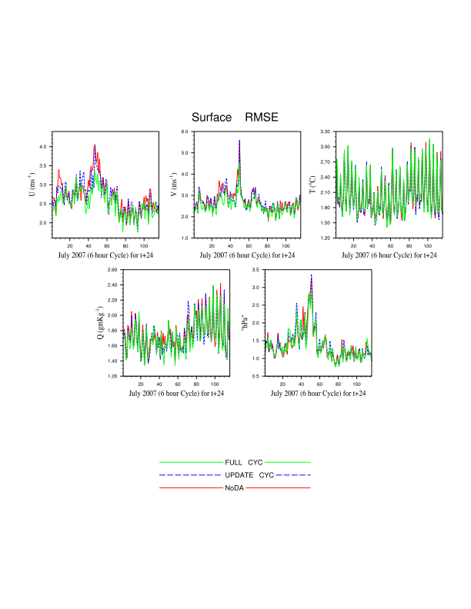
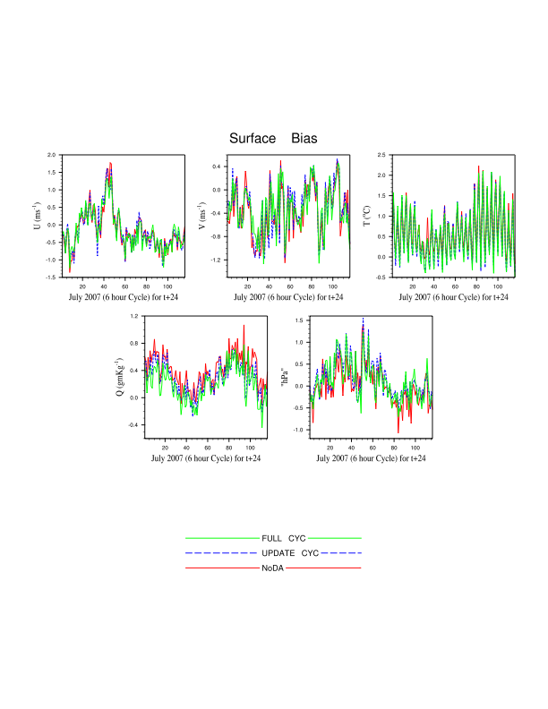
Verif_obs_plot -- Surface Time Series
July, 2013 WRFDA Tutorial WRFDA Tools Syed RH Rizvi

Slide 12
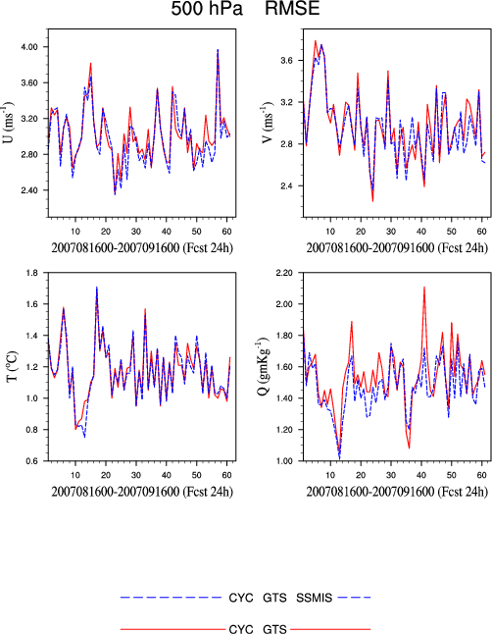
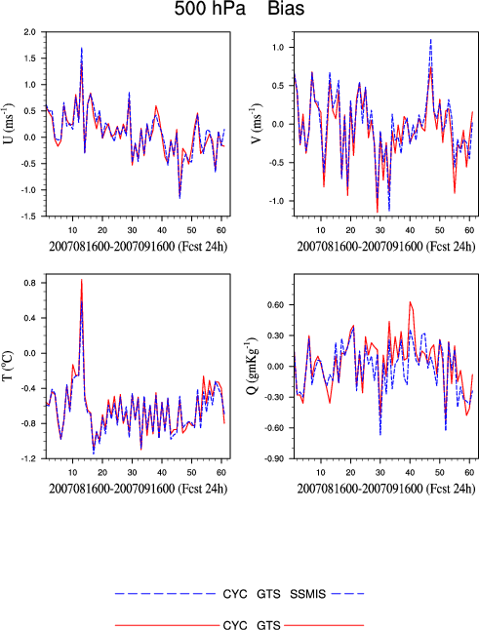
Verif_obs_plot -- Upper air Time Series
July, 2013 WRFDA Tutorial WRFDA Tools Syed RH Rizvi

Slide 13
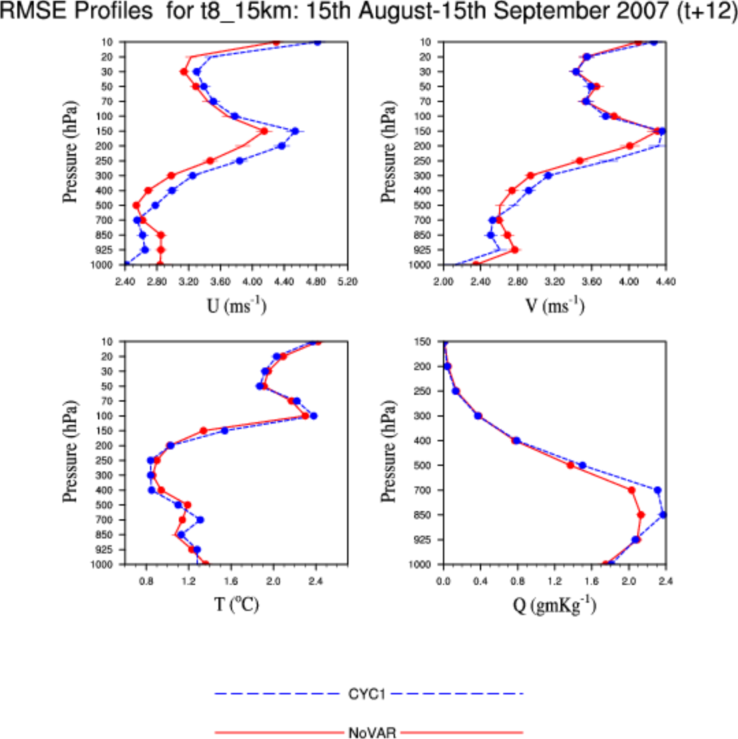
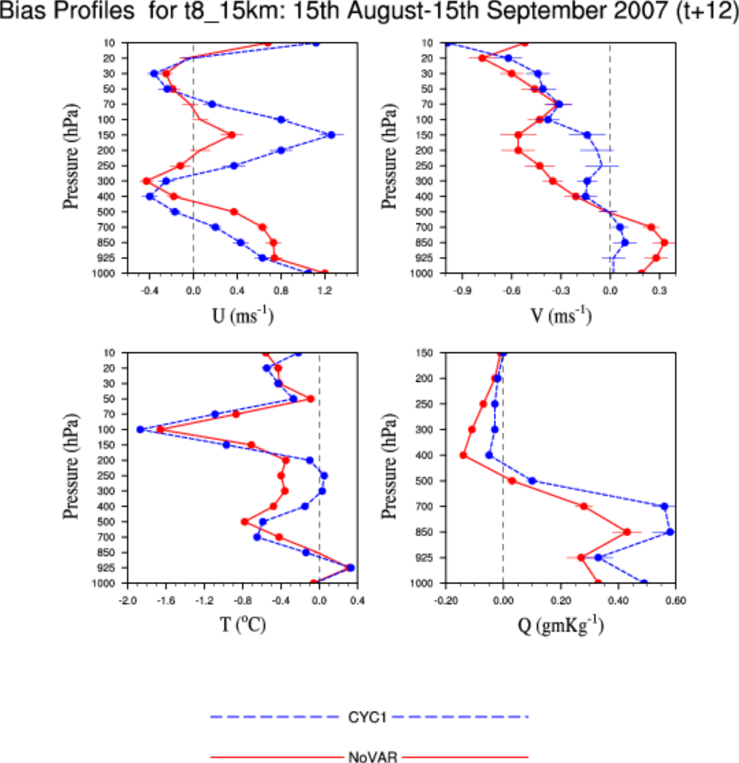
Verif_obs_plot -- Profile
July, 2013 WRFDA Tutorial WRFDA Tools Syed RH Rizvi

Slide 14
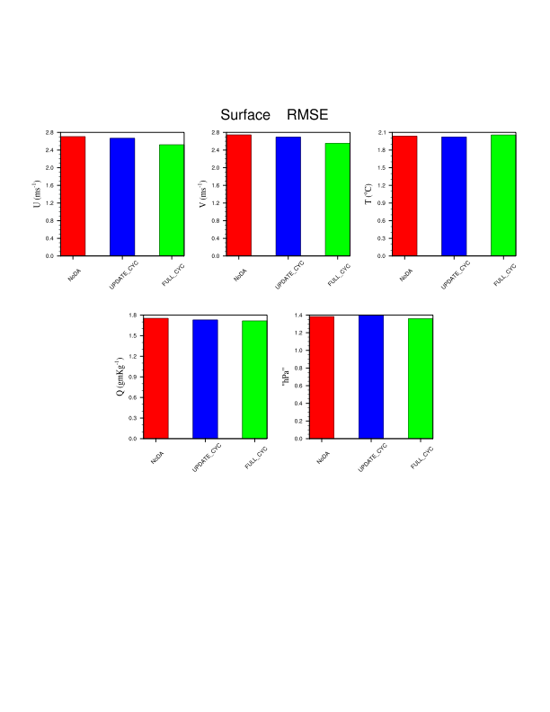
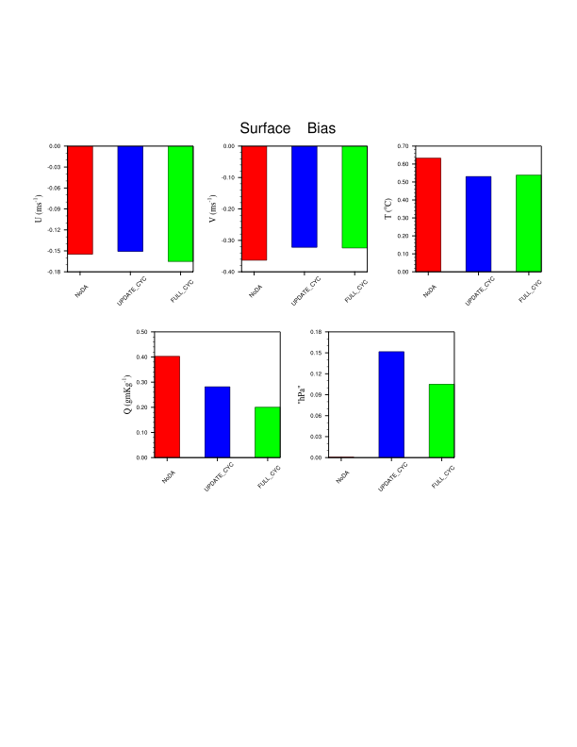
Verif_obs_plot -- Surface Time Average
July, 2013 WRFDA Tutorial WRFDA Tools Syed RH Rizvi

Slide 15
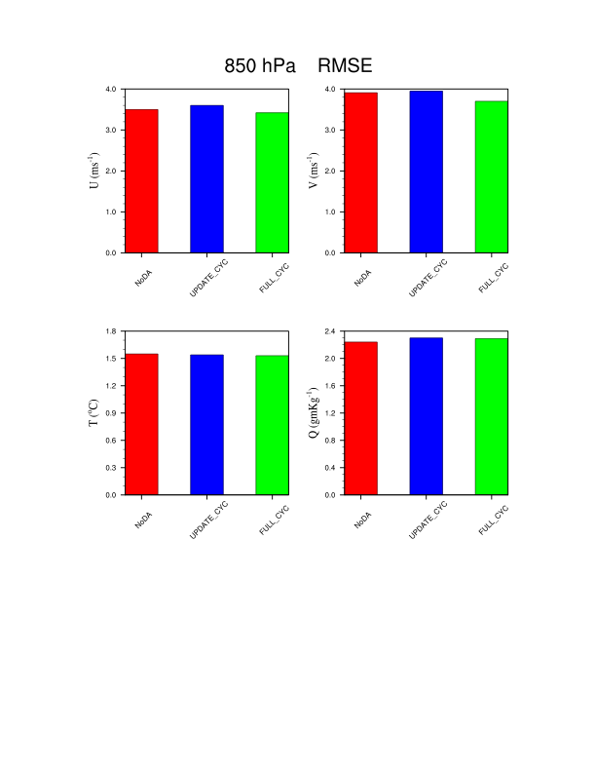
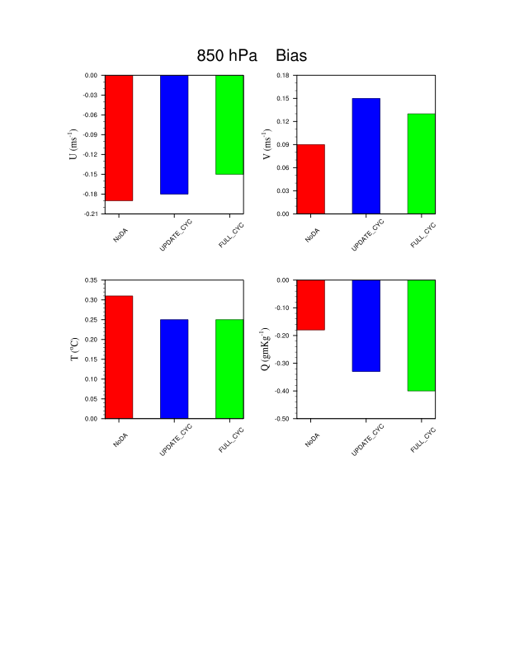
Verif_obs_plot -- Upper air Time Average
July, 2013 WRFDA Tutorial WRFDA Tools Syed RH Rizvi

Slide 16
How to run verification grid verification?
Basic requirement for each experiment output:
It should be in standard “wrf-netcdf” format with standard “wrfout” like file names
It should be at the same horizontal and vertical resolution
Forecasts corresponding to each experiment needs to be arranged in separate directories with date-wise (YYYYMMDDHH) sub-directories
How to run?
Desired graphics will be generated in “RUN_DIR” by executing “var/script/da_verif_grid.ksh” via a suitable wrapper script
July, 2013 WRFDA Tutorial WRFDA Tools Syed RH Rizvi

Slide 17
Wrapper for da_verif_grid.ksh
Important variables:
WRFVAR_DIR : Main WRFDA directory (full path)
REG_DIR : Directory holding forecast sub-directories for each experiment
RUN_DIR : Directory where plots will be generated
NUM_EXPT : Total number of experiments (Currently maximum 10)
EXP_DIR : Experiment directory names as they exist in REG_DIR (blank separated)
EXP_NAMES : Experiment names as they exist in REG_DIR (blank separated)
EXP_LEGENDS : Legend string for each experiments (comma separated)
DESIRED_LEVELS : Legend string for each experiments (comma separated)
DESIRED_SCORES : Diagnostics like "RMSE", "BIAS" or "ABIAS"
START_DATE : Starting date ("YYYYMMDDHH") for verification
END_DATE : Ending date ("YYYYMMDDHH") for verification
INTERVAL : Time interval (in hours) for incrementing date/time
VERIFY_HOUR : Verification hour
CONTROL_EXP_DIR : Directory name for verifying analysis
VERIFY_ITS_OWN_ANALYSIS : Set “true” or “false” if each experiment is going to be verified against its own analysis or against a fixed analysis in “CONTROL_EXP_DIR”
VERIFICATION_FILE_STRING : It should be “wrfout” or “wrfinput” depending on what is available
VERIFY_DATE_RANGE : String to specify X-axis title
PLOT_WKS : Name of workstation for plots like "X11", "pdf" etc.
July, 2013 WRFDA Tutorial WRFDA Tools Syed RH Rizvi

Slide 18
da_Verif_grid.ksh output
In RUN_DIR, the following graphics will be generated for each of the desired scores (RMSE, BIAS or ABIAS)
- Time series for surface fields (U10, V10, T2, Q2 & Psfc)
- Time series for upper air fields (U, V, T & Q) for the desired levels
- Upper air profiles for U, V, T & Q
- Time average for surface and upper air fields for the desired levels (Histogram)
-rw-r--r-- 1 rizvi ncar 235624 Dec 31 15:14 Time_Series_UPA_RMSE-850-hr24.pdf
-rw-r--r-- 1 rizvi ncar 237504 Dec 31 15:14 Time_Series_UPA_BIAS-850-hr24.pdf
-rw-r--r-- 1 rizvi ncar 183367 Dec 31 15:14 Time_Series_UPA_RMSE-200-hr24.pdf
-rw-r--r-- 1 rizvi ncar 173293 Dec 31 15:14 Time_Series_UPA_BIAS-200-hr24.pdf
-rw-r--r-- 1 rizvi ncar 322432 Dec 31 15:14 Time_Series_SFC_RMSE-hr24.pdf
-rw-r--r-- 1 rizvi ncar 325796 Dec 31 15:14 Time_Series_SFC_BIAS-hr24.pdf
-rw-r--r-- 1 rizvi ncar 100323 Dec 31 15:14 Time_Average_UPA_RMSE-850-hr24.pdf
-rw-r--r-- 1 rizvi ncar 112711 Dec 31 15:14 Time_Average_UPA_BIAS-850-hr24.pdf
-rw-r--r-- 1 rizvi ncar 71525 Dec 31 15:14 Time_Average_UPA_RMSE-200-hr24.pdf
-rw-r--r-- 1 rizvi ncar 81035 Dec 31 15:14 Time_Average_UPA_BIAS-200-hr24.pdf
-rw-r--r-- 1 rizvi ncar 163671 Dec 31 15:14 Time_Average_SFC_RMSE-hr24.pdf
-rw-r--r-- 1 rizvi ncar 182593 Dec 31 15:14 Time_Average_SFC_BIAS-hr24.pdf
-rw-r--r-- 1 rizvi ncar 237409 Dec 31 15:14 Profile_RMSE-hr24.pdf
-rw-r--r-- 1 rizvi ncar 238775 Dec 31 15:14 Profile_BIAS-hr24.pdf
July, 2013 WRFDA Tutorial WRFDA Tools Syed RH Rizvi

Slide 19
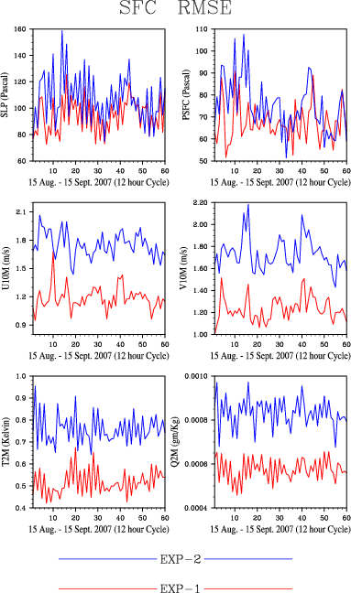
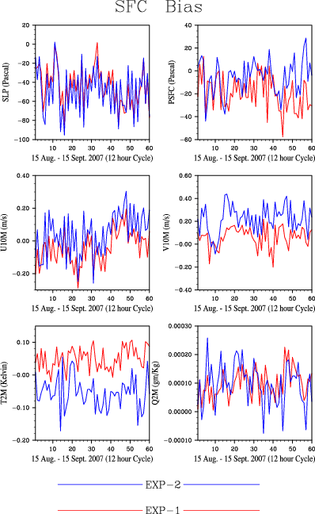
Verif_grid -- Surface Time Series
July, 2013 WRFDA Tutorial WRFDA Tools Syed RH Rizvi

Slide 20
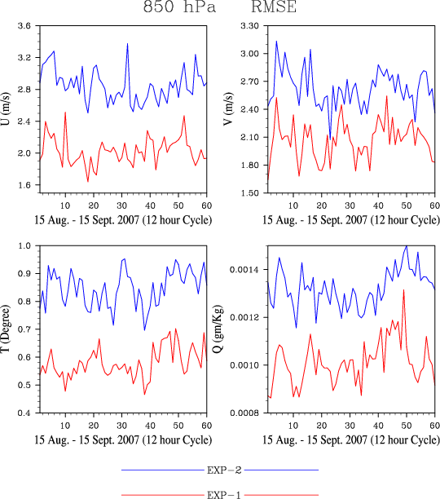
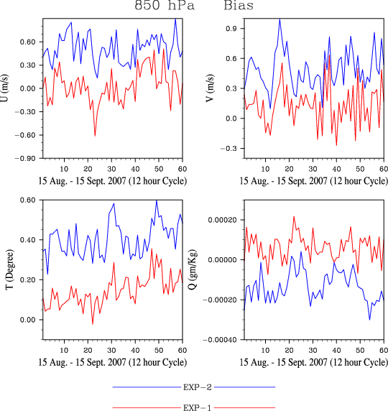
Verif_grid -- Upper air Time Series
July, 2013 WRFDA Tutorial WRFDA Tools Syed RH Rizvi

Slide 21
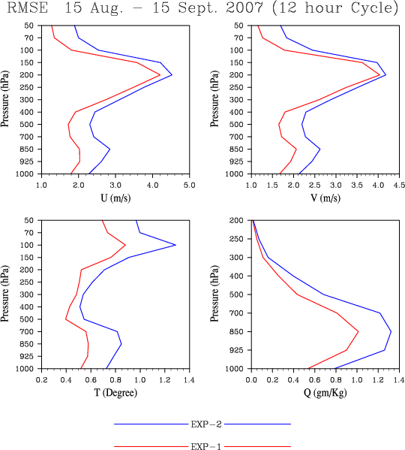
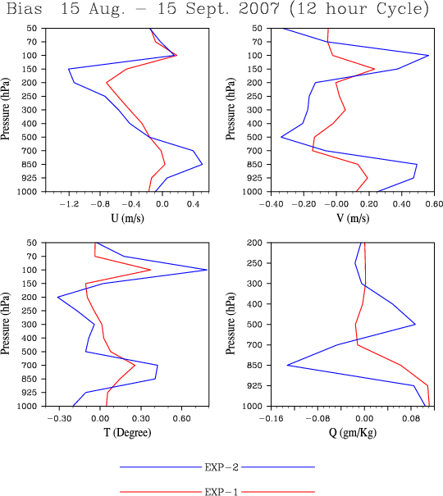
Verif_grid -- Profile
July, 2013 WRFDA Tutorial WRFDA Tools Syed RH Rizvi

Slide 22
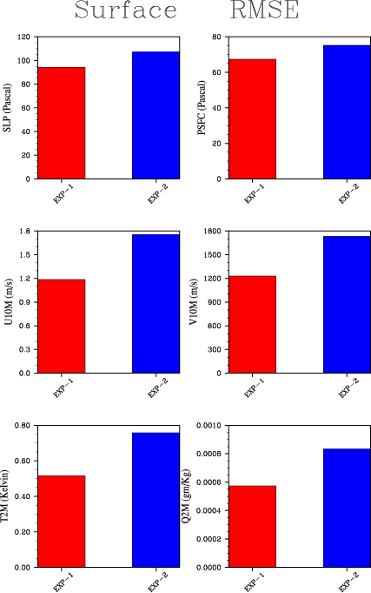
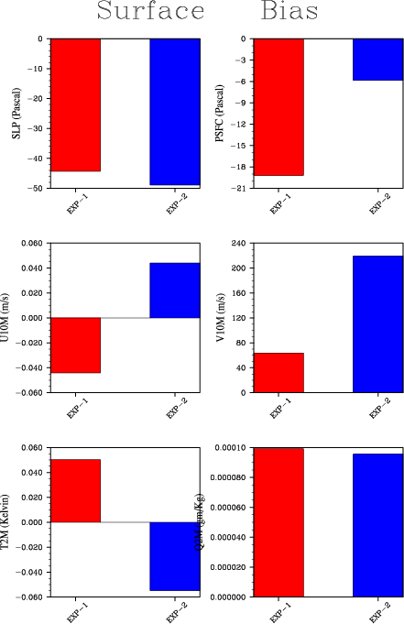
Verif_grid -- Surface Time Average
July, 2013 WRFDA Tutorial WRFDA Tools Syed RH Rizvi

Slide 23
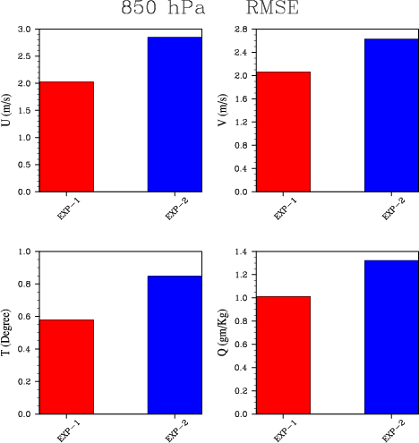
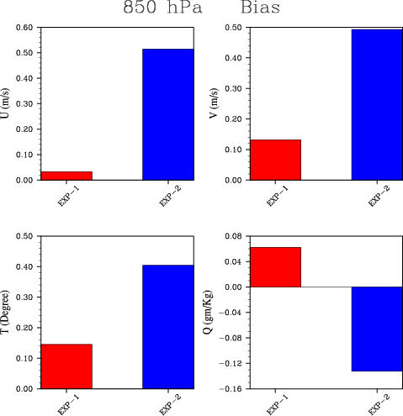
Verif_grid -- Upper air Time Average
July, 2013 WRFDA Tutorial WRFDA Tools Syed RH Rizvi

Slide 24
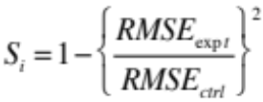
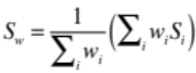
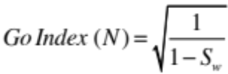
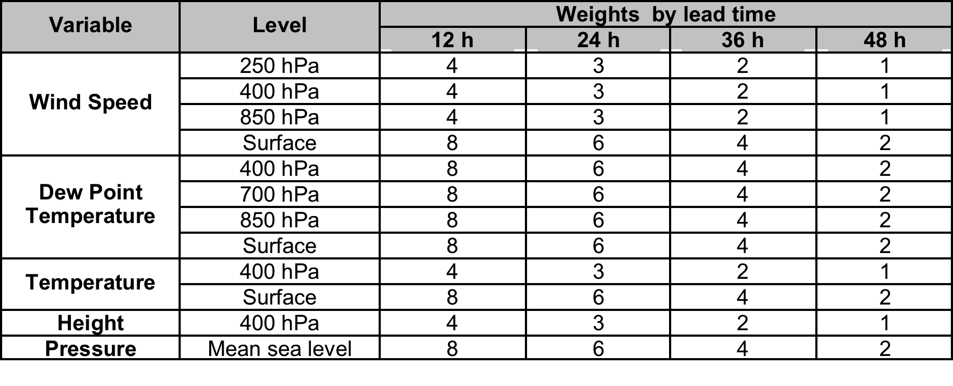
Upcoming new feature -AFWA Go-Index
Go-Index (N) is defined in terms of weighted average of RMSE of some selected variables at different levels for 12, 24, 36 and 48 hours forecast lead time (i)
Pre-defined weights (W_{i}) are as follows
Go-Index > 1 means, experiment (expt) performed better than control (ctrl)
July, 2013 WRFDA Tutorial WRFDA Tools Syed RH Rizvi

Slide 25
WRFDA Scripts and GroaphicTools
Shell scripts and NCL based graphics are available
http://www.mmm.ucar.edu/wrf/users/wrfda/download/tools.html
Some useful Shell Scripts:
da_run_wrfvar.ksh da_run_wrfvar_psot.ksh
da_run_suite_verif_obs.ksh da_run_suite_wrapper_qc_obs.ksh
da_run_psot.ksh da_plot_psot.ksh
da_run_gsi.ksh da_run_gsi_psot.ksh
da_tune_obs_hollingsworth.ksh da_tune_obs_desroziers.ksh
da_run_suite_wrapper_verif_obs.ksh da_verif_obs_plot.ksh
da_verif_anal_plot.ksh da_run_wps.ksh da_run_wrf.ksh
da_run_obsproc.ksh da_run_real.ksh
Some useful NCL Scripts:
WRF-Var_plot.ncl plot_cost_grad_fn.ncl plot_obascii_loc.ncl
plot_gts_omb_oma.ncl plot_rad_diags.ncl plot_rad_varbc_param.ncl
Verif_obs_time_series.ncl verif_obs_time_average.ncl verif_anal_vert_profile.ncl
verif_anal_time_series.ncl verif_anal_time_average.ncl verif_anal_vert_profile
Note: For details read “WRFDA/var/graphics/ncl/README”
July, 2013 WRFDA Tutorial WRFDA Tools Syed RH Rizvi

Slide 26
Obs error tuning (Desroziers method)
Step 1: Make sure that “va/build/da_tune_obs_desroziers.exe” exists
Step 2: Run two set of parallel WRFDA cycling experiments:
a) “unperturbed” : Normal WRFDA cycling run with default option
b) “perturbed” : WRFDA cycling run with “omb_add_noise” and “put_rand_seed” as “TRUE”
Step 3: Execute “var/scripts/da_tune_obs_desroziers.ksh” via a “wrapper” script.
Important environment variables to be declared in “wrapper” script
WRFVAR_DIR : Path for main WRFDA
Y_DIR : Path for WRF-Var normal run “unperturbed run”
YP_DIR : Path for WRF-Var run with “put_rand_seed” & “oma_add_noise” as true “perturbed run”
Finally, a file named “errfac.dat” will be generated which needs to be copied in “wrfda/run” directory
More details are available at https://wiki.ucar.edu/display/mmm/Syed+Rizvi
July, 2013 WRFDA Tutorial WRFDA Tools Syed RH Rizvi

Slide 27
Obs error tuning (Hollingsworth method)
Step 1: Make sure that “va/build/da_tune_obs_hollingsworth1.exe” & “var/build/da_tune_hollingsworth2.exe” exists
Step 2: Run WRFDA cycling run for at least one month
Step 3: Execute “var/scripts/da_tune_obs_hollingsworth.ksh” via a “wrapper” script.
Important environment variables to be declared in “wrapper” script
WRFVAR_DIR : Path for main WRFDA
EXP_DIR : RUN_DIR for WRFDA cycling run
START_DATE : Start date for the tuning period
END_DATE : End date for the tuning period
Finally, for each desired observation type like “sound” , “sound_u_omb.sigma_o_b”, “sound_v_omb.sigma_o_b” etc. will be created
More details are available at:
https://wiki.ucar.edu/display/mmm/Syed+Rizvi
July, 2013 WRFDA Tutorial WRFDA Tools Syed RH Rizvi

