Slide 1


WRFDA-3DVar Setup, Run, and Diagnostics
Craig Schwartz
Hui-Chuan Lin, Yong-Run Guo,
Syed Rizvi, Xin Zhang, and Hans Huang
WRFDA Tutorial, July 2013

Slide 2
Outline
Installing WRFDA-3DVar
Setting-up a WRFDA-3DVar run (namelist configurations)
Making a WRFDA-3DVar run
Running UPDATE_BC
WRFDA-3DVar diagnostics
This presentation is based on WRFDA V3.5

Slide 3
Installing WRFDA-3DVar

Slide 4
Source Code
Download WRFDA source code (WRFDA_V3.5.tar.gz) from
http://www.mmm.ucar.edu/wrf/users/wrfda/download/get_source.html

Slide 5
FORTRAN 90 Compilers
Supported and tested platforms:
IBM with XLF compiler V13.0
Linux with PGI compiler V10.1
Linux with INTEL compiler V12.0
Mac with INTEL compiler V11.1
Mac with PGI compiler V10.3-0 64-bit
Mac with GFORTRAN compiler V4.4.0
Mac with G95 compiler V4.0.3 (please download the patch of WRFPLUS on WRFDA home page)
  To check version numbers, use xlf -qversion, g95 -v, pgf90 -V, gfortran –v
Notes:
1. IBM
Needs XLF compiler V13.0 or later
2. Linux
PGI compiler V8.0-4 or later (only V10.3 or later supports -m64/-m32
option)
INTEL compiler V12.0 or later
GFORTRAN V4.4.0 or later
3. Mac
3.1 INTEL compiler V11.1 or later
If needs to build 32-bit executables, change LDFLAGS_LOCAL in
configure.wrf
From
LDFLAGS_LOCAL = -ip -Wl,-stack_addr,0xF10000000
-Wl,-stack_size,0x64000000
to
LDFLAGS_LOCAL = -ip -Wl,-stack_addr,0xF0000000
-Wl,-stack_size,0x40000000
3.2 PGI compiler V10.3-0
If compiled with CRTM
'-Mnomod' needs to be added to FC_FLAGS in
var/external/crtm/configure/pgf90.setup
'-Mnomod' needs bo be added to FCBASEOPTS in configure.wrf
3.3 GFORTRAN
For gfortran V4.4.0, needs to comment out '-funroll-loops' for FCOPTIM
in configure.wrf
For gfortran V4.5.0 or later, NO needs to comment out '-funroll-loops'
in configure.wrf
3.4 G95 compiler 0.92
To compile RTTOV
Needs to comment out '-fno-second-underscore' for
FFLAGS_ARCH_mod_iratlas in $RTTOV/build/arch/g95
Needs to add 'ranlib -c $(LIB)' to Makfile in src/main, src/coef_io,
src/coef_789, src/emis_atlas

Slide 6
Unsupported platforms
Due to lack of access to these platforms and compilers, we are unable to provide support:
  Sun (solaris)
  DEC alpha
  Other SGI
  Absoft
  Lahey
  Salford
  Pathscale
WRFDA does not work on
  PGI 5.x
  Windows
Please share with us (and other fellow users) your experiences on the various platforms and compilers.

Slide 7
Libraries Required by WRFDA
NetCDF: Network Common Data Form:
  http://www.unidata.ucar.edu/software/netcdf/
Set environmental variable for the NetCDF library:
  > setenv NETCDF $your_installation_dir/netcdf
Make sure the NetCDF library is compiled using the same compiler that will be used to build WRFDA, since libraries produced by one compiler may not be compatible with code compiled by another.

Slide 8
Optional Libraries
If using PREPBUFR or radiance data:
  BUFR: Binary Universal Form for the Representation of meteorological data
    http://www.nco.ncep.noaa.gov/sib/decoders/BUFRLIB/
    Included in WRFDA (as of V3.1.1)
If assimilating radiance data, either CRTM or RTTOV is required:
  CRTM: Community Radiative Transfer Model (version REL_2.0.2)
    ftp://ftp.emc.ncep.noaa.gov/jcsda/CRTM/
    Included in WRFDA (as of V3.2.1)
Set environmental variables:
  > setenv BUFR 1
  > setenv CRTM 1
  RTTOV: Radiative Transfer for TOVS (version 10)
    http://research.metoffice.gov.uk/research/interproj/nwpsaf/rtm
  > setenv RTTOV path_where lib/librttov10.2.0_*.a
  libraries are located

Slide 9
Configure WRFDA
> cd $your_sourcecode_dir/WRFDA
> ./configure wrfda
  configure.wrf will be created
checking for perl5... no
checking for perl... found /usr/bin/perl (perl)
Will use NETCDF in dir: /usr/local/netcdf-3.6.0-p1-g95ppc
PHDF5 not set in environment. Will configure WRF for use without.
$JASPERLIB or $JASPERINC not found in environment, configuring to build without grib2 I/O...
------------------------------------------------------------------------
Please select from among the following supported platforms.
1. Darwin (MACOS) PGI compiler with pgcc (serial)
2. Darwin (MACOS) PGI compiler with pgcc (smpar)
3. Darwin (MACOS) PGI compiler with pgcc (dmpar)
4. Darwin (MACOS) PGI compiler with pgcc (dm+sm)
5. Darwin (MACOS) intel compiler with icc (serial)
6. Darwin (MACOS) intel compiler with icc (smpar)
7. Darwin (MACOS) intel compiler with icc (dmpar)
8. Darwin (MACOS) intel compiler with icc (dm+sm)
9. Darwin (MACOS) intel compiler with cc (serial)
10. Darwin (MACOS) intel compiler with cc (smpar)
11. Darwin (MACOS) intel compiler with cc (dmpar)
12. Darwin (MACOS) intel compiler with cc (dm+sm)
13. Darwin (MACOS) g95 with gcc (serial)
14. Darwin (MACOS) g95 with gcc (dmpar)
15. Darwin (MACOS) xlf (serial)
16. Darwin (MACOS) xlf (dmpar)
Enter selection [1-16] :
serial: single-processor
dmpar: distributed-memory parallel
smpar: shared-memory parallel
dm+sm: distributed-memory with shared-memory parallel
On linux, smpar, dm+sm may not work properly because the MPI library may not be thread-safe.

Slide 10
Compile WRFDA
> ./compile all_wrfvar >&! log_compile
  43 executables in the var/build directory (linked to var/da):
    da_wrfvar.exe: WRFDA
    da_update_bc.exe: update_bc
    gen_be_stage0_wrf.exe, …: gen_be
    da_advance_time.exe: time manipulation
  OBSPROC executable in the var/obsproc/src
    obsproc.exe: OBSPROC
Clean the WRFDA directory before making your next compilation:
  > clean -a
Note: WRF compiles with the -r4 option while WRFDA compiles with -r8. For this reason, WRF and WRFDA cannot reside and be compiled under the same directory.

Slide 11
Setting-up a WRFDA-3DVar run

Slide 12
WRFDA-3DVar Equation
J(x): Scalar cost function
x: The analysis: what we’re trying to find!
x_{b}: Background field
B: Background error covariance matrix
y: Observations
H: Observation operator: computes model-simulated obs
R: Observation error covariance matrix

Slide 13
User-provided Data
J(x): Scalar cost function…………………....WRFDA output
x: The analysis………………………………..WRFDA output
x_{b}: Background field………………………….user input
B: Background error covariance matrix……user input
y: Observations……………………………….user input
H: Observation operator…………………..included in WRFDA
R: Observation error covariance matrix……user input

Slide 14
Sources of User-provided Data
Where do the input files come from?
Symbol | Description | Source
x_{b} | Background (“first-guess”) | real.exe or previous WRF forecast
B | Background error covariances | “gen_be” or default file provided with WRFDA
y | Observations | “obsproc” output or NCEP BUFR files
R | Observation error covariances | “obsproc” output or NCEP BUFR files

Slide 15
User-determined run-time options…the Namelist
The namelist variables discussed in the following slides refer to WRFDA-3DVar runs and conventional data assimilation only.
Please refer to specific lectures (background error covariance, radiance assimilation, …) for other namelist options.

Slide 16
What is a Namelist?
The Fortran namelist (namelist.input) file allows the user to configure a WRFDA run without recompiling the code.
  Specific Fortran 90 namelist format:
Descriptions of WRFDA namelist variables are given in the WRF User’s Guide and README.namelist in the WRFDA release (WRFDA/var/README.namelist).
&namelistname - start
…
/ - end

Slide 17
WRFDA Namelist
Default values of the namelist variables are defined by the WRFDA Registry (WRFDA/Registry/Registry.wrfvar).
Fill namelist.input with non-default and desired variable values before running WRFDA.
A WRFDA namelist file includes two parts:
&wrfvar1
/
&wrfvar2
/
…
&wrfvar22
/
&time_control
/
&fdda
/
…
&namelist_quilt
/
1) WRFDA namelist options:
Running options for WRFDA code.
2) WRF namelist options:
WRFDA needs certain information from the WRF configuration including domain and time settings.
Append your WRF namelist.input to the end of &wrfvar22 to create a complete/consistent namelist.input for WRFDA

Slide 18
Run-time Configurations
The next several slides pose configuration questions that should be considered before making a WRFDA-3DVar run.
  Important to carefully think about your configurations!
The appropriate namelist parameters associated with these questions are discussed.

Slide 19
Background Options
What’s the format of my background file?
&WRFVAR3
fg_format: Format of the first guess field
fg_format = 1 : ARW regional, default
fg_format = 2 : WRF-NMM regional (not tested)
  fg_format = 3 : ARW global (not tested)
  fg_format = 4 : KMA global (not tested)

Slide 20
Background Error Covariance Options
What type of background error covariance do I want to use?
&WRFVAR7
cv_options: Background error covariance option
  cv_options = 3 : global, default…see …/var/run/be.dat.cv3
  cv_options = 5 : regional, generated by “gen_be”
  cv_options = 6 : regional, generated by “gen_be” with
  multivariate moisture correlation, new in
  WRFDA V3.3

Slide 21
Observation Options
What’s the format of my conventional observations?
&WRFVAR3
ob_format: The format of the conventional and satellite
retrieval observation data going into WRFDA
  ob_format = 1 : NCEP PREPBUFR (ob.bufr, gpsro.bufr)
  ob_format = 2 : ASCII (ob.ascii), default
  ob_format = 3 : MADIS data format (not tested)

Slide 22
Observation Options
What observation types do I want to assimilate?
&WRFVAR4
USE_SYNOPOBS = T,
USE_SHIPSOBS = T,
USE_METAROBS = T,
USE_SOUNDOBS = T,
USE_PILOTOBS = T,
USE_AIREPOBS = T,
USE_GEOAMVOBS = T,
USE_POLARAMVOBS = T,
USE_BUOYOBS = T,
USE_PROFILEROBS = T,
USE_SATEMOBS = T,
USE_GPSZTDOBS = F,
USE_GPSPWOBS = T,
USE_GPSREFOBS = T,
USE_QSCATOBS = T,
USE_RADAROBS = F,
USE_RADAR_RV = F,
USE_RADAR_RF = F,
USE_AIRSRETOBS = T,
Assimilate this observation type?
Set to either True or False

Slide 23
Observation Options
How much do I want to thin my PREPBUFR obs?
&WRFVAR4—only for NCEP PREPBUFR OBS (ob_format = 1 )
thin_conv: For thinning NCEP PREFPBUFR obs
  thin_conv = .true. : default, should always set to true
  thin_conv = .false. : Used only for debugging purposes.
thin_mesh_conv (max_instruments): Thinning mesh (km) for each type of conventional observation. The observation index/order follows the definitions in WRFDA/var/da/da_control/da_control.f90 (e.g., sound =1, synop =2, …)
  By default, thin_mesh_conv = 20.0 (km)
Notes:
Thin_conv: NCEP Prepbufr has time duplication in data? How about little-r data from OBSPROC or PREPBUFR from Obsproc?

Slide 24
Observation Options
What time window for my observations do I want to use?
&WRFVAR21
  time_window_min = “2008-02-05_10:30:00”
&WRFVAR22
  time_window_max = “2008-02-05_13:30:00”
  Obs between time_window_min and time_window_max are processed.
  Note the “WRF format” of the times

Slide 25
Observation Options
How strictly do I want to reject conventional observations?
&WRFVAR5
check_max_iv: Turns on/off an “outlier check” to reject observations whose innovations (O-B) are larger than a value defined as a multiple (a) of the observation error (σ_{o}) for each observation: i.e., when O-B > (a*σ_{o}), the ob is rejected.
  check_max_iv = .true. : default, typically set to true
  check_max_iv = .false. : Use this option only if the observation data are known to have good quality.
max_error_t, max_error_uv, max_error_pw, max_error_q, max_error_ref, max_error_rv, max_error_p: The factors (a) that multiply σ_{o} in the check_max_iv test. Can be set individually for different meteorological variables.
By default, max_error* = 5.0 for all meteorological variables

Slide 26
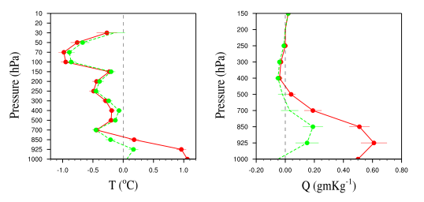
Observation Options
How do I want to handle surface observations?
&WRFVAR11
sfc_assi_options:
  sfc_assi_options = 1 (default): The surface observations will be assimilated based on the lowest model level first guess. Observations are not used when the height difference of the elevation of observing site and the lowest model level height is larger than 100 meters.
  sfc_assi_options = 2: The surface observations will be assimilated based on surface similarity theory in PBL. Innovations are computed based on 10-m wind and 2-m temperature & moisture.
Please use this option with caution, since the results could be very sensitive.

Slide 27
Analysis Options
At what time is my analysis valid?
&WRFVAR18
analysis_date = “2008-02-05_12:00:00”
(should be the same time as in your first-guess file)

Slide 28
Analysis Options
How do I want to configure minimization options?
&WRFVAR6
max_ext_its: Number of outer loops.
  1: default. Only one outer loop.
  Maximum number of outer loops is 10; common application is 2.
eps: Value for minimization convergence criterion. It is an array of dimension=max_ext_its.
  0.01(max_ext_its): default. The minimization is considered to converge when the norm of the cost function gradient is reduced at least 2 orders.
ntmax: Maximum number of iterations in an inner loop for the minimization in WRFDA.
  200(max_ext_its): default. The minimization in the inner loop stops when either the ntmax^{th} iteration is reached or the eps criterion is met.

Slide 29
Analysis Options
What type of analysis do I want to perform?
&WRFVAR17
analysis_type: Indicates job type of WRFDA.
analysis_type = “3D-VAR” (default): Run 3DVar data assimilation.
  analysis_type = “RANDOMCV”: Creates ensemble perturbations.
  analysis_type = “VERIFY” : Run WRFDA in verification mode (forces check_max_iv=.false. and ntmax=0).
    Please refer to “WRFDA Tools and Verification package” talk.
  analysis_type = “QC-OBS”: Run 3DVar data assimilation and produce
  filtered_obs file.
    By combining with check_max_iv=.true. and ntmax=0, you can produce a WRFDA filtered (QCd) observation data set (filtered_obs) without running data assimilation.

Slide 30
Analysis Options
How much output information do I want?
&WRFVAR1
print_detail_grad
print_detail_grad = .false. (default)
  print_detail_grad = .true.
  Output cost function and gradient values of every observation type
  each iteration into standard output files (rsl.out)
Notes:
Check on this one???? Hui

Slide 31
Analysis Options
How much output information do I want?
&WRFVAR11
calculate_cg_cost_fn = .false.
Outer EPS Inner J Jb Jo Jc Je Jp
Iter Iter
1 0.100E-01 0 11251.182 0.000 11251.182 0.000 0.000 0.000
1 0.100E-01 19 8634.570 885.427 7749.143 0.000 0.000 0.000
calculate_cg_cost_fn:
  calculate_cg_cost_fn = .false.
  (default) : Only the initial and
  final cost functions are
  computed and output in files
  called “cost_fn” and “grad_fn”.
  calculate_cg_cost_fn = .true. :
  The cost functions are derived
  and output at every iteration
  for diagnostic purposes in
  “cost_fn” and “grad_fn”.
calculate_cg_cost_fn = .true.
Outer EPS Inner J Jb Jo Jc Je Jp
Iter Iter
1 0.100E-01 0 11251.182 0.000 11251.182 0.000 0.000 0.000
1 0.100E-01 1 10384.156 41.768 10342.388 0.000 0.000 0.000
1 0.100E-01 2 9633.557 184.109 9449.448 0.000 0.000 0.000
1 0.100E-01 3 9245.700 327.121 8918.579 0.000 0.000 0.000
1 0.100E-01 4 9014.861 453.787 8561.075 0.000 0.000 0.000
1 0.100E-01 5 8872.989 559.714 8313.275 0.000 0.000 0.000
1 0.100E-01 6 8777.974 652.105 8125.869 0.000 0.000 0.000
1 0.100E-01 7 8720.998 721.735 7999.263 0.000 0.000 0.000
1 0.100E-01 8 8689.342 768.464 7920.878 0.000 0.000 0.000
1 0.100E-01 9 8665.605 810.136 7855.469 0.000 0.000 0.000
1 0.100E-01 10 8654.051 833.590 7820.461 0.000 0.000 0.000
1 0.100E-01 11 8646.376 851.091 7795.285 0.000 0.000 0.000
1 0.100E-01 12 8641.869 862.515 7779.355 0.000 0.000 0.000
1 0.100E-01 13 8638.219 872.853 7765.365 0.000 0.000 0.000
1 0.100E-01 14 8636.669 877.707 7758.962 0.000 0.000 0.000
1 0.100E-01 15 8635.794 880.667 7755.127 0.000 0.000 0.000
1 0.100E-01 16 8635.176 882.929 7752.247 0.000 0.000 0.000
1 0.100E-01 17 8634.861 884.169 7750.693 0.000 0.000 0.000
1 0.100E-01 18 8634.686 884.909 7749.777 0.000 0.000 0.000
1 0.100E-01 19 8634.570 885.427 7749.143 0.000 0.000 0.000
Notes:
Check on this one???? Hui

Slide 32
List of some namelist variables that are most likely to be user-modified
(for conventional observations…red, discussed herein)
&WRFVAR1
PRINT_DETAIL_GRAD = F,
&WRFVAR3
FG_FORMAT = 1,
OB_FORMAT = 2,
NUM_FGAT_TIME = 1
&WRFVAR4
THIN_CONV = T,
THIN_MESH_CONV = 30*20.0
USE_SYNOPOBS = T,
USE_SHIPSOBS = T,
USE_METAROBS = T,
USE_SOUNDOBS = T,
USE_PILOTOBS = T,
USE_AIREPOBS = T,
USE_GEOAMVOBS = T,
USE_POLARAMVOBS = T,
USE_BUOYOBS = T,
USE_PROFILEROBS = T,
USE_SATEMOBS = T,
USE_GPSZTDOBS = F,
USE_GPSPWOBS = T,
USE_GPSREFOBS = T,
USE_QSCATOBS = T,
USE_RADAROBS = F,
USE_RADAR_RV = F,
USE_RADAR_RF = F,
USE_AIRSRETOBS = T,
&WRFVAR5
CHECK_MAX_IV = T,
MAX_ERROR_T = 5.0,
MAX_ERROR_UV = 5.0,
MAX_ERROR_PW = 5.0,
MAX_ERROR_REF = 5.0,
MAX_ERROR_Q = 5.0,
MAX_ERROR_P = 5.0,
MAX_ERROR_RV = 5.0,
MAX_ERROR_RF = 5.0,
&WRFVAR6
MAX_EXT_ITS = 1,
NTMAX = 200,
EPS = 0.01, 0.01, 0.01
&WRFVAR7
CV_OPTIONS = 5,
AS1 = 0.25, 1.0, 1.5,
AS2 = 0.25, 1.0, 1.5,
AS3 = 0.25, 1.0, 1.5,
AS4 = 0.25, 1.0, 1.5,
AS5 = 0.25, 1.0, 1.5,
RF_PASSES = 6,
VAR_SCALING1 = 1.0,
VAR_SCALING2 = 1.0,
VAR_SCALING3 = 1.0,
VAR_SCALING4 = 1.0,
VAR_SCALING5 = 1.0,
LEN_SCALING1 = 1.0,
LEN_SCALING2 = 1.0,
LEN_SCALING3 = 1.0,
LEN_SCALING4 = 1.0,
LEN_SCALING5 = 1.0,
&WRFVAR11
CHECK_RH = 0,
SFC_ASSI_OPTIONS = 1,
CALCULATE_CG_COST_FN = F,
&WRFVAR15
NUM_PSEUDO = 0,
PSEUDO_X = 1.0,
PSEUDO_Y = 1.0,
PSEUDO_Z = 1.0,
PSEUDO_VAL = 1.0,
PSEUDO_ERR = 1.0
&WRFVAR17
ANALYSIS_TYPE = “3D-VAR”
&WRFVAR18
ANALYSIS_DATE = “2008-02-05_12:00:00”
&WRFVAR19
PSEUDO_VAR = “t”
&WRFVAR21
TIME_WINDOW_MIN = “2008-02-05_10:30:00”
&WRFVAR22
TIME_WINDOW_MAX = “2008-02-05_13:30:00”
Append your WRF namelist.input to the end of &wrfvar22 to create a complete/consistent namelist.input for WRFDA

Slide 33
Running WRFDA-3DVar

Slide 34
Before You Run…
Ensure the WRFDA executable has been created successfully
  WRFDA/var/build/da_wrfvar.exe
Get input files:
  The test data (WRFV3-Var-testdata.tar) can be downloaded from http://www.mmm.ucar.edu/wrf/users/wrfda/download/test_data.html
  Extract the test data into your local data directory, e.g., “your_choice_of_dat_dir”.
  Set up your environmental variable $DAT_DIR:
    > setenv DAT_DIR your_choice_of_dat_dir

Slide 35
Before You Run…
Check input files:
  Background (x_{b}): $DAT_DIR/rc/2007010200/wrfinput_d01
    NETCDF format.
    For cold-start mode, x_{b} is generated by WRF “real.exe”
    For cycling mode, x_{b} is generated by WRF from a previous cycle’s forecast.
  Background Error Statistics (B): $DAT_DIR/be/be.dat
    Binary format.
    Generated by “gen_be” for this specific test case domain.
    Please refer to “WRFDA Background Error Estimations” talk.
  Observations (y,R) : $DAT_DIR/ob/2007010200/ob.little_r (conventional obs only)
    ASCII or PREPBUFR format.
    Generated by OBSPROC from obs.2007010200, included in the tar file of the test data.
    Please refer to “Radiance Data Assimilation” talk for assimilating radiance data.
Prepare a WRFDA namelist containing runtime options:
  WRFDA/var/test/tutorial/namelist.input (example)

Slide 36
WRFDA-3DVar Input
Symbol | Description | WRFDA names
x_{b} | Background (“first-guess”) | ./fg
y | Observations | ./ob.ascii OR ./ob.bufr
R | Observation error covariances | ./ob.ascii OR ./ob.bufr
B | Background error covariances | ./be.dat
N/A | User-defined run-time options (namelist) | ./namelist.input
N/A | Land-use table | ./LANDUSE.TBL
N/A | WRFDA executable | ./da_wrfvar.exe

Slide 37
Working Directory - Input
Create a working directory, for example, “your_choice_of_ working_dir”.
  > mkdir -p your_choice_of_working_dir
Go into the working directory:
  > cd your_choice_of_working_dir
Prepare the input files (link or copy) for running WRFDA:
  ln -sf WRFDA/var/build/da_wrfvar.exe ./da_wrfvar.exe
  ln -sf WRFDA/run/LANDUSE.TBL ./LANDUSE.TBL
  ln -sf $DAT_DIR/rc/2007010200/wrfinput_d01 ./fg
  ln -sf $DAT_DIR/be/be.dat ./be.dat
  ln -sf $DAT_DIR/ob/2007010200/ob.little_r ./ob.ascii
  cp WRFDA/var/test/namelist.input ./namelist.input
  (or use your own namelist)

Slide 38
Running WRFDA
> ./da_wrfvar.exe >&! wrfda.log
mpirun –np 8 ./da_wrfvar.exe
If running in distributed-memory mode, you need to set up the computer resources (e.g., processor numbers, memory, wallclock…) based on the platform you are using. The log file names will be rsl.out.0000, rsl.out.0001,…

Slide 39
Working Directory - Output
In your_choice_of_working_dir, you should have at least the following files after WRFDA is successfully completed:
cost_fn (Cost function)
grad_fn (Gradient of cost function)
gts_omb_oma_01 (point-by-point O, O-B, O-A information, etc.)
namelist.output (Complete namelist)
statistics (domain-wide O-B and O-A statistics)
wrfvar_output (Analysis x, the input to the WRF model)
O: Observation
A: Analysis
B: Background (first-guess)

Slide 40
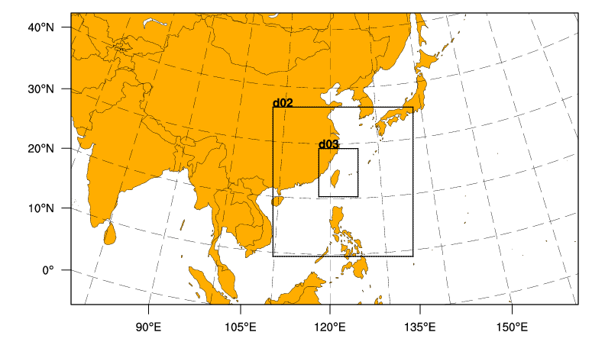
A word about nested domains
WRFDA can only process one file/domain at a time
  If you wish to run WRFDA for multiple nests, need to run WRFDA separately for each nest
d01

Slide 41
Running update_bc

Slide 42
update_bc
Why do we need update_bc?
  Need to update lateral boundary points to reflect our analysis
  Need to update lateral boundary tendencies for the first time
  Can also update lower boundary conditions
Field^{t+dt}
Field^{t+dt}
Field^{t}
Analysis^{t}
WRFDA
wrfbdy contains the tendency (Field^{t+dt}− Field^{t})/dt
wrfbdy needs to be updated to be (Field^{t+dt}− Analysis^{t})/dt after WRFDA

Slide 43
Applications of update_bc
Cold-start initial conditions (i.e., first-guess from “real.exe”):
  Update lateral boundaries after running WRFDA
  No need to update low boundary before running WRFDA
Cyclic initial conditions (i.e., first-guess from previous forecast):
  Update low BC before running WRFDA
  Update lateral BCs after running WRFDA
Dealing with nested domains:
  For coarse domain (domain_id = 1), update low boundary before running WRFDA (if cycling) and lateral boundaries after running WRFDA
  For fine mesh domains (domain_id > 1) update low boundary for each nest before running WRFDA (if cycling)…DO NOT update lateral boundaries

Slide 44
update_bc (lateral boundary condition)
x_{b}
B,R
WRFDA
x
Update Lateral BC
(UPDATE_BC)
Forecast
(WRF)
analysis
y
wrfvar_output
wrfbdy
updated wrfbdy
Always update lateral BC after running WRFDA for outermost domain

Slide 45
Steps to Run update_bc (for lateral BC)
Make sure UPDATE_BC executable has been created successfully:
  WRFDA/var/build/da_update_bc.exe
Go into the working directory and prepare the input files for update_bc:
  > cd your_choice_of_working_dir
  > cp ${DAT_DIR}/rc/2007010200/wrfbdy_d01 ./wrfbdy_d01
  > ln –sf WRFDA/var/build/da_update_bc.exe ./da_update_bc.exe
Prepare the namelist for update_bc: parame.in
&control_param
da_file = ‘./wrfvar_output’ - Analysis from WRFDA
wrf_bdy_file = ‘./wrfbdy_d01’ - BC from WPS and WRF real
debug = .true.
update_lateral_bdy = .true.
update_low_bdy = .false.
iswater = 16 - Should be 17 if using MODIS land-use
/
./da_update_bc.exe > &! da_update_bc_latbdy.log

Slide 46
(updating low boundary for cycling runs)
da_update_bc: update_low_bdy
  TSK: surface skin temperature (over water)
  TMN: soil temperature at lower boundary
  SST: sea surface temperature
  VEGFRA: vegetation fraction
  ALBBCK: background snow-free albedo
  SEAICE: sea ice flag
IVGTYP: dominant vegetation category (integer)
ISLTYP: dominant soil category (integer)
LANDMASK: 1=land, 0=water
XLAND: 1=land, 2=water
SNOW: snow water equivalent
SNOWC: snow cover
SNOWH: snow depth
da_update_bc: update_low_bdy & update_lsm
  SNOW: snow water equivalent
  CANWAT: canopy water
  RHOSN: snow density
  SNOWH: snow depth
  SNOWC: snow cover
  TSLB: soil temperature
  SMOIS: soil moisture
  SH2O: soil liquid water
WRFDA adds increments to
  U
  V
  T
  PSFC
  QVAPOR
  and modifies
  PH
  P
  MU
  U10
  V10
  T2
  Q2
fields need to be consistent with SEAICE
snow over water needs to be removed

Slide 47
update_bc (low boundary condition)
wrfvar_input
wrfinput
updated fg
(wrfout in wrfinput format)
from “real.exe”
Background
Preprocessing
(WPS , real)
x^{b}
Update Low BC
(UPDATE_BC)
x^{f}
Cycled Background
fg
WRFDA
Forecast
(WRF)
Only need to update low BC if using cyclic initial conditions

Slide 48
Steps to Run update_bc (for low BC)
Make sure UPDATE_BC executable has been created successfully:
  WRFDA/var/build/da_update_bc.exe
Go into the working directory and prepare the input files for update_bc:
  > cd your_choice_of_working_dir
  > cp ${your_wrf_run_dir}/wrfvar_input_d01 ./fg
  > ln –sf WRFDA/var/build/da_update_bc.exe ./da_update_bc.exe
Prepare the namelist for update_bc: parame.in
&control_param
da_file = ‘./fg’ - First guess (wrfout in wrfinput format) for WRFDA
wrf_input = ‘${DAT_DIR}/rc/2007010200/wrfinput_d01’ - IC from WPS and WRF real
debug = .true.
update_lateral_bdy = .false.
update_low_bdy = .true.
iswater = 16 - Should be 17 if using MODIS land-use
/
./da_update_bc.exe > &! da_update_bc_lowbdy.log

Slide 49
WRFDA-3DVar Diagnostics

Slide 50
ASCII output files in the WRFDA working directory:
wrfda.log or rsl.out.0000
namelist.output
filtered_obs_01 (analysis_type=“QC-OBS”)
rej_obs_conv_01.000
qcstat_conv_01
cost_fn
grad_fn
gts_omb_oma_01
statistics
jo
After each WRFDA run, it is important to:
Check the log file (or rsl.out.0000) to see if WRFDA has completed successfully, how many iterations it took to converge, etc.
Check the statistics file to see if the values are reasonable

Slide 51
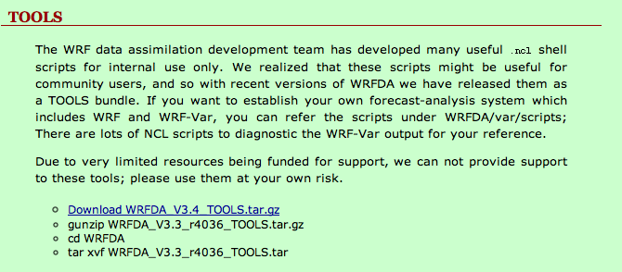
http://www.mmm.ucar.edu/wrf/users/wrfda/download/tools.html
var/graphics/ncl contains various NCL plotting scripts,
see var/graphics/ncl/README

Slide 52
wrfda.log (rsl.out.0000)
*** VARIATIONAL ANALYSIS ***
DYNAMICS OPTION: Eulerian Mass Coordinate
WRF NUMBER OF TILES = 1
Set up observations (ob)
Very important information about your WRFDA run, including observation summary, values of cost function and its gradient, etc.
Additional diagnostics may be printed in these files by including various “print_detail_xxx” WRFDA namelist options (&wrfvar1)(using these options, the log file size could become quite large).
Final: 15 iter, J= 1.76436785D+04, g= 2.06098421D+00
----------------------------------------------------------
Diagnostics
Final cost function J = 17643.68
Total number of obs. = 26726
Final value of J = 17643.67853
Final value of Jo = 15284.64894
Final value of Jb = 2359.02958
Final value of Jc = 0.00000
Final value of Je = 0.00000
Final value of Jp = 0.00000
Final J / total num_obs = 0.66017
Jb factor used(1) = 1.00000
Jb factor used(2) = 1.00000
Jb factor used(3) = 1.00000
Jb factor used(4) = 1.00000
Jb factor used(5) = 1.00000
Jb factor used = 1.00000
Je factor used = 1.00000
VarBC factor used = 1.00000
*** WRF-Var completed successfully ***

Slide 53
namelist.output
When WRFDA is run, a namelist.output file is produced with all values of namelist variables (default and/or from namelist.input).
namelist.input
namelist.output
&WRFVAR1
WRITE_INCREMENTS = F, WRFVAR_MEM_MODEL = 0, VAR4D = F,
MULTI_INC = 0, VAR4D_COUPLING = 2, PRINT_DETAIL_RADAR = F,
PRINT_DETAIL_RAD = F, PRINT_DETAIL_XA = F, PRINT_DETAIL_XB = F,
PRINT_DETAIL_OBS = F, PRINT_DETAIL_F_OBS = F, PRINT_DETAIL_MAP = F,
PRINT_DETAIL_GRAD = T, PRINT_DETAIL_REGRESSION = F, PRINT_DETAIL_SPECTRAL = F,
PRINT_DETAIL_TESTING = F, PRINT_DETAIL_PARALLEL = F, PRINT_DETAIL_BE = F,
CHECK_MAX_IV_PRINT = T, CHECK_BUDDY_PRINT = F,
/
&WRFVAR2
ANALYSIS_ACCU = 900, CALC_W_INCREMENT = F, DT_CLOUD_MODEL = F,
WRITE_MOD_FILTERED_OBS = F,
/
&WRFVAR3
FG_FORMAT=1, OB_FORMAT=2, NUM_FGAT_TIME=1
/
&WRFVAR4
USE_SYNOPOBS=F, USE_SHIPSOBS=T, USE_METAROBS=T, USE_SOUNDOBS=T, USE_MTGIRSOBS=T, USE_PILOTOBS=T,
&wrfvar1
print_detail_grad=.true.
/
&wrfvar2
/
&wrfvar3
ob_format=2,
num_fgat_time=1,
/
&wrfvar4
use_synopobs=.false.
/

Slide 54
filtered_obs_01
Similar to ob.ascii (observation input file to WRFDA) but contains the observations filtered by WRFDA
To output this file, set WRFDA namelist option: analysis_type = “QC-OBS” (&wrfvar17)
What is filtered_obs for?
  Can be used for checking what observations are actually assimilated in WRFDA
  Can be used for running WRFDA in VERIFY mode with analysis_type = “VERIFY”
filtered_obs should NOT be used for running regular WRFDA

Slide 55
rej_obs_conv_01.000
Contains observations that fail check_max_iv check (if check_max_iv = .true.)
  01: outer loop index.
  000: processor id.
See slide 25 and &wrfvar5
Obs_type Variable Lat Lon Pressure
sound T 50.68 -127.36 215.00
sound Q 50.68 -127.36 215.00
sound U 47.46 -111.38 850.00
sound V 31.86 -106.70 400.00
synop U 50.11 -127.93 991.10
synop V 48.76 -123.11 994.50
synop Ps 53.43 -114.71 1013.01
synop Q 53.43 -114.71 1013.01
gpsref GpsR 36.26 -71.36 53.34
qscat V 23.20 -74.22 1013.25

Slide 56
qcstat_conv_01
Contains the number of observations that pass or fail WRFDA’s internal QC (e.g., check_max_iv check) for observations with pressure as a vertical coordinate
  01: outer loop index.
WRF-Var data utilization statistics for outer iteration 1
ptop 1000.0 900.0 800.0 600.0 400.0 300.0 250.0 200.0 150.0 100.0 50.0 0.0
obs type var pbot 1200.0 999.9 899.9 799.0 599.9 399.9 299.9 249.9 199.9 149.9 99.9 2000.0
--------------------------------------------------------------------------------------------------------------
sound U used 20 29 37 48 91 41 41 44 45 79 99 574
rej 1 2 0 0 0 0 0 0 0 0 0 3
sound V used 21 30 37 48 91 41 41 44 45 79 99 576
rej 0 1 0 0 0 0 0 0 0 0 0 1
sound T used 32 135 130 452 447 200 118 68 113 191 293 2179
rej 0 2 0 0 0 0 0 0 1 6 5 14
sound Q used 32 135 130 451 439 193 105 53 81 159 218 1996
rej 0 0 0 0 4 3 0 1 1 4 2 15
synop U used 83 0 0 0 0 0 0 0 0 0 0 83
rej 1 0 0 0 0 0 0 0 0 0 0 1
synop V used 83 0 0 0 0 0 0 0 0 0 0 83
rej 1 0 0 0 0 0 0 0 0 0 0 1
synop T used 137 0 0 0 0 0 0 0 0 0 0 137
rej 0 0 0 0 0 0 0 0 0 0 0 0
synop Q used 130 0 0 0 0 0 0 0 0 0 0 130
rej 4 0 0 0 0 0 0 0 0 0 0 4

Slide 57
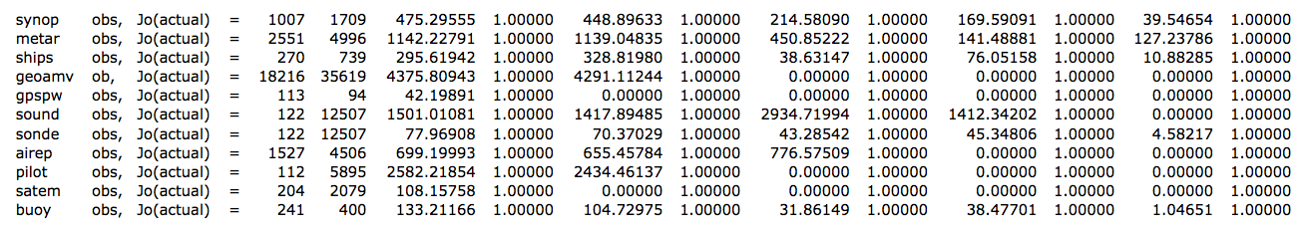
jo
Contains cost function of each observation type:
Sum of individual Jo (numbers in red boxes) should equal the printout value in WRFDA log file, e.g., rsl.out.0000:
  Final value of Jo = 28880.81069
Numbers in blue boxes are observation error tuning factors used in WRFDA:
  Tuned obs_error = obs_error * tuning_factor
Where obs_error values are assigned by OBSPROC and tuning_factor=1 by default.

Slide 58
cost_fn and grad_fn
Contains values of the cost function and its gradient.
  If calculate_cg_cost_fn =.false., only the initial and final values of the cost and gradient functions are output as follows:
cost_fn
Outer EPS Inner J Jb Jo Jc Je Jp Js Jl
Iter Iter
1 0.100E-01 0 24322.148 0.000 24322.148 0.000 0.000 0.000 0.000 0.000
1 0.100E-01 21 16141.945 1847.293 14294.652 0.000 0.000 0.000 0.000 0.000
grad_fn
Outer EPS Inner G Gb Go Ge Gp Gs Gl
Iter Iter
1 0.100E-01 0 543.846 0.000 543.846 0.000 0.000 0.000 0.000
1 0.100E-01 21 4.767 60.783 60.970 0.000 0.000 0.000 0.000
b: background term
o: observation term
c: JcDFI term
e: alpha term
p: radiance variational bias
correction term
s: skin temperature or
cloud cover term
l: lateral boundary conditions control variable (4dvar only)
  If calculate_cg_cost_fn =.true., the cost function and its gradient at each iteration will be computed and written into cost_fn and grad_fn.
WRFDA tools: plot_cost_grad_fn.ncl

Slide 59
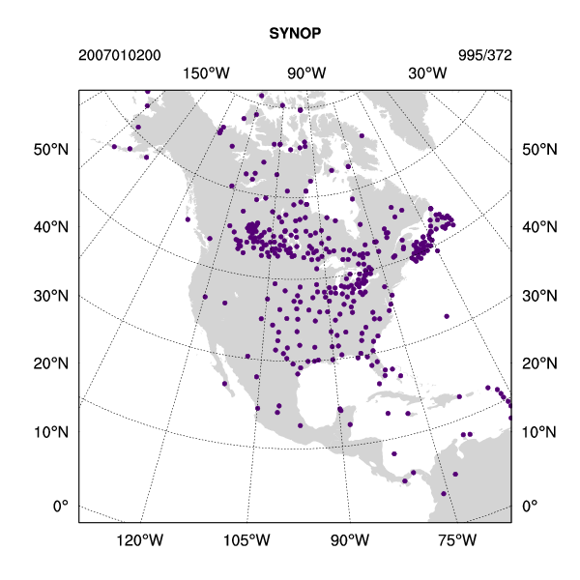
gts_omb_oma_01
Contains complete point-by-point, detailed observation information.
Number of obs
Obs index, Level index, station ID, lat, lon, pressure
obs_type
Number of levels
For u: Obs, O-B, QC flag, Obs error, O-A
synop 995
1
1 176556 21.51 -104.90 89973.8836463 3.3147587 1.2193668 2 1.1000000 0.1849281 -1.5412909
-1.4225501 2 1.1000000 -1.6862257 295.5511624 2.5999150 2 2.0000000 1.3689324 89973.8836463
-273.5464584 2 100.0000000 -236.6028635 0.0134689 0.0048657 0 0.0036749 0.0050584
Measured quantities for each observation type vary:
synop: u, v, t, p, q
metar: u, v, t, p, q
ship: u, v, t, p, q
geoamv: u, v
polaramv: u, v
gpspw: tpw
sound: u, v, t, q
sonde_sfc: u, v, t, p, q
airep: u, v, t
pilot: u, v
satem: thickness
qscat: u, v
profiler: u, v
buoy: u, v, t, p, q
airsr: t, q
gpsref: ref
WRFDA tools: plot_gts_omb_oma.ncl
WRFDA tools: plot_ob_ascii_loc.ncl

Slide 60
statistics
Contains domain-wide O-B and O-A information:
Diagnostics of OI for synop
var u (m/s) n k v (m/s) n k t (K) n k p (Pa) n k q (kg/kg) n k
Number: 331 332 355 330 361
Minimum(n,k): -5.4017 363 0 -5.4086 878 0 -9.7206 592 0 -390.7893 931 0 -0.4461E-02 719 0
Maximum(n,k): 5.0466 886 0 5.2878 630 0 7.7302 421 0 471.9343 944 0 0.5408E-02 787 0
Average : -0.8471 -0.1995 -1.1171 20.4177 -0.2525E-03
RMSE : 2.3023 2.1150 3.1978 116.1518 0.8045E-03
Diagnostics of AO for synop
var u (m/s) n k v (m/s) n k t (K) n k p (Pa) n k q (kg/kg) n k
Number: 331 332 355 330 361
Minimum(n,k): -4.2496 172 0 -5.0463 683 0 -8.9005 583 0 -472.9290 931 0 -0.4152E-02 719 0
Maximum(n,k): 5.5540 886 0 5.7990 630 0 8.8192 421 0 392.4096 944 0 0.5058E-02 1 0
Average : -0.0847 -0.0376 -0.4283 1.1709 0.1625E-04
RMSE : 1.8650 1.8093 2.1990 101.3816 0.5958E-03
Minimum of gridded analysis increments
Lvl u i j v i j t i j p i j q i j
1 -1.8915 17 32 -1.9965 36 24 -5.2526 20 35 -314.7470 44 1 -0.1451E-02 18 32
2 -1.9476 16 32 -2.0070 36 24 -3.0142 21 36 -311.2885 44 1 -0.1438E-02 18 33
Maximum of gridded analysis increments
Lvl u i j v i j t i j p i j q i j
1 1.3750 41 8 1.5739 28 12 3.2994 24 20 197.8351 28 2 0.1401E-02 39 8
2 1.4844 40 8 1.6180 28 13 1.7471 7 20 195.5165 28 2 0.1591E-02 39 8
Mean of gridded analysis increments
Lvl u v t p q
1 -0.0327 0.0632 -0.1477 17.4414 -0.1047E-03
2 -0.0031 0.0736 0.0116 17.2543 -0.8066E-04
RMSE of gridded analysis increments
Lvl u v t p q
1 0.7546 0.6040 1.3120 72.0441 0.4258E-03
2 0.7995 0.6483 0.9169 71.2614 0.4476E-03

Slide 61
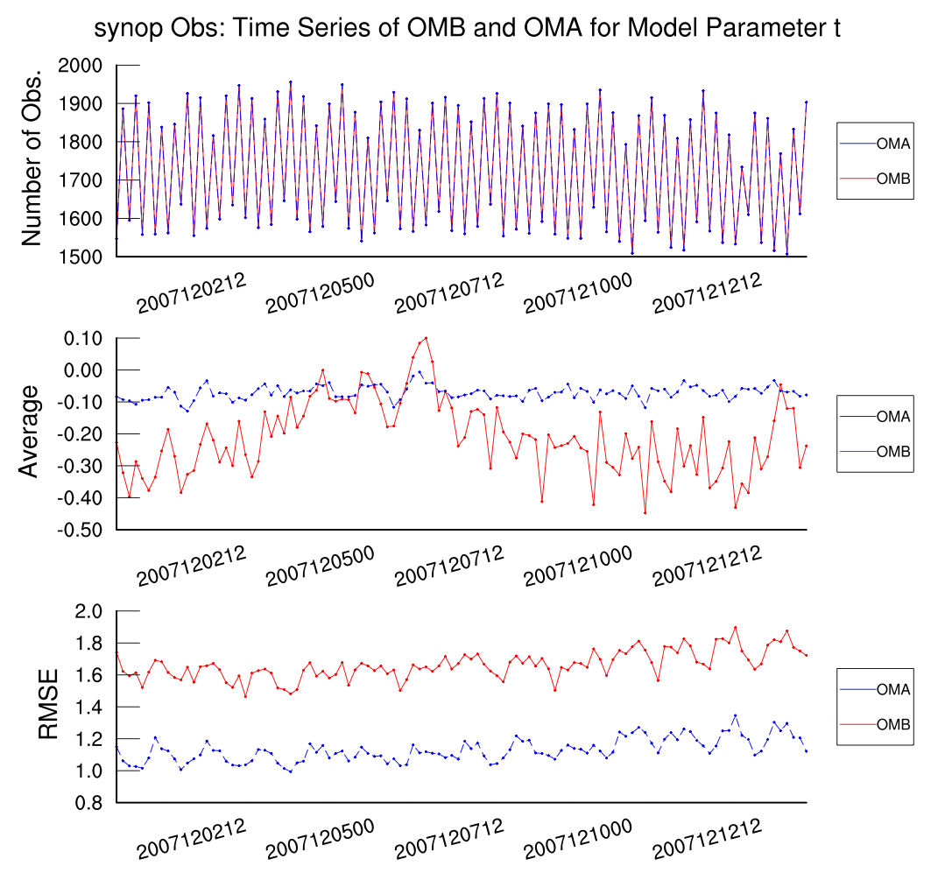
Information contained in statistics files can be used to plot time series of O-B and O-A for each observation variable and type.

Slide 62
Wrap-up

Slide 63
A Few Things I Didn’t Cover
First-Guess at Appropriate Time (FGAT; &wrfvar3)
Background error covariance tuning (&wrfvar7)
Radiance assimilation (&wrfvar4, &wrfvar14)
Pseudo-single observation tests (&wrfvar15, &wrfvar19)

Slide 64
How to Cycle Properly
In the WRF namelist, add the following (assuming 6-hr cycling):
  &time_control
  write_input = .true.,
  inputout_interval = 360, 360,
  inputout_begin_h = 6, 6,
  inputout_end_h = 6, 6,
  input_outname="wrfvar_input_d<domain>_<date>”,
This will output “wrfvar_input_d<domain>_<date>”.
  Use this file as your first-guess for the next data assimilation cycle
  Don’t forget to update the lower boundary when cycling!
You can also use “wrfout” files as input to WRFDA if frames_per_outfile=1

Slide 65
WRFDA in the WRF Modeling System
x^{lbc}
Background
Preprocessing
(WPS , real)
x_{b}
Update Low BC
(UPDATE_BC)
wrfvar_input_d01_2008-02-05_18:00:00
wrfvar_input_d02_2008-02-05_18:00:00
Cold-Start Background
x^{f}
Cycled Background
fg
Observation
Preprocessing
(OBSPROC)
y , R
WRFDA
x
^{wrfvar_output}
Update Lateral BC
(UPDATE_BC)
Forecast
(WRF)
The following data do not go through OBSPROC
  Radar in ASCII (requires separate pre-processing)
  Radiance in BUFR
  PREPBUFR (+ GPSRO in BUFR)
wrfinput_d01
wrfinput_d02
Write out wrf forecast in wrfinput format in cycling mode
  write_input = .true.,
  inputout_interval = 360, 360,
  inputout_begin_h = 6, 6,
  inputout_end_h = 6, 6,
  input_outname="wrfvar_input_d<domain>_<date>",
WRFDA processes only one domain at a time
Background
Error
(gen_be)
B

Slide 66
WRFDA USERS PAGE
  http://www.mmm.ucar.edu/wrf/users/wrfda/index.html
WRFDA USERS GUIDE
  http://www.mmm.ucar.edu/wrf/users/wrfda/Docs/user_guide_V3.5/users_guide_chap6.htm
README files contained in the tar file
  WRFDA/README.VAR
  WRFDA/var/README.namelist
  WRFDA/var/README.basics
  WRFDA/var/README.radiance
wrfhelp@ucar.edu

Slide 68
Extra Slides for your Reference

Slide 69
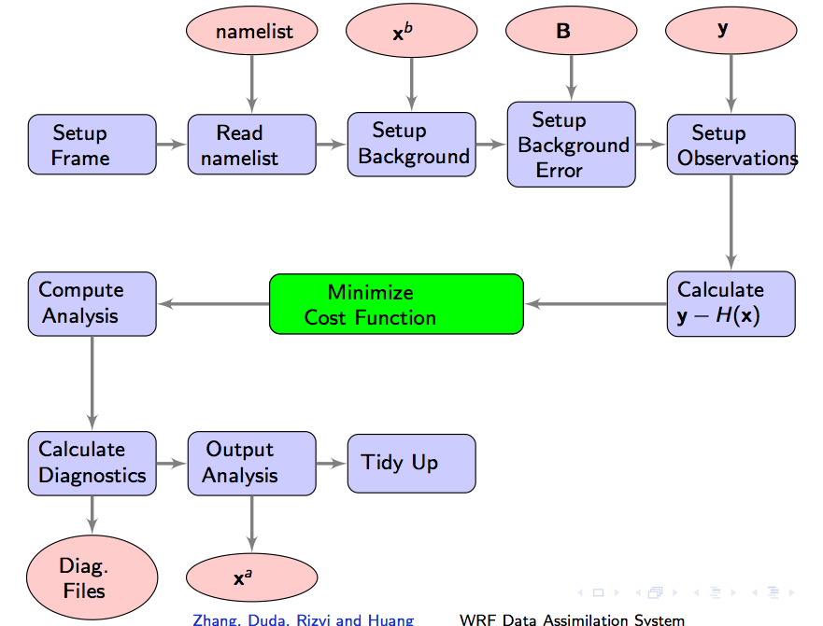
WRFDA Code Flow
In
Out

Slide 70
Namelist - WRFVAR3
num_fgat_time: Number of data time windows (slots) used in WRFDA.
  1 = 3DVAR: Default.
time window=±3hr
num_fgat_time=1
FG
Analysis time
  >1 apply to FGAT and 4D-Var (for ob_format = 2 and radiance only).
09Z 10Z 11Z 12Z 13Z 14Z 15Z
obs
First-Guess at Appropriate Time (FGAT):
  An option in WRF-3DVar that allows the observations to be applied at the correct time, rather than at the middle of the time window.
FG
FG
FG
FG
FG
FG
FG
time window=±3hr
num_fgat_time=7
09Z 10Z 11Z 12Z 13Z 14Z 15Z
obs
obs
obs
obs
obs
obs
obs
Analysis time

Slide 71
Running WRFDA with FGAT
prepare hourly obs files using OBSPROC
prepare hourly first guess files from previous WRF forecasts
when running WRFDA-3DVar,
  set num_fgat_time = 7 in namelist.input &wrfvar3
  link hourly obs to be ob01.ascii, ob02.ascii, ..., ob07.ascii
  link hourly first guess (previous WRF hourly forecasts) to be fg01, fg02, ..., fg07
  link first guess valid at analysis time to be fg
OBSPROC
&record9 of namelist.3dvar_obs
&record9
use_for='FGAT'
num_slots_past=3
num_slots_ahead=3
WRF model
add the following settings (write_input, inputout_interval, input_outname, inputout_begin_h, inputout_end_h) in &time_control of namelist.input
&time_control
write_input = .true.
inputout_interval = 60
input_outname = 'wrfinput_d<domain>_<date>'
inputout_begin_h = 3
inputout_end_h = 9
WRFDA-3DVar
&wrfvar3 record of namelist.input
&wrfvar3
num_fgat_time = 7
ln -sf obs_gts_2007-01-01_21:00:00.FGAT ob01.ascii
ln -sf obs_gts_2007-01-01_22:00:00.FGAT ob02.ascii
ln -sf obs_gts_2007-01-01_23:00:00.FGAT ob03.ascii
ln -sf obs_gts_2007-01-02_00:00:00.FGAT ob04.ascii
ln -sf obs_gts_2007-01-02_01:00:00.FGAT ob05.ascii
ln -sf obs_gts_2007-01-02_02:00:00.FGAT ob06.ascii
ln -sf obs_gts_2007-01-02_03:00:00.FGAT ob07.ascii
ln -sf wrfinput_d01_2007-01-01_21:00:00 fg01
ln -sf wrfinput_d01_2007-01-01_22:00:00 fg02
ln -sf wrfinput_d01_2007-01-01_23:00:00 fg03
ln -sf wrfinput_d01_2007-01-02_00:00:00 fg04
ln -sf wrfinput_d01_2007-01-02_01:00:00 fg05
ln -sf wrfinput_d01_2007-01-02_02:00:00 fg06
ln -sf wrfinput_d01_2007-01-02_03:00:00 fg07
ln -sf wrfinput_d01_2007-01-02_00:00:00 fg

