Slide 1


Hybrid Variational/Ensemble Data Assimilation
Zhiquan Liu (liuz@ucar.edu)
NCAR/NESL/MMM
WRFDA Tutorial, July 2013

Slide 2
Outline
Background
Hybrid formulation in a variational framework
Some results
Introduction to hybrid practice
WRFDA Tutorial, July 2013

Slide 3
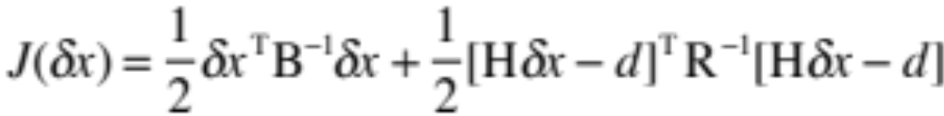
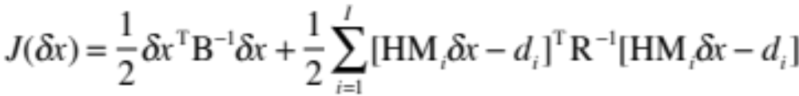
Motivation of Hybrid DA
3D-Var uses static (“climate”) BE
4D-Var implicitly uses flow-dependent information, but still starts from static BE
Hybrid uses flow-dependent background error covariance from forecast ensemble perturbation in a variational DA system
WRFDA Tutorial, July 2013

Slide 4
What is the Hybrid DA?
Ensemble mean is analyzed by a variational algorithm (i.e., minimize a cost function).
  It combines (so “hybrid”) the 3DVAR “climate” background error covariance and “error of the day” from ensemble perturbation.
Hybrid algorithm (again in a variational framework) itself usually does not generate ensemble analyses.
Need a separate system to update ensemble
  Could be ensemble forecasts already available from NWP centers
  Could be an Ensemble Kalman Filter-based DA system
  Or multiple model/physics ensemble
Ensemble needs to be good to well represent “error of the day”
WRFDA Tutorial, July 2013

Slide 5
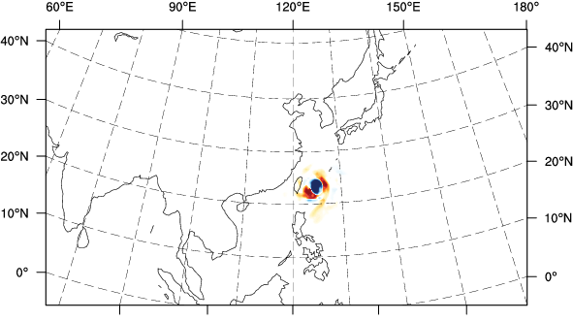
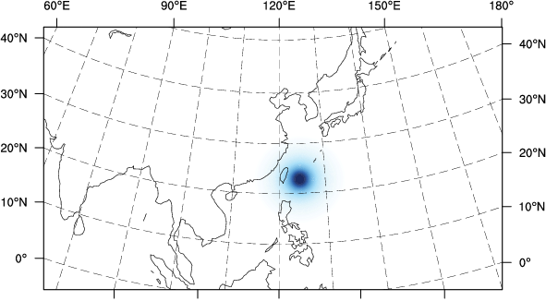
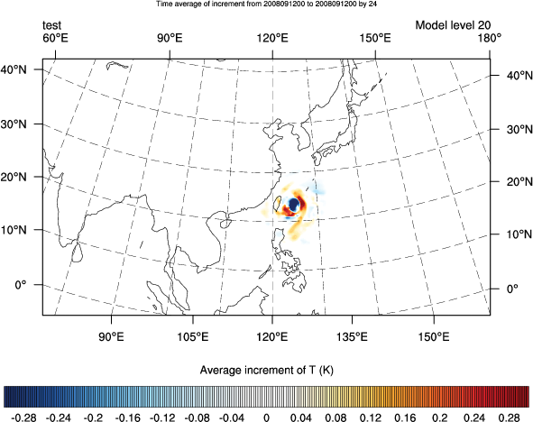
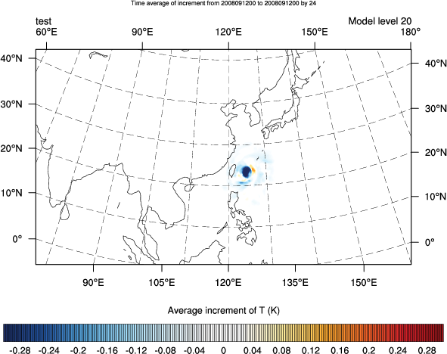
single observation tests
Potential temperature increment, 21st model level
Pure EnKF
3DVAR
Hybrid-full ensemble
Hybrid 50/50

Slide 6

Hybrid formulation (1)
(Hamill and Snyder, 2000)
3DVAR cost function
Idea: replace B by a weighted sum of static B_{s} and the ensemble B_{e}
  Has been demonstrated on a simple model.
  Difficult to implement for large NWP model.
WRFDA Tutorial, July 2013

Slide 7
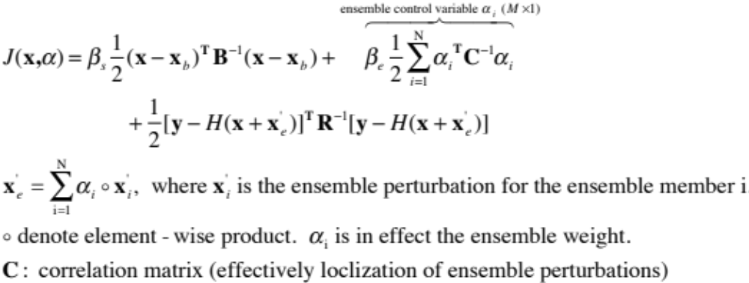
Hybrid formulation (2): used in WRFDA
(Lorenc, 2003)
Ensemble covariance is included in the 3DVAR cost function through augmentation of control variables
In practical implementation, α_{i} can be reduced to horizontal 2D fields (i.e., use same weight in different vertical levels) to save computing cost.
β_{s} and β_{e} (1/β_{s} + 1/β_{e} =1) can be tuned to have different weight between static and ensemble part.
WRFDA Tutorial, July 2013

Slide 8
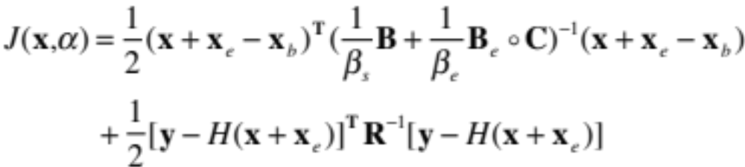
Hybrid formulation (3)
Equivalently can write in another form (Wang et al., 2008)
C is “localization” matrix
WRFDA Tutorial, July 2013

Slide 9










Hybrid DA data flow
Ensemble Perturbations (extra input for hybrid)
For cycling data assimilation/forecast
Experiment, need a mechanism to
update ensemble.
.
.
.
.
.
.
.
.
.
B
x_{b}
Hybrid
3/4D-Var
x_{a}
WRFDA Tutorial, July 2013

Slide 10
EnKF-based Ensemble Generation
EnKF with perturbed observations
EnKF without perturbed observations
  All based on square-root filter
  Ensemble Transformed Kalman Filter (ETKF)
  Ensemble Adjustment Kalman Filter (EAKF)
  Ensemble Square-Root Filter (EnSRF)
Most implementation assimilates obs sequentially (i.e., one by one, or box by box)
  can be parallelized
More information was given in 2012 slides.
WRFDA Tutorial, July 2013

Slide 11
Advantages of the Hybrid DA
Hybrid localization is in model space while EnKF localization is usually in observation space.
For some observation types, e.g., radiances, localization is not well defined in observation space
Easier to make use of existing radiance VarBC in hybrid
For small-size ensemble, use of static B could be beneficial to have a higher-rank covariance.
WRFDA Tutorial, July 2013

Slide 12
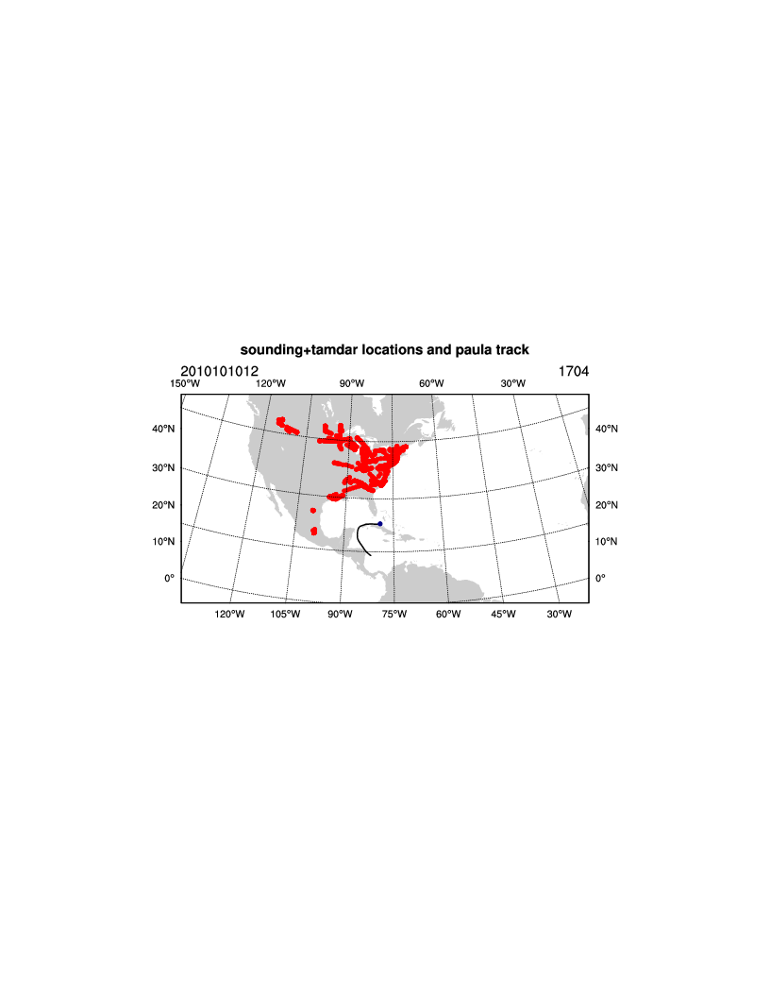
a Hurricane Case Study (Dongmei Xu)
Paula case: 0600 UTC 10 October 2010 to 1200 UTC 15 October 2010;
Background: 15km interpolated from GFS data;
Resolution: 718x 373 (15km) and 43 levels;
Observations: GTS and TAMDAR;
Cycle frequency: 6 hours;
Background error:CV5;
Time widows: 2 hours;
TAMDAR: a new Tropospheric Airborne Meteorological Data Reporting (TAMDAR) observing system that has been developed by AirDat company.

Slide 13
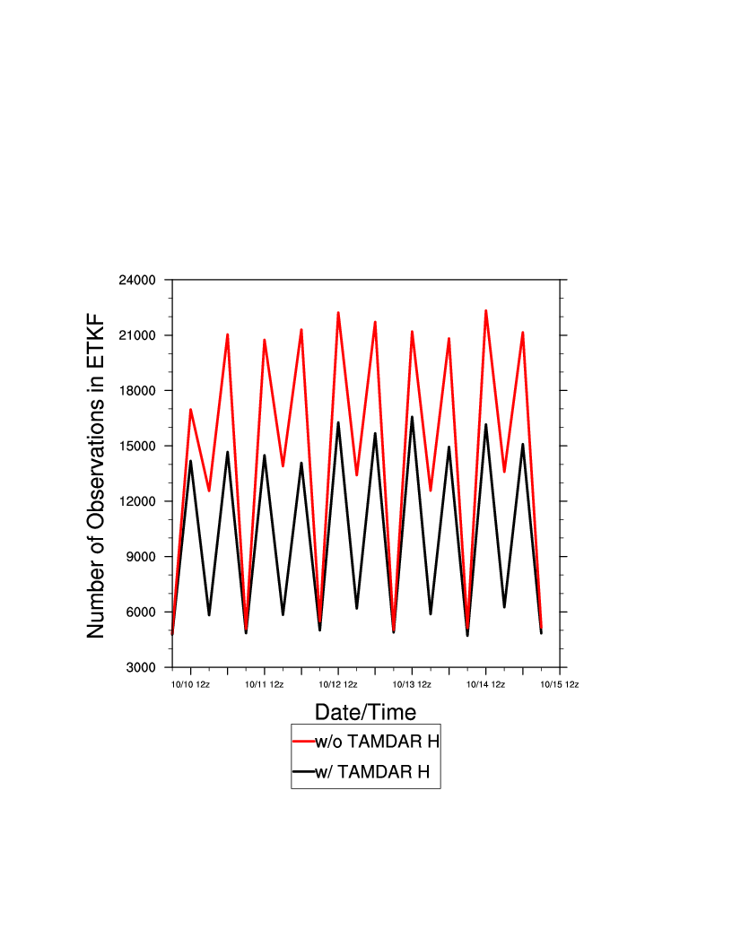
Experimental design
Experiments:
  CYC1:assimilate GTS and TAMDAR with Hybrid (w/ TAMDAR H);
  CYC2:same to CYC1,but no TAMDAR (w/o TAMDAR H)
  CYC3:assimilate GTS and TAMDAR with standard 3DVAR (Deterministic WRFDA)

Slide 14
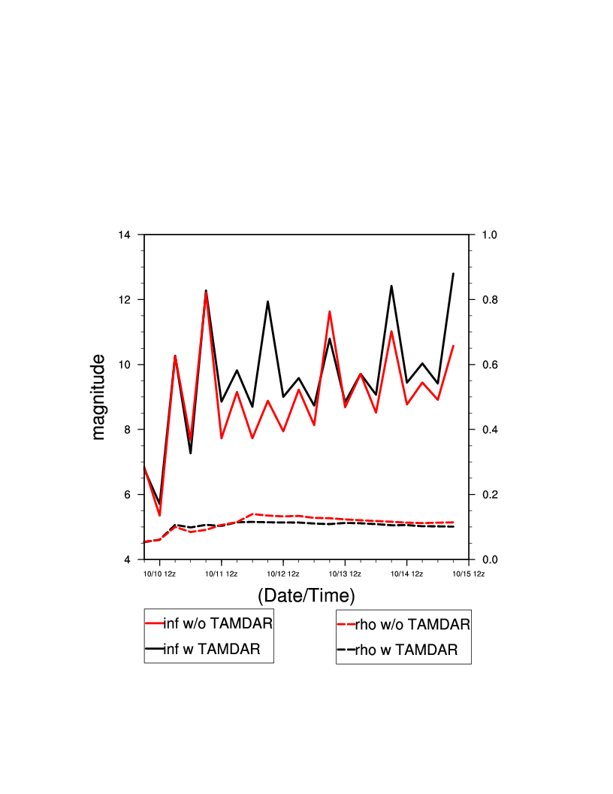
inflation and fraction factor
Brief introduction of TAMDAR

Slide 15
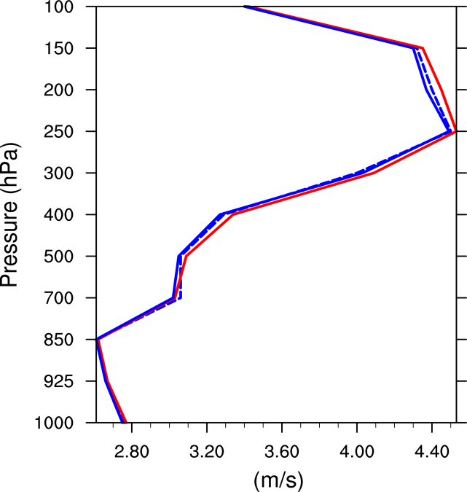
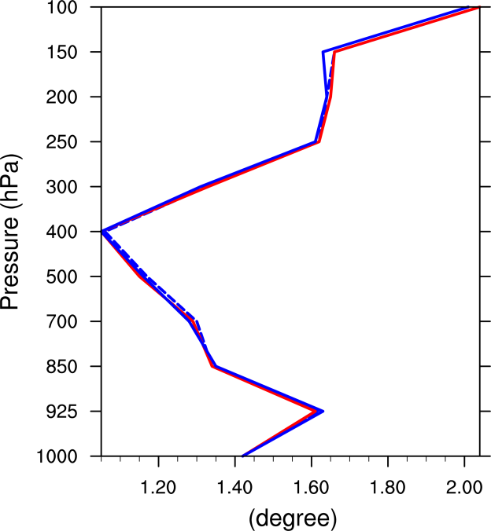
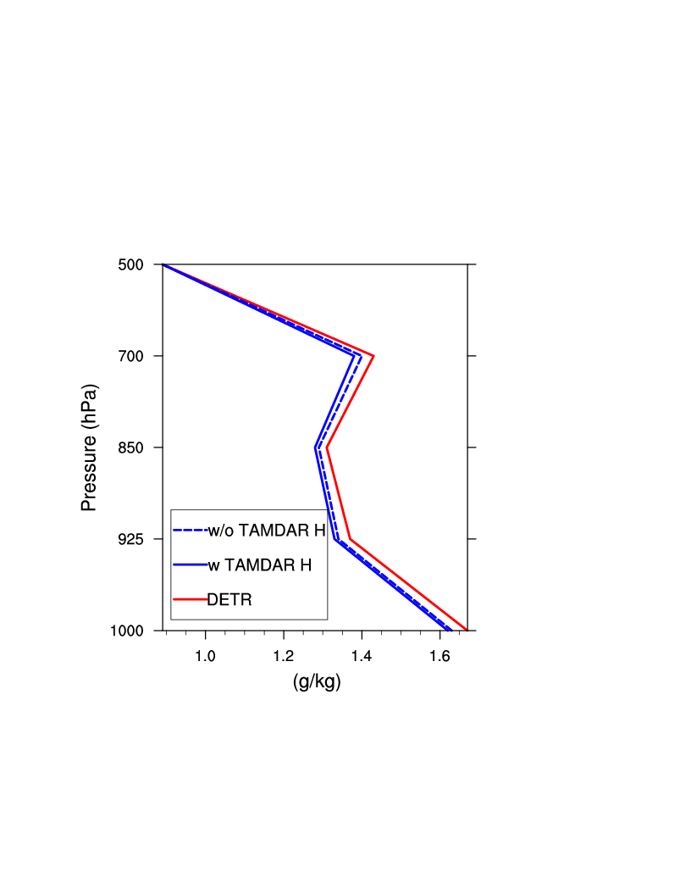
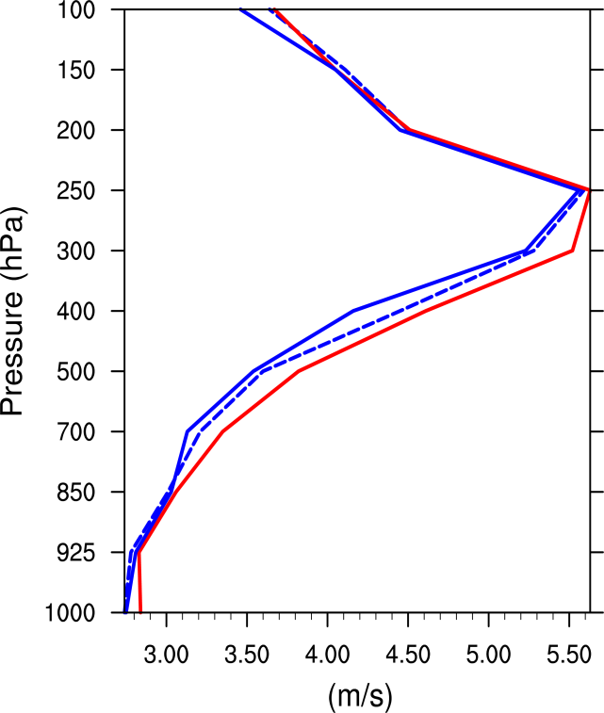
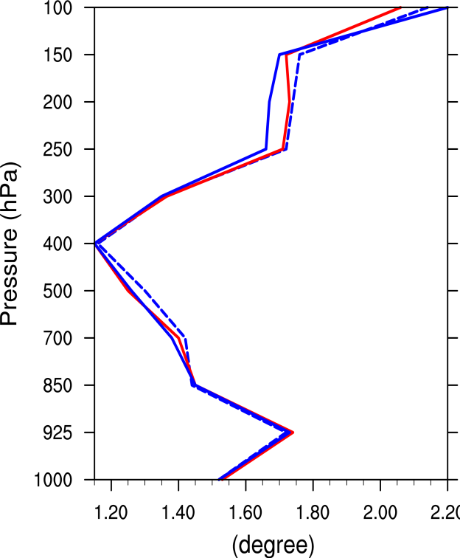
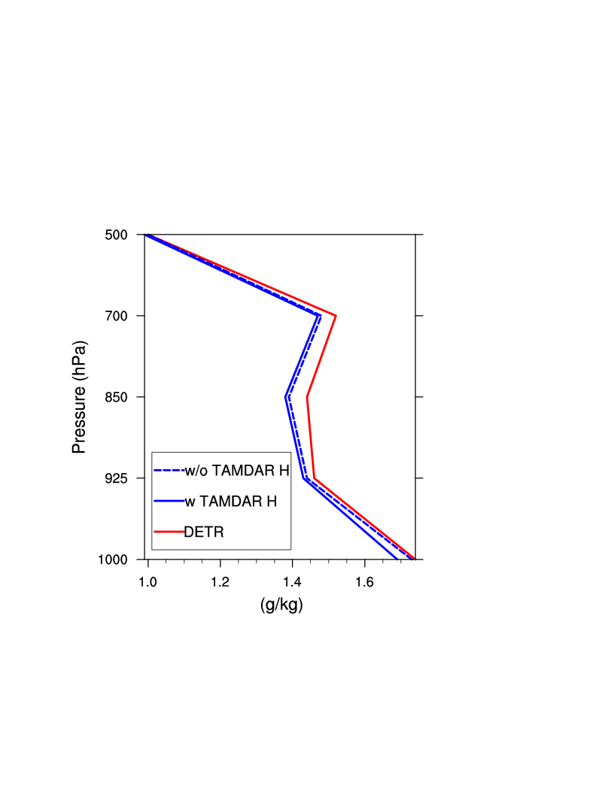
Forecast Verification: RMSE
Brief introduction of TAMDAR
V
T
Q
+12hr
V
T
Q
+24hr

Slide 16
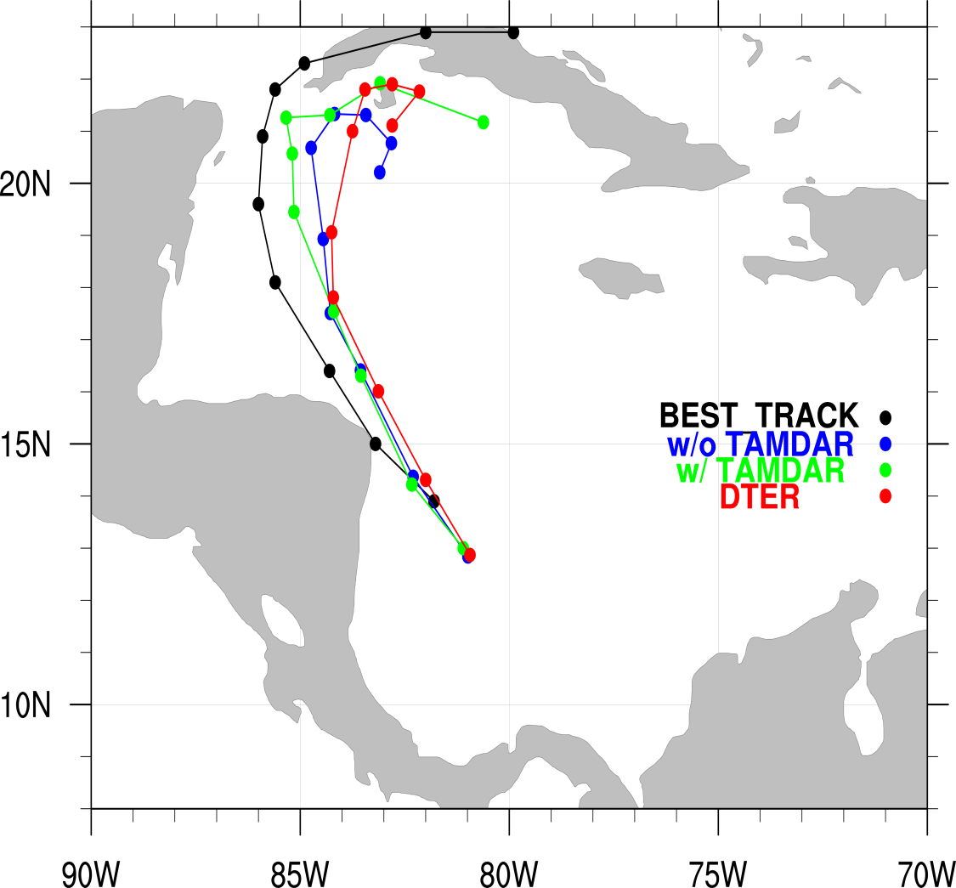
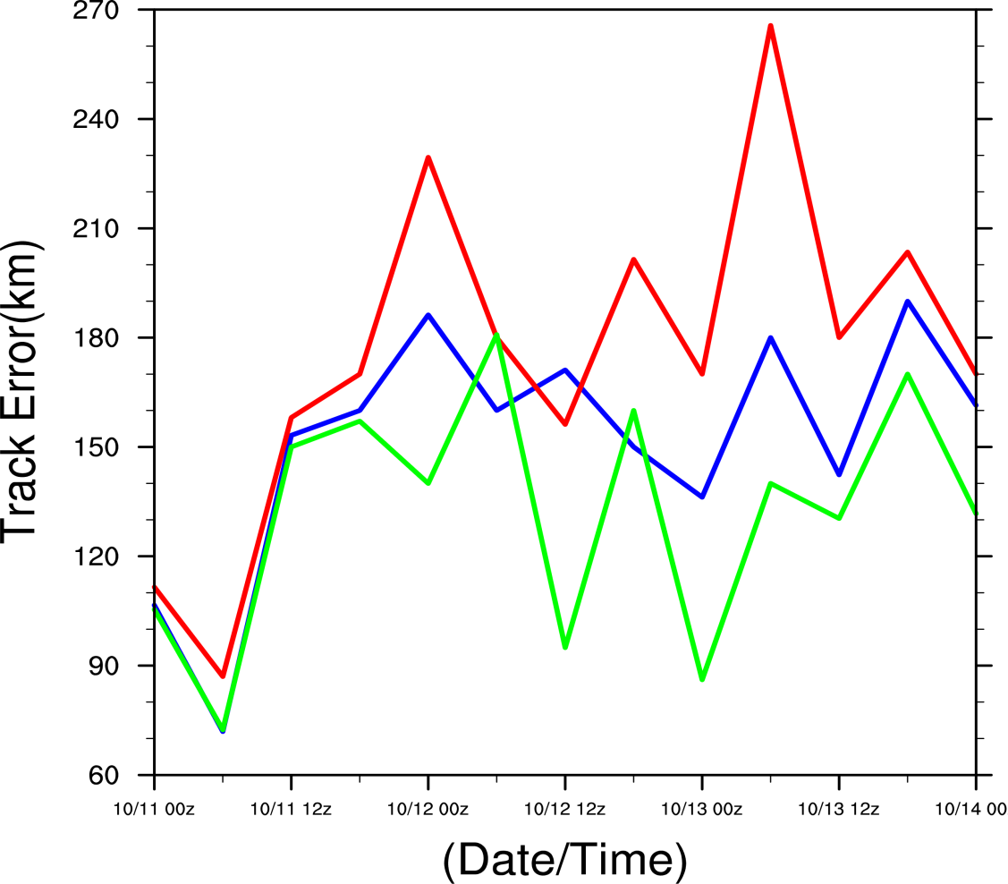
Track Forecast Verification (+24hr)
Brief introduction of TAMDAR

Slide 17
Hybrid practice
Computation steps:
    Computing ensemble mean (gen_be_ensmean.exe).
    Extracting ensemble perturbations (gen_be_ep2.exe).
    Running WRFDA in “hybrid” mode (da_wrfvar.exe).
    Displaying results for: ens_mean, std_dev, ensemble perturbations, hybrid increments, cost function
    If time permits, play with different namelist settings: “je_factor” and “alpha_corr_scale”.
Scripts to use:
    Some NCL scripts to display results.
Ensemble generation part not included in current practice
WRFDA Tutorial, July 2013

Slide 18
Namelist for WRFDA in hybrid mode
&wrfvar7
je_factor=2, # half/half for Jb and Je term
&wrfvar16
alphacv_method=2, # ensemble part is in model space (u,v,t,q,ps)
ensdim_alpha=10,
alpha_corr_type=3, # 1=Exponential; 2=SOAR; 3=Gaussian
alpha_corr_scale=750., # correlation scale in km
alpha_std_dev=1.,
alpha_vertloc=true, (use program “gen_be_vertloc.exe 42” to generate file)
WRFDA Tutorial, July 2013

Slide 19
References
T. M. Hamill and C. Snyder, 2000: A hybrid ensemble Kalman filter-3D variational analysis scheme. Mon. Wea. Rev., 128, 2905–2919.
Houtekamer, P. L., and H. L. Mitchell, 1998: Data assimilation using an ensemble Kalman filter technique. Mon. Wea. Rev, 126, 796–811.
Hunt, B. R., E. J. Kostelich, and I. Szunyogh, 2007: Efficient data assimilation for spatiotemporal chaos: A local ensemble transform Kalman filter. Physica D, 230, 112–126.
Lorenc, A. C., 2003: The potential of the ensemble Kalman filter for NWP—A comparison with 4D-VAR. Quart. J. Roy. Me teor. Soc., 129, 3183–3203.
Wang, X., D. Barker, C. Snyder, T. M. Hamill, 2008: A hybrid ETKF-3DVAR data assimilation scheme for the WRF model. Part I: observing system simulation experiment. Mon. Wea. Rev., 136, 5116-5131.
WRFDA Tutorial, July 2013

Slide 20
References
Evensen, G., 1994: Sequential data assimilation with a nonlinear quasi-geostrophic model
using Monte Carlo methods to forecast error statistics. J. Geophys. Res., 99, 10143-10162.
Bishop, C. H., B. J. Etherton, and S. J. Majumdar, 2001: Adaptive sampling with the ensemble transform Kalman filter. Part I: Theoretical aspects. Mon. Wea. Rev., 129, 420–436.
Anderson, J. L., 2003: A Local Least Squares Framework for Ensemble Filtering. Mon. Wea. Rev., 131, 634–642.
Whitaker, J. S., and T. M. Hamill, 2002: Ensemble Data Assimilation without Perturbed
Observations. Mon. Wea. Rev., 130, 1913–1924.
Liu, Z., C. S. Schwartz, C. Snyder, and S.-Y. Ha, 2012: Impact of assimilating AMSU-A
radiances on forecasts of 2008 Atlantic tropic al cyclones initialized with a limited-area
ensemble Kalman filter. Mon. Wea. Rev., 140 , 4017-4034.
Schwartz, C. S., Z. Liu, X.-Y. Huang, Y.-H. Kuo, and C.-T. Fong, 2013: Comparing limited-area 3DVAR and hybrid variational-ensemble data assimilation methods for typhoon track forecasts: Sensitivity to outer loops and vortex relocation. Mon. Wea. Rev., in press
WRFDA Tutorial, July 2013

