Slide 1


Radiance Data Assimilation
in WRFDA
Zhiquan Liu (liuz@ucar.edu)
NCAR/NESL/MMM
WRFDA Tutorial, July 2013

Slide 2
Outline
An introduction of radiance data assimilation
  Principal of satellite measurements
  Introduction to the Radiative Transfer theory
  Elements of Radiance DA
Practical aspects with WRFDA
WRFDA Tutorial, July 2013

Slide 3
Part I: An Introduction of radiance data assimilation
WRFDA Tutorial, July 2013

Slide 4
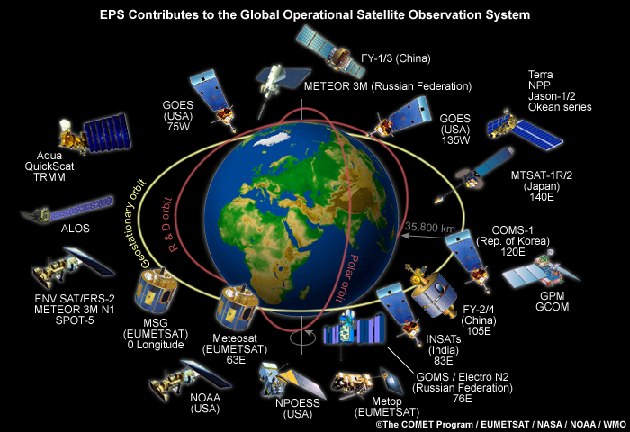
Environment monitoring satellites
WRFDA Tutorial, July 2013

Slide 5
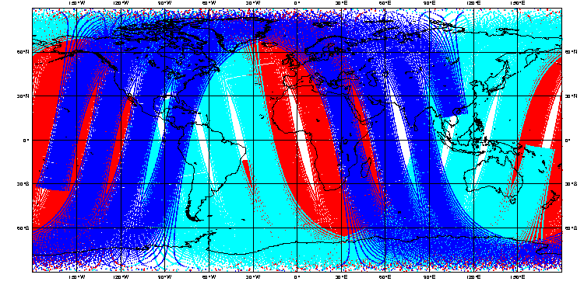
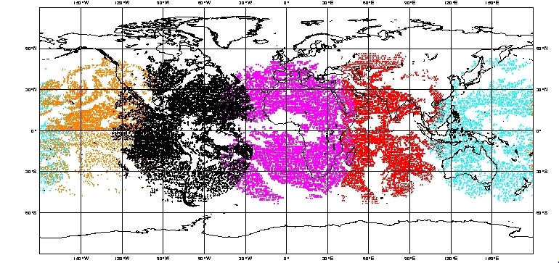
NOAA-15
NOAA-16
NOAA-17
Polar-orbiting
satellites
Geostationary
satellites
Goes-W
Goes-E
Met-7
Met-5
GMS(Goes-9)
WRFDA Tutorial, July 2013

Slide 6
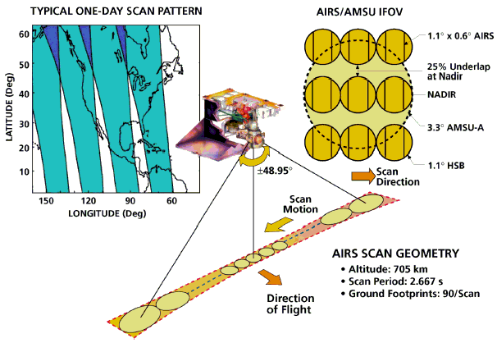
Cross-track scan geometry of satellite instruments
WRFDA Tutorial, July 2013

Slide 7
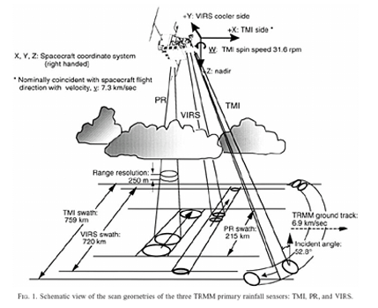
TMI/SSMI/SSMIS scan geometry
Conical scan
Same size of foot-print
WRFDA Tutorial, July 2013

Slide 8
What do satellite instruments measure?
They DO NOT measure TEMPERATURE
They DO NOT measure HUMIDITY
They DO NOT measure WIND
Satellite (passive) instruments simply measure the radiance (energy in specific unit) that reaches the top of the atmosphere (TOA) at frequency range ν₁~ν₂. The measured radiance is related to geophysical atmospheric variables by the radiative transfer equation. Radiances are often converted to “brightness temperature” (equivalent blackbody temperature, by inverting Planck function).
WRFDA Tutorial, July 2013

Slide 9
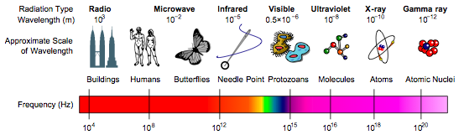
Passive Sensors from Weather/Environment Satellites
AMSU-A
AMSU-B
MHS
SSMI
SSMIS
TMI
AMSR-E
ATMS
HIRS
AIRS
IASI
CrIS
AVHRR
MODIS
VIIRS
SBUV
Electromagnetic Spectrum
WRFDA Tutorial, July 2013

Slide 10
Why assimilating Radiances?
Avoid complicated errors (random and systematic) introduced by pre-processing such as cloud clearing, angle (limb) adjustment and surface corrections.
Avoid having to change (retune) data assimilation system when the data provider changes the pre-processing/retrieval
Faster access to data from new platforms (e.g. AMSU data from NOAA-16 assimilated 6 weeks after launch)
Allows consistent treatment of historical data for re-analysis appplications
WRFDA Tutorial, July 2013

Slide 11
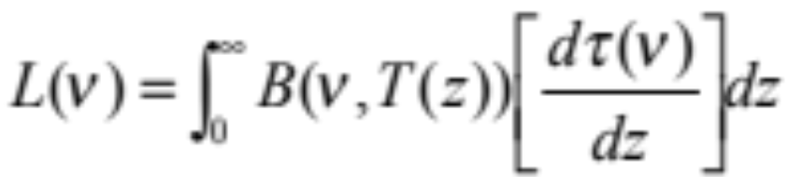
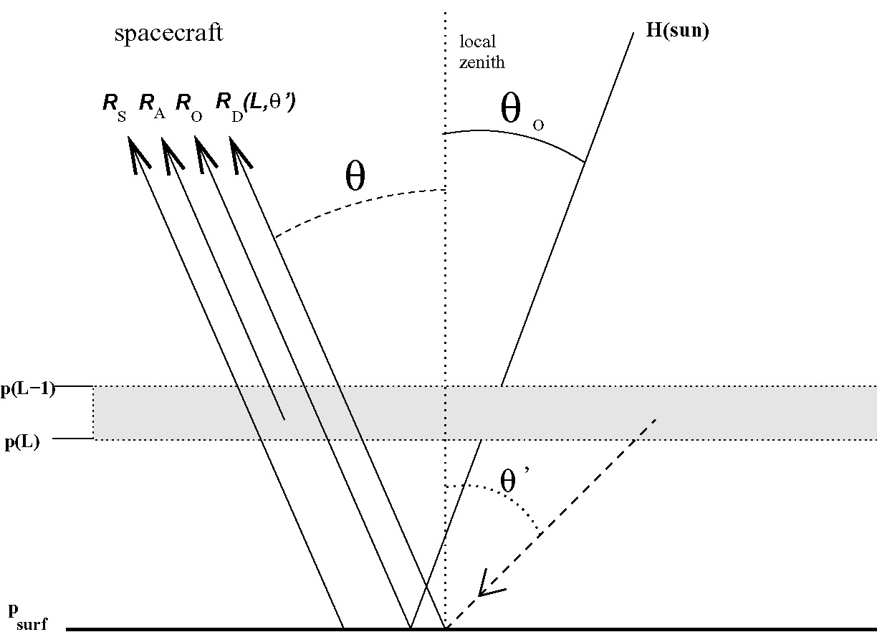
Radiative Transfer: Forward model
+
+
Cloud/Rain
Aerosol
Surface
^{TOA radiance}
^{at frequency ν}
^{Planck function}
^{Atmospheric Absorption}
^{(weighting function)}
Emission/reflection
Diffusion/scattering
Surface emission R_{s}
Up-welling atmosphere emission R_{A}
Reflected solar radiation R_{O}
Down-welling & reflected atmos.
Emission (R_{D})
WRFDA Tutorial, July 2013

Slide 12
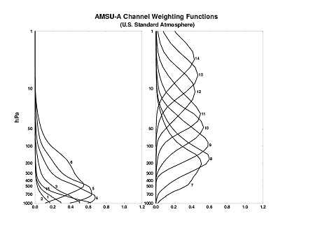
Weighting functions of different channels
Window Channels
(1~4,15) not used
Channels above model
top should not be used
Ch4: 700mb
Ch5: 500~700mb
Ch6: 400~500mb
Ch7: 200~300mb
Sounding Channels
(5~11) sensitive to
Temperature.
Ch8: 200mb
Ch9: 100mb
Ch10: 50mb
Ch11: 30mb
WRFDA Tutorial, July 2013

Slide 13
Radiance Assimilation in 3D/4D-VAR
Solving the inverse problem by minimizing a cost function
Observation operators include Radiative Transfer Model
1. Solving the inverse problem along with other observations
in a more consistent way.
2. Pixels are no longer independent each other due to the horizontal correlation in B.
3. Can affect no-measured quantities through multivariate correlation in B.
WRFDA Tutorial, July 2013

Slide 14
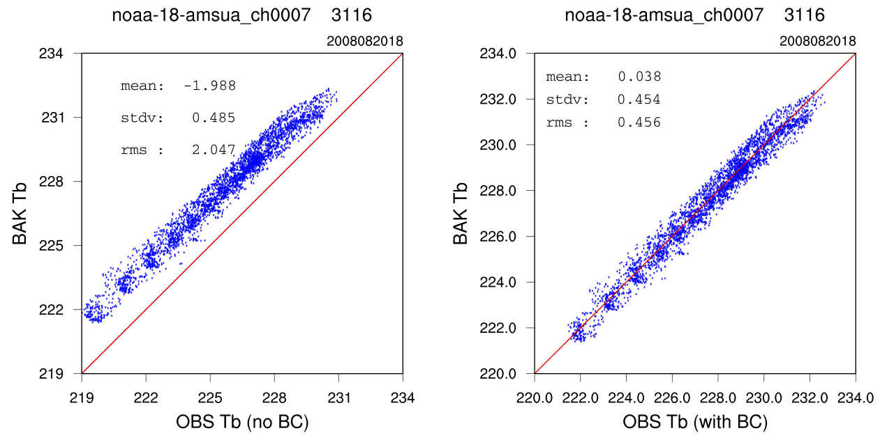
Radiance obs is biased
WRFDA Tutorial, July 2013

Slide 15


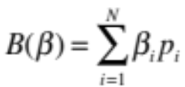
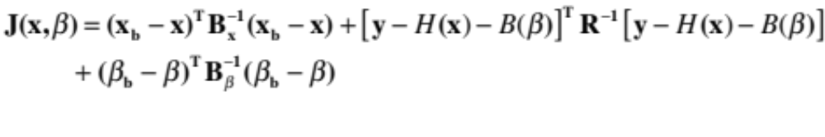
Variational Bias Correction (VarBC) in WRFDA (T. Auligné)
Bias-correction coefficients
Modeling of errors in satellite radiances:
Predictors:
  Offset (i.e., 1)
  1000-300mb thickness
  200-50mb thickness
  Surface skin temperature
  Total column water vapor
  Scan, Scan^2, Scan^3
Bias parameters can be estimated within the variational assimilation, jointly with the atmospheric model state (Derber and Wu 1998) (Dee 2005) (Auligné et al. 2007)
Inclusion of the bias parameters in the control vector : x^{T}  [x, β]^{T}
J_{b}: background term for x
J_{o}: corrected observation term
J_{p}: background term for β
Can be used for radiance offline monitoring by removing J_{b} term and
other obs., and using some analysis fields as reference.
WRFDA Tutorial, July 2013

Slide 16
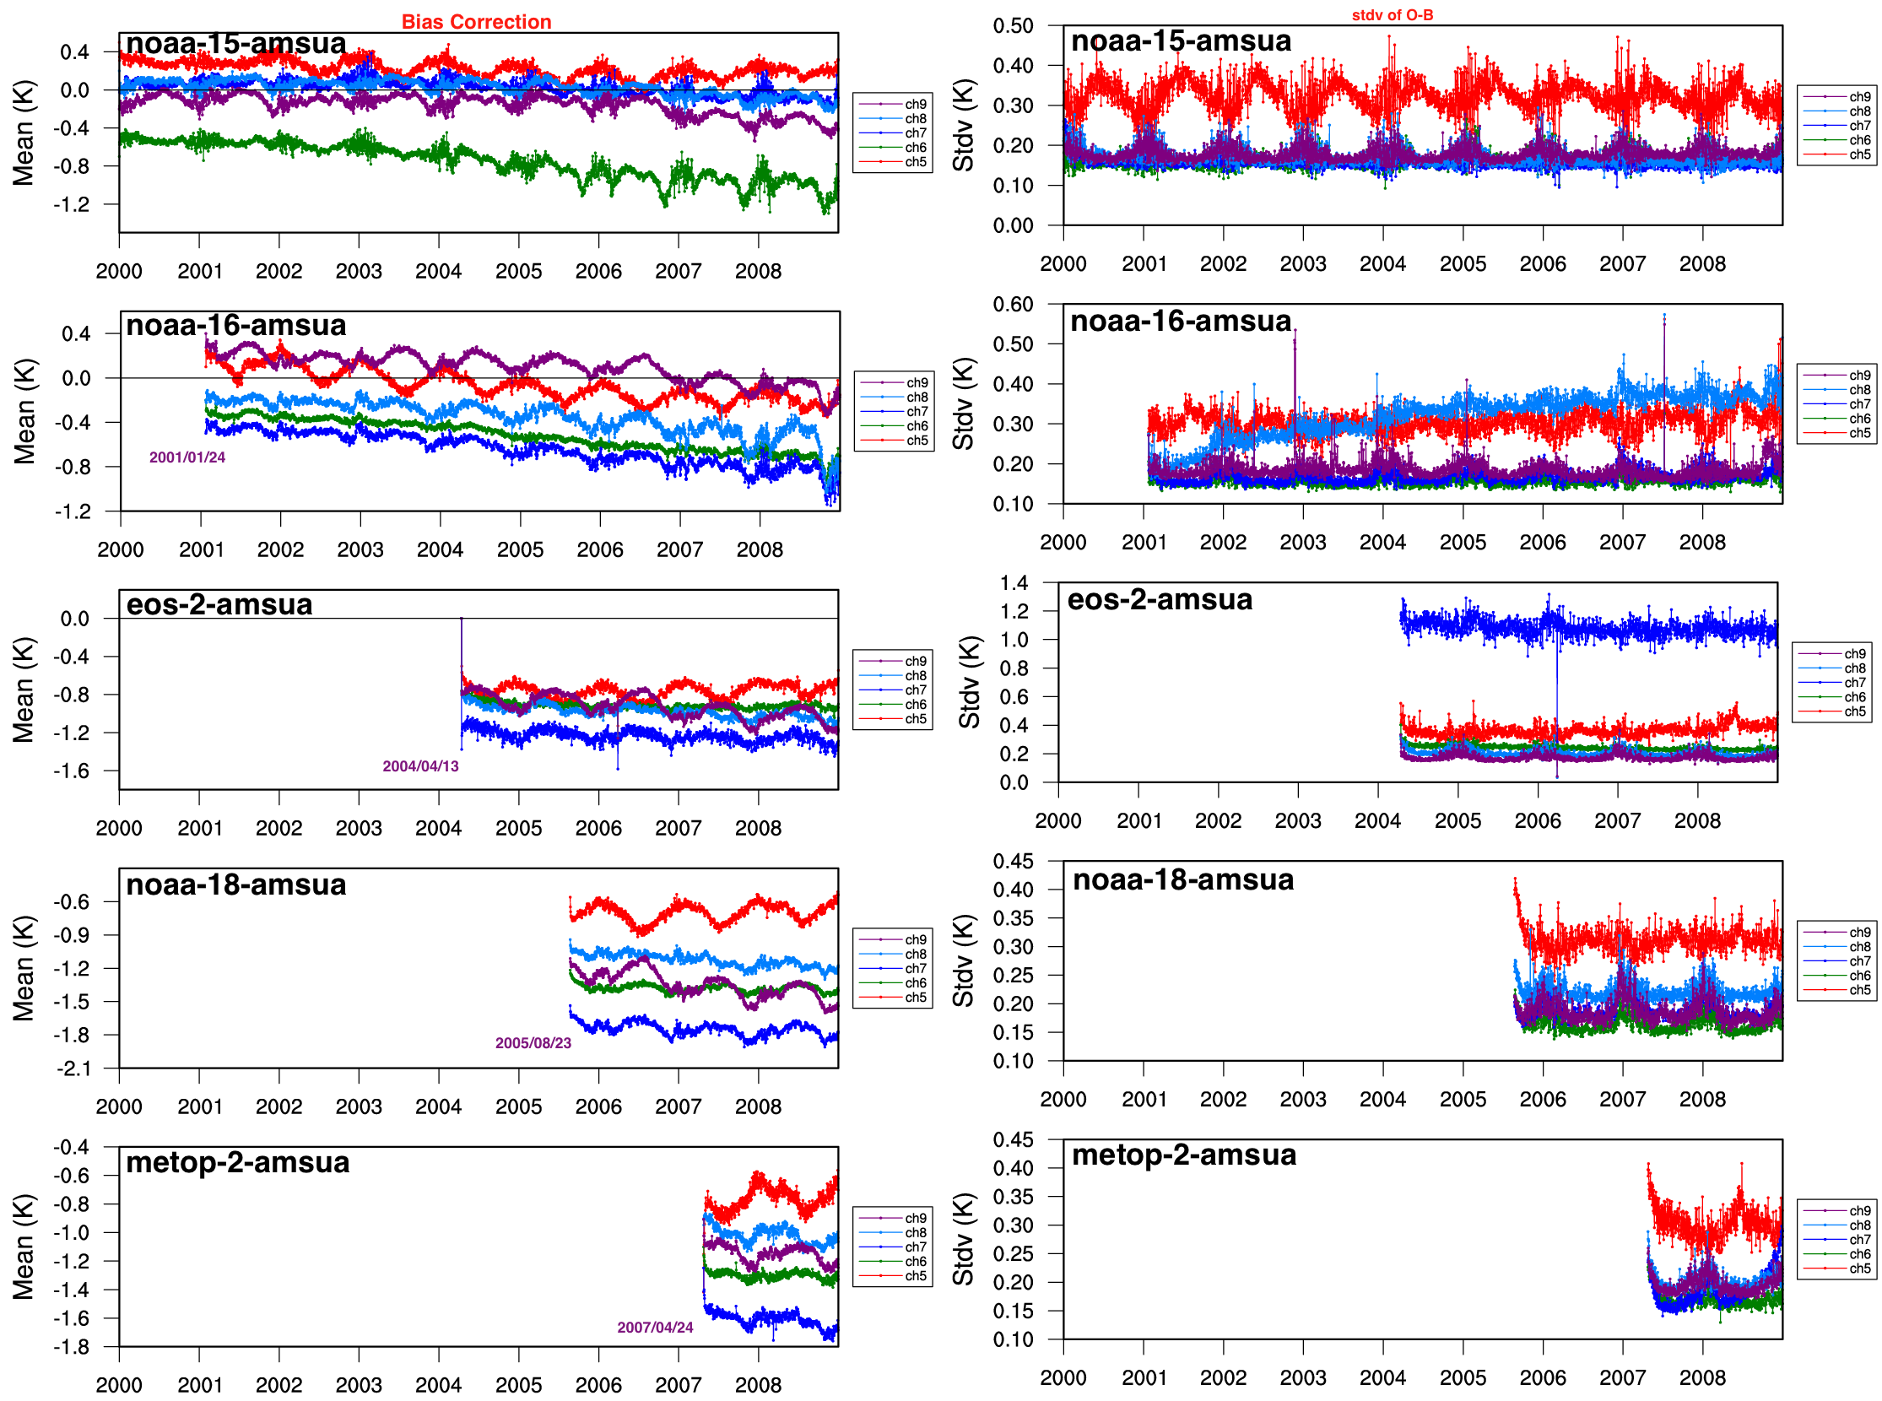
Radiance Monitoring against
ERA-Interim over Arctic domain
WRFDA Tutorial, July 2013

Slide 17
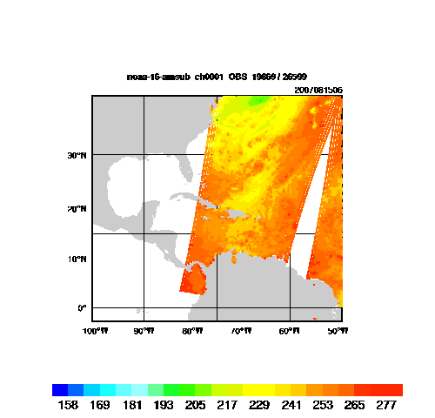
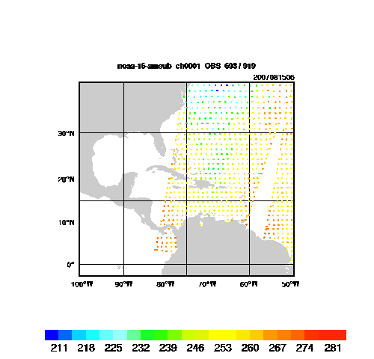
Observation Thinning
Dense data are very likely correlated, which is not taken
into account in the observation covariance matrix R.
No Thinning
120km Thinning Mesh
WRFDA Tutorial, July 2013

Slide 18
Part II: Practice with WRFDA
Data Ingest (sources, instruments)
Radiative transfer model
Channel selection
Variational Bias correction
Diagnostics and monitoring
WRFDA Tutorial, July 2013

Slide 19
Data Ingest (V3.5)
NCEP global BUFR format radiance data within a 6h time window (20 sensors from 9 satellites)
  5 HIRS from NOAA16, 17, 18, 19, METOP-2
  6 AMSU-A from NOAA15,16,18,19, EOS-Aqua, METOP-2
  3 AMSU-B from NOAA15, 16, 17
  3 MHS from NOAA18, 19, METOP-2
  1 AIRS from EOS-Aqua
  1 IASI from METOP-2
  1 ATMS from NPP
NRL/AFWA/NESDIS produced DMSP-16 SSMI/S BUFR radiance data.
FY-3 MWTS and MWHS, CMA binary format.
WRFDA Tutorial, July 2013

Slide 20
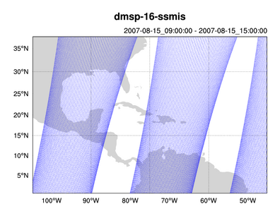
NCEP near real-time ftp server with radiance BUFR data
ftp://ftp.ncep.noaa.gov/pub/data/nccf/com/gfs/prod/gdas.${yyyymmddhh}
NOAA Historical archive: http://nomads.ncdc.noaa.gov/data/gdas/
NCAR archive: http://dss.ucar.edu/datasets/ds735.0/
NCEP naming convention
WRF-Var naming convention
gdas1.t00z.1bamua.tm00.bufr_d
gdas1.t00z.1bamub.tm00.bufr_d
gdas1.t00z.1bhrs3.tm00.bufr_d
gdas1.t00z.1bhrs4.tm00.bufr_d
gdas1.t00z.1bmhs.tm00.bufr_d
gdas1.t00z.airsev.tm00.bufr_d
amsua.bufr
amsub.bufr
hirs3.bufr
hirs4.bufr
mhs.bufr
airs.bufr
Direct input to WRFDA, no pre-processing required.
Quality control, thinning, time and domain check, bias correction are done inside WRF-Var
Namelist switches to decide if reading the data or not
  Use_amsuaobs
  Use_amsubobs
  Use_hirs3obs
  Use_hirs4obs
  Use_mhsobs
  Use_airsobs
  Use_eos_amsuaobs
  Use_ssmisobs
WRFDA Tutorial, July 2013

Slide 21
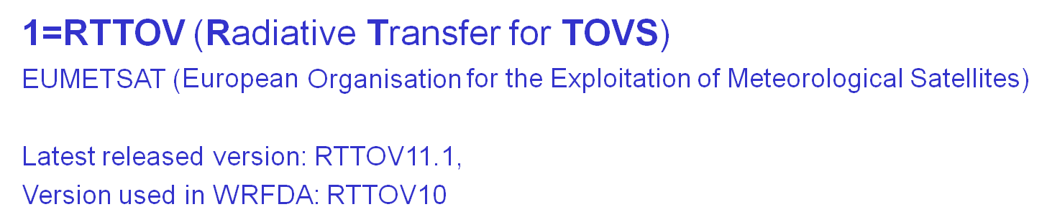
Choose Radiative Transfer Model
Controlled by the namelist variable: “rtm_option”
2=CRTM (Community Radiative Transfer Model)
JCSDA (Joint Center for Satellite Data Assimilation)
ftp://ftp.emc.ncep.noaa.gov/jcsda/CRTM/
Latest released version: CRTM REL-2.1.3,
Version included in WRFDA: CRTM REL-2.0.2
CRTM code and (limited) coeffs included in WRFDA release (since V3.2.1)
WRFDA Tutorial, July 2013

Slide 22
Channel selection and error specification
WRFDA/var/run/radiance_info>ls -l
total 160
-rw-r--r-- 1 hclin users 1588 Aug 22 17:01 dmsp-16-ssmis.info
-rw-r--r-- 1 hclin users 17790 Aug 22 17:01 eos-2-airs.info
-rw-r--r-- 1 hclin users 1033 Aug 22 17:01 eos-2-amsua.info
-rw-r--r-- 1 hclin users 1036 Aug 22 17:01 metop-2-amsua.info
-rw-r--r-- 1 hclin users 391 Aug 22 17:01 metop-2-mhs.info
-rw-r--r-- 1 hclin users 1021 Aug 22 17:01 noaa-15-amsua.info
-rw-r--r-- 1 hclin users 391 Aug 22 17:01 noaa-15-amsub.info
-rw-r--r-- 1 hclin users 1277 Aug 22 17:01 noaa-15-hirs.info
-rw-r--r-- 1 hclin users 1021 Aug 22 17:01 noaa-16-amsua.info
-rw-r--r-- 1 hclin users 391 Aug 22 17:01 noaa-16-amsub.info
-rw-r--r-- 1 hclin users 1275 Aug 22 17:01 noaa-16-hirs.info
-rw-r--r-- 1 hclin users 391 Aug 22 17:01 noaa-17-amsub.info
-rw-r--r-- 1 hclin users 1277 Aug 22 17:01 noaa-17-hirs.info
-rw-r--r-- 1 hclin users 1036 Aug 22 17:01 noaa-18-amsua.info
-rw-r--r-- 1 hclin users 1286 Aug 22 17:01 noaa-18-hirs.info
-rw-r--r-- 1 hclin users 391 Aug 22 17:01 noaa-18-mhs.info
metop-2-mhs.info
-1: not used; 1: used error for each channel
sensor channel IR/MW use idum varch polarisation(0:vertical;1:horizontal)
203 1 1 -1 0 0.2500000000E+01 0.0000000000E+00
203 2 1 -1 0 0.2500000000E+01 0.0000000000E+00
203 3 1 1 0 0.2500000000E+01 0.1000000000E+01
203 4 1 1 0 0.2000000000E+01 0.1000000000E+01
203 5 1 1 0 0.2000000000E+01 0.0000000000E+00
WRFDA Tutorial, July 2013

Slide 23
Setup and run WRFDA with radiances
To run WRFDA, first create a working directory,
for example, WRFDA/var/test, then follow the steps below:
cd WRFDA/var/test (go to the working directory)
ln -sf WRFDA/run/LANDUSE.TBL ./LANDUSE.TBL
ln -sf $DAT_DIR/rc/2007010200/wrfinput_d01 ./fg (link first guess file as fg)
ln -sf WRFDA/var/obsproc/obs_gts_2007-01-02_00:00:00.3DVAR ./ob.ascii (link OBSPROC processed
observation file as ob.ascii)
ln -sf $DAT_DIR/be/be.dat ./be.dat (link background error statistics as be.dat)
ln -sf WRFDA/var/da/da_wrfvar.exe ./da_wrfvar.exe (link executable)
ln -sf $DAT_DIR/2007010200/gdas1.t00z.1bamua.tm00.bufr_d ./amsua.bufr
ln -sf ~WRFDA/var/run/radiance_info ./radiance_info
ln -sf ~WRFDA/var/run/VARBC.in .
(CRTM only) > ln -sf WRFDA/var/run/crtm_coeffs ./crtm_coeffs #(crtm_coeffs is a directory)
(RTTOV only) > ln -sf your_path/rtcoef_rttov10/rttov7pred51L ./rttov_coeffs #(rttov_coeffs is a directory)
vi namelist.input (&wrfvar4, &wrfvar14, &wrfvar21, &wrfvar22)
da_wrfvar.exe >&! wrfda.log
WRFDA Tutorial, July 2013

Slide 24
Control which instruments will be assimilated and
Which CRTM/RTTOV coeffs files will be loaded
Namelist variables for tested instruments:
RTMINIT_NSENSOR = 14
RTMINIT_PLATFORM = 1, 1, 1, 1, 9,10, 1, 1, 1, 1, 1, 10, 9, 2
RTMINIT_SATID = 15,16,18,19, 2, 2,15,16,17,18, 19, 2, 2,16
RTMINIT_SENSOR = 3, 3, 3, 3, 3, 3, 4, 4, 4,15, 15,15,11,10
NOAA-15-AMSUA (1, 15 ,3)
NOAA-16-AMSUA
NOAA-18-AMSUA
NOAA-19-AMSUA
EOS-2-AMSUA ( 9, 2, 3)
METOP-2-AMSUA (10, 2, 3)
NOAA-15-AMSUB (1, 15, 4)
NOAA-16-AMSUB
NOAA-17-AMSUB
NOAA-18-MHS (1, 18, 15)
NOAA-19-MHS
METOP-2-MHS (10, 2, 15)
EOS-2-AIRS (9, 2, 11)
DMSP-16-SSMIS (2, 16, 10)
CRTM and RTTOV share
the same “instrument triplet”
convention for user’s config.
This facilitates the user’s config.
When switching b.w. two RTMs.
WRFDA Tutorial, July 2013

Slide 25
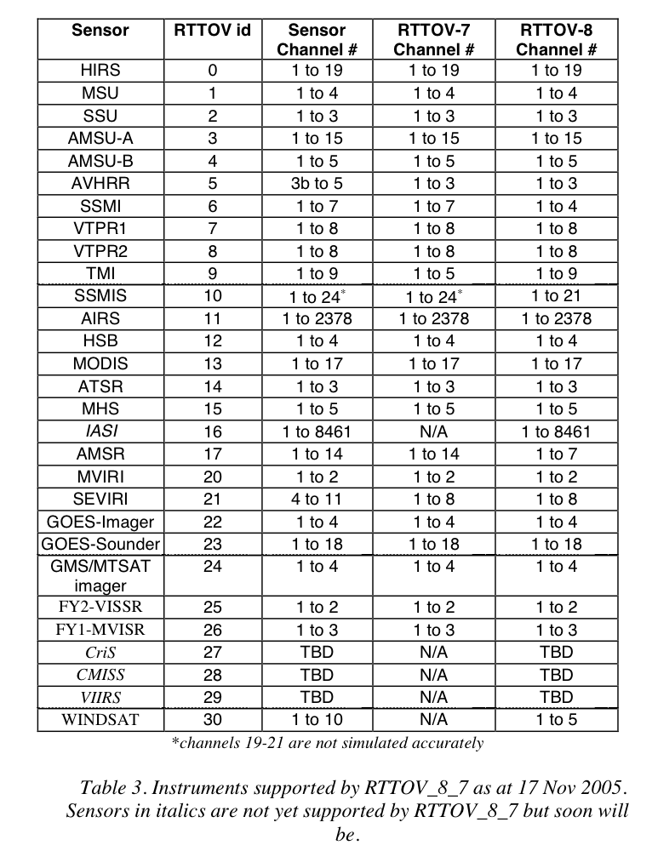
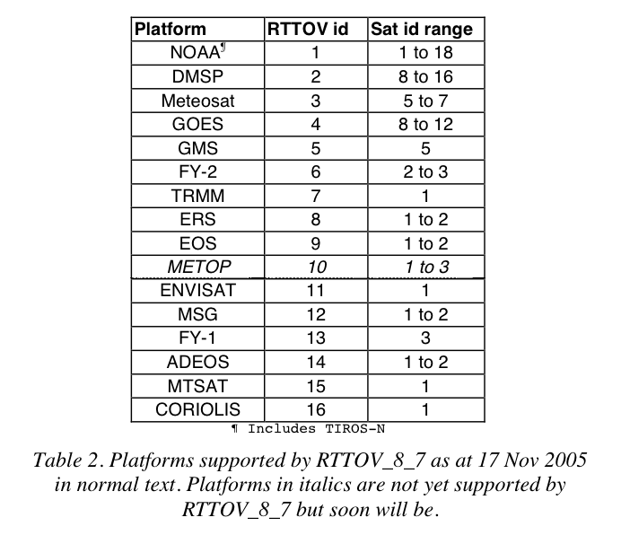
more sensors supported, from RTTOV_8_7 Users Guide
http://www.metoffice.gov.uk/research/interproj/nwpsaf/rtm/rttov8_ug.pdf
sensor_id
Instrument triplets platform_id
        satellite_id
        sensor_id
platform_id
satellite_id
WRFDA Tutorial, July 2013

Slide 26
Radiance namelist variables
THINNING: Logical, TRUE will perform thinning
THINNING_MESH (30): Real array with dimension RTMINIT_NSENSOR, values indicate thinning mesh (in KM) for different sensors.
QC_RAD=true: Logical, control if perform quality control, always set to TRUE.
WRITE_IV_RAD_ASCII: Logical, control if output Observation minus Background files, which are ASCII format and separated by sensors and processors.
WRITE_OA_RAD_ASCII: Logical, control if output Observation minus Analysis files (including also O minus B), which are ASCII format and separated by sensors and processors.
ONLY_SEA_RAD: Logical, control if only assimilating radiance over water.
USE_CRTM_KMATRIX: new from Version 3.1.1, much faster. Set to TRUE.
USE_RTTOV_KMATRIX: new from version 3.3, much faster. Set to TRUE
WRFDA Tutorial, July 2013

Slide 27
Radiance namelist (VarBC related)
USE_VARBC=true
freeze_varbc=false (VarBC coeffs not change during minimization)
varbc_factor=1. (for scaling the VarBC preconditioning)
varbc_nbgerr=5000, (default value prior to V3.3.1 is 1 which is improper )
varbc_nobsmin=500. (defines the minimum number of observations required for the computation of the predictor statistics during the first assimilation cycle. If there are not enough data (according to "VARBC_NOBSMIN")
on the first cycle, the next cycle will perform a coldstart again)
WRFDA Tutorial, July 2013

Slide 28
Variational Bias Correction (VarBC)
VARBC.in file is an ASCII file that controls all of what is going into the VarBC.
Sample VARBC.in
Cold start from an empty coeffs file
For the first cycle
VARBC version 1.0 - Number of instruments:
2
------------------------------------------------
Platform_id Sat_id Sensor_id Nchanl Npredmax
------------------------------------------------
1 15 3 5 8
-----> Bias predictor statistics: Mean & Std & Nbgerr
1.0 0.0 0.0 0.0 0.0 0.0 0.0 0.0
0.0 1.0 1.0 1.0 1.0 1.0 1.0 1.0
10000 10000 10000 10000 10000 10000 10000 10000
-----> Chanl_id Chanl_nb Pred_use(-1/0/1) Param
5 5 0 0 0 0 0 0 0 0
6 6 0 0 0 0 0 0 0 0
7 7 0 0 0 0 0 0 0 0
8 8 0 0 0 0 0 0 0 0
9 9 0 0 0 0 0 0 0 0
------------------------------------------------
Platform_id Sat_id Sensor_id Nchanl Npredmax
------------------------------------------------
1 16 4 3 8
-----> Bias predictor statistics: Mean & Std & Nbgerr
1.0 0.0 0.0 0.0 0.0 0.0 0.0 0.0
0.0 1.0 1.0 1.0 1.0 1.0 1.0 1.0
10000 10000 10000 10000 10000 10000 10000 10000
-----> Chanl_id Chanl_nb Pred_use(-1/0/1) Param
3 3 0 0 0 0 0 0 0 0
4 4 0 0 0 0 0 0 0 0
5 5 0 0 0 0 0 0 0 0
Not used any more. Now controlled
by namelist “varbc_nbgerr”
WRFDA Tutorial, July 2013

Slide 29
Sample VARBC.out (output from WRF-Var, used as VARBC.in for the next cycle)
VARBC version 1.0 - Number of instruments:
4
------------------------------------------------
Platform_id Sat_id Sensor_id Nchanl Npredmax
------------------------------------------------
1 15 4 5 8
-----> Bias predictor statistics: Mean & Std & Nbgerr
1.0 9273.1 8677.8 290.4 24.0 51.7 3502.8 260484.8
0.0 273.5 293.3 8.0 12.3 28.9 2827.2 252657.9
10000 10000 10000 10000 10000 10000 10000 10000
-----> Chanl_id Chanl_nb Pred_use(-1/0/1) Param
1 1 0 0 0 0 0 0 0 0 -3.400 0.000 0.000 0.000 0.000 0.000 0.000 0.000
2 2 0 0 0 0 0 0 0 0 -0.200 0.000 0.000 0.000 0.000 0.000 0.000 0.000
3 3 1 1 1 1 1 1 1 1 1.213 -0.062 0.003 -0.070 0.008 -0.230 -0.111 -0.024
4 4 1 1 1 1 1 1 1 1 3.056 0.050 0.053 0.015 -0.059 0.304 0.241 0.203
5 5 1 1 1 1 1 1 1 1 0.869 0.034 -0.089 0.074 0.019 -0.118 -0.031 0.022
------------------------------------------------
Platform_id Sat_id Sensor_id Nchanl Npredmax
------------------------------------------------
1 16 4 5 8
-----> Bias predictor statistics: Mean & Std & Nbgerr
1.0 9280.2 8641.2 290.0 24.1 52.6 3568.9 264767.4
0.0 209.5 245.9 7.9 11.3 28.3 2792.1 249977.0
10000 10000 10000 10000 10000 10000 10000 10000
-----> Chanl_id Chanl_nb Pred_use(-1/0/1) Param
1 1 0 0 0 0 0 0 0 0 0.700 0.000 0.000 0.000 0.000 0.000 0.000 0.000
2 2 0 0 0 0 0 0 0 0 -0.800 0.000 0.000 0.000 0.000 0.000 0.000 0.000
3 3 1 1 1 1 1 1 1 1 0.372 -0.028 0.010 0.060 0.025 0.117 0.023 -0.042
4 4 1 1 1 1 1 1 1 1 0.968 0.016 -0.003 -0.041 0.045 -0.018 -0.030 -0.028
5 5 1 1 1 1 1 1 1 1 -3.290 0.073 -0.093 0.096 0.018 0.011 0.010 0.004
Control whether a cold-start (if 0)
Or warm-start (if 1) VarBC
Bias correction coefficients for 8 predictors
(used only for warm-start case)
WRFDA Tutorial, July 2013

Slide 30
Radiance output Post-Processing/Visualization
~WRFDA/var/scripts/da_rad_diags.ksh (included in the TOOLS bundle that can be downloaded from http://www.mmm.ucar.edu/wrf/users/wrfda/download/tools.html
  WRFDA will output radiance inv* or oma* ASCII files separated for different sensors and CPUs.
  Script converts ASCII files to one NETCDF file for each sensor (a Fortran90 program), then plot *.nc files with a NCL script
  NCL script can plot various graphics
    Channel TB, Histogram, scatter plot, time series etc.
    Can be included in the script to routinely produce graphics after WRF-Var runs
    Users can control (by simple script parameter setup) to plot over smaller domain, only over land or sea, QCed or no-QCed observations.
WRFDA Tutorial, July 2013

Slide 31
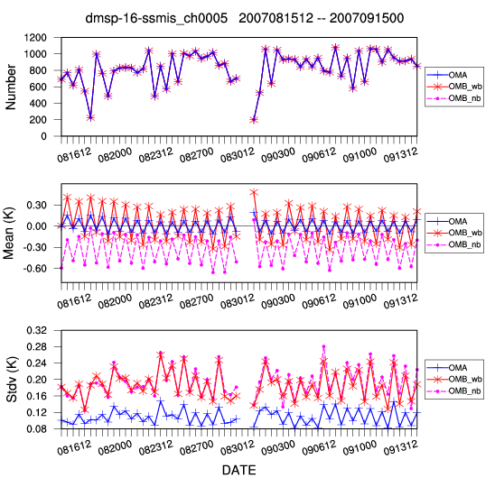
Time series of radiance OMB/OMA for DMSP-16 SSMI/S
WRFDA Tutorial, July 2013

Slide 32
Conclusions
Radiance data assimilation are important
  Major source of information over ocean and Southern Hemisphere
Radiance DA is not trivial
  Very easy to degrade the analysis!
  Each sensor requires a lot of attention (observation operator, bias correction, QC, observation error, cloud/rain detection, …)
  Challenge for regional DA: lower model top, bias correction
It’s only the beginning…
  New generation of satellite instruments
  Future developments will increase satellite impact
    Better representation of surface emissivity over land
    Use of cloudy/rainy radiances
    ………………………………………………………
Get familiar with radiance DA with more practice
  wrfhelp@ucar.edu
WRFDA Tutorial, July 2013

