Slide 1
Observation Preprocessor for WRF-Var
Yong-Run Guo
National Center for Atmospheric Research
P.O.Box 3000, Boulder, CO 80307
Presented in WRF Tutorial, 24 July 2006

Slide 2
WRF-Var in the WRF Modeling System
WRF
Background
Preprocessing
(SI)
x^{b}
Observation
Preprocessor
yº
WRFVAR
xª
Update
Boundary
Conditions
WRF Forecast
Background
Error
Calculation
B
Namelist.3dvar
Options for running 3DVAR
Namelist.input
Grid dimensions for mpp
The observations are one of the important input files for WRF-Var, no observations will be no data assimilation.

Slide 3
The data format of observations accepted by WRF-Var
Official format: BUFR --- International WMO standard format
  not fully tested in WRF-Var,
  ob_format = 1 in WRF-Var
ASCII format --- for research and operational:
Current working format,
ob_format = 2 in WRF-Var
fully supported
** Radar OBS (Radial velocity and reflectivity) processing not included here (but the data file format provided below).

Slide 4
Web sites for 3DVAR_OBSPROC
The 3DVAR OBS preprocessor program can be obtained from:
http://www.mmm.ucar.edu/wrf/WG4/wrfvar/wrfvar-tutorial.htm
Click “b) The 3D-Var Observation Preprocessor (3DVAR_OBSPROC)”
The presentation for this 3DVAR preprocessor can be found from:
http://www.mmm.ucar.edu/people/guo/individual_guo/OBSPROC/Slide1.html
The files inputted to and Outputted from 3DVAR_OBSPROC are ASCII files.

Slide 5
Advantages of ASCII format observations
The input file to 3DVAR_OBSPROC is the MM5/LITTLE_R format.
Anyone who is familiar with MM5 modeling system should be familiar with the MM5/LITTLE_R format.
This is a report-based format, so all types of the observation data can be easily ‘cat’ted together to form a monolithic file.
It is easily to read, edit,…. with an ASCII file.
The output file from observation preprocessor, 3DVAR_OBSPROC program is still an ASCII file. It is easily manipulated for specific purposes of research, such as single point data tests, etc.
Users’ duty is just to convert their own observations in any format to the MM5/LITTLE_R format. Then that data can be processed by 3DVAR_OBSPROC, and assimilated with WRF-Var system.
Disadvantages of ASCII format observations
The size of the observation file is larger in compared with the WMO BUFR format file, not suitable for the remote sensing data, such as Radiance, etc.

Slide 6
Input OBS (LITTLE_R) file to preprocessor
OBS decoded file in LITTLE_R format containing Reports
Report containing Records (header, data,…, and ending) and 3 tail integers (3I7)
Record containing fields
  The fields in the header record (Fortran format in parenthesis)
  The fields in the data record (Fortran format in parenthesis)
  The fields in the ending record

Slide 7
No | Field | No | Filed | No | Field
1 | Latitude (f20.5) | 2 | Longitude (f20.5) | 3 | ID (a40)
4 | Name (a40) | 5 | Platform (a40) | 6 | Source (a40)
7 | Elevation (f20.5) | 8 | Num_vld_fld (i10) | 9 | Num_error (i10)
10 | Num_warning (i10) | 11 | Seq_num (i10) | 12 | Num_dupd (i10)
13 | Is_sound (L10) | 14 | Bogus (L10) | 15 | Discard (L10)
16 | Valid_time%sut (i10) | 17 | Valid_time%julian (i10) | 18 | Valid_time%date_char(a20)
19 | Slp%data (f13.5) | 20 | Slp%qc (i7) | 21 | Ref_pres%data (f13.5)
22 | Ref_pres%qc (i7) | 23 | Ground_t%data (f13.5) | 24 | Ground_t%qc (i7)
25 | SST%data (f13.5) | 26 | SST%qc (i7) | 27 | Psfc%data (f13.5)
28 | Psfc%qc (i7) | 29 | Precip%data (f13.5) | 30 | Precip%qc (i7)
31 | T_max%data (f13.5) | 32 | T_max%qc (i7) | 33 | T_min%data (f13.5)
34 | T_min%qc (i7) | 35 | T_min_night%data (f13.5) | 36 | T_min_night%qc (i7)
37 | P_tend03%data (f13.5) | 38 | P_tend03%qc (i7) | 39 | P_tend24%data (f13.5)
40 | P_tend24%qc (i7) | 41 | Cloud_cvr%data (f13.5) | 42 | Cloud_cvr%qc (i7)
43 | Celling%data (f13.5) | 44 | Celling%qc (i7) | 45 | Pw%data (f13.5)
46 | Pw%qc (i7) | 47 | Tb19v%data (f13.5) | 48 | Tb19v%qc (i7)
49 | Tb19h%data (f13.5) | 50 | Tb19h%qc (i7) | 51 | Tb22v%data (f13.5)
52 | Tb22v%qc (i7) | 53 | Tb37v%data (f13.5) | 54 | Tb37v%qc (i7)
55 | Tb37h%data (f13.5) | 56 | Tb37h%qc (i7) | 57 | Tb85v%data (f13.5)
58 | Tb85v%qc (i7) | 59 | Tb85h%data (f13.5) | 60 | Tb85h%qc

Slide 8
The fields in the data record (Fortran format in parenthesis)
No | Field | No | Field
1 | Pressure%data (f13.5) | 2 | Pressure%qc (i7)
3 | Height%data 9f13.5) | 4 | Height%qc (i7)
5 | Temperature%data (f13.5) | 6 | Temperature%qc (i7)
7 | Dew_point%data (f13.5) | 8 | Dew_point%qc (i7)
9 | Speed%data (f13.5) | 10 | Speed%qc (i7)
11 | Direction%data (f13.5) | 12 | Direction%qc (i7)
13 | U%data (f13.5) | 14 | U%qc (i7)
15 | V%data (f13.5) | 16 | V%qc (i7)
17 | RH%data (f13.5) | 18 | RH%qc (i7)
19 | Thickness%data (f13.5) | 20 | Thickness%qc (i7)

Slide 9
The fields in the ending record
No | field | No | field | No | field | No | field
1 | -777777.00000 | 2 | 0 | 3 | -777777.00000 | 4 | 0
5 | -888888.00000 | 6 | 0 | 7 | -888888.00000 | 8 | 0
9 | -888888.00000 | 10 | 0 | 11 | -888888.00000 | 12 | 0
13 | -888888.00000 | 14 | 0 | 15 | -888888.00000 | 16 | 0
17 | -888888.00000 | 18 | 0 | 19 | -888888.00000 | 20 | 0

Slide 10
Interface programs in AFWA, KMA, CAA,..
Interface programs to convert the data format from AFWA, KMA, CAA,… observation database to MM5/LITTLE_R format to provide the OBS file to WRF-Var OBS preprocessor
In NCAR, MM5 Utility fetch.csh will obtain the OBS data file in LITTLE_R format from NCAR archive.
Observation
Database
Interface
programs
3DVAR_
OBSPROC
WRF-Var
AFWA, KMA,CAA,…
NCAR

Slide 11
Why do we need the OBS preprocessor?
To prepare the OBS data file suitable for WRF-Var needs
Clean out the unnecessary information for WRF-Var, and keep the necessary information for WRF-Var assimilation
For example (Typhoon Sam case 1999081912Z),
LITTLE_R obs file : 40425051 bytes,
3DVAR obs file : 3934484 bytes)
Save the OBS data processing time, one OBS file can be repeatedly used for multiple times of WRF-Var experiments.
The output file from 3DVAR_OBSPROC is still to be an ACSII format for easy manipulation (read, check, and edit), especially for research purpose.

Slide 12
Tasks of the OBS preprocessor: 3DVAR_OBSPROC
1, To perform a time-windowed and, in case of regional application (domain_check_h = .TRUE.), geographically-filtered dump of the ingested observations
Currently, there is no time-check for observation data in WRF-Var assimilation code, so to select the observation data within a suitable time-window must be performed in 3DVAR_OBSPROC.
  For the regional application with the IPROJ = 1 (Lambert conformal), 2 (Polar Stereographic), or 3 (Mercator), there is a geographic-filtered performed based on the model domain settings. For the global application with the IPROJ = 0, no geographic-filtered is performed.

Slide 13
Tasks of the OBS preprocessor: 3DVAR_OBSPROC (cont.)
  2, To retrieve the pressure or height based on the observed information with the hydrostatic assumption
  3, To remove the duplicate reports of observations
  4, To re-order (from bottom to top) and merge the data reports with the same platform, time, and location based on the pressure.
  5, To discard the data above the model top (p<p_{top}) in the upper-air observations (remove_above_lid = .TRUE.)

Slide 14
Tasks of the OBS preprocessor: 3DVAR_OBSPROC (cont.)
  6, To assign the observation errors to the different types of observations
Observations errors
→ NCEP OBS error (Parrish and Derber 1992)
→US Air Force (AFWA) OBS error file
→Directly from the observation reports
  7, To perform the vertical consistency check and super adiabatic check for the multi-level observations

Slide 15
Tasks of the OBS preprocessor: 3DVAR_OBSPROC (cont.)
  8, To complete thinning with the SATOB, SSMI, and QSCAT data
  The data points nearest to the model grid-points will be picked up for assimilation.
  9, To write out the OBS files in ASCII format as the WRF-Var input
  → GTS data (obs_gts.3dvar): pressure, Wind, height, temperature, dewpoint, RH, etc.
  → SSMI data (obs_ssmi_retrieval.3dvar): PW and surface wind speed
  10, To plot the distribution for each type of observations
  →MAP_plot

Slide 16
Flow chart of OBS preprocessor
Read in data and discard the data
outside domain and time
Get namelist
Sort, and merge
the duplicated data
Assign the OBS
errors
Check the data
completeness
QC index reduction
Setup map parameters
Check vertical consistency
And adiabatic
END
Write out obs_gst.3dvar
(obs_ssmi_retrieval.3dvar)
SATOB, QSCAT and
SSMI data Thinning

Slide 17
Types of observations to be processed
→18 types (SYNOP, SHIPS, METAR,
TEMP , AIREP, PILOT , AMDAR,
PROFL, SATOB, SATEM, SSMT1, SSMT2, SSMI, GPSPW, GPSZD, GPSRF, QSCAT, BOGUS)
(* Radar radial velocity and reflectivity)

Slide 18
WMO code for each type of observations
Name | WMO code | WMO code name
SYNOP | 12, 14 | SYNOP, SYNOP MOBIL
SHIP | 13 | SHIP
METAR | 15, 16 | METAR, SPECI
PILOT | 32, 33, 34 | PILOT, PILOT SHIP, PILOT MOBIL
SOUND | 35, 36, 37, 38 | TEMP, TEMP SHIP, TEMP DROP, TEMP MOBIL
AMDAR | 42 | AMDAR
SATEM | 86 | SATEM
SATOB | 88 | SATOB
AIREP | 96, 97 | AIREP
GPSPW | 111 | GPSPW (Ground-based GPS precipitable water)
GPSZD | 114 | GPSZD (Ground-based GPS Zenith Total Delay)
GPSRF | 116 | GPSRF (Space-based GPS Refractivity)
SSMT1 | 121 | SSMT1
SSMT2 | 122 | SSMT2
SSMI | 125 | SSMI
PROFL | 132 | WIND PROFILER
BOGUS | 135 | TCBOU (Typhoon bogus), BOGUS (other bogus)
QSCAT | 281 | Quik SCAT level-2B SeaWind
OTHER |  | UNKNOWN

Slide 19
Input and output files for OBS preprocessor
3 Input files
  OBS decoded file (Reports) in little_r format
A report (F90 pointer linking structure)
        header record (fields)
        Level1 data record (fields)
…………………
        Leveln data record (fields)
        Ending record (fields)
        3 Integers in format(3i7)
  Namelist file (namelist.3dvar_obs) (See: README.namelist)
Record1: input file names
Record2: analysis times
Record3: Maximum number of observations allowed
Record4: quality control switches
Record5: print switches
Record6: define the reference state: ptop, etc.
Record7: Geographic parameters
Record8: Domain settings
  AFWA OBS errors file: obserr.txt (provided by 3DVAR system)

Slide 20
Output files
1, Obs_gts.3dvar and obs_ssmi_retrieval.3dvar
Header: the information for this OBS file and data format
Data : header record and data records for each of levels
    These are the OBS input file to WRF-Var program
    obs_ssmi_retrieval.3dvar needed only when SSMI retrieval data available
    These files can be used as input to MAP_plot to obtain the gmeta plot file with NCAR GRAPHICS
  2, 3dvar_obs.out ---- a program execution log file
  The printing out from the program execution. It can used to monitor the execution and to identify the troubles if any
  3, Diagnostic files depended on the print switches in namelist

Slide 21
File: obs_gts.3dvar
TOTAL = 8169, MISS. =-888888.,
SYNOP = 1432, METAR = 164, SHIP = 86, BUOY = 0, TEMP = 179, AMDAR = 0,
AIREP = 265, PILOT = 0, SATEM = 0, SATOB = 6043, GPSPW = 0, SSMT1 = 0,
SSMT2 = 0, TOVS = 0, QSCAT = 0, PROFL = 0, OTHER = 0,
PHIC = 28.50, XLONC = 116.00, TRUE1 = 10.00, TRUE2 = 45.00, XIM11 = 1.00, XJM11 = 1.00,
TS0 = 275.00, TLP = 50.00, PTOP = 7000., PS0 =100000.,
IXC = 67, JXC = 81, IPROJ = 1, IDD = 1, MAXNES= 10,
NESTIX= 67, 67, 67, 67, 67, 67, 67, 67, 67, 67,
NESTJX= 81, 81, 81, 81, 81, 81, 81, 81, 81, 81,
NUMC = 1, 1, 1, 1, 1, 1, 1, 1, 1, 1,
DIS = 135.00, 0.00, 0.00, 0.00, 0.00, 0.00, 0.00, 0.00, 0.00, 0.00,
NESTI = 1, 1, 1, 1, 1, 1, 1, 1, 1, 1,
NESTJ = 1, 1, 1, 1, 1, 1, 1, 1, 1, 1,
INFO = PLATFORM, DATE, NAME, LEVELS, LATITUDE, LONGITUDE, ELEVATION, ID.
SRFC = SLP, PW (DATA,QC,ERROR).
EACH = PRES, SPEED, DIR, HEIGHT, TEMP, DEW PT, HUMID (DATA,QC,ERROR)*LEVELS.
INFO_FMT = (A12,1X,A19,1X,A40,1X,I6,3(F12.3,11X),6X,A5)
SRFC_FMT = (F12.3,I4,F7.2,F12.3,I4,F7.2)
EACH_FMT = (3(F12.3,I4,F7.2),11X,3(F12.3,I4,F7.2),11X,1(F12.3,I4,F7.2)))
#------------------------------------------------------------------------------#
FM-35 TEMP 1999-08-19_11:00:00 AHMADABAD / INDIA 17 23.070 72.630 55.000 42647
-888888.000 -88 200.00 -888888.000 -88 0.20
100000.000 0 100.00 3.000 0 1.10 225.000 0 5.00 53.000 0 7.00 305.550 0 1.00 298.550 0 1.00 65.984 0 15.00
92500.000 0 100.00 3.000 0 1.10 220.000 0 5.00 745.000 0 7.48 300.550 0 1.00 295.550 0 1.00 73.714 0 12.60
91600.000 0 100.00 -888888.000 -88 1.10 -888888.000 -88 5.00 830.000 0 7.54 300.150 0 1.00 295.150 0 1.00 73.653 0 12.30
87300.000 0 100.00 -888888.000 -88 1.10 -888888.000 -88 5.00 1251.000 0 7.84 297.350 0 1.00 291.350 0 1.00 68.712 0 10.82
85000.000 0 100.00 6.000 0 1.10 250.000 0 5.00 1498.000 0 8.00 295.350 0 1.00 290.750 0 1.00 74.809 0 10.00
79200.000 0 100.00 -888888.000 -88 1.13 -888888.000 -88 5.00 2104.000 0 8.22 290.750 0 1.00 288.550 0 1.00 86.755 0 10.00
78000.000 0 100.00 -888888.000 -88 1.18 -888888.000 -88 5.00 2238.000 0 8.27 292.950 0 1.00 281.950 0 1.00 48.599 0 10.00
70700.000 0 100.00 -888888.000 -88 1.39 -888888.000 -88 5.00 3076.000 0 8.57 289.950 0 1.00 268.950 0 1.00 23.245 0 10.00
70000.000 0 100.00 2.000 0 1.40 30.000 0 5.00 3168.000 0 8.60 -888888.000 -11 1.00 -888888.000 -11 1.00 -888888.000 -11 10.00
61100.000 0 100.00 -888888.000 -88 1.76 -888888.000 -88 5.00 4312.000 3 10.01 282.350 0 1.00 271.350 0 1.00 45.937 0 10.00
60000.000 0 100.00 -888888.000 -88 1.80 -888888.000 -88 5.00 4463.000 3 10.20 281.350 0 1.00 272.350 0 1.00 52.920 0 10.00
57400.000 0 100.00 -888888.000 -88 1.90 -888888.000 -88 5.00 4828.000 3 10.66 279.150 0 1.00 274.150 0 1.00 70.188 0 10.00
52700.000 0 100.00 -888888.000 -88 2.14 -888888.000 -88 5.00 5526.000 3 11.55 275.550 0 1.00 272.650 0 1.00 81.128 0 10.00
50300.000 0 100.00 -888888.000 -88 2.28 -888888.000 -88 5.00 5902.000 3 12.04 273.350 0 1.00 269.650 0 1.00 76.187 0 10.00
50200.000 0 100.00 -888888.000 -88 2.29 -888888.000 -88 5.00 5918.000 3 12.06 273.150 0 1.00 269.450 0 1.00 76.157 0 10.00
50000.000 0 100.00 3.000 0 2.30 95.000 0 5.00 5950.000 0 12.10 272.850 0 1.00 269.250 0 1.00 76.682 0 10.00
46900.000 0 100.00 2.000 0 2.42 100.000 0 5.00 6461.000 3 12.90 270.450 0 1.00 266.250 0 1.00 72.904 0 10.00
FM-35 TEMP 1999-08-19_11:00:00 BOMBAY / SANTACRUZ / INDIA 25 19.120 72.850 14.000 430 …………………………………………………………
# of observations
Model domain information
Data format

Slide 22
How to plot the OBS distribution?
Go to the directory 3DVAR_OBSPROC/MAP_plot
Modify the shell script Map.csh
    To fill in TIME_ANALYSIS, etc., and OBSDATA file name
Run shell script Map.csh
    You will have a gmeta file: gmeta.${TIME_ANALYSIS} to show the the distribution of observations contained in OBSDATA file.

Slide 23
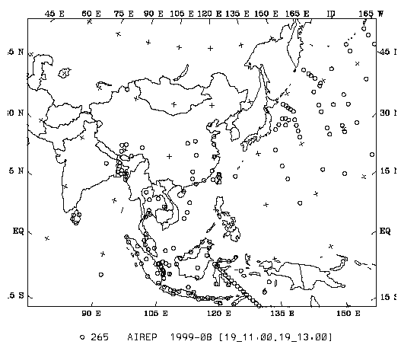
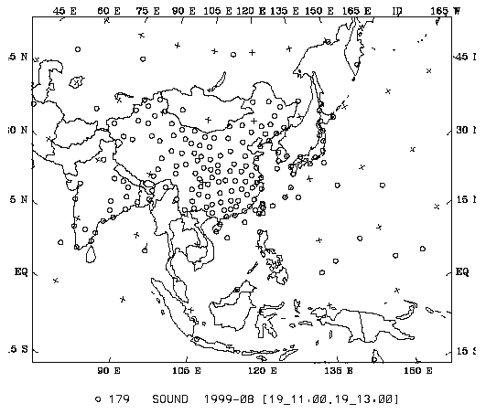
Distribution for each type of observations

Slide 24
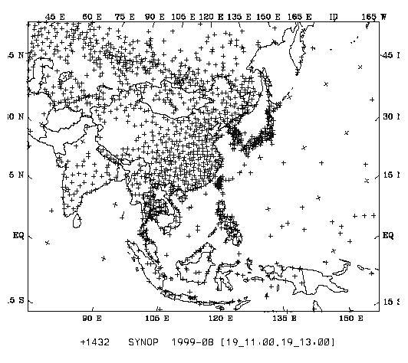
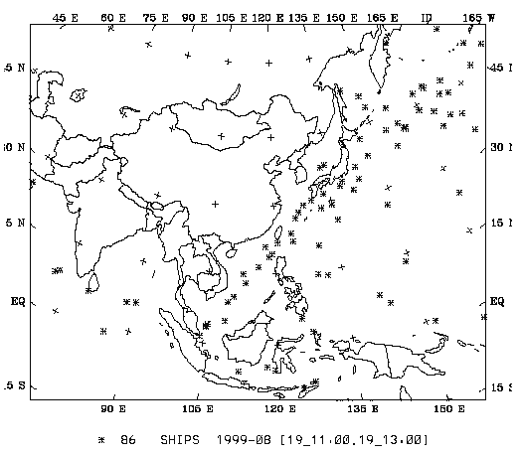
Distribution for each type of observations

Slide 25
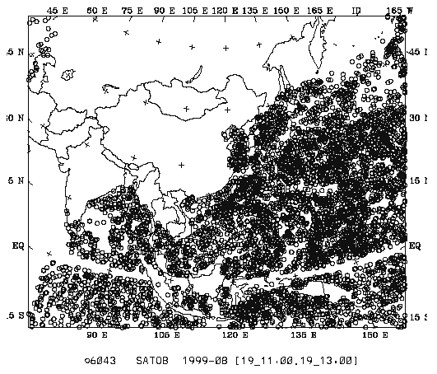
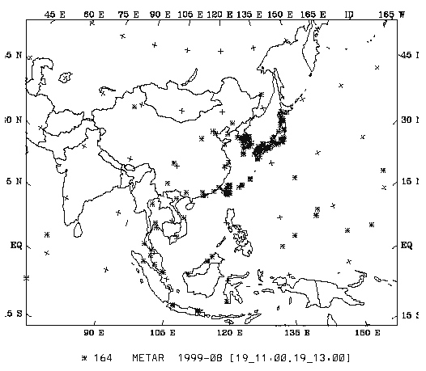
Distribution for each type of observations

Slide 26
Radar data input file to WRFVar
TOTAL RADAR (14X, I3) – FMT = (A14,I3)
#---------------------------------------------------------------------------------------------------------------
Head record for specific Radar information (site, lat0, lon0, elv, date, # of data locations, max_levs)
– FMT = (A5,2X,A12,2(F8.3,2X),F8.1,2X,A19,2I6)
#----------------------------------------------------------------------------------------------------------------
Head record for the specific location (FM-128 RADAR, date, lat, lon, elv, levs)
-- FMT=(A12,3X,A19,2X,2(F12.3,2X),F8.1,2X,I6)
Data-level record (height<m>, Radial_V<m/s>, qc, err, Reflectivity<dbz>, qc, err)
Data-level record (height<m>, Radial_V<m/s>, qc, err, Reflectivity<dbz>, qc, err)
………………………………………………………………………………………
– FMT=(3X,F12.1,2(F12.3,I4,F12.3,2X))
Head record for specific Radar information (site, lat0, lon0, elv, date, # of data locations, max_levs)
#----------------------------------------------------------------------------------------------------------------
Head record for the specific location (FM-128 RADAR, date, lat, lon, elv, levs)
Data-level record (height<m>, Radial_V<m/s>, qc, err, Reflectivity<dbz>, qc, err)
Data-level record (height<m>, Radial_V<m/s>, qc, err, Reflectivity<dbz>, qc, err)
………………………………………………………………………………………

Slide 27
TOTAL RADAR = 2
#------------------------------------------------------------------------------#
RADAR JINDO 126.328 34.471 499.0 2002-08-31_00:00:00 5706 9
#------------------------------------------------------------------------------#
FM-128 RADAR 2002-08-31_00:00:00 34.314 124.003 499.0 2
3803.5 7.918 1 0.500 17.704 1 1.125
7480.6 -888888.000 -88 -888888.000 -888888.000 -88 -888888.000
FM-128 RADAR 2002-08-31_00:00:00 34.360 124.002 499.0 2
3795.2 7.125 1 0.500 18.214 1 1.160
7467.1 -888888.000 -88 -888888.000 -888888.000 -88 -888888.000
FM-128 RADAR 2002-08-31_00:00:00 34.405 124.000 499.0 2
3790.2 6.714 1 0.598 14.864 0 0.707
7459.0 -888888.000 -88 -888888.000 -888888.000 -88 -888888.000
FM-128 RADAR 2002-08-31_00:00:00 35.275 123.974 499.0 2
4325.9 4.118 0 0.500 16.650 0 3.959
8315.9 -888888.000 -88 -888888.000 -888888.000 -88 -888888.000
..................................................................................................................................................
RADAR JINDO 126.328 34.471 499.0 2002-08-31_00:00:00 5706 9
#------------------------------------------------------------------------------#
FM-128 RADAR 2002-08-31_00:00:00 34.314 124.003 499.0 2
3803.5 7.918 1 0.500 17.704 1 1.125
7480.6 -888888.000 -88 -888888.000 -888888.000 -88 -888888.000
FM-128 RADAR 2002-08-31_00:00:00 34.360 124.002 499.0 2
3795.2 7.125 1 0.500 18.214 1 1.160
7467.1 -888888.000 -88 -888888.000 -888888.000 -88 -888888.000
FM-128 RADAR 2002-08-31_00:00:00 34.405 124.000 499.0 2
3790.2 6.714 1 0.598 14.864 0 0.707
7459.0 -888888.000 -88 -888888.000 -888888.000 -88 -888888.000
FM-128 RADAR 2002-08-31_00:00:00 35.275 123.974 499.0 2
4325.9 4.118 0 0.500 16.650 0 3.959
8315.9 -888888.000 -88 -888888.000 -888888.000 -88 -888888.000
..................................................................................................................................................

Slide 28
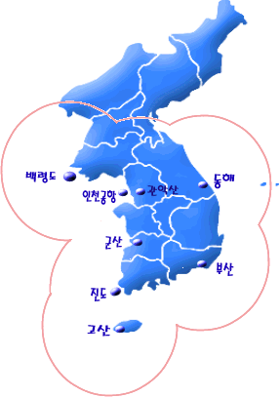
KMA Radar sites
References for Radar data assimilation
with WRFVar
Xiao, Q., Y.-H. Kuo, J. Sun, W.-C. Lee, D. M. Barker, and Eunha Lim, 2006: An approach of radar reflectivity data assimilation and its assessment with inland QPF of Typhoon Rusa (2002) at landfall, J. Appl. Meteor., in press.
Xiao, Q., Y.-H. Kuo, J. Sun, W.-C. Lee, Eunha Lim, Y.-R. Guo, and D. M. Barker, 2005: Assimilation of Doppler radar observations with aregional 3D-Var system: Impact of Doppler velocities on forecasts of a heavy rainfall case. J. Appl. Meteor., 44, 768-788.
GwangDuk
(S-band)
Backryungdo
Gwanak
Donghae
Incheon Int’l Airport
Gunsan
MyunBong
Busan
Jindo
(S-band)
Jejudo

Slide 29
Flow chart for preprocessing
Lon, Lat, Z coordinate
JNI
SPRINT
CEDRIC
dBZ
GDK
SPRINT
CEDRIC
Make a composite map
res.: 0.02º x0.02º x 0.5km
domain: Fig. 1
dBZ
dBZ
Vr
RKJK
SPRINT
CEDRIC
dBZ
Vr
RKSG
SPRINT
CEDRIC
Quality control
reflectivity >= 10 dBZ
Neglect location where
no. of data layers < 5
- Fig. 2
WRFVar
Forecast
- With IAU
Thinning
Select one at every 12 pts
dx = about 24km
Fig. 1
Velocity unfolding
reference velocity : 3hr forecast
from 10km model
- Fig. 3
Verification
- Fig.4

