Slide 1


WRF Boundary Relaxation
WRF uses a boundary relaxation applied in a ”nudging” of model tendencies, following Davies and Turner (1977):
X_{lbc} is the corresponding boundary value provided by the host model, which
is speciﬁed in the following form:

Slide 2
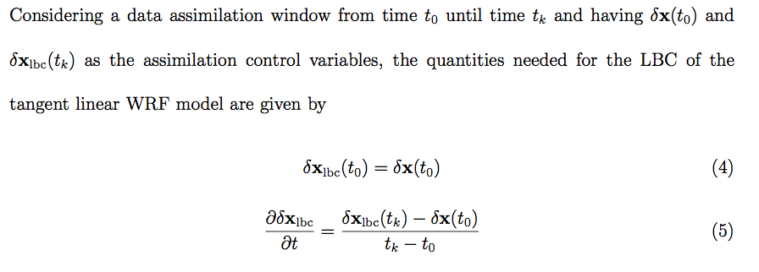
4D-Var LBC control

Slide 3
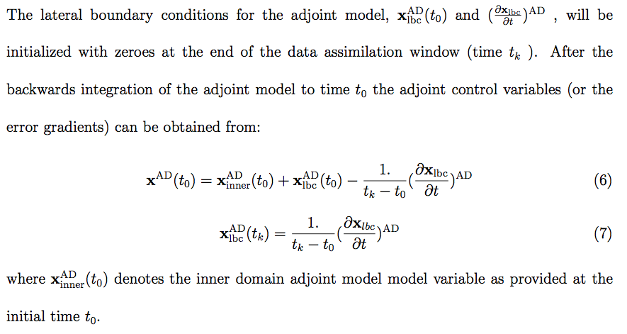
4D-Var LBC control (Cont’d)

Slide 4
Validation Experiment 1
A single 500hPa Temperature observation at 6 hour which is far from the boundary

Slide 5
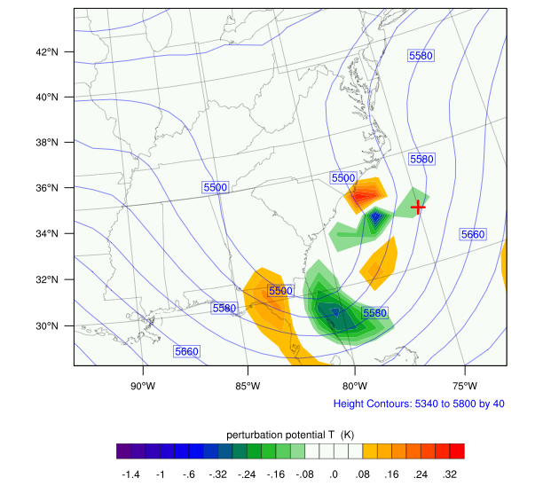
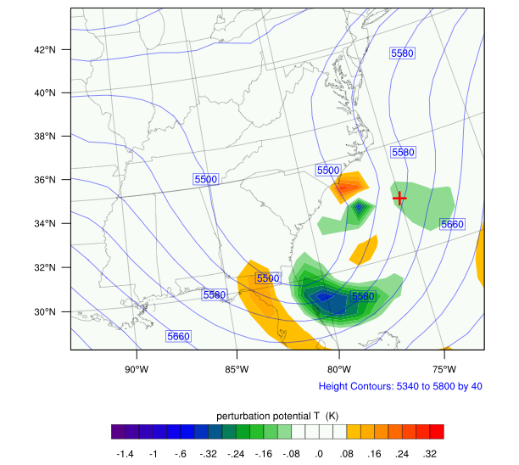
Perturbation Potential Temperature at 0 hour
Without LBC control
With LBC control
+ is the location of T observation at 6 hour

Slide 6
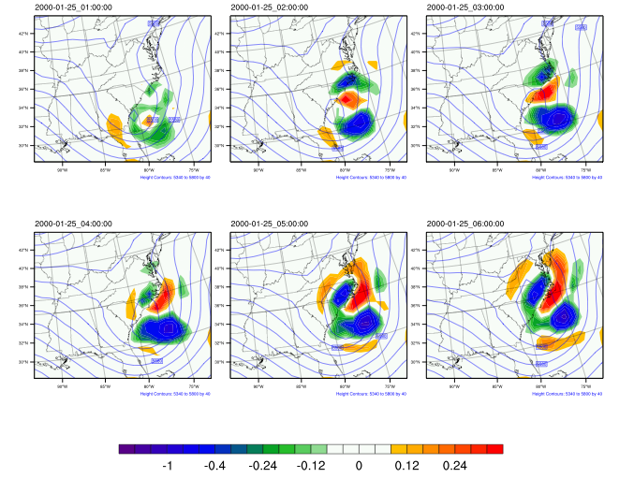
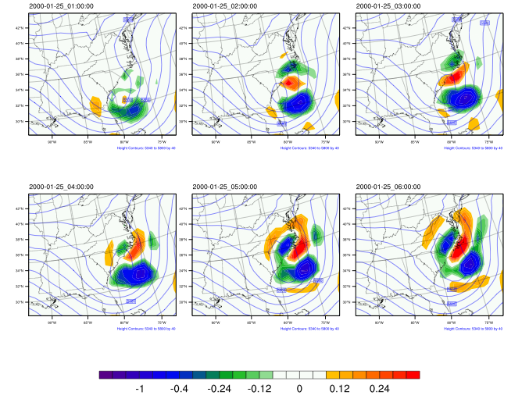
Perturbation Potential Temperature at 1-6 hour
Without LBC control
With LBC control

Slide 7
Remark
The Final J_{lbc} is increased from 0 to 0.01;
LBC control does have some impact on the initial potential temperature perturbation since it close to the boundary relaxation zone;
For the 1-6 hour perturbation evolution, they are almost the same no matter the LBC control is used or not, which implies that the LBC doesn't change the minimization too much.

Slide 8
Validation Experiment 2
A single 500hPa Temperature observation at 6 hour which is close to the boundary

Slide 9
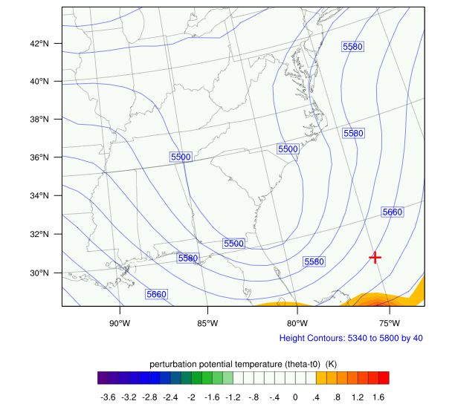
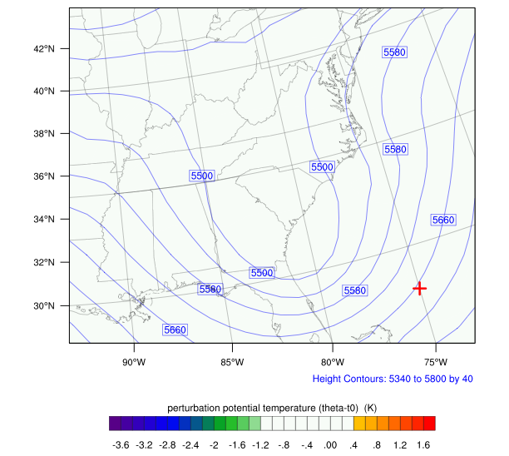
Perturbation Potential Temperature at 0 hour
Without LBC control
With LBC control
+ is the location of T observation at 6 hour

Slide 10
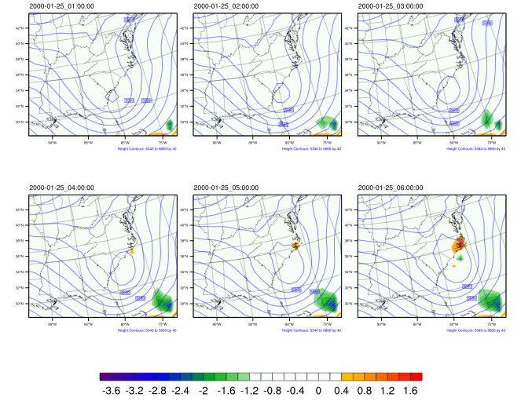
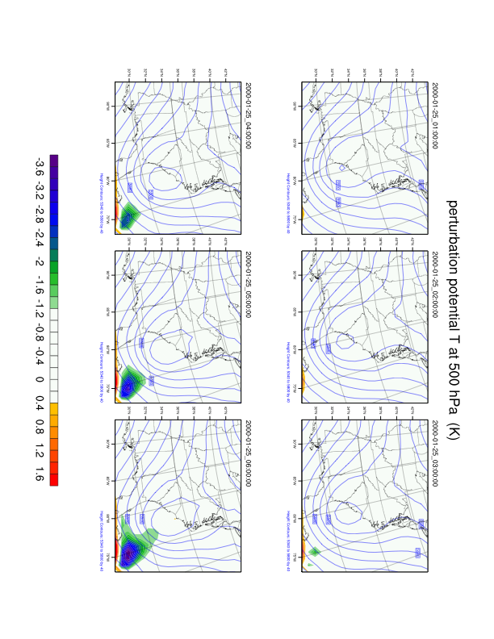
Perturbation Potential Temperature at 1-6 hour
Without LBC control
With LBC control

Slide 11
Remark
The Final J_{lbc} is increased from 0 to 0.5;
LBC control has significant impact on the initial potential temperature perturbation;
Based on the flow field, the response of the 6 hour observation should be outside the domain. If the LBC participate the minimization, the main analysis response will be in LBC, otherwise, some fake or overestimated responses will be appeared in IC along the south boundary;
For the 1-6 hour perturbation evolution, there is a strong tendency entering into the south boundary with LBC control, and location of the 6 hour perturbation is much better than that w/o LBC control.

