Slide 1
WRF-Var System
WRF Tutorial
July 25th 2006
Syed RH Rizvi
MMM Division, NCAR,
PO Box 3000, Boulder, Colorado,
80307-3000, USA
rizvi@ucar.edu
Web Site: http://www.mmm.ucar.edu/wrf/WG4

Slide 2
WRF-Var in the
WRF Modeling System

Slide 3
WRF-Var in the WRF Modeling System
WRF-Var
Blue = Supported by WRF-Var Team

Slide 4
WRF-Var in the WRF Modeling System
1. Prepare BE data (initially use default statistics)
WRF-Var
Background
Error
(default data)
P_{f}
Blue = Supported by WRF-Var Team

Slide 5
WRF-Var in the WRF Modeling System
2. Prepare background (run SI/real).
x^{lbc}
Background
Preprocessing
(SI, real)
x^{b}
Cold-Start Background
WRF-Var
Background
Error
(default data)
P_{f}
Blue = Supported by WRF-Var Team

Slide 6
WRF-Var in the WRF Modeling System
3. Prepare observations (run 3DVAR_OBSPROC).
x^{lbc}
Background
Preprocessing
(SI, real)
x^{b}
Cold-Start Background
Observation
Preprocessing
(3DVAR_OBSPROC)
yº
WRF-Var
Background
Error
(default data)
P_{f}
Blue = Supported by WRF-Var Team

Slide 7
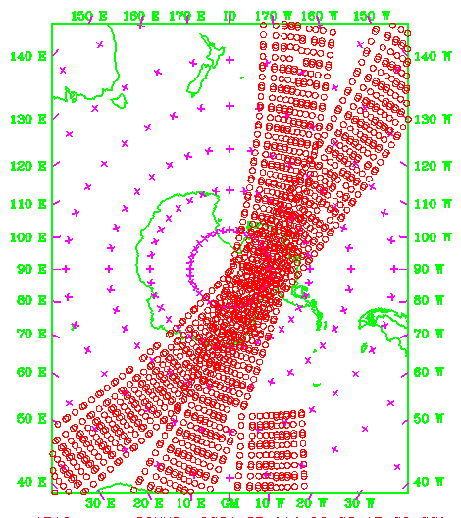
Observation Preprocessing (3DVAR_OBSPROC)
Reads in observation files from decoders/GTS.
Performs gross QC, e.g. domain/time,
consistency, duplicate, merging.
Simple thinning option.
Assign observation errors.
Outputs in text “3D-Var format” for further
QC and assimilation in WRF-Var.
Plots observation distributions.
Note: Work under way to convert to BUFR,
rather than text files.
Example thinned AIRS distribution
00 UTC 15th May 2004 (+/-2hrs):

Slide 8
WRF-Var in the WRF Modeling System
4. Run WRF-Var.
x^{lbc}
Background
Preprocessing
(SI, real)
x^{b}
Cold-Start Background
Observation
Preprocessing
(3DVAR_OBSPROC)
yº
WRF-Var
xª
Background
Error
(default data)
P_{f}
Blue = Supported by WRF-Var Team

Slide 9
WRF-Var in the WRF Modeling System
5. Run WRF_BC.
x^{lbc}
Background
Preprocessing
(SI, real)
x^{b}
Cold-Start Background
Observation
Preprocessing
(3DVAR_OBSPROC)
yº
WRF-Var
xª
Update Lateral
& Lower BCs
(WRF_BC)
Background
Error
(default data)
P_{f}
Blue = Supported by WRF-Var Team

Slide 10
WRF-Var in the WRF Modeling System
6a. Run forecast (cold-start mode).
x^{lbc}
Background
Preprocessing
(SI, real)
x^{b}
Cold-Start Background
Observation
Preprocessing
(3DVAR_OBSPROC)
yº
WRF-Var
xª
Update Lateral
& Lower BCs
(WRF_BC)
Forecast
(WRF)
Background
Error
(default data)
P_{f}
Blue = Supported by WRF-Var Team

Slide 11
WRF-Var in the WRF Modeling System
6b. Run forecast (cycling mode).
x^{lbc}
Background
Preprocessing
(SI, real)
x^{b}
Cycled Background
Observation
Preprocessing
(3DVAR_OBSPROC)
yº
WRF-Var
xª
Update Lateral
& Lower BCs
(WRF_BC)
Forecast
(WRF)
Background
Error
(default data)
P_{f}
Blue = Supported by WRF-Var Team

Slide 12
Cold-Start/Cycling Use of WRF-Var
Initial/“one-off”” tests of WRF-Var and WRF will adopt the “cold-start” method.
However, there are a number of advantages in using the “cycling” approach:
1. The analysis is better balanced (background/subsequent model are the same).
Typically, the cycled background will contain higher resolution information.
Fewer spin-up problems (e.g. hydrometeors are initialized to zero in SI/real).
Improvements (and degradations!) will accumulate through subsequent cycles.
The assimilation is cleaner (no danger of assimilating observations twice).
Therefore, cycling WRF-Var/WRF is the ultimate goal!
Warning: If you are only assimilating a sub-set of the observations available to
the cold-start background (e.g. global analysis), you may find you cannot beat
“noobs” (I.e. running WRF from real output). In this case, use “cold-start” mode.

Slide 13
Background Error (BE) Estimation in WRF-Var
The number 1 question from WRF-Var users is
“What background error covariances are best for my application?”.
Procedure:
Use default statistics files supplied with code (MM5, GFS-based).
Create your own, once you have run your system for ~a few weeks.
Implement, tune, and iterate.
A new utility gen_be has been developed at NCAR to calculate BEs.

Slide 14
WRF-Var in the WRF Modeling System
7. WRF-Var/WRF Ultimate Configuration!
x^{lbc}
Background
Preprocessing
(SI, real)
x^{b}
Cycled Background
Observation
Preprocessing
(3DVAR_OBSPROC)
yº
WRF-Var
xª
Update Lateral
& Lower BCs
(WRF_BC)
Forecast
(WRF)
Background
Error
(gen_be)
P_{f}
Blue = Supported by WRF-Var Team

Slide 15
WRF-Var Code Overview

Slide 16
WRF-Var
WRF-Var
START
Namelist
File
x^{b}
P_{f}
yº
Setup
Frame
Read
Namelist
Setup
Background
Setup
Background
Errors
Setup
Observations
Compute
Analysis
Minimize Cost Function
Calculate
O-B
“Outer Loop”
Calculate
Diagnostics
Output
Analysis
Tidy Up
Diagnostics
File
xª
WRF-Var
END

Slide 17
Setup Frame
Reads grid dimensions from “namelist.input” file.
Use WRF framework’s distributed memory capability to initialize tile, memory, patch dimensions, etc.

Slide 18
WRF-Var
WRF-Var
START
Namelist
File
x^{b}
P_{f}
yº
Setup
Frame
Read
Namelist
Setup
Background
Setup
Background
Errors
Setup
Observations
Compute
Analysis
Minimize Cost Function
Calculate
O-B
“Outer Loop”
Calculate
Diagnostics
Output
Analysis
Tidy Up
Diagnostics
File
xª
WRF-Var
END

Slide 19
Read Namelist
Reads WRF-Var data assimilation options from “namelist.3dvar” file.
“namelist.3dvar” file is created automatically at run-time by the DA_Run_WRF_Var.csh script in wrfvar/run.
Performs consistency checks between namelist options.

Slide 20
namelist.3dvar
&record1
MODEL_TYPE = 'WRF',
WRITE_INCREMENTS = .FALSE. ,
GLOBAL = .FALSE.,
PRINT_DETAIL = 0 /
&record2
ANALYSIS_TYPE = '3D-VAR',
ANALYSIS_DATE = '2004-05-01_00:00:00.0000',
ANALYSIS_ACCU = 900 /
&record3
fg_format = 1,
ob_format = 2,
num_fgat_time = 1 /
&record4
PROCESS_OBS = 'YES',
obs_qc_pointer = 0,
Use_SynopObs = .TRUE.,
Use_ShipsObs = .TRUE.,
Use_MetarObs = .TRUE.,
Use_PilotObs = .TRUE.,
Use_SoundObs = .TRUE.,
Use_SatemObs = .TRUE.,
Use_GeoAMVObs = .TRUE.,
Use_PolarAMVObs = .TRUE.,
Use_AirepObs = .TRUE.,
Use_GpspwObs = .TRUE.,
Use_GpsrefObs = .TRUE.,
Use_ProfilerObs = .TRUE.,
Use_BuoyObs = .TRUE.,
Use_SsmiRetrievalObs = .FALSE.,
Use_SsmiTbObs = .FALSE.,
use_ssmt1obs = .FALSE.,
use_ssmt2obs = .FALSE.,
use_qscatobs = .TRUE.,
use_radarobs = .FALSE.,
Use_Radar_rv = .FALSE.,
Use_Radar_rf = .FALSE.,
check_max_iv = .FALSE.,
use_obs_errfac = .FALSE.,
put_rand_seed = .FALSE.,
omb_set_rand = .FALSE.,
omb_add_noise = .FALSE. /
&record11
minimisation_option = 2,
write_outer_loop = .FALSE.,
lat_stats_option = .FALSE.,
calculate_cg_cost_function = .FALSE.,
cv_options = 3,
cv_options_hum = 3,
check_rh = 2,
as1 = 0.25, 0.75, 1.5,
as2 = 0.25, 0.75, 1.5,
as3 = 0.25, 0.75, 1.5,
as4 = 0.25, 0.75, 1.5,
as5 = 0.25, 0.75, 1.5,
sfc_assi_options = 1,
set_omb_rand_fac = 1.0,
seed_array1 = 0,
seed_array2 = 0 /
&record12
balance_type = 1 /
&record13
vert_corr = 2,
vertical_ip = 0,
vert_evalue = 1,
max_vert_var1 = 99.0,
max_vert_var2 = 99.0,
max_vert_var3 = 99.0,
max_vert_var4 = 99.0,
max_vert_var5 = 99.0 /
&pseudo_ob_nl
num_pseudo = 0,
pseudo_x = 165.0,
pseudo_y = 65.0,
pseudo_z = 15.0,
pseudo_val = 1.0,
pseudo_err = 1.0,
pseudo_var = 'u' /
&record5
TIME_WINDOW = 3.,
/
&record6
max_ext_its = 1,
EPS = 1.E-02, 1.E-02, 1.E-02, 1.E-02, 1.E-02, 1.E-02, 1.E-02,,
NTMAX = 100,
NSAVE = 4,
WRITE_SWITCH = .FALSE.,
WRITE_INTERVAL = 5 /
&record7
RF_PASSES = 6,
VAR_SCALING1 = 1.0,
VAR_SCALING2 = 1.0,
VAR_SCALING3 = 1.0,
VAR_SCALING4 = 1.0,
VAR_SCALING5 = 1.0,
LEN_SCALING1 = 1.0,
LEN_SCALING2 = 1.0,
LEN_SCALING3 = 1.0,
LEN_SCALING4 = 1.0,
LEN_SCALING5 = 1.0 /
&record8
def_sub_domain = .FALSE.,
x_start_sub_domain = 55.0,
y_start_sub_domain = 35.0,
x_end_sub_domain = 80.0,
y_end_sub_domain = 60.0 /
&record10
Testing_3DVAR = .FALSE.,
Test_Transforms = .FALSE.,
Test_Statistics = .FALSE.,
Interpolate_Stats = .TRUE. /

Slide 21
WRF-Var
WRF-Var
START
Namelist
File
x^{b}
P_{f}
yº
Setup
Frame
Read
Namelist
Setup
Background
Setup
Background
Errors
Setup
Observations
Compute
Analysis
Minimize Cost Function
Calculate
O-B
“Outer Loop”
Calculate
Diagnostics
Output
Analysis
Tidy Up
Diagnostics
File
xª
WRF-Var
END

Slide 22
Setup Background (First-Guess)
Reads in the first-guess field.
Format depends on namelist option “fg_format” – 1 = WRF, 2 = MM5, etc.
Extracts necessary fields.
Creates background FORTRAN 90 derived data type “xb” e.g. xb % mix, xb % u(:,:,:), ….

Slide 23
WRF-Var
WRF-Var
START
Namelist
File
x^{b}
P_{f}
yº
Setup
Frame
Read
Namelist
Setup
Background
Setup
Background
Errors
Setup
Observations
Compute
Analysis
Minimize Cost Function
Calculate
O-B
“Outer Loop”
Calculate
Diagnostics
Output
Analysis
Tidy Up
Diagnostics
File
xª
WRF-Var
END

Slide 24
Setup Background Errors
Reads in background error statistics.
Format depends on namelist option “cv_options” – 2=MM5, 3 = GFS-based, 4=Global, 5=WRF regional.
Extracts necessary quantities – eigenvectors, eigenvalues, lengthscales, regression coefficients, etc (see gen_be talk).
Creates background error FORTRAN 90 derived data type “be” e.g. be % v1 % evec(:,:), be % v2 % eval(:), etc, ….

Slide 25
WRF-Var
WRF-Var
START
Namelist
File
x^{b}
P_{f}
yº
Setup
Frame
Read
Namelist
Setup
Background
Setup
Background
Errors
Setup
Observations
Compute
Analysis
Minimize Cost Function
Calculate
O-B
“Outer Loop”
Calculate
Diagnostics
Output
Analysis
Tidy Up
Diagnostics
File
xª
WRF-Var
END

Slide 26
Setup Observations
Reads in observations.
Format depends on namelist variable “ob_format” – 1 = BUFR, 2 = ASCII “WRF-Var” format.
Creates observation FORTRAN 90 derived data type “ob” e.g. ob % num_gpspw, ob % metar(:), ob % sound(:) % u(:), etc, ….
Identifies Obs outside/inside the domain

Slide 27
WRF-Var
WRF-Var
START
Namelist
File
x^{b}
P_{f}
yº
Setup
Frame
Read
Namelist
Setup
Background
Setup
Background
Errors
Setup
Observations
Compute
Analysis
Minimize Cost Function
Calculate
O-B
“Outer Loop”
Calculate
Diagnostics
Output
Analysis
Tidy Up
Diagnostics
File
xª
WRF-Var
END

Slide 28
Calculate Innovation Vector (O-B)
Calculates “model equivalent” B of observation O through interpolation and change of variable.
Computes observation minus first guess (O-B) value.
Creates innovation vector FORTRAN 90 derived data type “iv” e.g. iv % metar(:), iv % qscat(:) % u, etc, ….

Slide 29
WRF-Var
WRF-Var
START
Namelist
File
x^{b}
P_{f}
yº
Setup
Frame
Read
Namelist
Setup
Background
Setup
Background
Errors
Setup
Observations
Compute
Analysis
Minimize Cost Function
Calculate
O-B
“Outer Loop”
Calculate
Diagnostics
Output
Analysis
Tidy Up
Diagnostics
File
xª
WRF-Var
END

Slide 30
Minimize Cost Function
a) Initializes analysis increments to zero.
b) Computes cost function.
c) Computes gradient of cost function.
d) Uses cost function and gradient to calculate new value of control variable v
e) Iterate b) to d).

Slide 31
WRF-Var “Inner Loop”
Control Variable (CV) Transform: x’=Uv
Linear Model (LM) Integration: x’(t)=Mx’(t₀)
Switch on in 4D-Var mode
Observation Operator: y’=Hx’
Minimize J
Cost Function J = Jb(v) + Jo(y’)
Adjoint Observation Operator: x’_{adj}=H^{T}y_{adj}
Adjoint LM Integration: x’_{adj} (t₀) =M^{T}x’_{adj}(t)
Adjoint CV Transform v_{adj}=U^{T}x_{adj}
Cost Function Gradient = Jb(v) + Jo(v_{adj} )

Slide 32
WRF-Var
WRF-Var
START
Namelist
File
x^{b}
P_{f}
yº
Setup
Frame
Read
Namelist
Setup
Background
Setup
Background
Errors
Setup
Observations
Compute
Analysis
Minimize Cost Function
Calculate
O-B
“Outer Loop”
Calculate
Diagnostics
Output
Analysis
Tidy Up
Diagnostics
File
xª
WRF-Var
END

Slide 33
Compute Analysis
Once WRF-Var has found a converged control variable, convert to model space analysis increments.
Calculate analysis = first-guess + analysis increment.
Performs consistency checks e.g. remove negative humidities from analysis.

Slide 34
WRF-Var
WRF-Var
START
Namelist
File
x^{b}
P_{f}
yº
Setup
Frame
Read
Namelist
Setup
Background
Setup
Background
Errors
Setup
Observations
Compute
Analysis
Minimize Cost Function
Calculate
O-B
“Outer Loop”
Calculate
Diagnostics
Output
Analysis
Tidy Up
Diagnostics
File
xª
WRF-Var
END

Slide 35
Compute Diagnostics
Compute O-B, O-A statistics for all observation types and variables.
Compute A-B (analysis increment) statistics for all model variables and levels.
Statistics include minimum, maximum (and their locations), mean and standard deviation.
Also compute “specialist diagnostics” for error tuning (fort.45, fort.46, fort.47, fort.50 etc.).

Slide 36
WRF-Var
WRF-Var
START
Namelist
File
x^{b}
P_{f}
yº
Setup
Frame
Read
Namelist
Setup
Background
Setup
Background
Errors
Setup
Observations
Compute
Analysis
Minimize Cost Function
Calculate
O-B
“Outer Loop”
Calculate
Diagnostics
Output
Analysis
Tidy Up
Diagnostics
File
xª
WRF-Var
END

Slide 37
Output Analysis
Outputs analysis in native model format. Choice made by namelist option fg_format – 1 = WRF, 2 = MM5, etc.
Also output analysis increments (for diagnostic purposes) in native model format. Switch off by setting DA_WRITE_INCREMENTS = .FALSE. in namelist.3dvar.

Slide 38
WRF-Var
WRF-Var
START
Namelist
File
x^{b}
P_{f}
yº
Setup
Frame
Read
Namelist
Setup
Background
Setup
Background
Errors
Setup
Observations
Compute
Analysis
Minimize Cost Function
Calculate
O-B
“Outer Loop”
Calculate
Diagnostics
Output
Analysis
Tidy Up
Diagnostics
File
xª
WRF-Var
END

Slide 39
Tidy Up
Deallocate dynamically-allocated arrays, structures, etc.
Timing information.
Clean end to WRF-Var.

Slide 40
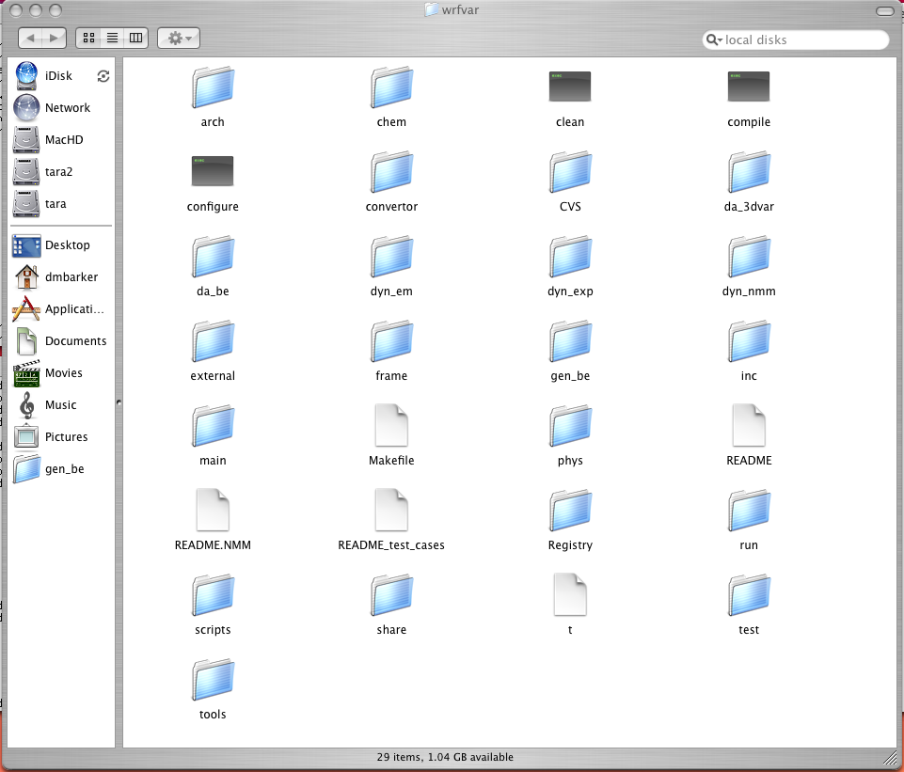
Source Code 1: wrfvar

Slide 41
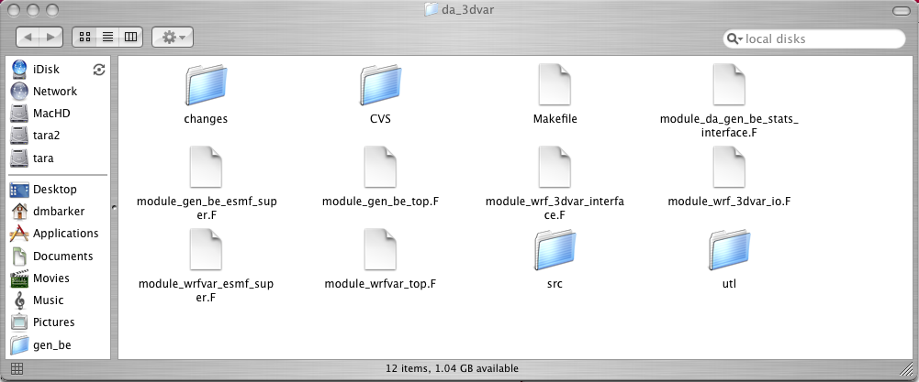
Source Code 2: wrfvar/da_3dvar

Slide 42
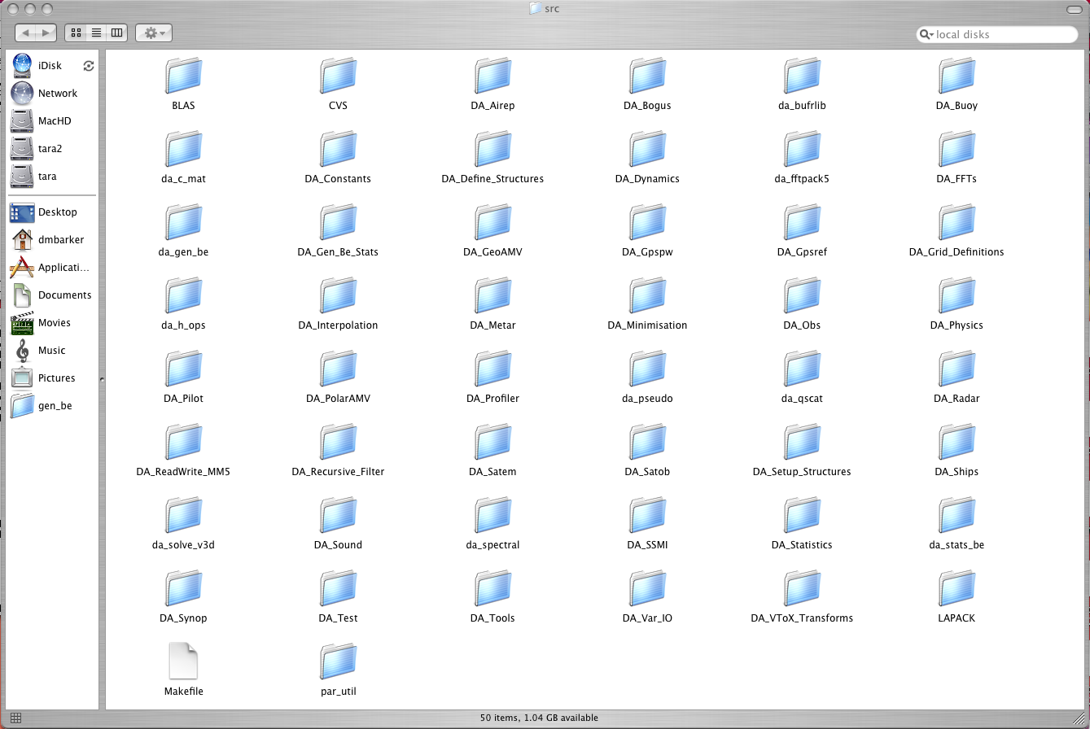
Source Code 3: wrfvar/da_3dvar/src

Slide 43
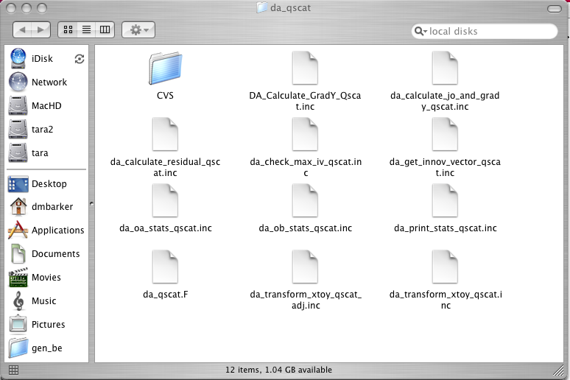
Source Code 4: wrfvar/da_3dvar/src/da_qscat

Slide 44
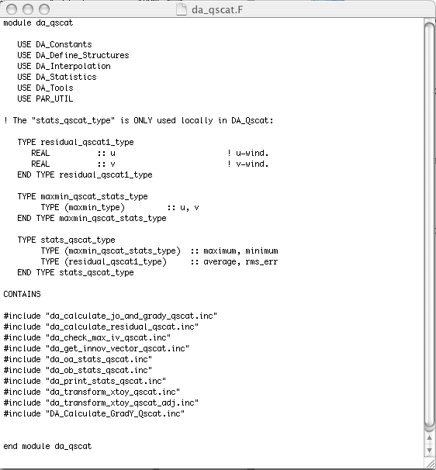
Source Code 5: wrfvar/da_3dvar/src/da_qscat/da_qscat.F

Slide 45
Procedure for adding new Observations
Edit DA_Define_Structure.F to add new data type.
Make new observation sub-directory under “src”.
Develop desired programs like getting innovation vector, forward observation operator, tangent linear & its adjoint, gradient & cost function etc. in this new sub-directory.
Input observation (update DA_Obs).
Sometimes it might be needed to add certain grid arrays in Registry.
Link into minimization package (DA_Minimisation)

Slide 46
DA_Run_WRF-Var.csh (summary)
# USER: Define non-default job via environment variables:
e.g.: setenv START_DATE 2004050200 overrides the default.
##########################################################################
#USER: DO NOT MAKE CHANGES BELOW (if you do, you're on your own!)
##########################################################################
# [1.0] Specify default environment variables:
e.g. if ( ! $?START_DATE ) setenv START_DATE 2004050100 # Analysis date.
# [2.0] Perform sanity checks:
e.g. check input observation file exists
# [3.0] Prepare for assimilation:
Create WRF-Var V2.1 namelist file (namelist.3dvar).
Create WRF V2.1 namelist file (namelist.input).
#[4.0] Run WRF-Var:
e.g. mpirun -v -np 16 -nolocal -machinefile hosts ./wrfvar.exe >&! /dev/null

Slide 47
Learning To Use WRF-Var
Consult the documentation at:
http://www.mmm.ucar.edu/wrf/WG4
Run through the Online WRF-Var Tutorial available at
http://www.mmm.ucar.edu/wrf/WG4/wrfvar.htm
If still confused, ask questions - wrfhelp@ucar.edu

