Slide 1
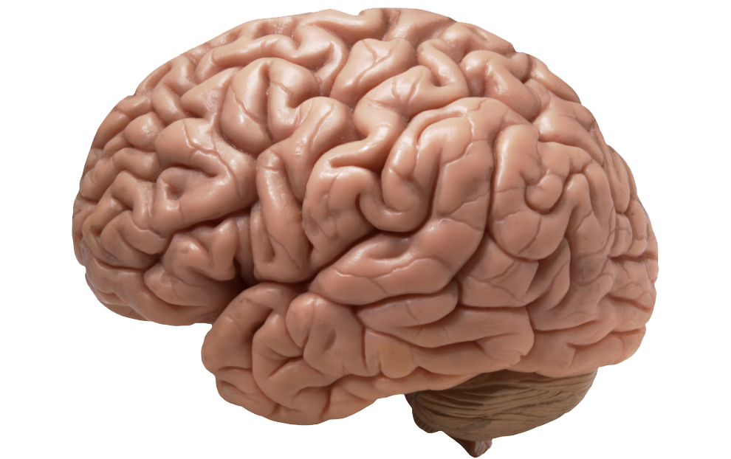
A Multi-pass approach to large –scale connectomics
Alex Fornito, Andrew Zalesky and Michael Breakspear

Slide 2

Opportunity
Progress in multi-beam EM imaging technology
Feasible to collect nanometer resolution imagery of a cubic millimeter of tissue

Slide 3
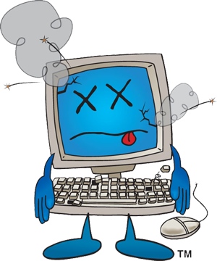
challenge
Machine learning algorithms used to process the images are slow
Balancing accuracy and time efficiency

Slide 4
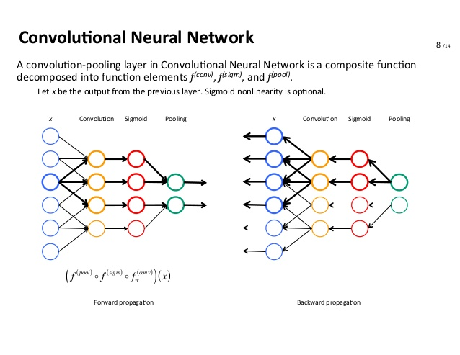
Action
CNNs
The Multi-pass Pipeline!

Slide 5
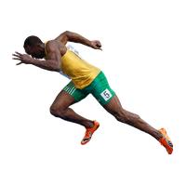
resolution
Kasthuri dataset comparison

Slide 6

feedback
Different types of classifiers
Not too long

