Slide 1
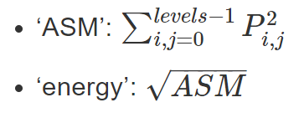
Synchallenge: Jenny Wu, Intro to Connectomics
Kept the percentile intensity feature, changed to 30 percentile
Added canny feature to create an image of just the edges: changed thresholds to low 0.1 and high 0.4
Added Hessian matrix feature to compute the matrix for each pixel
Changed the grey level co-occurrence matrix feature property from ‘homogeneity’ to ‘energy’.
Final F1 score: 0.83

