Slide 1
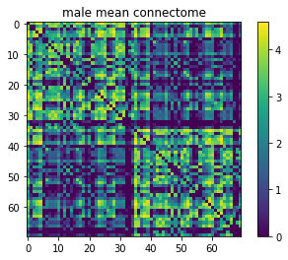
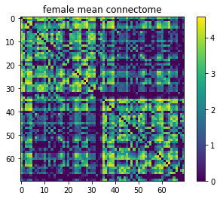
Classy Classification, The
0.678
Clustering
Node_connectivity
Triangles
Is_bipartite
Degree_centrality

