Slide 1
Mapping Memories in Mice Minds
By Dan, Nathan, Anthony, and Jenny
Intro to Connectomics

Slide 2
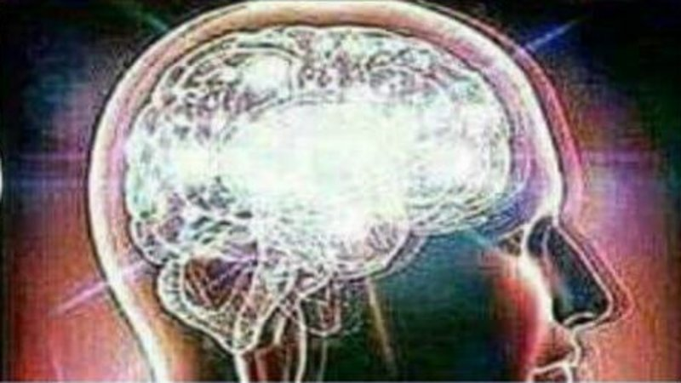
Inspiration
Goal: Understand cellular structure & connections that allow for formation, encoding, and storage of memories
Attempts to map brain memories have been limited

Slide 3
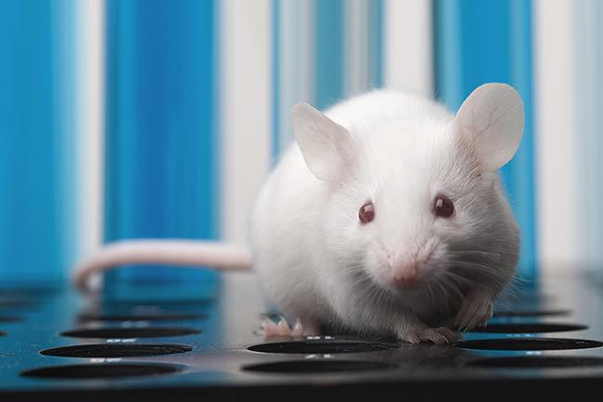
Steps
Train 30 mice to respond to reward-based stimuli
Pick highest performing mouse to image with Zeiss Crossbeam 550 FIB-SEM
Create brain graphs
Build neural network modeling original mouse brain
Convert network to virtual simulations
Use simulations to conduct experiments & compare to original mouse

Slide 4
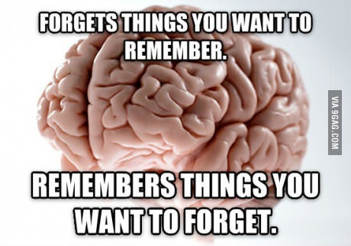
Costs & Practicality
Lab Location: Send Request for Proposals
Data Upload/Storage: $200 million for 60 months via AWS
Amazon Glacier: $0.004 per GB
FIB-SEM Mouse Imaging: $2.075 billion
Projected cost of virtual simulation: $6.851 billion
CLARITY light microscopy technique can later be used to analyze a wider array of mice

