Slide 1
Statistical Inference on Errorfully observed graphs
Priebe et al.
Presented by Darius Irani

Slide 2
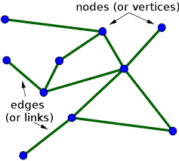
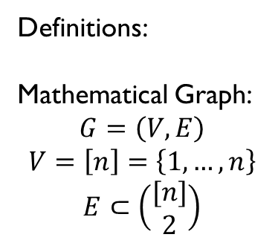
Opportunity
Definitions:
Mathematical Graph:
$$G=\left(V,E\right)$$
$$V=\left[n\right]=\left\{1,…,n\right\}$$
$$E⊂\left(\begin{matrix}[n] \\ 2\end{matrix}\right)$$
Statistical graph inference is a burgeoning field
Complex systems can be modeled, and information extracted using mathematical graphs
Technological advancement has enlarged our datasets – lots to be learned

Slide 3
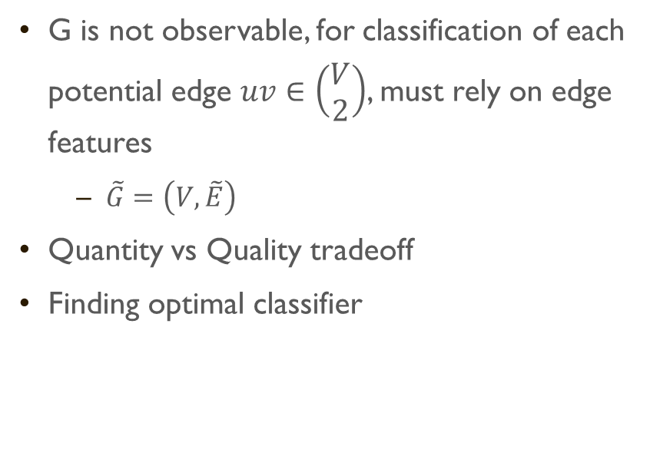
Challenge
G is not observable, for classification of each potential edge $uv∈\left(\begin{matrix}V \\ 2\end{matrix}\right)$, must rely on edge features
$\tilde{G}=\left(V,\tilde{E}\right)$
Quantity vs Quality tradeoff
Finding optimal classifier

Slide 4
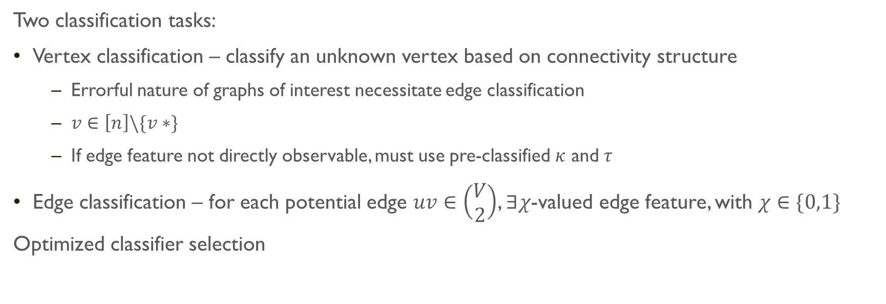
Action
Two classification tasks:
Vertex classification – classify an unknown vertex based on connectivity structure
Errorful nature of graphs of interest necessitate edge classification
$v∈\left[n\right]\backslash \{v∗\}$
If edge feature not directly observable, must use pre-classified $κ$ and $τ$
Edge classification – for each potential edge $uv∈\left(\begin{matrix}V \\ 2\end{matrix}\right)$, $∃χ$-valued edge feature, with $χ∈\{0,1\}$
Optimized classifier selection

Slide 5
Resolution
Framework for extracting information from errorfully observed graphs
Optimizing classifier selection for graph
Quantity/quality tradeoff in C. elegans connectome graph

Slide 6
Feedback/Future Work
Very informative and sequential presentation of statistical techniques
Illustrative examples in connectomics to demonstrate theoretical procedures
Presented a series of other techniques that could complement foundational methods discussed in paper, which could be subject of future research
Large sample approximation
Minimizing projection error
Missing model

Slide 7
Sources
Priebe, Carey E., Sussman, Daniel L., Tang, Minh., Vogelstein, Joshua T. 2012. “Statistical Inference on Errorfully Observed Graphs”. Journal of Computational and Graphical Statistics. 24.

