Slide 1
Connectomic reconstruction of the inner plexiform layer in the mouse retina
Presentation by Elliot Liu

Slide 2
Opportunity
Understanding neural wiring
Proximity ≠ Connectivity

Slide 3
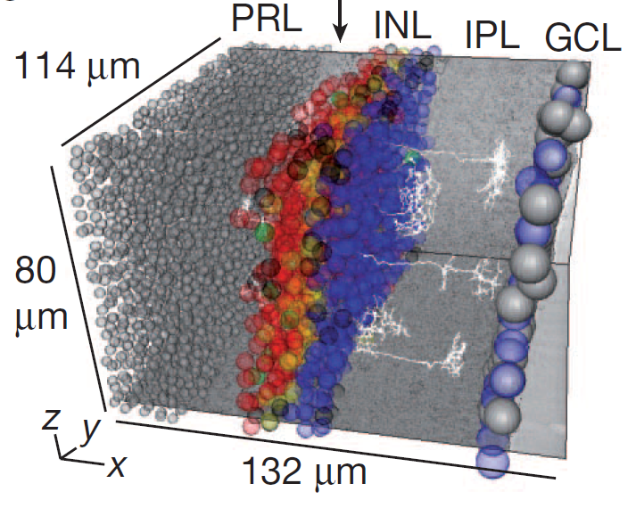
Challenge
Volume of data
1 million μm³ of data set
$10 million if traced by hand
electron microscopy technology

Slide 4
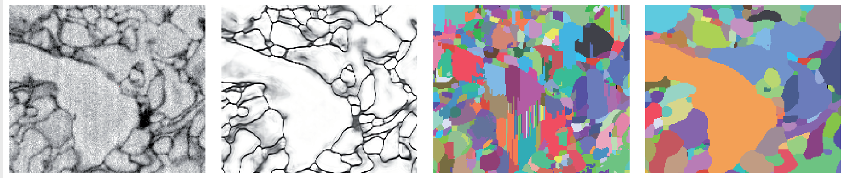
Action
“crowd-sourced manual annotation”
224 students (probably all undergrads)
“machine-learning-based boundary detection”
“automatic volume segmentation”
Raw data
Edge classifier
Initial segmentation
Iterated segmentation

Slide 5
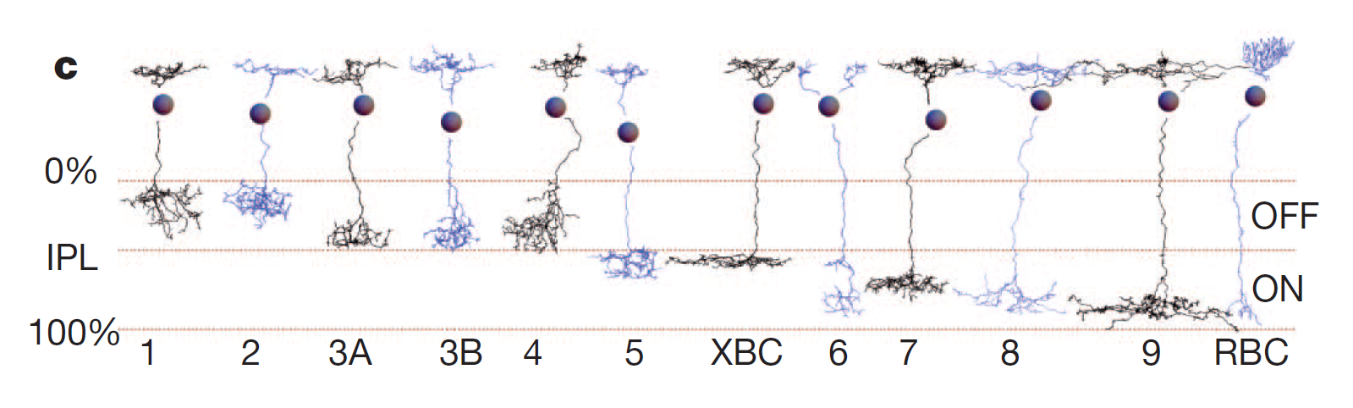
Resolution
Validated 10 known types of bipolar cells
Discovered a new type of bipolar cell, XBC
“luminance adaption pathway”

Slide 6
Resolution
Validated 10 known types of bipolar cells
Discovered a new type of bipolar cell, XBC
“luminance adaption pathway”
Found cases where nearby cells do not form synapse

Slide 7
Feedback
Good variety of vocabulary, some sentences rhyme
Good presentation for different audiences:
Clear abstract
graphs and charts in body
detailed method in appendix

Slide 8

Feedback
Good variety of vocabulary, some sentences rhyme
Good presentation for different audiences:
Clear abstract
graphs and charts in body
detailed method in appendix

