Slide 1
Human Connectomics across the Life Span
Xi-Nian Zuo, Ye He, Richard F. Betzel, Stan Colcombe, Olaf Sporns, and Michael P. Milham
Presented by Kevin Torgas

Slide 2
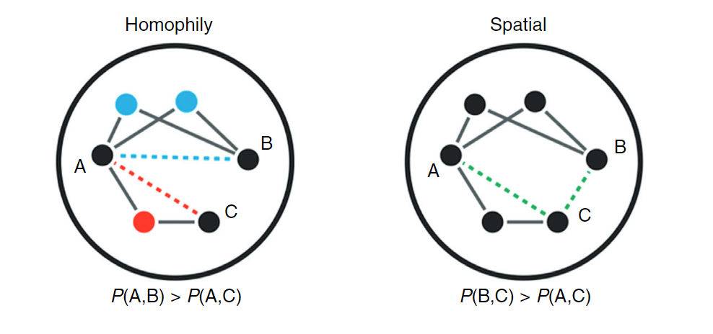
Opportunity - something awesome is happening, exploit it
The combination of different fields and the development of imaging techniques allowed us to study connectomes from a multidisciplinary approach
Graph theory and network science allows us to predict the behavior of connectomes in plasticity by considering the wiring penalty and homophily
By combining neurobiological and network science approaches, connectomes become more accurate and more informative

Slide 3
Challenge - it’s difficult though, why haven’t other people done it?
Test-Retest Reliability
Differences across individuals vs. differences in the same individual over time
Standardization and coordination across imaging studies
Software, hardware, data acquisition
Differences in confounding signals change with age
Motion and other sources of noise

Slide 4
Action - what did you do that was so awesome?
Changes in the Human Connectome over the lifespan
Inverted U shape of Grey and White matter
Higher order areas (eg. Prefrontal) show greater deterioration compared to sensorimotor areas
Connectivity in young vs old subjects
Pediatric studies showed increasing long range connectivity and decreasing short range connectivity
Aging studies showed decreasing long range connectivity
Functional connectivity remains in tact far longer than structural connectivity

Slide 5
Resolution - your result, and how it changes the world
Hunting down the source of mental illnesses
75% of mental illness originates before the age of 24
Precision Medicine and Care
Neurological ‘growth’ curves

Slide 6
Feedback/Future Work: What did you like about the paper? What didn't you like? AND/OR how can this be extended?
Very good at explaining relevant information from different fields
No example connectome or depiction of the inverted U trends
A visual example of this data would be very helpful

Slide 7
Reference
Human Connectomics across the Life Span
Zuo, Xi-Nian et al.
Trends in Cognitive Sciences , Volume 21 , Issue 1 , 32 - 45

