Slide 1
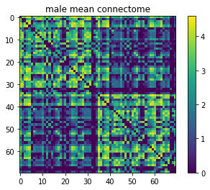
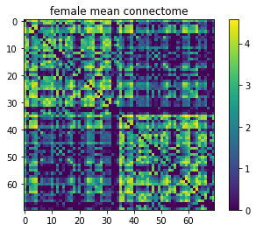
Classy Classification, The
0.66
Clustering,
Node_connectivity, Is_bipartite,
Triangles, Degree_centrality
Random Forest, SVM, Logarithmic Regression, Gradient-Boosted Decision Trees, Neural Network

