Slide 1
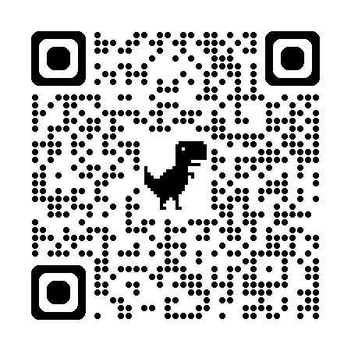
TEACHME · SOCRATIC SCENARIOS — RETRIEVAL-AUGMENTED OPERATIONAL TRAINING
PROTOTYPE · SIMULATION-VALIDATED
TeachMe— Retrieve for the learner,
not just the query.
TeachMe is a domain-agnostic platform for training users to operate complex, safety-critical equipment. It combines educational frameworks, agent-guided instruction, and retrieval from an expert-reviewed knowledge graph to provide grounded guidance, adaptive practice, and mastery-based progression.
A technician learning the Optomec HD2 — or a mariner learning the rules of the road — needs answers at the right level of complexity, with a guarantee that the system will never hallucinate a safety value. If a technician internalizes even one incorrect parameter during training, they may leave more dangerous than when they started.
Architecture Overview
Knowledge Graph
Learner Model
Retrieval
Mentor + Narrator
Instructional Modes
Typed nodes and edges
Proficiency + mastery gates
Graph + prompt enricher
Two agent architecture
Socratic, Scenario, Reach back, Lab
What’s Working Now
NEW: WE NOW MEASURE WHETHER THE TUTOR ACTUALLY USES ITS CORPUS (COMPANION POSTER)
01
02
03
04
Corpus-bound Narrator
Typed causal graph
Dual-axis mastery gates
Four modes, one progression
Reports machine behavior verbatim from reviewed graph nodes; cannot generate from model weights.
100+ nodes, six fault domains: Symptom→FailureMode→CorrectiveAction with SafetyHazard co-retrieved along the chain.
Declarative proficiency (Socratic probes) must clear before procedural practice; gates are transparent and auditable.
Socratic Practice → Scenario Mode (deterministic fault injection) → Reachback Lookup → Retrieval Lab.
→ so a technician can't internalize a hallucinated safety value; silent corpus shows the gap, never fabricates it.
→ so safety context travels with the diagnosis instead of being a separate lookup a flat store can miss.
→ so an instructor can point at a score and say exactly why the system advanced or held a learner.
→ so training load is sequenced and instructors inspect what retrieval will surface before a learner sees it.
Five-Level Expertise Continuum
One Engine, Three Domains
Naive
Proficient
EDDIE · Aerosol Jet Printing — flagship
Complete Novice
vocabulary only
YOU ARE HERE
SOPs + physics + cues
Optomec HD2 operator training; 100+ nodes, six fault domains, hazards co-retrieved.
no lab background
Roadside Tire Change
Novice
Intermediate
authored as graph + corpus alone — inherits probes, scenarios, gates, consequences.
eng. tech, new domain
supervised hands-on
COLREG Collision Avoidance
rules of the road + interactive simulator: real kinematics, Collision Risk Index, per-rule scoring.
→ so a new domain is an authoring task, not a software project.
IF THIS WORKS
TARGET
far-transfer performance on novel fault combinations vs. direct instruction — not yet measured on real learners; the Workflow Demo exists to de-risk this bet first.
A technician reaches independent, unsupervised operation faster and with fewer escalations — because training builds far-transfer diagnostic capability, not recall.
HOW WE KEEP OURSELVES HONEST
“In safety-critical training, ‘I don't know, but here's the SOP for this state’ beats a confident wrong answer.”
SIGNAL
WHAT IT CAN CLAIM
TRUST
CAN'T RULE OUT
Corpus-bound Narrator
Eliminates hallucinated machine behavior by construction — every observable traces to a reviewed node.
strong
states outside the authored fault domains aren't narratable (a coverage gap, made visible not hidden)
Dual-axis learner model
Transparent, auditable tutor decisions, inspectable in the Retrieval Lab.
strong
deliberately simpler than probabilistic knowledge tracing — may miss subtler learner states
Far-transfer outcome
PBL design targets far transfer to novel fault combinations.
weak
whether the simulated-learner loop predicts real technician outcomes
Corpus necessity audit
We test whether answers actually depend on the corpus — a calibrated screen, verified on five different base models, before any human trial.
strong
evidence is from simulation — it audits the tutor’s grounding, not how well humans learn
LEFT OUT ON PURPOSE free-running text generation. The Narrator can only quote the reviewed corpus — so no prompt, and no jailbreak, can make it invent machine behavior.
THE QUESTIONS WE'RE CHASING
How do we effectively use AI in high-consequence environments?
Q1 · Do learners trained on injected faults diagnose novel fault combinations better than those taught by direct instruction?
Q2 · Does passing a mastery gate predict safe, unsupervised operation on the real equipment?
Q3 · How far can the learning sciences take operational readiness in high-consequence work?
Mia Ndousse-Fetter
William Gray-Roncal
And Team
TeachMe · one engine, many domains — retrieve what teaches, not just what matches.
APL

