Slide 1
Curie
Sheetal Konnur and William Harrington

Slide 2
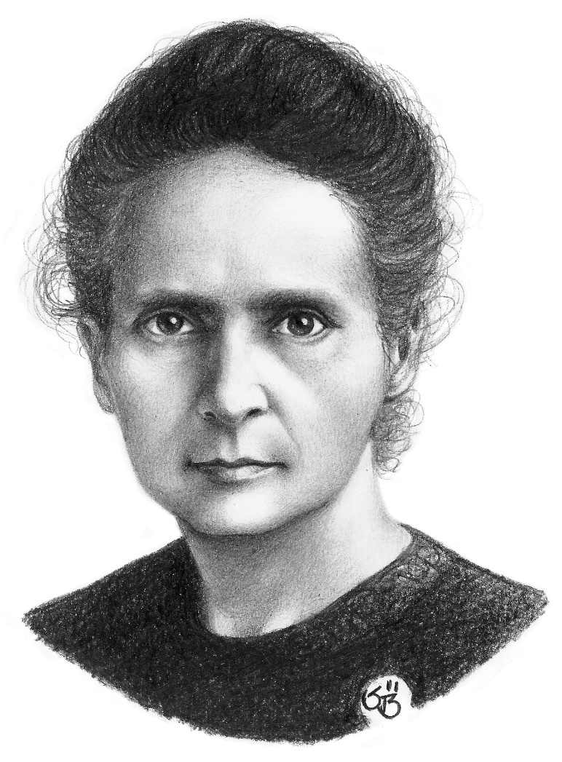
Marie Curie
Biography
Facial Gestures
Awards
Report

Slide 3
Biography
I am Marie, I was born in kingdom of Poland.
I am the pioneering researcher on radioactivity.
I am the first woman to win a Nobel Prize, the first person and only woman to win twice.
I am also the first woman to become a professor at the University of Paris.

Slide 4
Awards
Nobel Prize in Physics
Davy Medal (with Pierre)
Matteucci Medal (with Pierre)
Actonian Prize
Elliott Cresson Medal
Nobel Prize in Chemistry
Franklin Medal of the American Philosophical Society

Slide 5
Facial gestures
Happy
Normal
Confused
Surprised

Slide 6

Happy

Slide 7
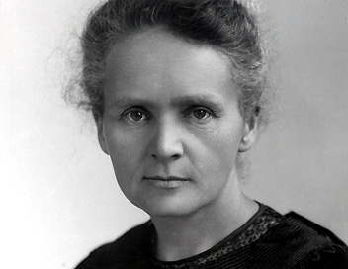
Normal

Slide 8

Confused

Slide 9

Surprised

