Slide 1
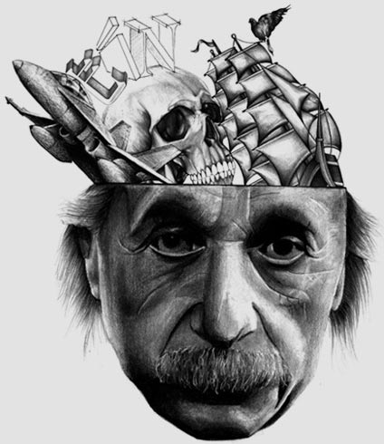
Do you think I am a genius?
The Great Quatum Debate play
How was your childhood?
Python Script
Did you ever learn to swim?
Did you ever wanted to become president?
Is the afterlife as you expected?

Slide 2

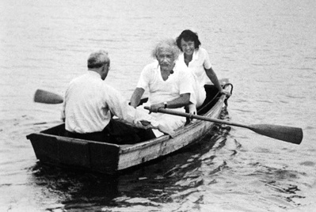
Nope, never stop me from Sailing!

Slide 3
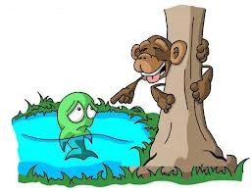
Everybody is genius. But if you judge fish by its ability to climb tree, it will live its whole life believing that it is stupid.

Slide 4
Python Script for Robot Actions

Slide 5
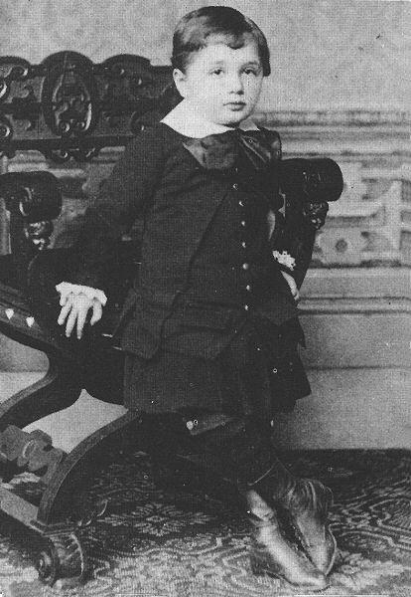
When born was thought to be monstrosity by my own mother due to my head having an unusual shape, too big in the back you see.
It was not until 4 years old did utter my first words , did so at such a slow pace that my parents thought I was a slow child.

Slide 6
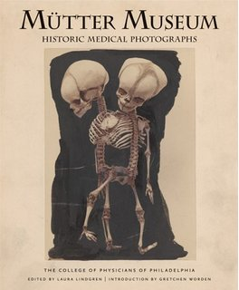
more traveling than when live. Due to my brain stolen when dead. sent all over the world. It has settle down at the Mutter Museum in Philadelphia, Pennsylvania.

Slide 7
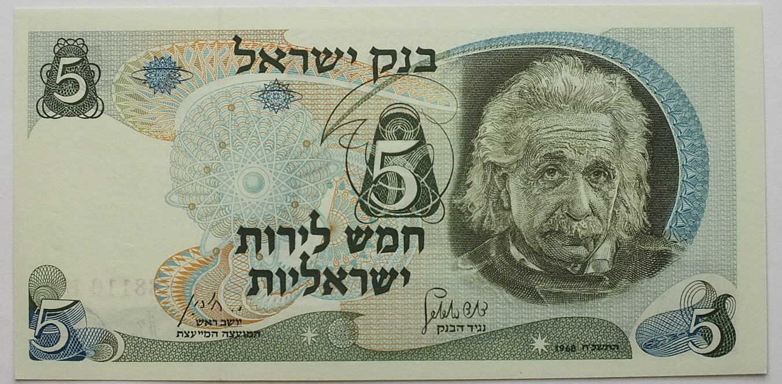
No, lacked natural aptitude and the experience to deal, properly with people. But that did not stop people from trying, you know was offer to be second president of Israel when seventy three old.

Slide 8
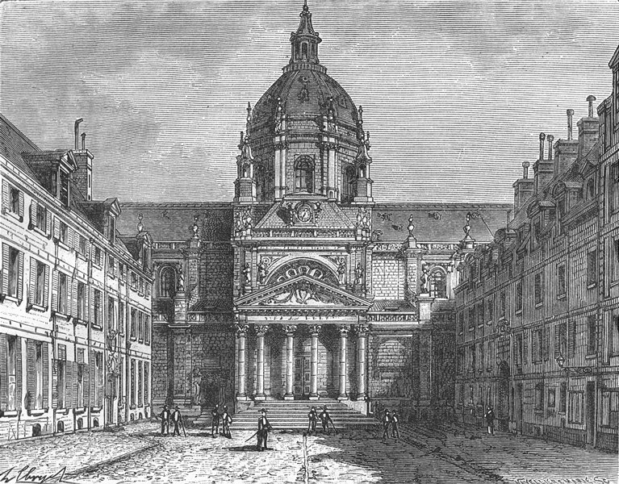
Act I part 2
Quantum Debate at Curie Laboratory, Sorbonne University in Paris, 1921.

Slide 9
Interaction 1.2. Switching randomly between behaviors
Need a button that uses fuzzy logic to determine next action

Slide 10
Newton attacks
Newton attacks, Einstein keeps distance
All initial and additional space is used for robots chasing one another, escaping, fighting and dancing without music with their bodies.
A hyperlink to go to slide 1.6B

Slide 11
Einstein attacks
Einstein attacks, Newton keeps distance
All initial and additional space is used for robots chasing one another, escaping, fighting and dancing without music with their bodies.
A hyperlink to go to slide 1.6B

Slide 12
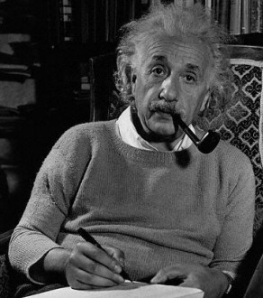
Slide 1.6B
Albert Einstein
Einstein1: (to Newton) You fool! (Einstein looks angry, jumps up and down towards Newton. Newton is much taller than Einstein) You, who claim to be better than all the rest of us, who claim that you are alone out of all the great people in the world, do not even realize the simple behaviors of relativity ….

Slide 13

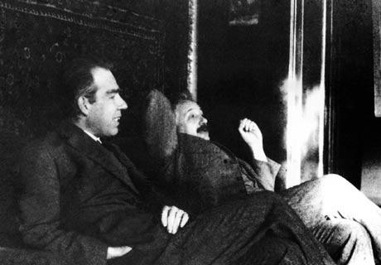
Slide 1.7:
Bohr disputes with Einstein, famous photo

Slide 14
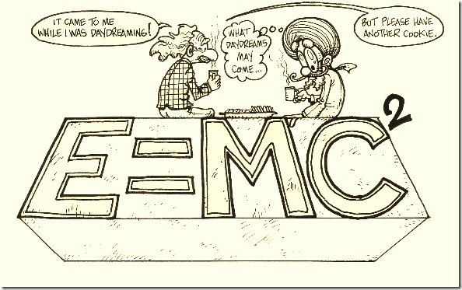
Slide 1.8:
Einstein Relativity Theory

Slide 15
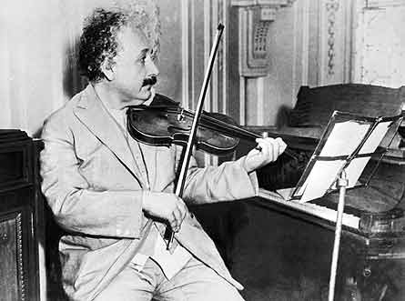
Einstein2: you know, we need some music now. I will play my violin, you Mary will play your all instruments and you (turns to cat, Newton and Bohr)…., I do not know. So, let’s visit Dr. Curie’s salon. (Departs stage with others in good mood)

Slide 16
Act II
Quantum Physics Jam Session

Slide 17
Einstein3 and Bohr. We are sorry, we just had some little conversation and we forgot about your invitation.
Einstein, Bohr and Marie (take their instruments and positions.)

Slide 18
Einstein4 (to Curie) Where is the restroom?
Curie (points with hand).
Einstein (leaves).

Slide 19
Einstein5: (just enters the room and hears this)
(Angrily, jumping up and down) I beg to differ! God does not play dice!

Slide 20
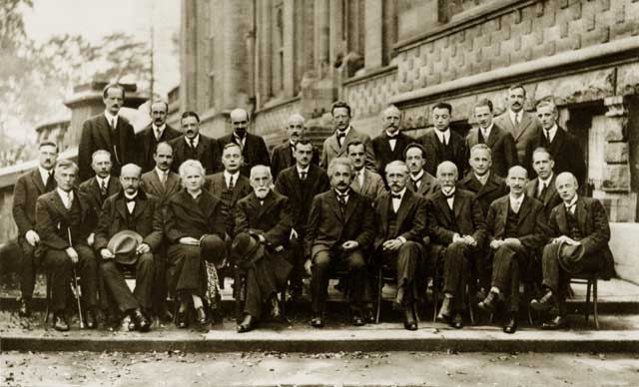
Slide 1.17:
Einstein, Newton, Bohr, SchrÖdinger or some other famous physicists
Interaction 2.2.
Cat is occupied with himself. Dances and sings, but not in center.
Newton communicates with Bohr. They both keep distance.
Never bounce, come close and go apart again.
Einstein turns or drives always to the person who talks but keeps distance.

Slide 21
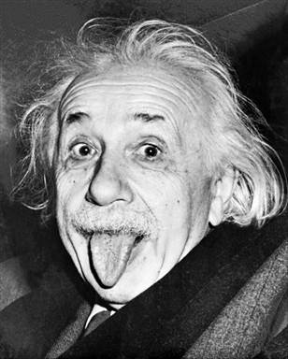
Slide 1.18:
Einstein with tongue out, famous photo.
Einstein6: (opens mouth in anger) Ehhh!

Slide 22
Slide 1.19:
Newton gravity and relativistic gravity
Einstein7: (patronizingly to Newton). Yes, it does. In fact, gravity does more at the cosmological level than even you had predicted.
However, according to Professor Schrödinger, her owner (points to Schrödinger’s cat), it does not have as big a role at the subatomic level.

Slide 23
Interaction 2.3.
Cat and Einstein in intense communication. Newton tries to break in. They all keep distances. Never bounce, come close and go apart again. The robot vision software prevents the robots from any collisions, despite fast and chaotic motion of all of them.

Slide 24
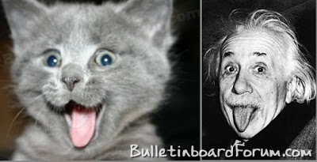
Slide 1.20
Einstein and Schrodinger Cat

Slide 25
Slide 1.21. Dark Energy, Space time
Einstein8 (not paying any attention to the cat or anybody else, continues)
However, contradictory to what you might have been expecting, the universe is expanding, as in, all the galaxies are moving apart so rapidly that you can see it on a telescope.
Another force, dark energy by name, pulls the galaxies apart more rapidly than gravity can pull them together.
I have discovered that space and time together form a four dimensional space. I have called this spacetime. Think of spacetime as a rubber sheet. When you place a large object, such as a star, on spacetime, it is like putting a large ball on a rubber sheet.

Slide 26
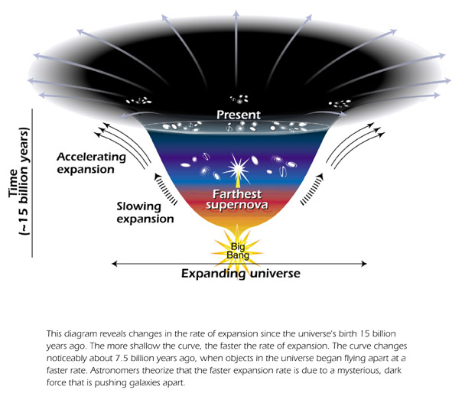
Slide 1.21. Dark Energy, Space time

Slide 27
Slide 1.23. Gravity and spacetime
Einstein9: (to the cat) You are not a star. Thus…, wait, what did I say?. Aha. (thinks to remind himself) The object makes a dent in the rubber sheet, and the paths of passing objects, such as planets, will change because of the dent. This is a basic model for gravity, and it is why the earth revolves around the sun. Now, because of gravity’s influence on spacetime, gravity can actually slow time around a large cosmological object such as a star. Evidence also shows that light will bend when passing through a gravitational field.

Slide 28
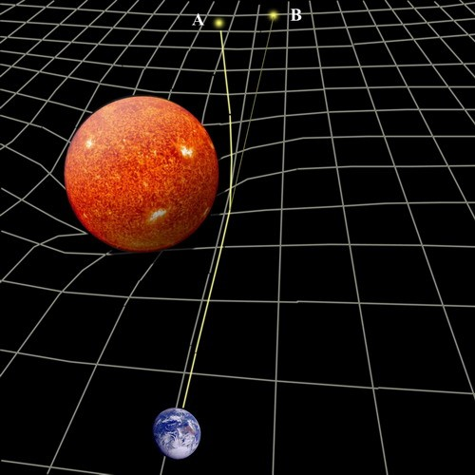
Slide 1.23. Gravity and spacetime

Slide 29
Interaction 2.5. Newton remains still in the middle of the stage. Einstein and Bohr come close. They seem to dance forward and backward, coming close and dancing around. Cat tries to be involved in their interaction.

Slide 30
Einstein10: Newton, you are the stupidest physics professor I have ever met! I have even to explain you what a Non-Euclidean geometry is. I think that you ought to replace your head.

Slide 31
Interaction 2.6. Newton stands still in the middle. Einstein and Bohr come close. They seem to dance forward and backward, coming close and dancing around. Cat tries to be involved in their interaction.

Slide 32
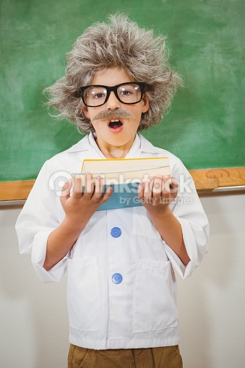
Slide 1.32
Photo of very surprised Einstein
Einstein11: (Muttering): Hm. It seems as if he really has changed his head!

Slide 33
Interaction 2.7. Newton dances quickly in the middle. Einstein and Bohr dance around him. Cat dances forward and backward, coming close and dancing around. Cat and Newton try to be involved in Einstein/Bohr interaction.

Slide 34
Slide 1.33.
Schrödinger Cat State – superposition
Einstein12: (losing control) SHUT UP!

Slide 35
Slide 1.35.
Measurement of Cat State together with God playing dice.
Interaction 2.8. Einstein dances in circles in the middle. Cat, Newton and Bohr dance in line around him. Cat however dances forward and backward, coming close and dancing around. Cat and Newton try to be involved in Einstein/Bohr interaction by random motions from time to time towards Einstein. Cat falls to sleep and is awaken from time to time.
Einstein13: (Angrily, pointing at Bohr) Here’s where I don’t believe you two. It cannot be that there are absolutely no laws governing the electron, that it can be anywhere. There must be something systematic! God does not play dice!

Slide 36
Slide 1.36.
Nucleus and the electron cloud.
Einstein14: Strange, ugh. (to the audience), let me give you an example of the full picture of quantum mechanics. (he is truly mad). You see, the atom consists of the nucleus and the electron cloud. Now, if the nucleus of an atom were the size of a poppy seed, the rest of the atom would be larger than a palace.
Einstein15: As I was saying, the atom is mostly empty space. Now, according to quantum theory, the nucleus could be anywhere inside the atom. Just think about it. This means that an atom can pass right through another one, because the empty spaces can line up. So, according to quantum theory, it is possible for us to walk straight through a wall. Although the chances are miniscule, it is possible that the nuclei of the wall and the nuclei of our body never touched if we walked at the wall. So, how can you simply call this ‘strange’? Quantum mechanics is like gluing an elephant, a gorilla, a snake, and a horse and calling it the finest creation of evolution.

Slide 37
Slide 2.37. Offended cat.
Interaction 2.9. Bohr stands in the middle. Cat sleeps and snores. Newton and Einstein dance in line around him, forward and backward, coming closer and further apart. Newton tries to be involved in Einstein/Bohr interaction by random motions from time to time towards Einstein. Bohr is angry and excited

Slide 38
Slide 2.38. Bohr, Einstein and Newton arguing.
Einstein16: (Angry) So what? How do you know that that other electron wasn’t just an escaped piece of beta radiation? According to you-

Slide 39
Slide 2.39. Some funny photo of a cat
EPR experiment and entanglement
Interaction 2.10. Cat is extremely excited. Dances and makes gestures towards other robots. Bohr in circles in the middle. Newton and Einstein dance in line around him, forward and backward, coming closer and further apart. Newton tries to be involved in Einstein/Bohr interaction by random motions from time to time towards Einstein. Bohr is angry and excited.

Slide 40
Slide 2.40. Einstein, Podolsky, Rosen paper and Entanglement

Slide 41
Einstein17: (sings and dances)
  If you understand, then show him the way
  And rescue his psyche from quantum decay.
  If you care about animal rights,
  Consider the horrible plights,
  Of Schrödinger’s cat,
  And others like that,
  For many long days and nights.

Slide 42
Interaction 2.12.
Einstein18: Come on, you again will talk about the war and your Radio-Medicine help to war victims?
Marie Curie: No, the case is even more dangerous than the past Great War. I allowed myself to invite one more guest. This individuum comes from future.
Einstein19: Is it a woman?
Bohr and Einstein20: How this can be?
Bohr and Einstein21: What can I do?
Einstein22: What can I do?
Countess Quanta Do not ask me. You know what you should do. And only you can do this. The politicians are stupid and uninformed. They will trust only you.
Einstein23: I will have to start working on practical atomic weapons? I am just a theoretician. I am famous as a pacifist. I was always against the war.

Slide 43
Marie Curie: You know American President Roosevelt. He is the only one who can do something.
Einstein24: And what if Americans will build the bomb and do the same as Hitler wanted? I will be responsible for this for all eternity.
Countess Quanta They have two choices. To use it or not. But if they have it first, Hitler will be restrained.
Einstein25: What Americans will do?
Countess Quanta You have to make a choice. You have to take responsibility. Regardless.
Einstein26: It is a great burden on my soul.
The scene ends with the feeling of incoming doom, hopefulness, sense of responsibility of scientists to save the world

Slide 44
Bohr (leaving): or if this guy is crazy?
Einstein27 (leaving, saying goodbay): this guy is a genius, it was reading my thougths. I have no choice.
Marie Curie sits in amazement. Silent. Cat, silent.
Einstein, Bohr leave to their selected responsible tasks.

Slide 45
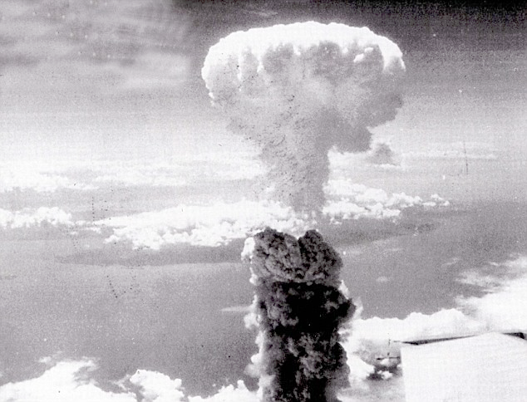
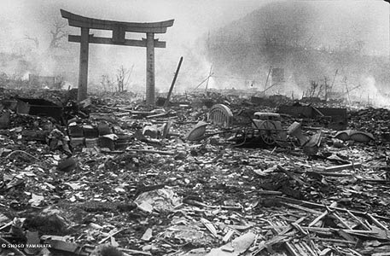
Slides Atomic Bombs Explosions in Hiroshima and Nagasaki
Newton sits and cries.
We hear explosion of bombs of the World War II and finally two atomic bomb explosions
.

Slide 46
Voice provided by:
www.ivona.com German, Hans
Kinect mouse program from:
Tom futuretechblog.com/?p=26

