Slide 1
Menjadi AGILE untuk menghadapi Era Digital yang Unpredictable
WRI - OPEN TALK
Tema “Develop People in Millennial Age”
Politeknik Negeri Malang
20 Oktober 2018

Slide 2
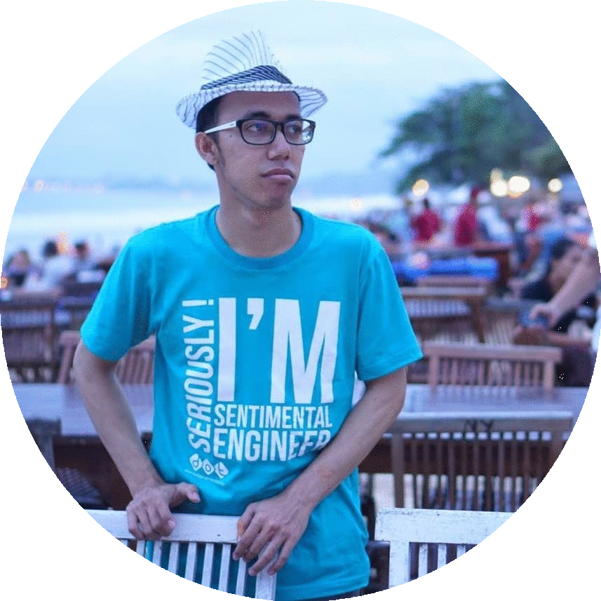
About Me
Misbakhul Mustofin (Tofin) [tofin@dot-indonesia.com]
DOT Indonesia Scrum Master
External:
Salah satu penggerak komunitas KelasMobile Malang dan Scrum Chapter Malang
Research Area : Internship, Agile & Scrum, Collaboration, Android Development, UI Design, Backend (Lumen)

Slide 3
Era Digital yang Unpredictable

Slide 4
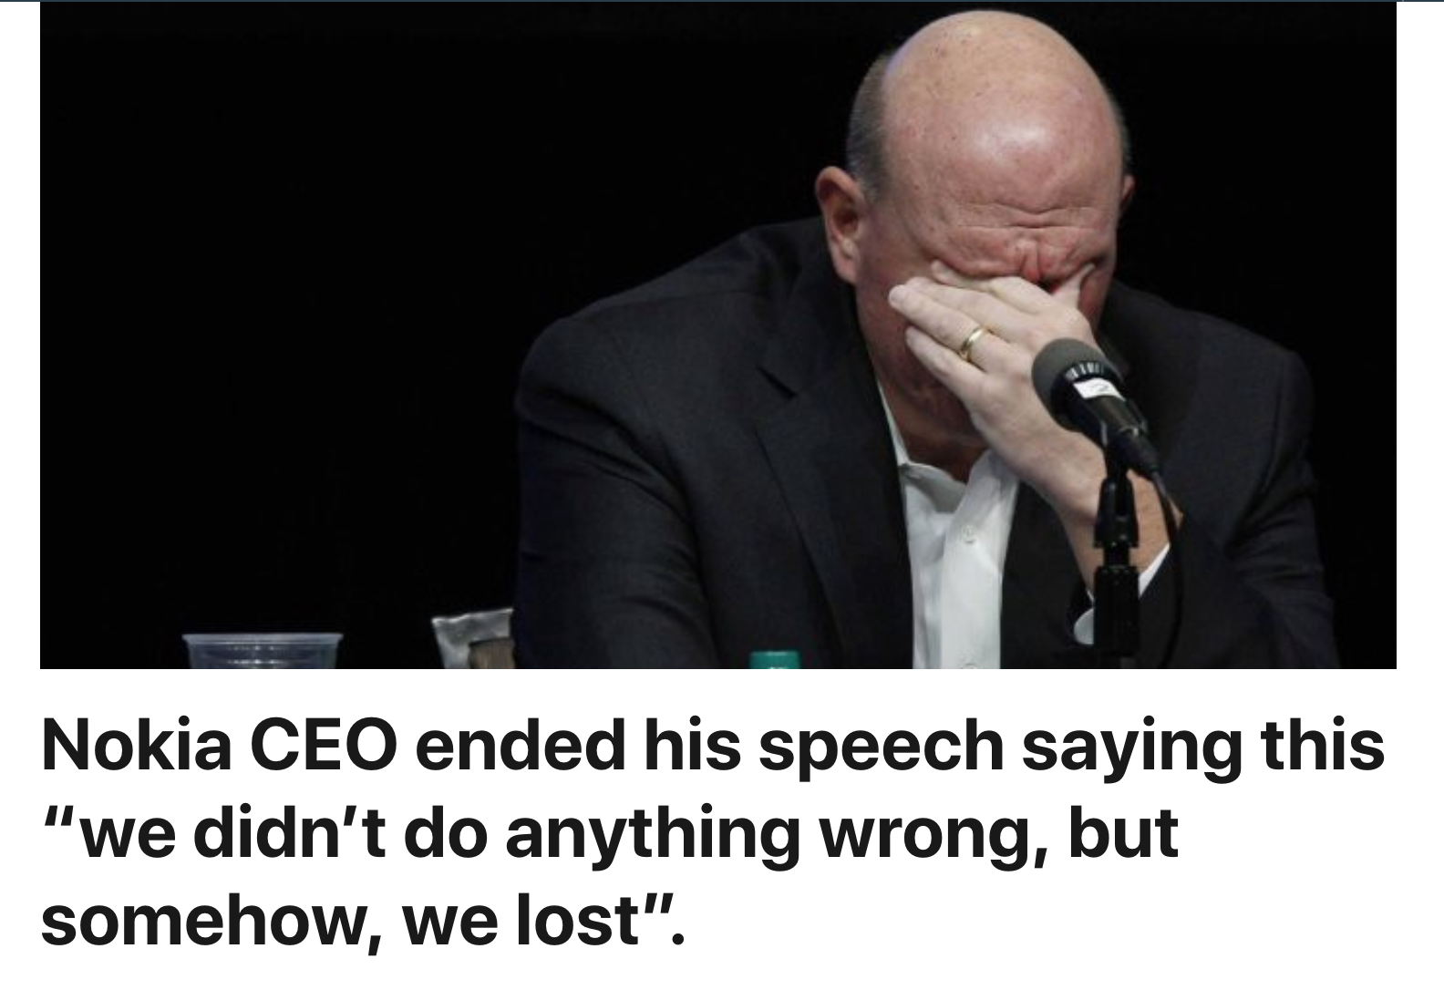
May 9, 2016
https://www.linkedin.com/pulse/nokia-ceo-ended-his-speech-saying-we-didnt-do-anything-rahul-gupta/

Slide 5
Nokia has been a respectable company. They didn’t do anything wrong in their business, however, the world changed too fast. Their opponents were too powerful.

Slide 6
They missed out on learning, they missed out on changing, and thus they lost the opportunity at hand to make it big. Not only did they miss the opportunity to earn big money, they lost their chance of survival.

Slide 7
The message of this story is, if you don’t change, you shall be removed from the competition.

Slide 8
It’s not wrong if you don’t want to learn new things. However, if your thoughts and mindset cannot catch up with time,
you will be eliminated.

Slide 9
another story...

Slide 10
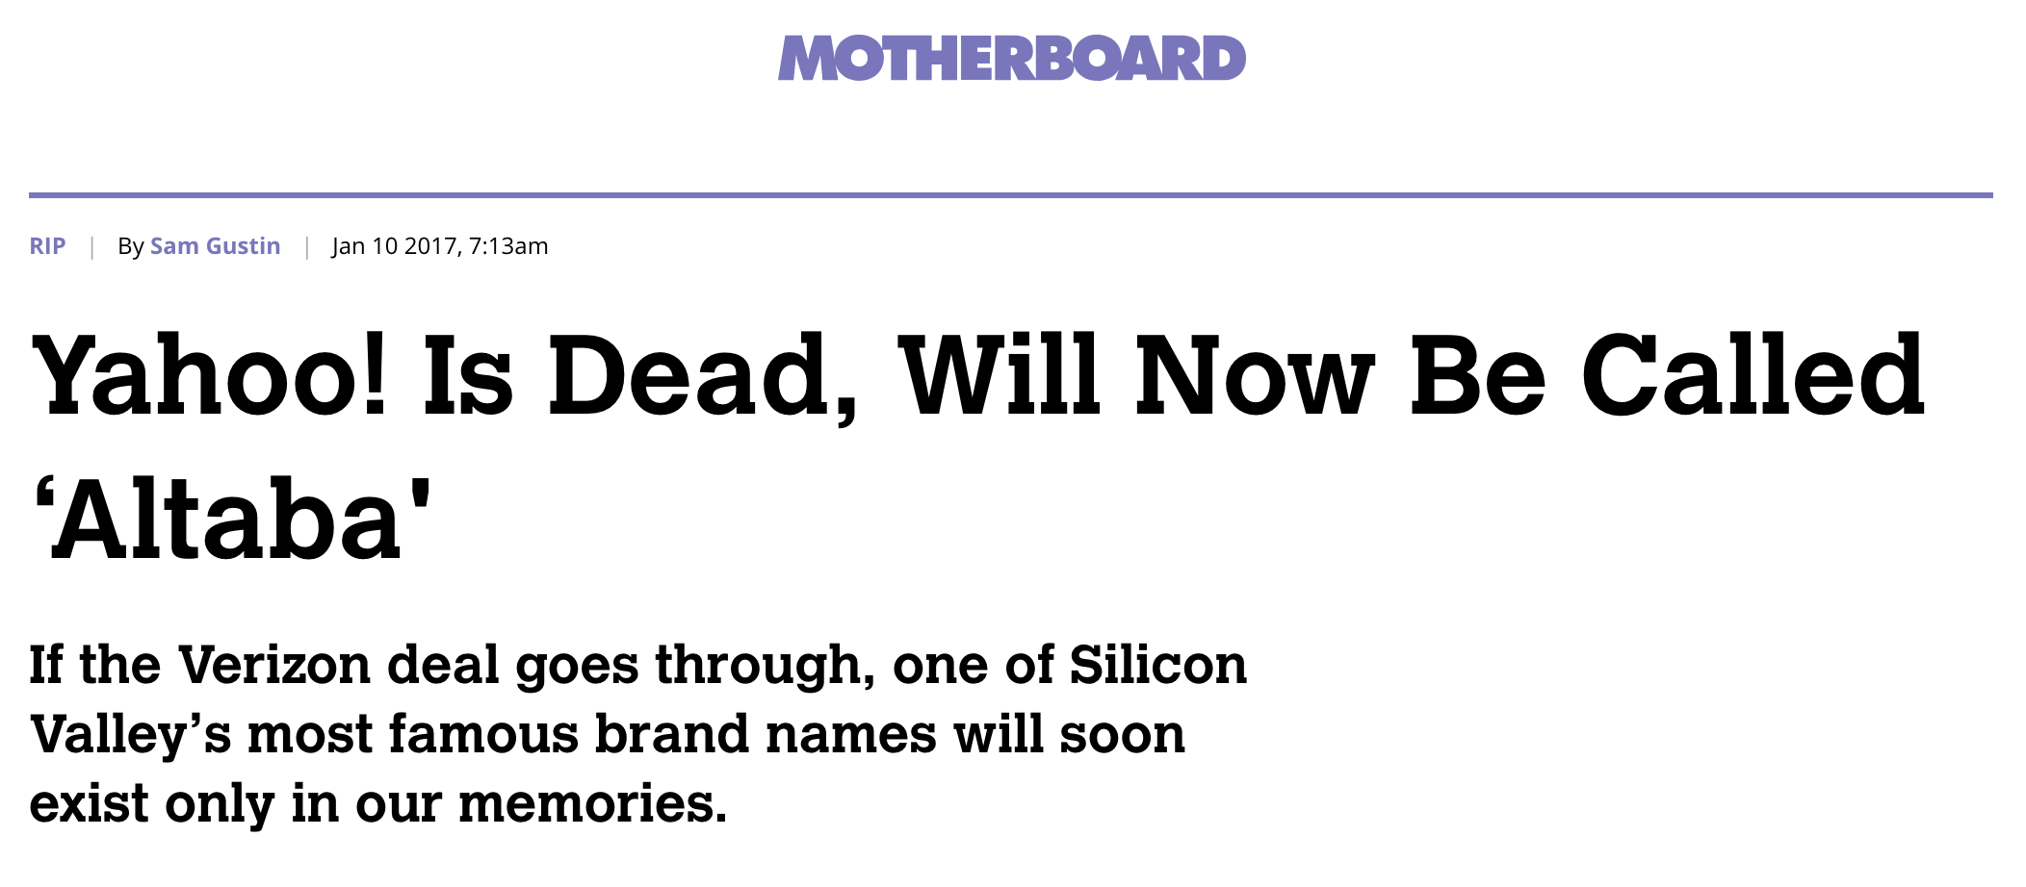
https://motherboard.vice.com/en_us/article/gv5339/yahoo-changing-name-to-altaba-once-vz-deal-closes
Jan 10 2017, 7:13am

Slide 11
Say goodbye to Yahoo.
The troubled internet giant announced in a public filing on Monday that it will change its name to Altaba following the $4.8 billion sale of its core business to telecom titan Verizon, marking the end of one of the most famous brand names in Silicon Valley history.

Slide 12
Being AGILE

Slide 13
AGILE
Menurut translate.google.com/#en/id/agile
tangkas
lincah
gesit
cerdas
cekatan
galir

Slide 14
AGILE
Menurut kakak tofin
Agile lebih ke sifat ADAPTIF dimana kita mampu beradaptasi dan menyikapi perubahan dengan lebih baik.

Slide 15
agilemanifesto.org
Individuals and interactions over processes and tools
Working software over comprehensive documentation
Customer collaboration over contract negotiation
Responding to change over following a plan

Slide 16
Framework Agile
Scrum
Kanban
Feature Driven Development (FDD)
Extreme Programming (XP)

Slide 17
Scrum
OPENESS
COURAGE
RESPECT
FOCUS
COMMITMENT

Slide 18
The Three Pillars of Empiricism (Scrum)
TRANSPARENCY
INSPECTION
ADAPTATION

Slide 19
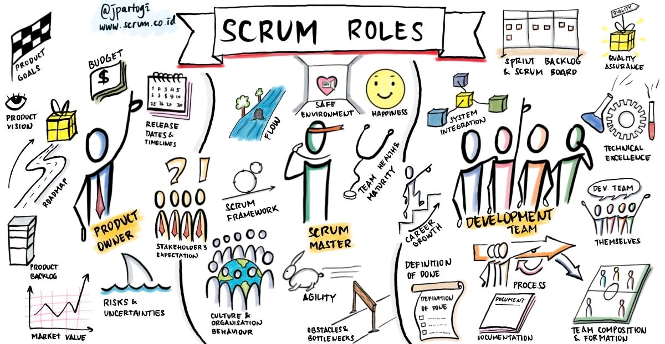

Slide 20
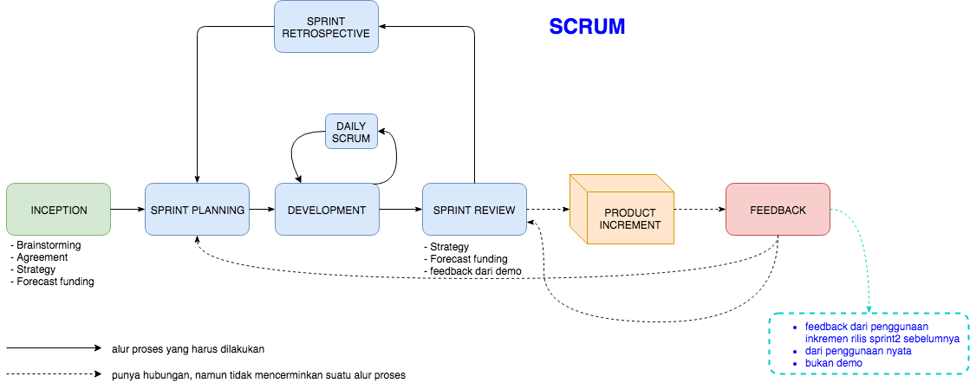
Scrum Events

Slide 21
LET’S DISCUSS...

