Slide 1
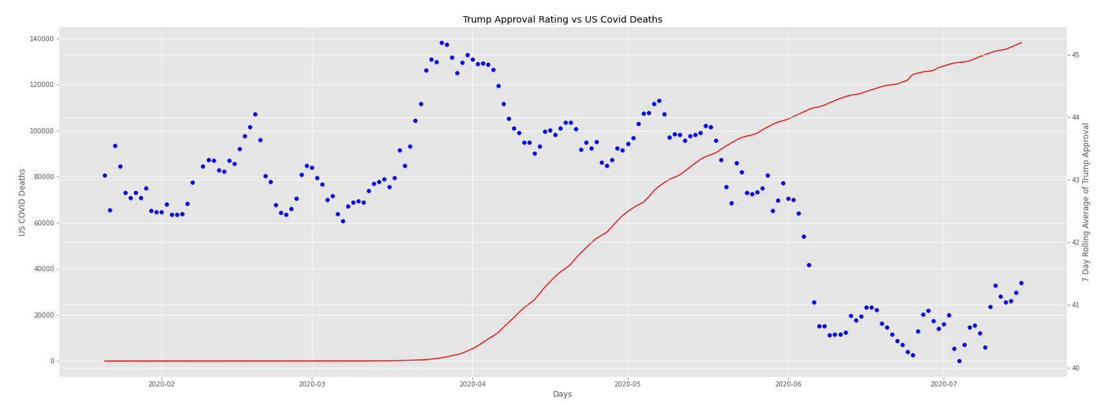
Red line plot represents the aggregate / total US Covid Deaths (per the New York Times) as of that day
Each blue scatter-point represents the bi-directional rolling 7-day average of Trump’s approval rating (based on data gathered by FiveThirtyEight) as of that day.

Slide 2
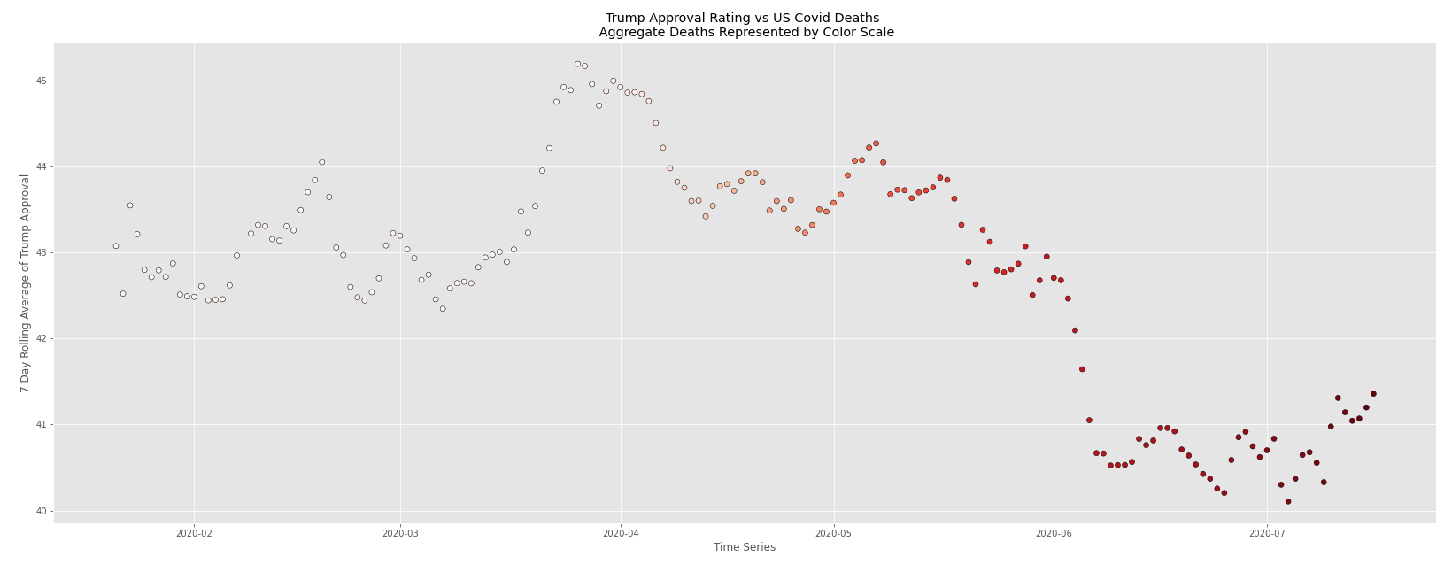
This plot uses the same underlying data as the previous slide.
The aggregate US COVID deaths have been converted from the line plot to the color scale for the approval rating scatter plot.

Slide 3
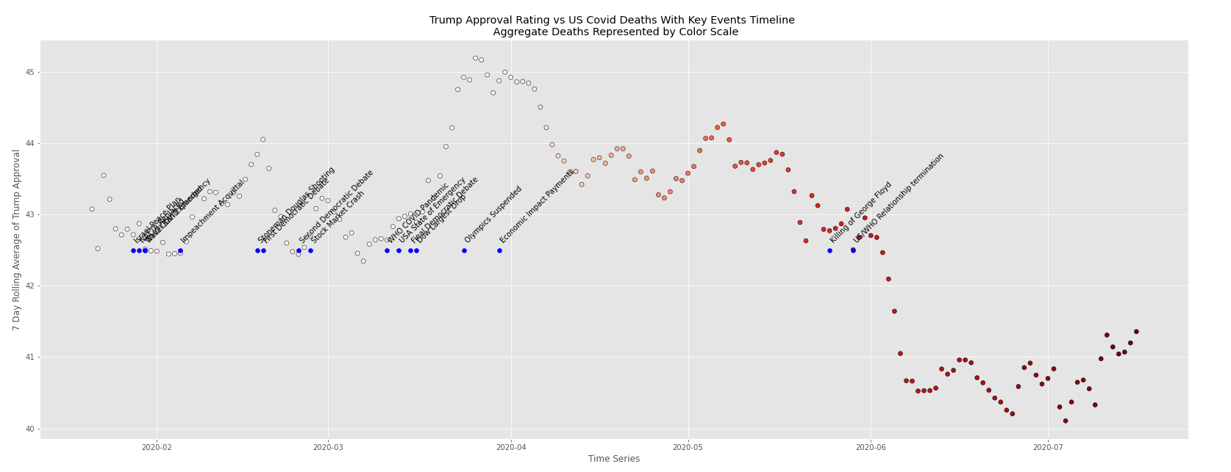
Same plot as the previous slide, with the addition of a timeline representing key / major US and Geo-Political events during the time series represented by the plot

