Slide 1
BLE APP Inventor
跳繩

Slide 2

Download RL62M.py from GitHub
https://github.com/wright0418/EPY_Library/blob/main/RL62M.py
SAVE the File to EPY Board

Slide 3

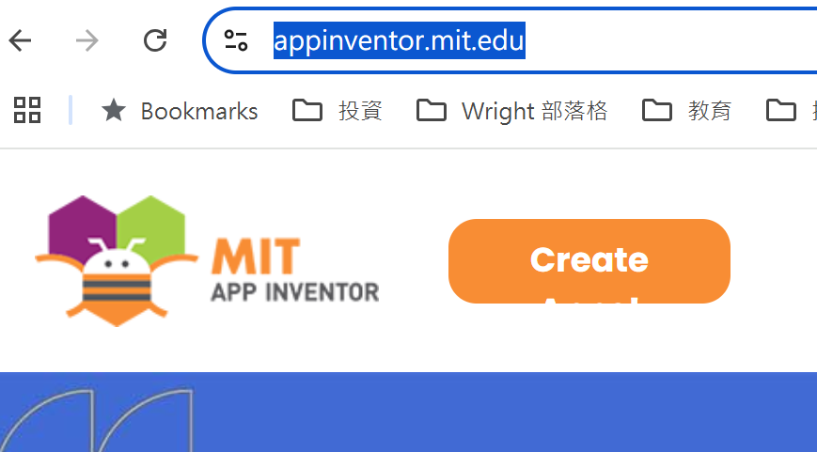
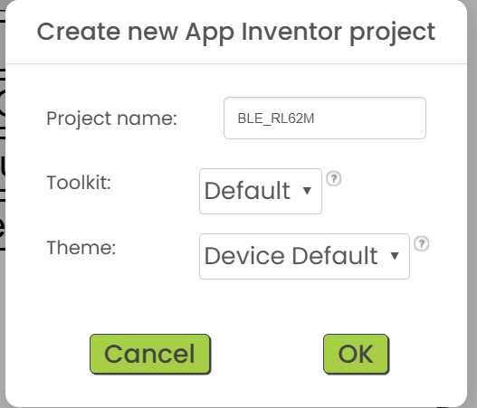
進入 App Inventor Create New Project
https://appinventor.mit.edu/
選新的 Style
Create a new Project
Input Project Name

Slide 4
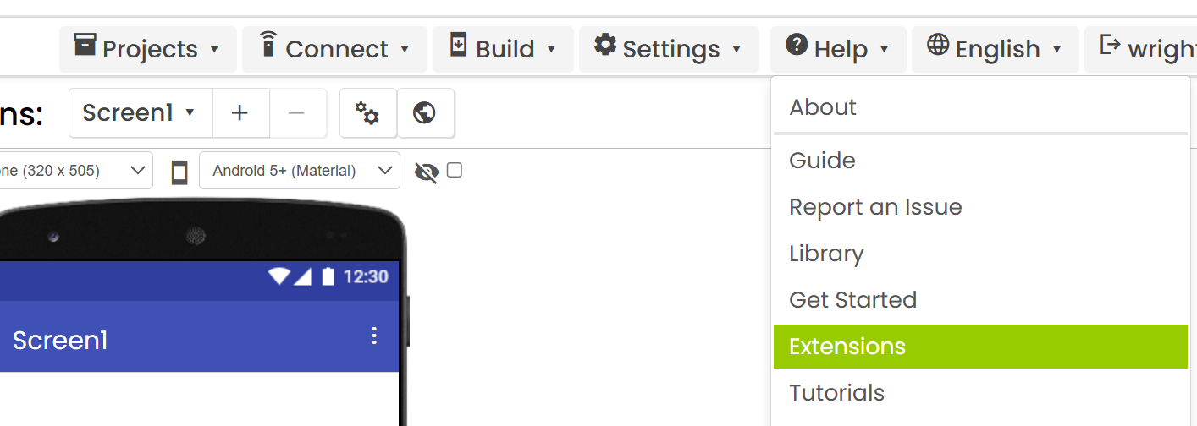
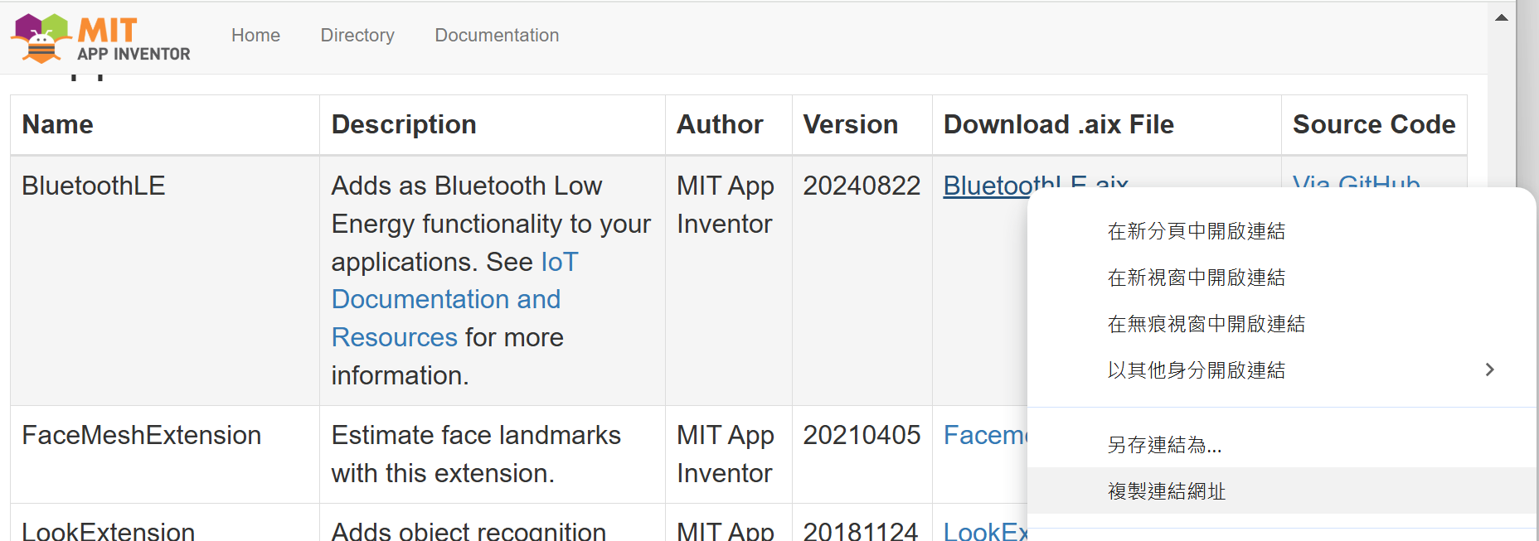
Click mouse right
Copy the hyper link address

Slide 5
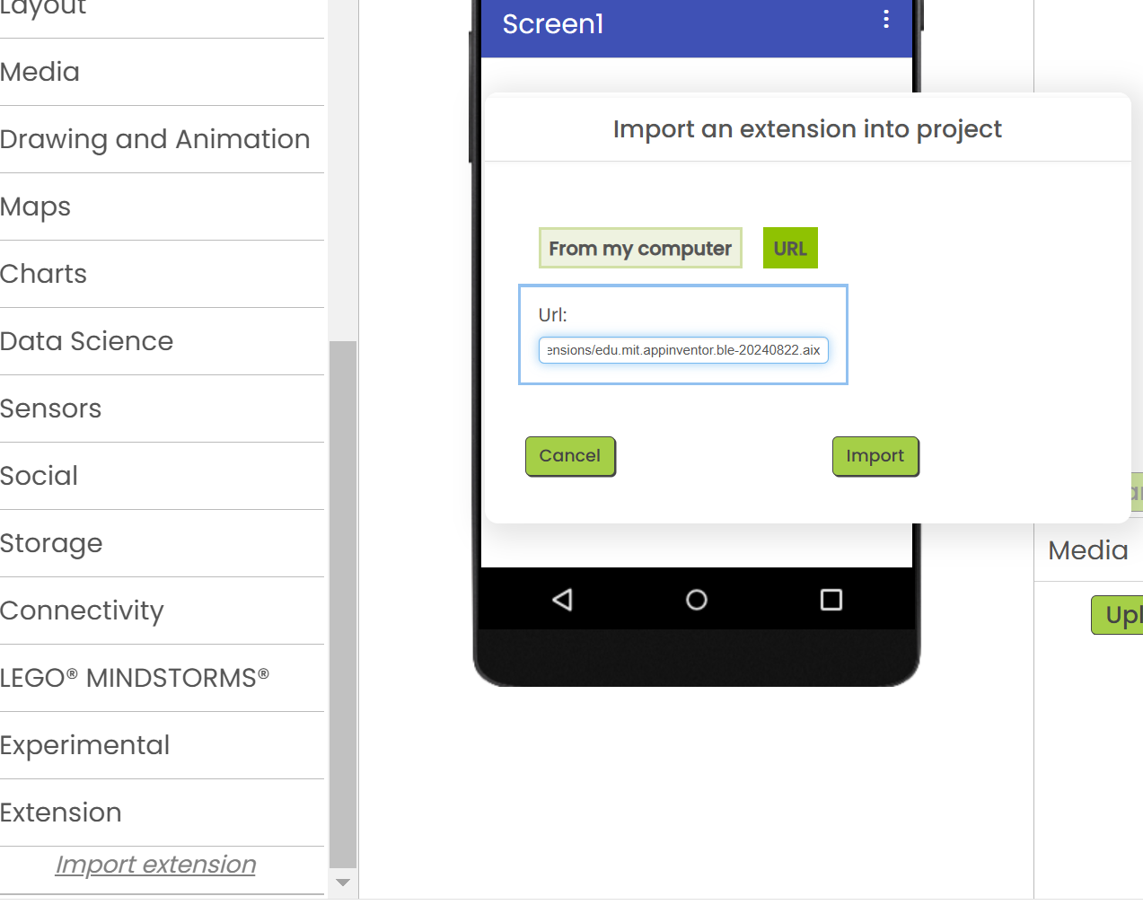

Import BLE library to Project
3
4
5
1
2

Slide 6
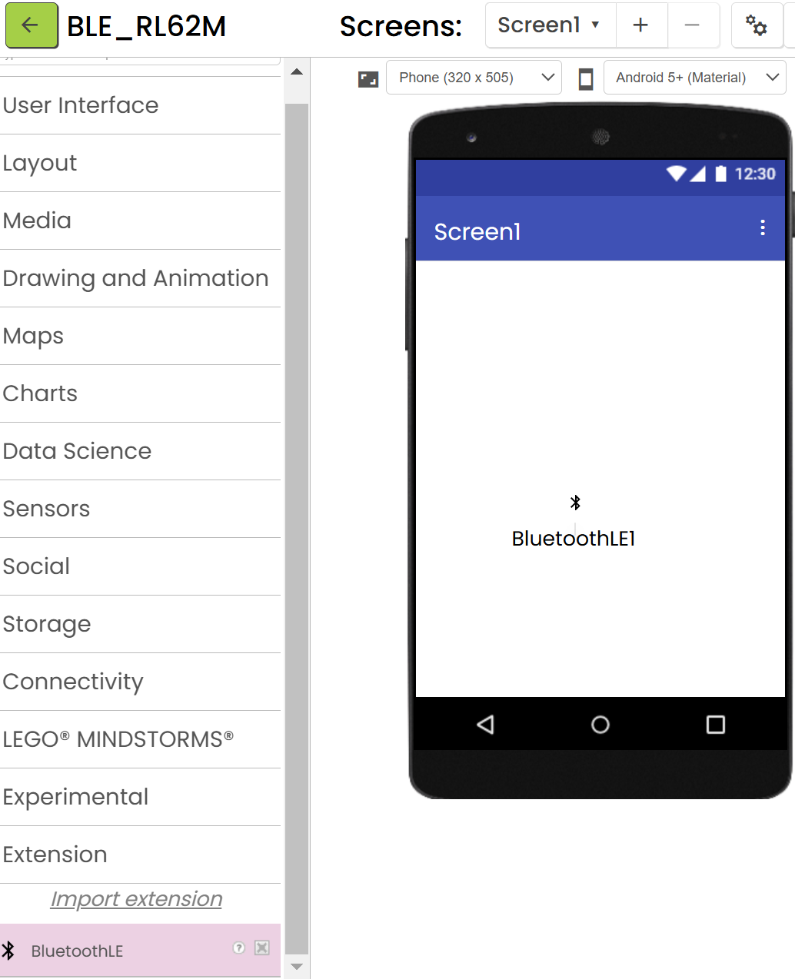
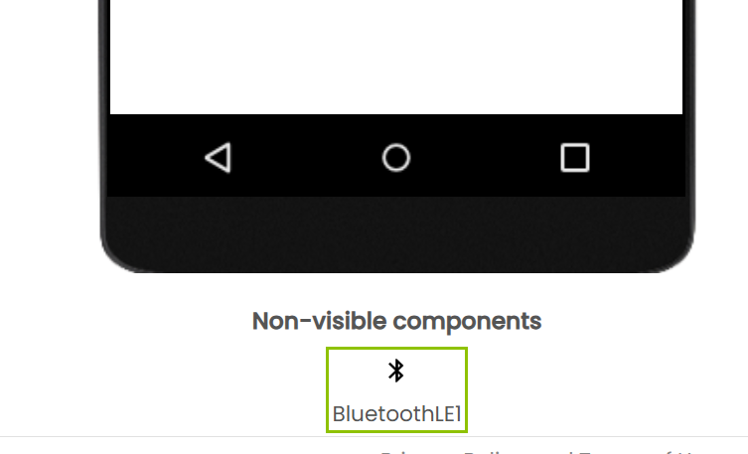
Project Use BLE
拖拉 BLE Library to Screen1

Slide 7
規劃 App Inventor 畫面
SCAN BLE Button
BLE Device List
Two Button
One List
three Text Lable
1. game status
2. Times
3. 次
Game Start Button
Game Status
2345
次

Slide 8
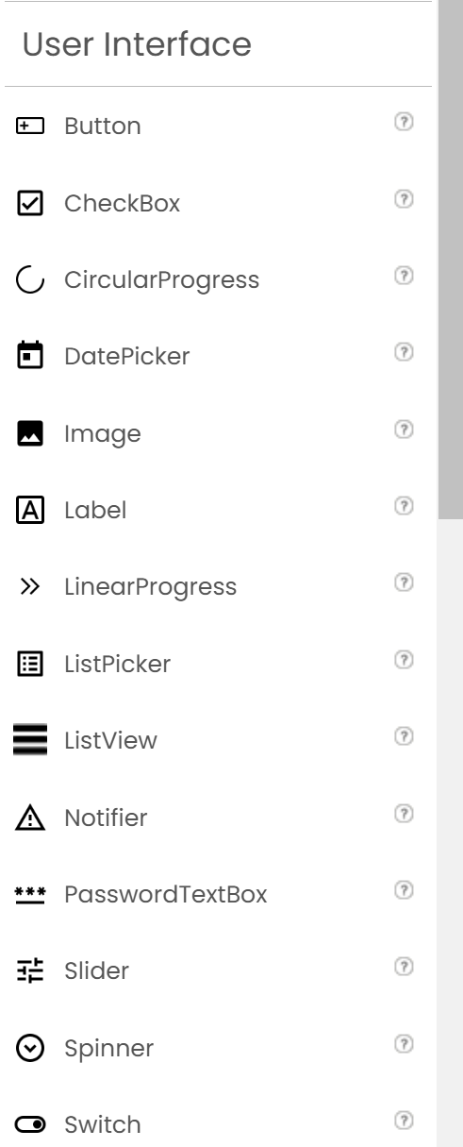
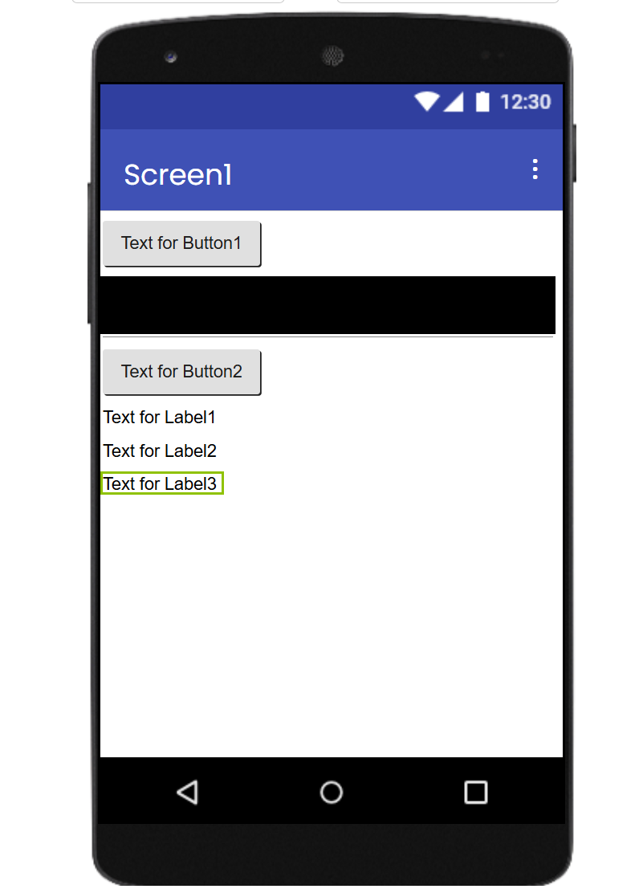
安排 APP 畫面 Step1
Use all UI from User interface

Slide 9
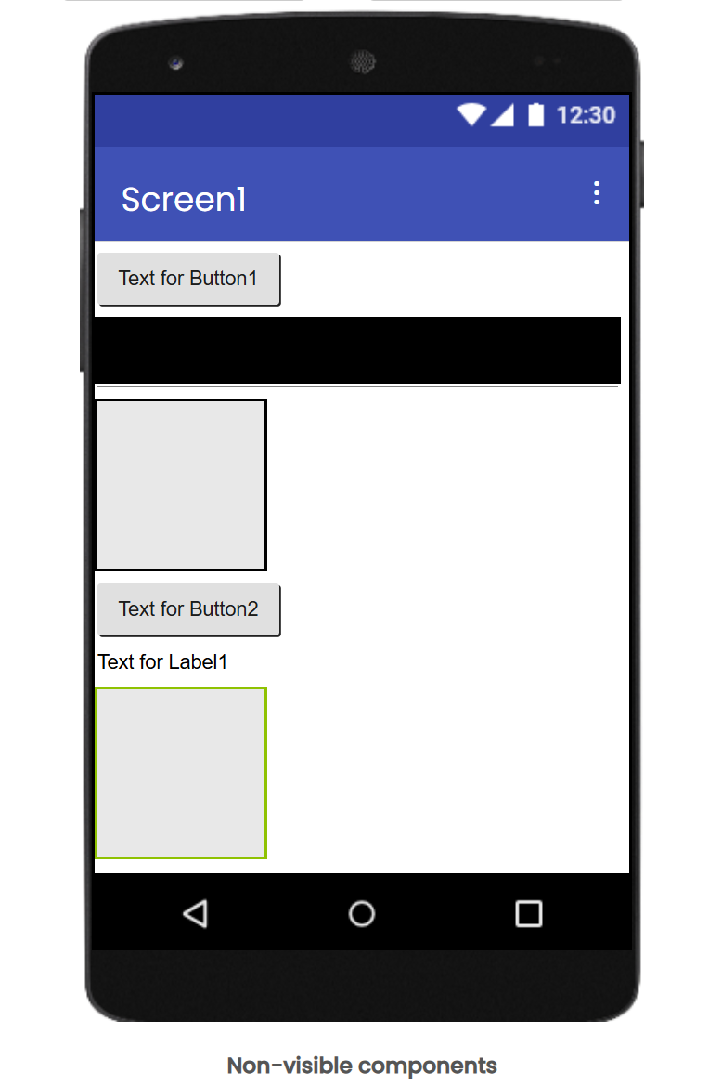
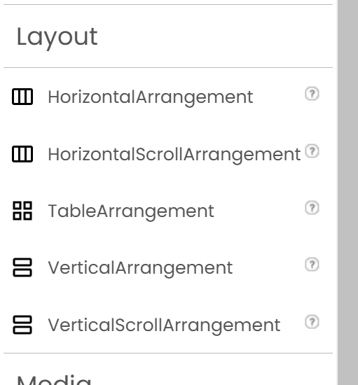
安排 APP 畫面 Step2
Select Layout 元件 from Layout

Slide 10
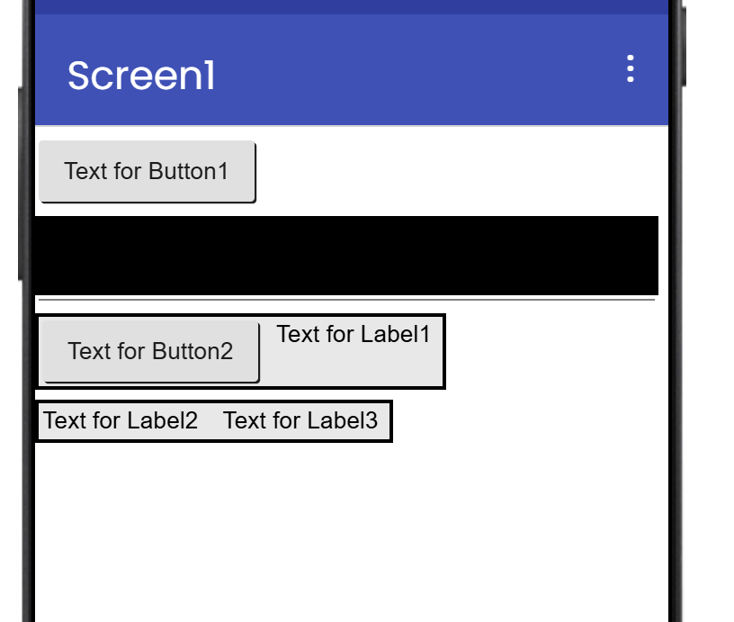
安排 水平Layout 裡面 包含元件
安排 水平 Layout 裡面 包含元件

Slide 11
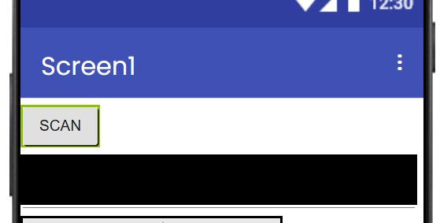
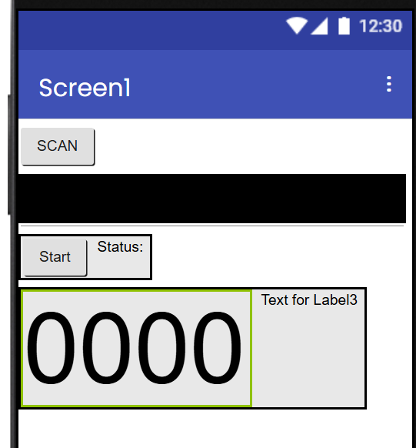
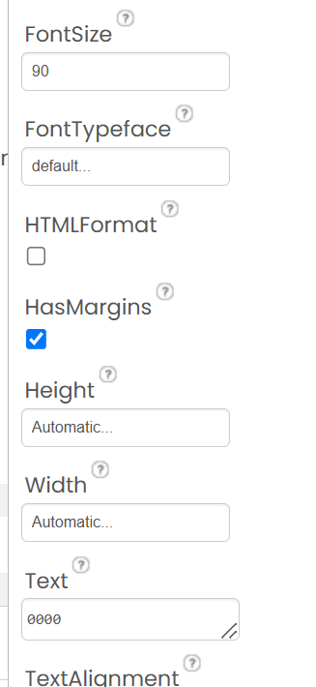
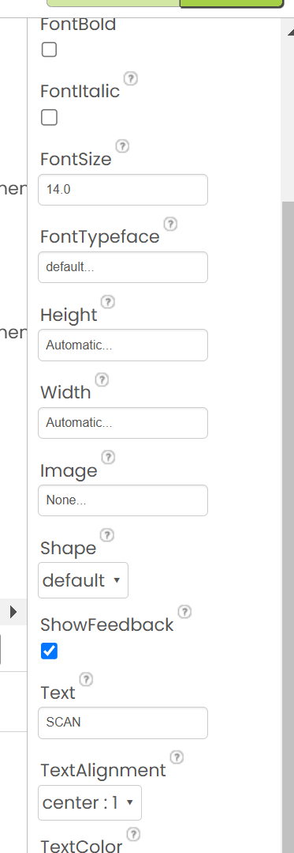
定義 每一個 元件 屬性

Slide 12
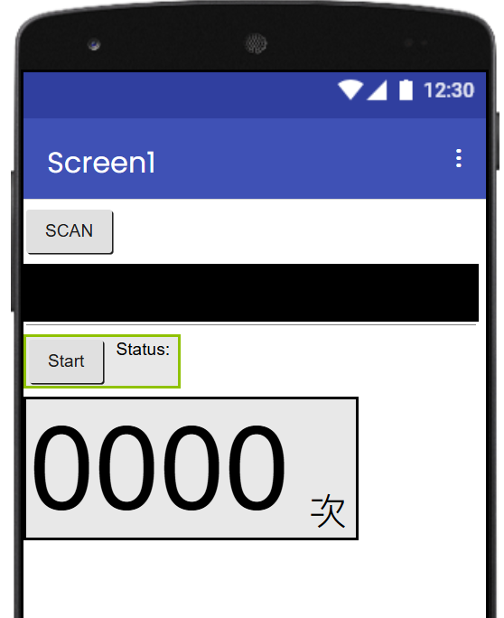

Slide 13
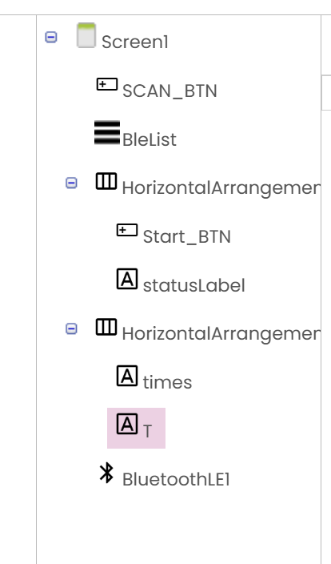
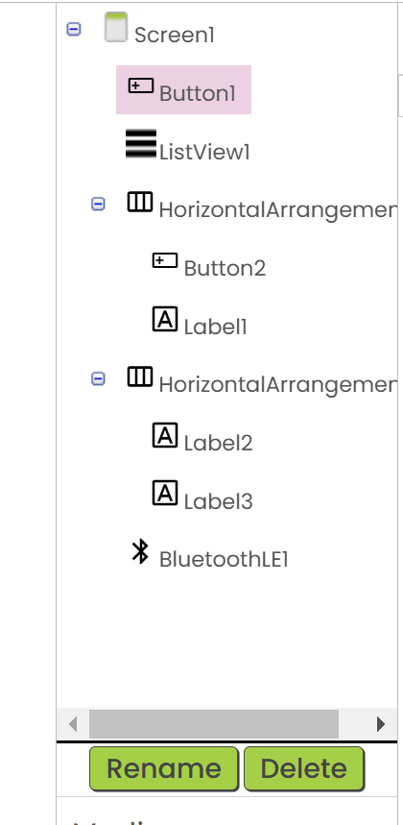
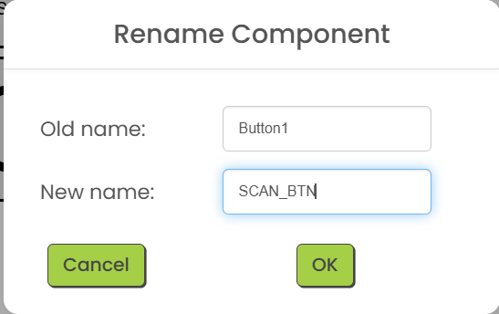
修改元件 變數名稱

Slide 14
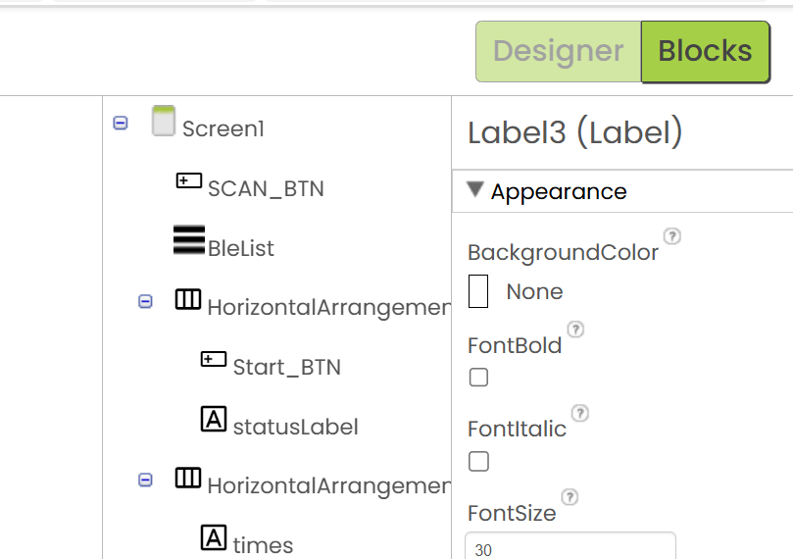
Write BLE Code

Slide 15
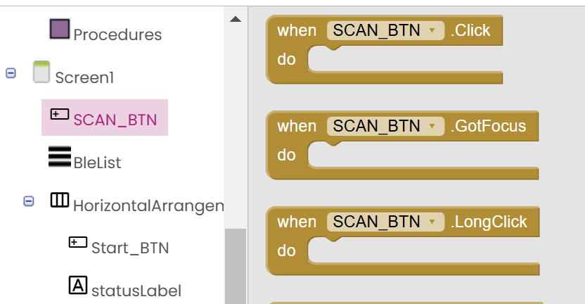
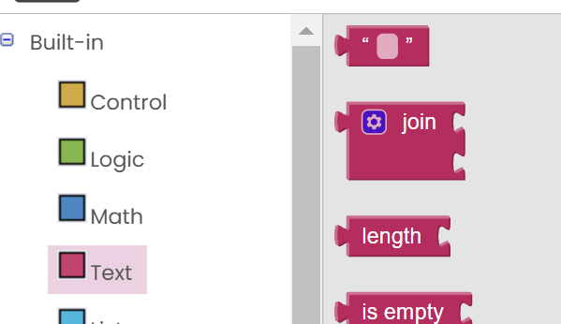


BLE Scan Device
Service UUID
524CACC0-3C17-D293-8E48-14FE2E4DA212

Slide 16
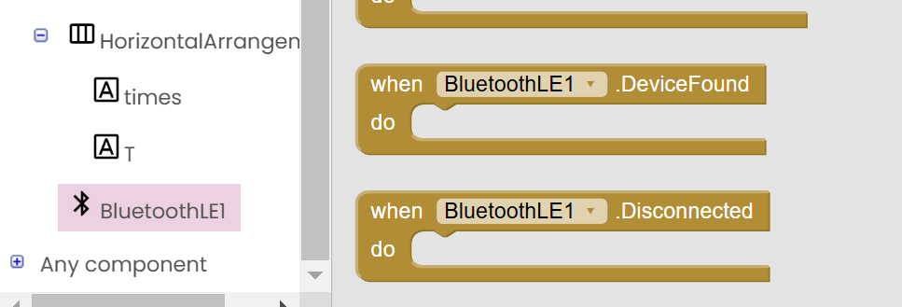




Slide 17
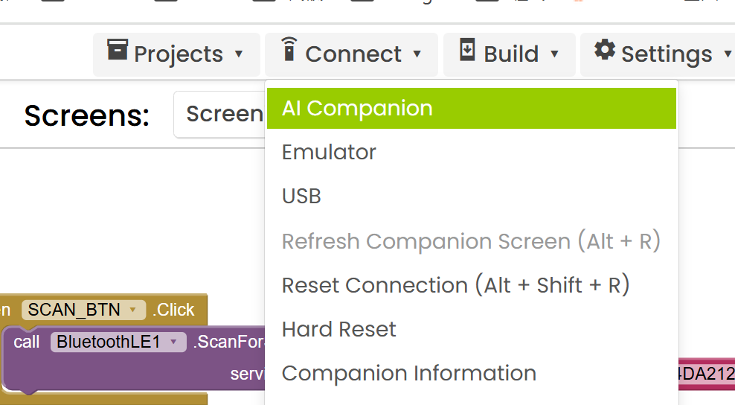
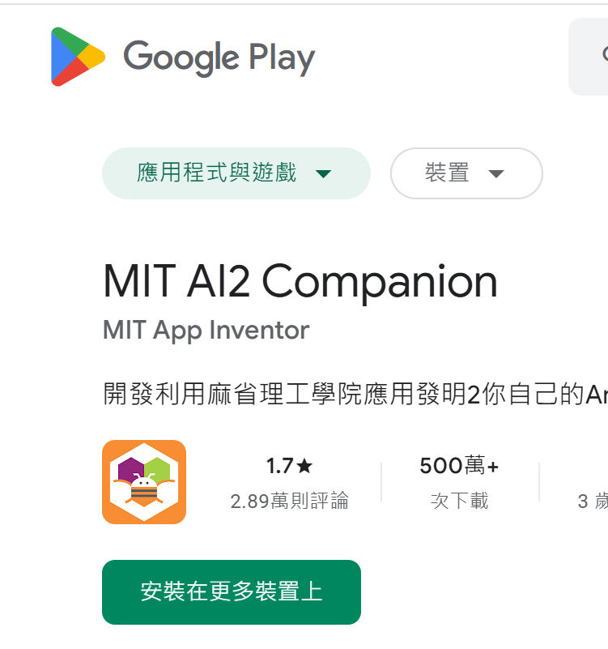
Test APP

Slide 18
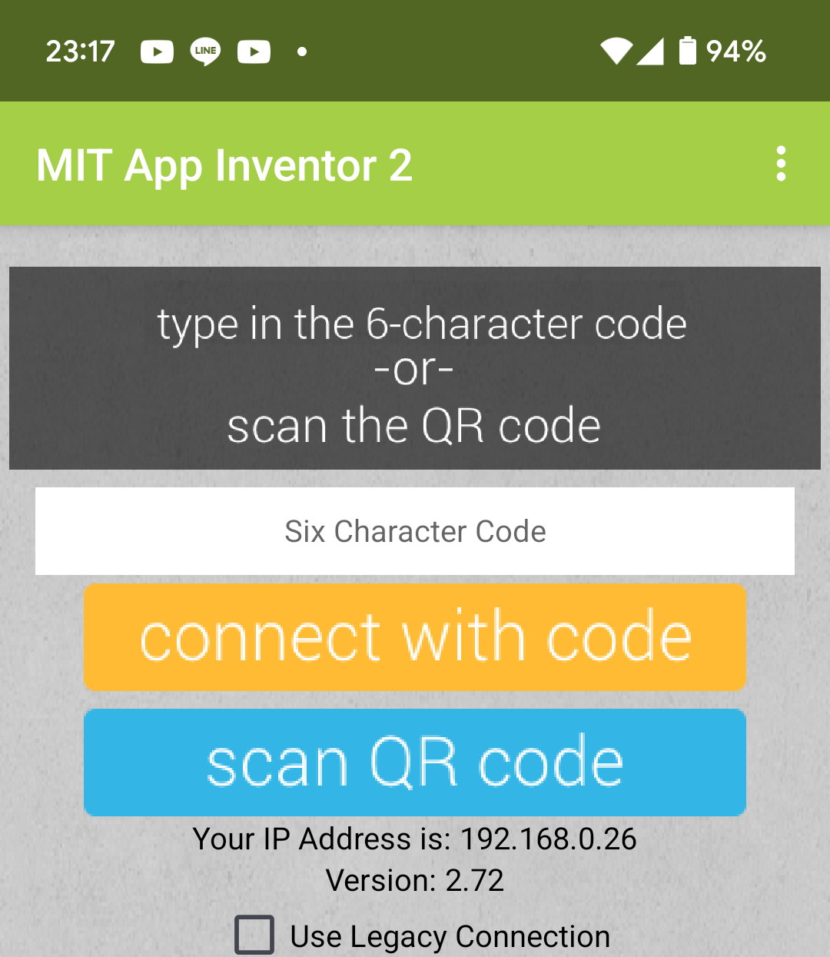
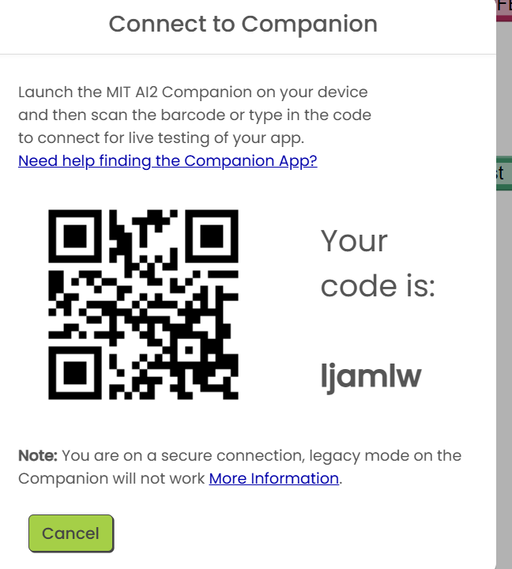

Slide 19
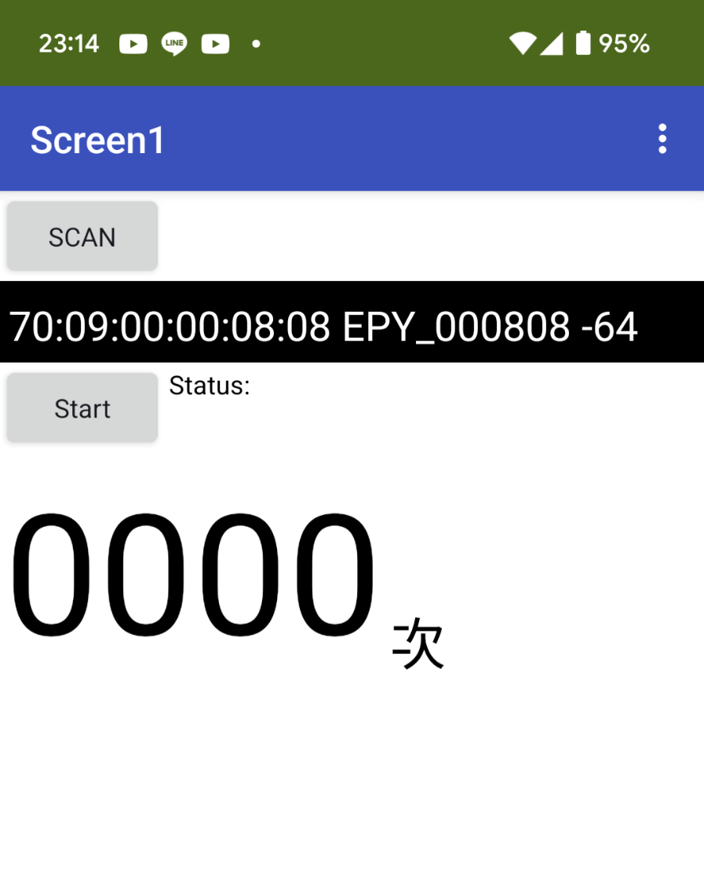

Slide 20
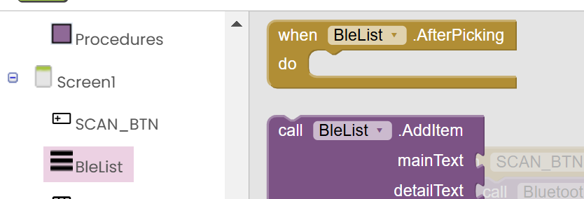


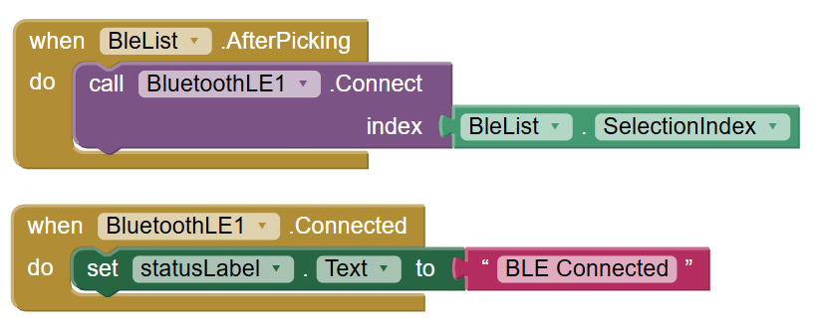
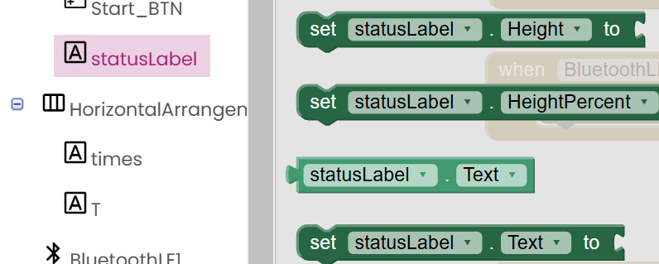

Slide 21

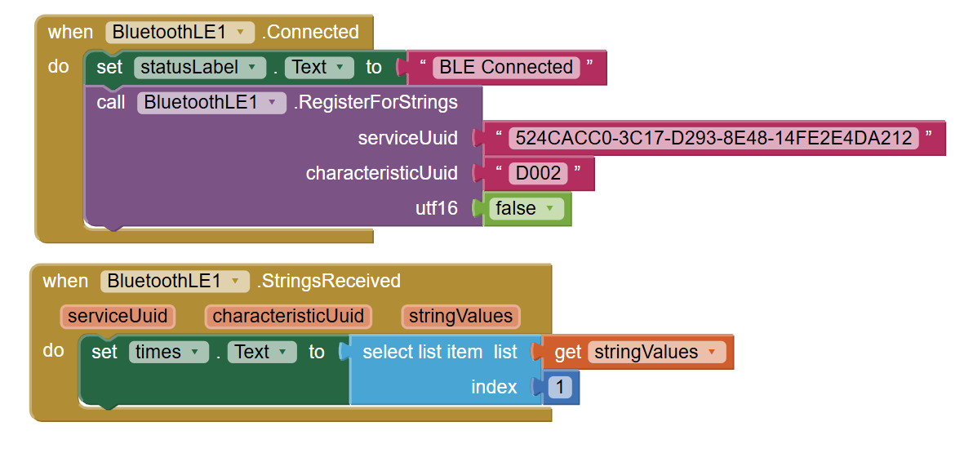


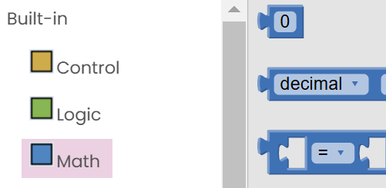
EPY Send to APP

Slide 22
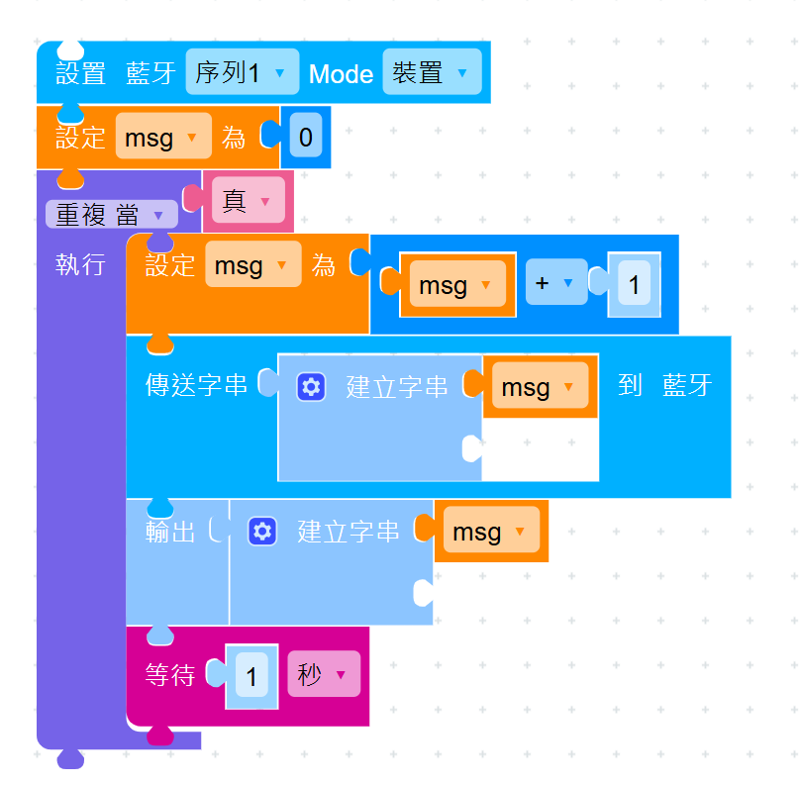
EPY Send Times TEST Code

Slide 23
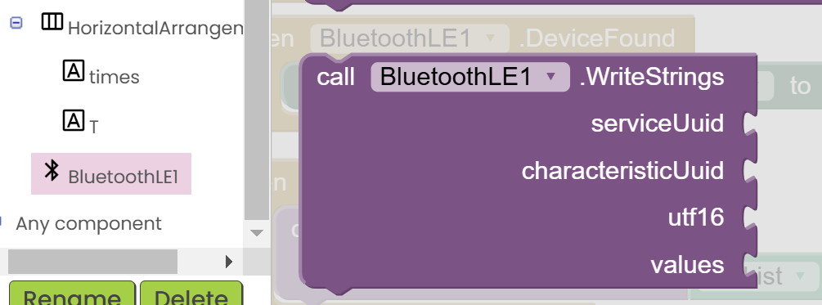
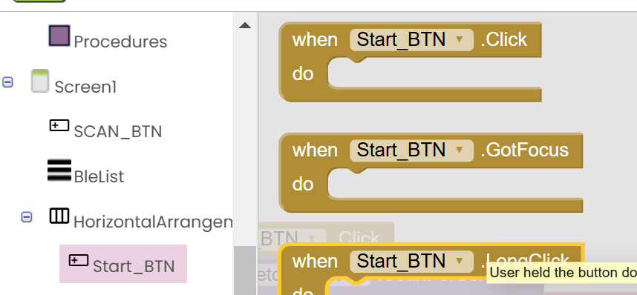
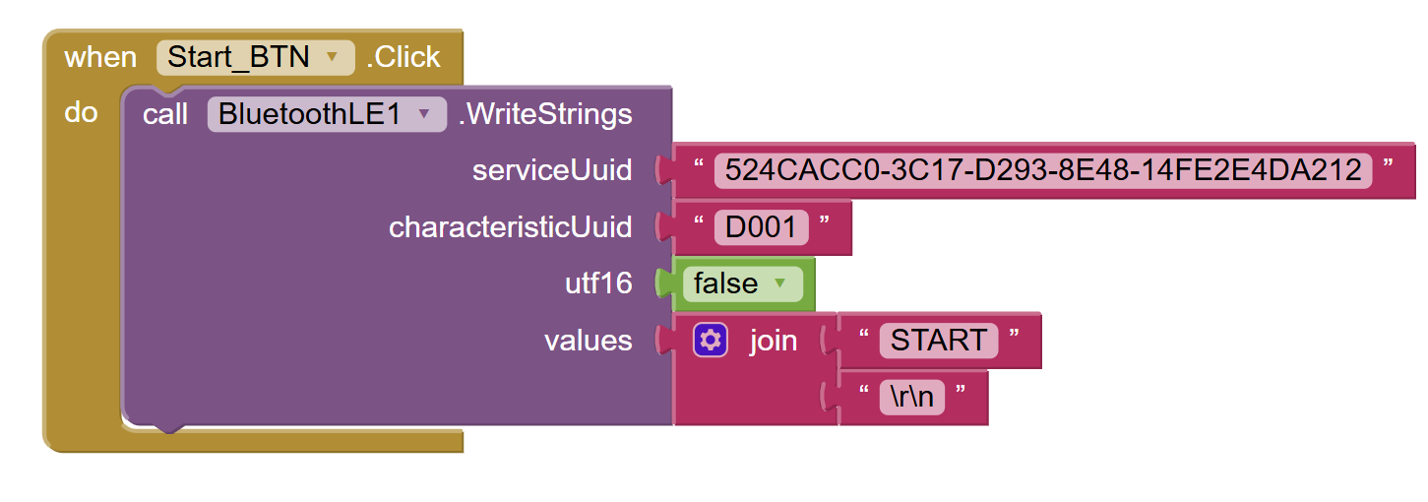

Send Game Start

Slide 24
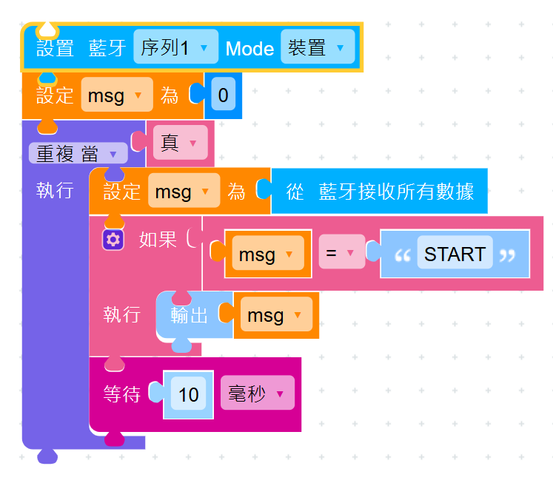

Slide 25
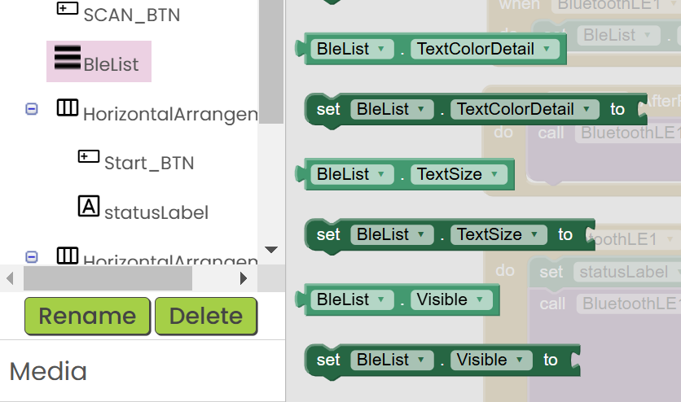
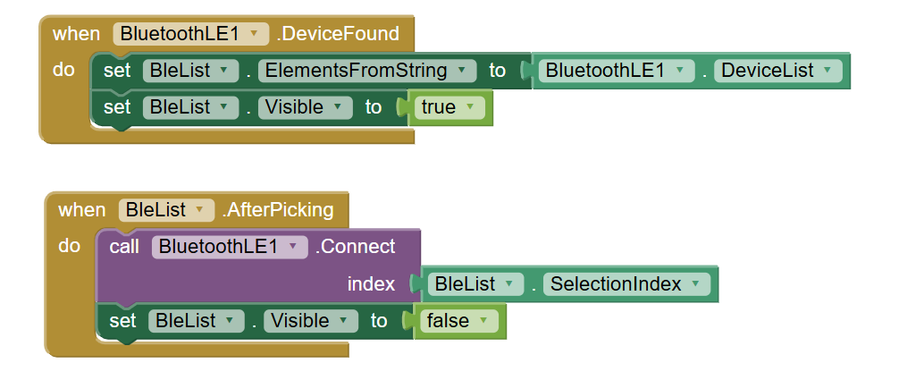
顯示與隱藏 BLE List

Slide 26
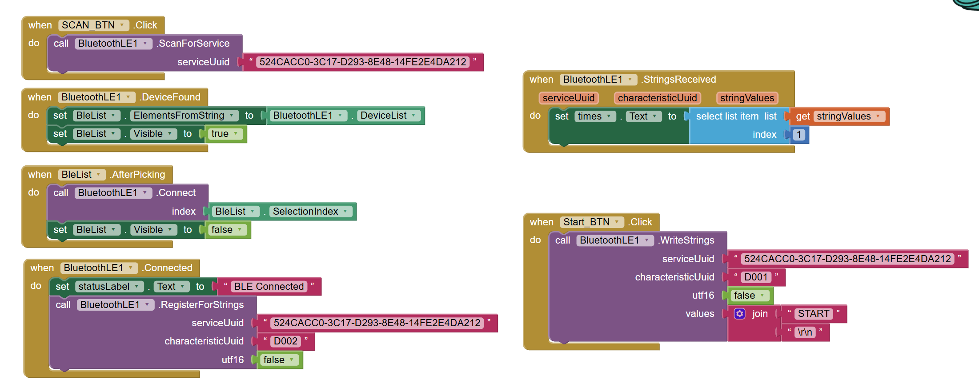

Slide 27
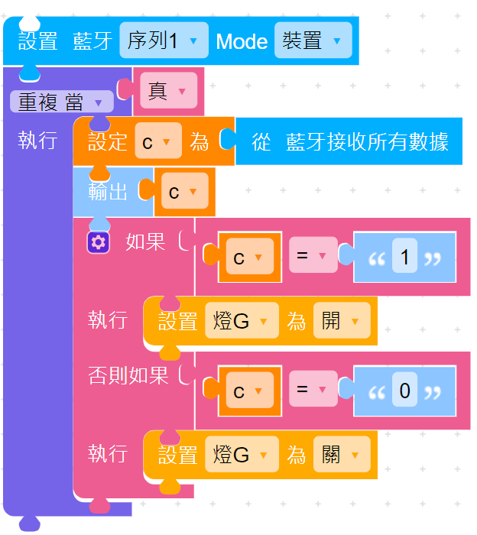
如何來做自己的跳繩APP

