Slide 1
Reactive programming
And the rxJava framework

Slide 2
The whY and the whAt..
WHY:
Applications that demand large amounts of data processing, multi user response times in the seconds and 100% uptime.
What:
A Reactive system is flexible, scalable and loosely coupled. Allowing for a maintainable, responsive, fault tolerant system.
A Reactive system can be split up into four principles:
Responsive
Resilient
Elastic
Message Driven. (Asynchronous message passing)
Ensures loose coupling, which leads to code that is easier to test and debug.
http://www.reactivemanifesto.org/

Slide 3
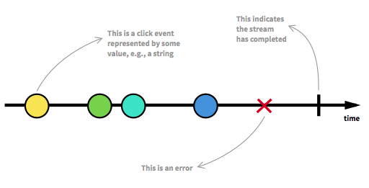
Reactive programming
Whats the take home, Reactive = Asynchronous Streams – by andrea saltz
Streams can be anything; variables, data structures, user inputs, caches..
Listen to the stream and react to it..
Streams are a time ordered sequence, which can emit either a value, error or a completed signal.
E.x. A function is executed when a button click event is emitted and another function is executed when an error is emitted. A button press stream is completed when a window is closed and would execute a function for a completed stream This is called ‘subscribing’ to the stream and the functions are called observers.

Slide 4
Example – click event
clickStream: ---c----c--c----c------c-->
vvvvv map(c becomes 1) vvvv
---1----1--1----1------1--> New Stream
vvvvvvvvv scan(+) vvvvvvvvv
counterStream: ---1----2--3----4------5--> New Stream
clickStream.map(f) – each value is mapped to 1.
clickStream.map(f).span(g) – aggregates the previous value with the current value and emits the current total number of clicks.

Slide 5
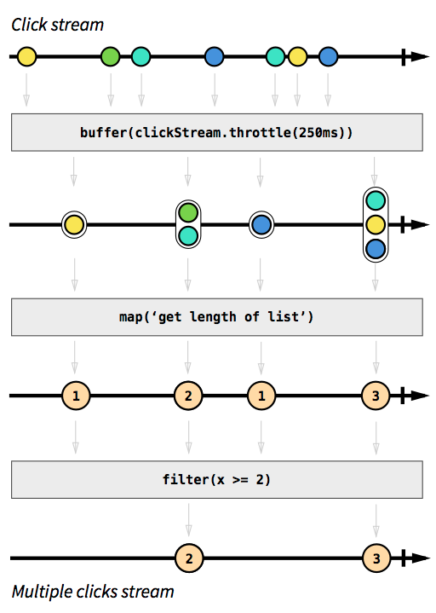
How About Filtering
Group streams into lists – every 250 ms a new list will be created.
Get length of list.
Filter lists for two clicks or more.

Slide 6
Why use the rx library
Extra level of abstraction allows developers to focus on the business logic rather than the implementation detail.
Abstraction allows programmers to not worry about synchronisation, thread safety, non-blocking io.
Observables are not opinionated.
Large number of languages supported, with a similar api for javascript, java, python, c++, …
Lets take a look…

Slide 7
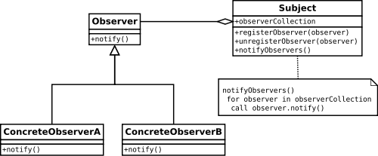
RX Library
Used to produce asynchronous, event based programs by producing an observable sequence (streams).
Implements the observer pattern to achieve this

Slide 8
RX Library - Observable
Observables allow us to operate on the data without callbacks, allowing code to be more de-coupled and testable.
No need for synchronisation of the callbacks.
No more premature futures blocking (future.get()).
Observables can emit single values similar to futures and also sequences or infinite streams. Think of an Observable as a ‘push’ iterable that waits on the next value.
An observer subscribes to an Observable and reacts to the emitted object – react pattern.

Slide 9
RX Library - Observable
Normal method call flow
Call a method.
Store the return value.
Use that return value and do something with it.
Asynchronous flow
Define method for doing something
Define observable with method parameters
Subscribe method to observable, which invokes observable

Slide 10
RX Library - Observable
You connect your observer through the subscriber method.
When an item is emitted from the observable, the onNext method is called.
When an error is emitted in the stream an onError method is called and no more onNext methods will be called after.
When the stream in completed the onCompleted method is called.
Hot and Cold Observables…
Hot observables have all ready started emitting before the observer has subscribed. They start emitting at creation.
Cold observables only start emitting when the observer has subscribed.

Slide 11
RX Library - Operators
We can transform, combine and manipulate observables with operators.
Operators are split up into groups for:
Creating Observables
Filter emitted items
Combining observables
Error handling – allows you to recover your observable from an onError
Conditional and boolean operators – allows you to evaluate emitted item
Mathematical and Aggregation
Conversion Operator – transform from observable to object or data structure.
And more specialised operator types…

Slide 12
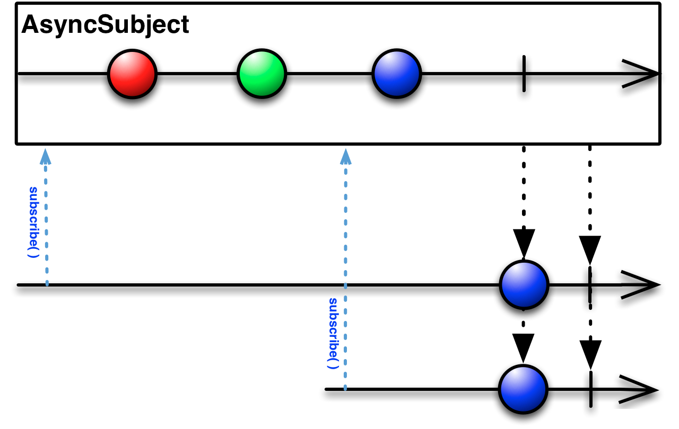
RX Library – Subjects and Schedulers
Subjects allow us to re-emit items into another observable depending on the subject type behavior.
Schedulers allow us to apply multithreading to our operators.

Slide 13
RX Library – Backpressure & Hot and Cold Observables
Backpressure
Backpressure can happen when an Observable is emitting items more rapidly than an operator or subscriber can consume them.
This can usually be resolved by using window, buffer and other operator methods to cache and delay the emissions.
Hot and Cold Observables
A cold observable starts emitting when a observer or subscriber has signaled for it to do so. Examples of a cold Observable are database queries, web requests and file retrievals.
A hot observable has already started emitting and an observer subscribes to the stream at some point in time. The observables data integrity can not be fulfilled. Examples of hot Observables are mouse and keyboard events

Slide 14
RX Library – Importance of unsubscribing
val squareObs = Observable.interval(10 millis).map(x => x*x).take(10)
squareObs.subscribe(println(_))
// => 0 1 4 9 16 25 36 49 64 81
Observable.interval(10 millis) creates an observable that produces infinite stream and produces 10 values and then terminates.
There must be away of unsubscribing from interval, map and take, when a listener is no longer interested in receiving data from this stream and we want to get back to the source
if the observable created by Observable.interval(10 millis) did not honor the unsubscribe call the observable would continue running and produce data forever

