Slide 1
Slides in the classroom
Put your name here

Slide 2
R Markdown
This is an R Markdown presentation. Markdown is a simple formatting syntax for authoring HTML, PDF, and MS Word documents. For more details on using R Markdown see http://rmarkdown.rstudio.com.
When you click the Knit button a document will be generated that includes both content as well as the output of any embedded R code chunks within the document.

Slide 3
Slide with Bullets
Bullet 1
Bullet 2
Bullet 3

Slide 4
Statistics to compute
Mean
Standard deviation
Variance
Range
Max and Min

Slide 5
Slide with R Output
summary(cars)
## speed dist ## Min. : 4.0 Min. : 2.00 ## 1st Qu.:12.0 1st Qu.: 26.00 ## Median :15.0 Median : 36.00 ## Mean :15.4 Mean : 42.98 ## 3rd Qu.:19.0 3rd Qu.: 56.00 ## Max. :25.0 Max. :120.00
mcar <- mean(cars$speed)
Using calculated values in the slides.
The mean of the the Speed column is 15.4.

Slide 6
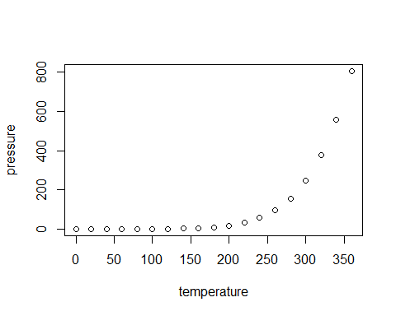
Slide with Plot

Slide 7
Equations
$$s^{2}=\frac{\sum_{i=1}^{N}{(}x_{i}−\overline{x})^{2}}{N−1}$$

Slide 8
Equations II
Create an aligned equation environment
Rather easy to create these

Slide 9
Creating Tables
Col1 | Col2 | Col3
January | Free | Day
February | Reel | Fish
March | Hotness | Cold¹
My Dataset

Slide 10
Included a footnote here…
Tables and images appear on separate slides.

Slide 11
Plain slide.
Great for full page graphics etc.

Slide 12
Notes
1. Very

