Slide 1

.NET 5 and beyond
Wriju Ghosh
Cloud Solution Architect, Microsoft
Twitter @wrijugh

Slide 2
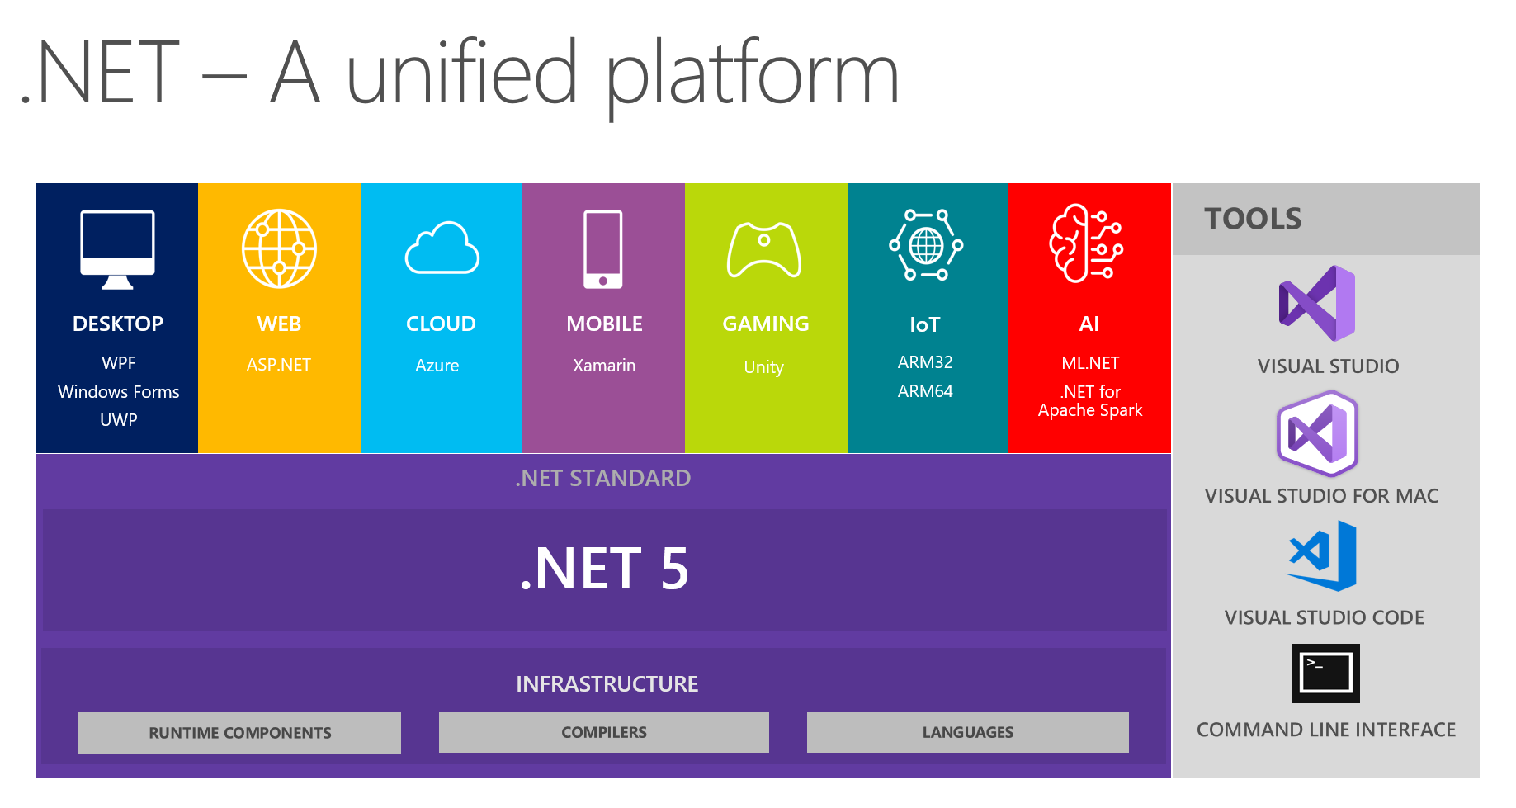

Slide 3
Few facts
The next release after .NET Core 3.0 will be .NET 5. This will be the next big release in the .NET family.
There will be just one .NET going forward, and you will be able to use it to target Windows, Linux, macOS, iOS, Android, tvOS, watchOS and WebAssembly and more.
Microsoft is skipping the version 4 because it would confuse users that are familiar with the .NET Framework, which has been using the 4.x series for a long time.

Slide 4
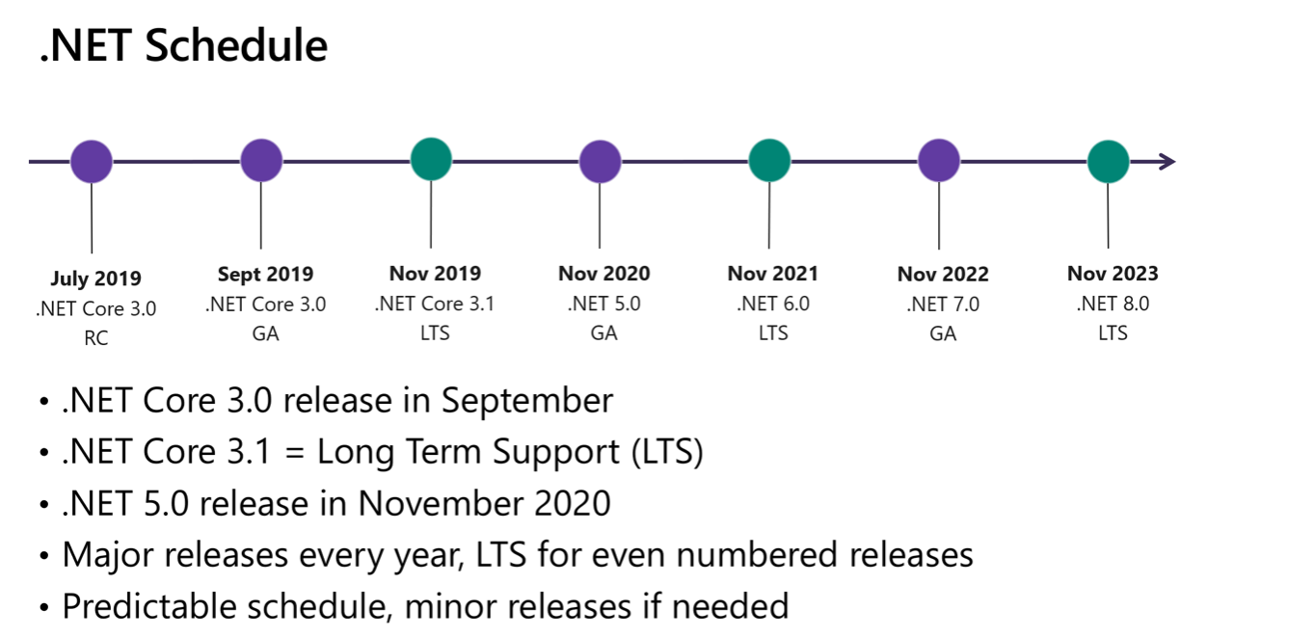

Slide 5
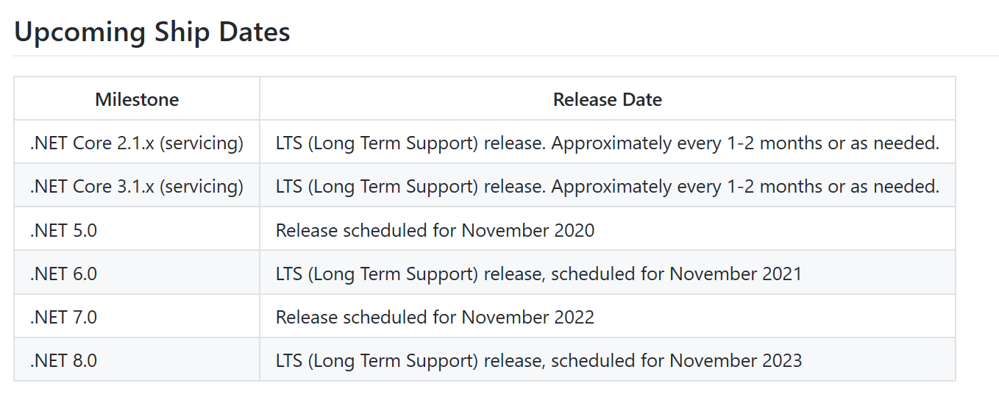

Slide 6
FAQ
Will there be .NET Core 4 before .NET 5?
Microsoft is skipping the version 4 because it would confuse users that are familiar with the .NET Framework, which has been using the 4.x series for a long time.
Additionally, Microsoft wanted to clearly communicate that .NET 5 is the future for the .NET platform
What will happen with Mono project?
Microsoft is in the process of making CoreCLR and Mono drop-in replacements for one another. Microsoft will make it as simple as a build switch to choose between the different runtime options.

Slide 7
Official Blogs
https://devblogs.microsoft.com/dotnet/introducing-net-5/
https://devblogs.microsoft.com/dotnet/net-core-is-the-future-of-net/
GitHub Page https://github.com/dotnet/core/blob/master/roadmap.md
Release Note https://github.com/dotnet/core/blob/master/release-notes/README.md
.NET 5 Preview 6 https://devblogs.microsoft.com/dotnet/announcing-net-5-0-preview-6/

