Slide 1
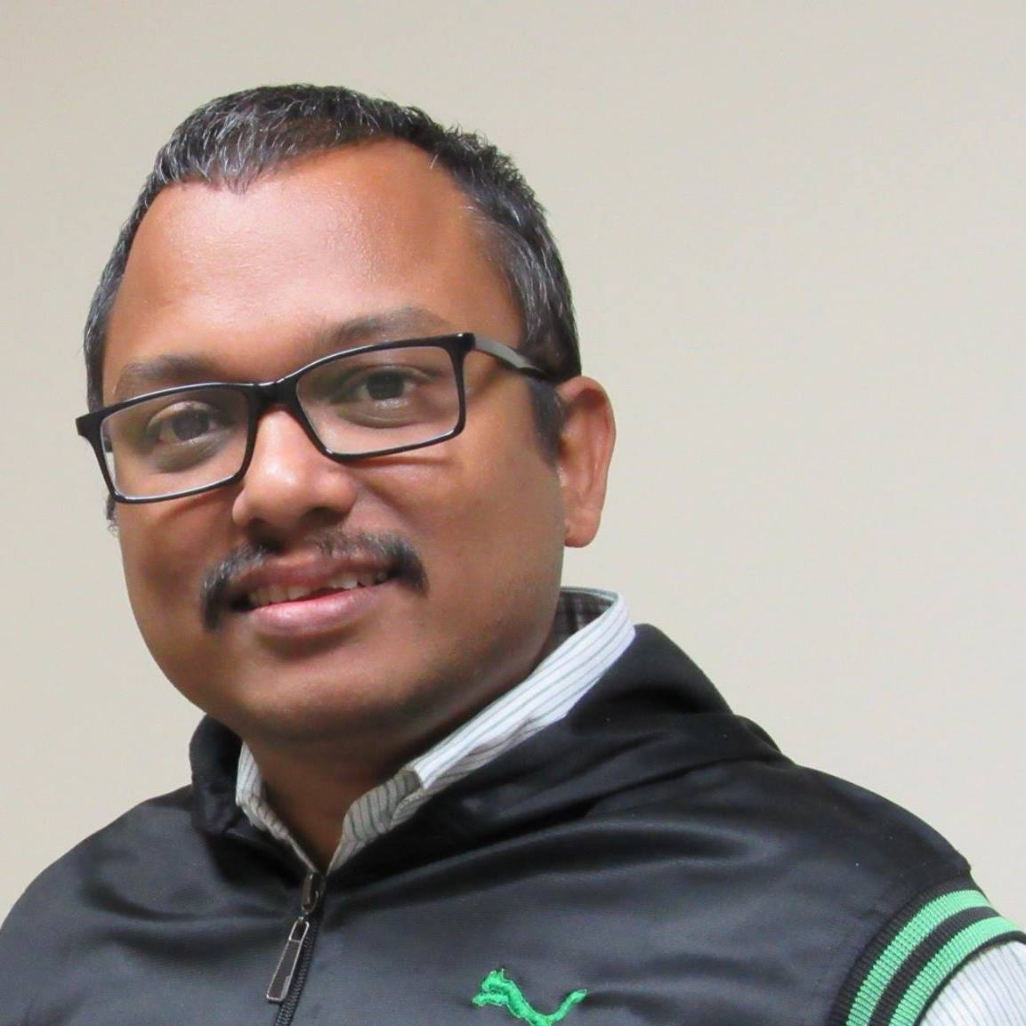
HTML Day 1
Basic Tags, Tools, Concept
Wriju Ghosh, Twitter @wrijugh
https://wrijugh.github.io/web-students/

