Slide 1

Pollen grain classification

Slide 2
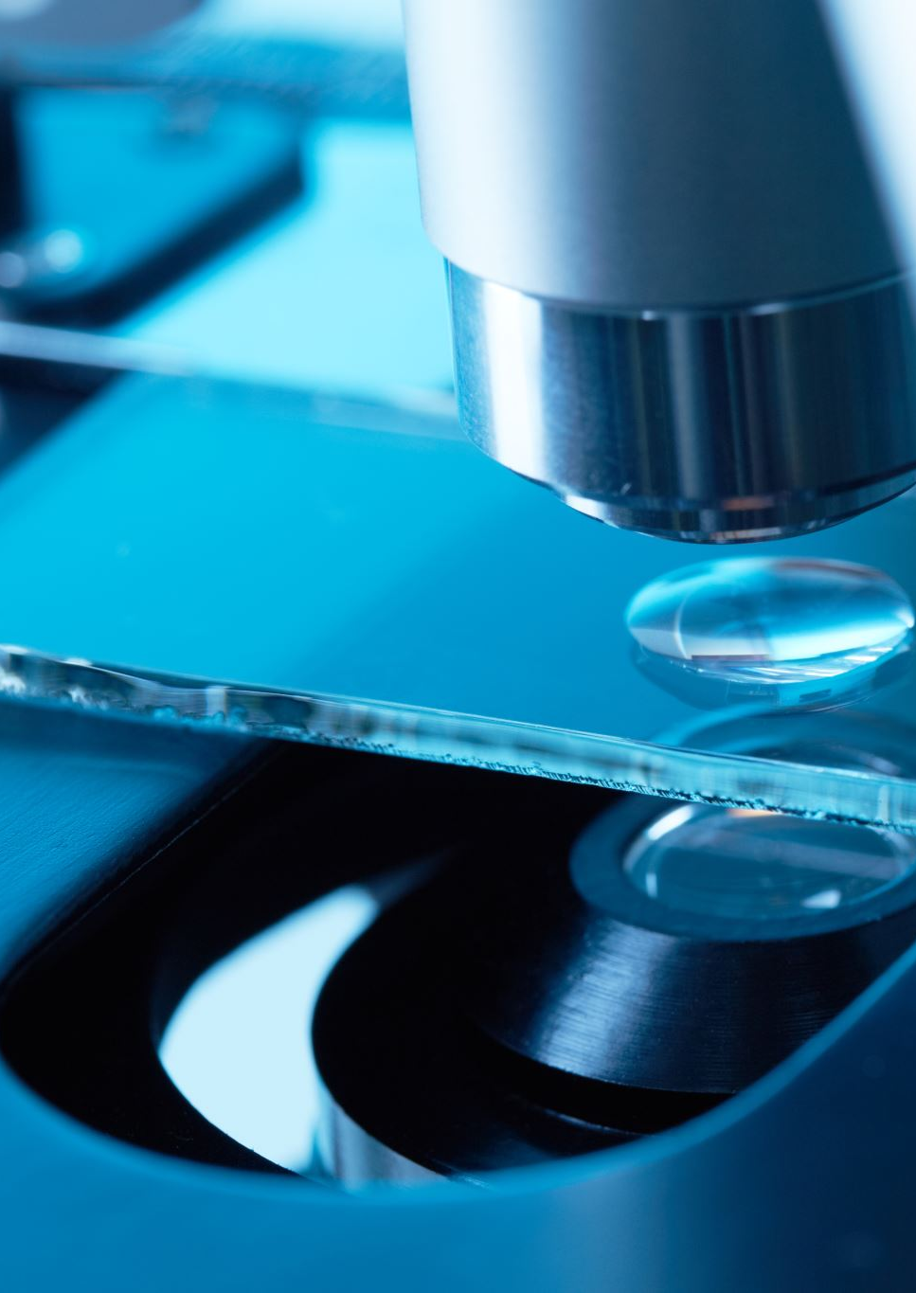
About: microscopic Data
In the field of Ecology, years of research revolve around collection of a given specimen & all its data
The data in question must be properly cleaned, sorted, and stored.
After collecting a given specimen, it goes under a microscope, where the subject is magnified.
Applying techniques like staining & dark/light field further extend time.
Because of this, Datasets are much smaller, and feature rich.
Datasets suffer from subjective labeling

Slide 3
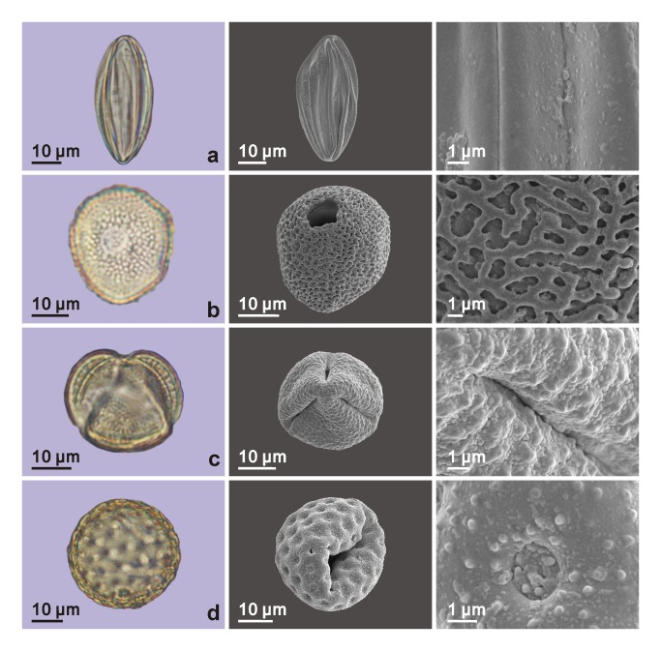
Pollen
Pollen remains difficult to identify traditionally, w/ avg. microscopy accuracy scores of 67%
-Pollen grains come in a multitude of shapes/sizes individualized to a single plant
Pollen grains are on avg. Comparable to a speck of dust, making their study especially sensitive.

Slide 4
GOAl:
Can deep learning improve upon the 67% accuracy?
To further maximize the utility of a small dataset, we will rely on imagenet weights w/ a prebuilt transfer learning model to expand available training data for classification tasks.
Training categorical classifier w/ augmentation to avoid overfitting : Pollen dataset
Generating accurate synthetic images w/ Lice/Pollen & using them in the classifier.
With enough training data generated, specimen can still be identified accurately with debris & other imperfections attached.
The success of such methods could speed up the time processing data

Slide 5
About the dataset
There are 5 folders of each category, for the families/species of pollen and lice. The total image count is 2273: 1034 for pollen and 1239 for lice.
Pollen images are taken using Light-Field Microscopy while Lice images use both light and dark-field microscopy.
Pollen families are similar enough to make training easier
Pollen images are a consistent resolution of 300x300 px. The pollen images are centered and retain most visual detail while the edges may be blurry. Lice images on the other hand are not visually consistent due to zoom and focus, photos within the same folder have different color backgrounds, and many of the photos lack proper rotating and cropping. There are also visible debris as well as dark spots on the lice.

Slide 6
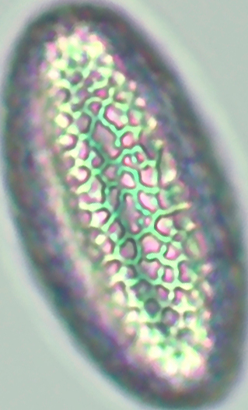
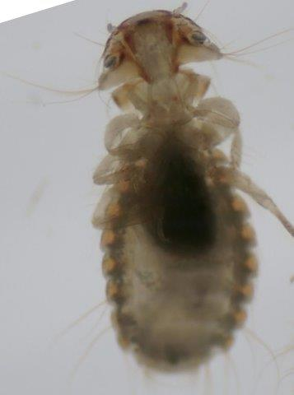
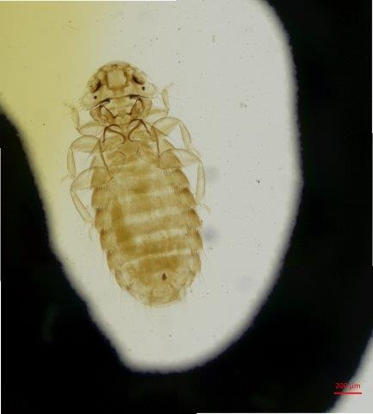
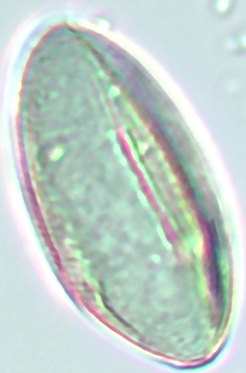
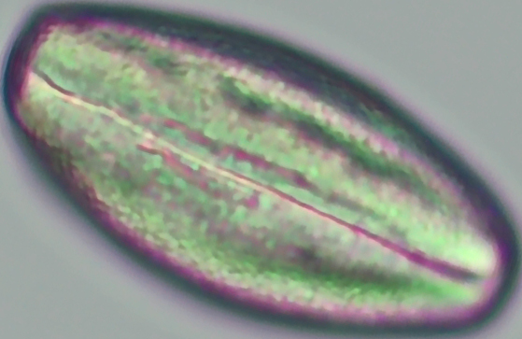
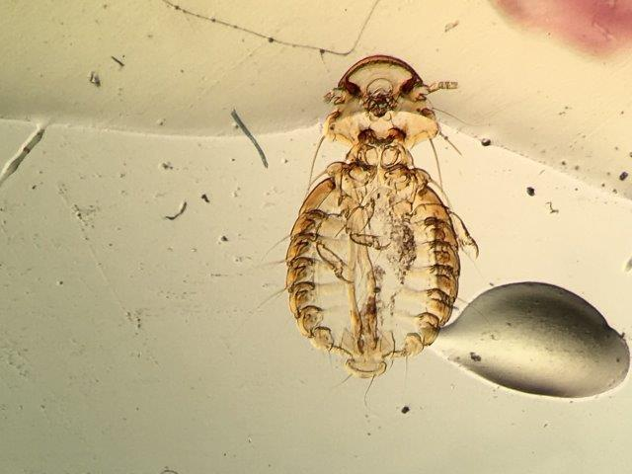
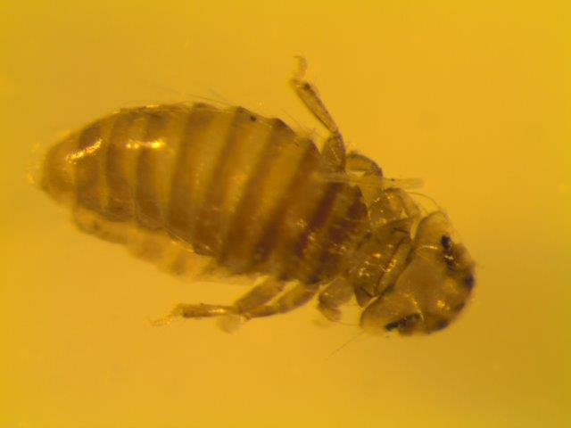
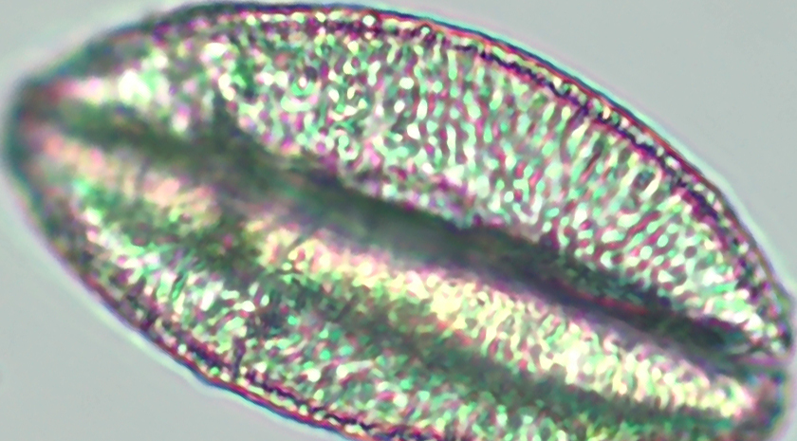

Slide 7
Technical Details
ResNet101V2
-No augmentation
-Frozen top layers
80/20 val train split
-ImageNet weights
-5 Convolutional Layers :
2x Dense 'relu' activation
2x Dropout Layers ( . 2)
1x Dense Output Layer 'softmax' activation w/ 5 outputs for each class
Size 32 Batch
Adam Optimizer : learning rate 1e^-4 // Categorical crossentropy Loss
Test dataset | Loss: 0.0357 | Accuracy: 98.79% | Recall: 98.80% | Precision: 98.80% | F1: 98.80%
Validation Dataset | .1261 | 97% | 96.75% | 96.75% | 96.75%

Slide 8
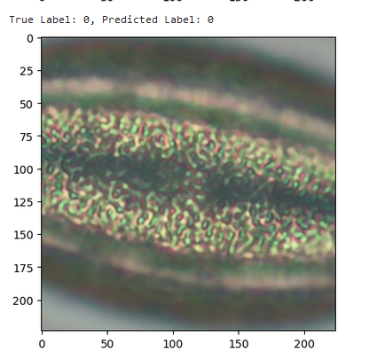
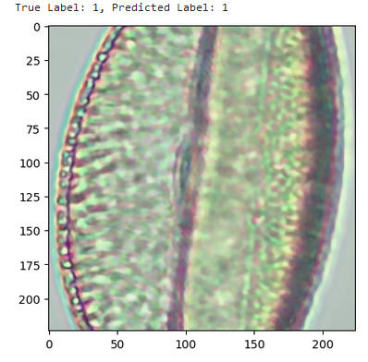
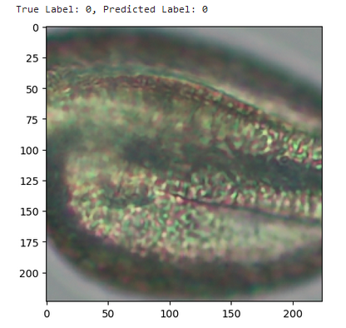
outcome/challenges
Problems w/ this Model:
Model Overfitting : Feature memorization
Can be refined w/ data augmentation & L1 regularization functions
Diversify data selection w/ more unique pollen data
Using less complex models like ResNet50

