Slide 1
JavaScript

Slide 2
JavaScript
Overview
Variables
Functions and Scope
Event Handling
JQuery
Note: Javascript comments can use /* multi-line syntax */
or //single line syntax
Notes:
Javascript is a very important language in the modern web environment.
Later on we will make heavy use of the browser javascript functionality. It is also important to note that many fancy features used to improve user experiences on the web are built around JavaScript functionality.

Slide 3
History
1995: Javascript started in the browser (Netscape)
Done as a way to give the client a little more control after they had downloaded the webpage from the server
Add a bit of functionality and reduce the load on the server
1997: Formalised by ECMAScript
Became a web standard
ECMA is an old 60s standard (European computer manufacturers association)
Kinda like DSE – that doesn’t mean anything anymore either
2009: Moved to server (node.js) – writing backend server code in javascript

Slide 4
Overview
JavaScript is a dynamic scripting language used to change HTML elements on a page or respond to events in a browser
It is more commonly used through a library that helps provide advanced functionality and ease-of-use
JQuery, AngularJS, D3, Prototype, React. . .
JavaScript is case sensitive
JavaScript ignores excessive white space
Statements should be ended with a semicolon ;
It is included in all browsers
Notes:
Javascript had made major advances in the last 5-6 years
Javascript is much faster
Manipulating the DOM is much faster
It has a lot more powerful APIs
Implementation across browsers is a lot more consistent
Pretty much don’t need Jquery anymore since browsers are up to date

Slide 5
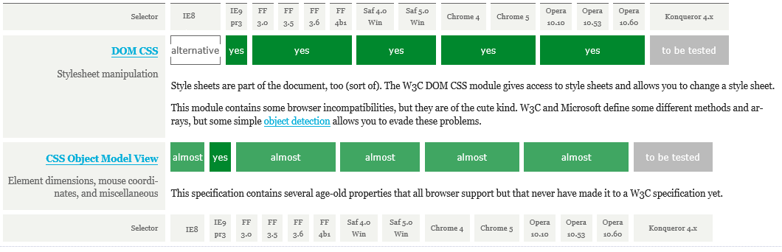
Incompatibilities between browsers and versions
There are sites that report incompatibilities (also called browser quirks)
Some problems can be avoided by using JavaScript libraries such as JQuery
http://www.quirksmode.org/compatibility.html

Slide 6
Overview
JavaScript can be included in a HTML document in two ways:
Embedding the <script></script> tags in the head or body element
Linking a separate JavaScript file to the HTML Document
<body>
<script>document.write("Really, I have to do coding?")</script>
</body>
// this script accesses the document object (html body) to write text
<head>
<script src="../Scripts/file.js" ></script>
</head>
Notes:
JavaScript programs are just content in the HTML document so they have their own tag the script tag:
<script language="JavaScript" type="text/javascript">
A page can have multiple scripts using a combination of embedding or linking.
Regardless of their location, these scripts can be executed immediately or just contain definitions of functions that will be called elsewhere in the page. The HTML engine reads the scripts twice: once to parse any function definitions and a second time, to execute code that is not a function definition.

Slide 7
Overview
JavaScript doesn’t support classes
Technically it’s not an object orientated programming language
It can emulate objects but there are no class definitions for objects
It’s Dynamic and weakly typed
Dynamic
Dynamic - you can add properties to objects whenever you want (even after it’s been made)
As the developer you have to manage the properties yourself (no compile errors)
Notes:
Javascript does not throw compile errors. It works or it doesn’t
Javascript is not compiled. Compiled languages are checked for functionality, correct data types etc before they are used whereas interpreted languages are run and interpreted when needed.
Javascript must be used more carefully.

Slide 8
Overview
It’s Dynamic and weakly typed
Weakly typed
Everything is declared with a var. What may start off as a string could end up as a number or Boolean but they are all var!
Functions can receive variables of whatever type – it’ not specified
In most cases, javascript will perform type conversions automatically when they are needed
5 + stars = ‘5 stars’
5 +’5’ = 10 55 // must use parseInt('5') or parseFloat();
Notes:
Javascript does not throw compile errors. It works or it doesn’t

Slide 9
Overview
Debugging Tools
JavaScript can be debugged using both VS2015 or the built in Browser debugger
IE/Firefox use F12 to open the debugging tools
Click on line numbers in the JavaScript code to create break points
Break points stop the code at that location so you can look at specific values
Use the Document Object Model (DOM) explorer to check names of IDs, classes and edit CSS quickly
Use the Network tools to inspect JSON transfers and post back content

Slide 10
JavaScript Variables
JavaScript uses variables
Variables are used to temporarily store information that can change over time when the script is running
Variables are defined using the var syntax with a unique name
var height = 6;
var text = "Hello World" ;
var text2 = 'Hello World' ; // preferred string

Slide 11
JavaScript Variables
Types
String, number, Boolean, array, object, null, undefined
If you ask for a variable that isn’t initialised – it returns undefined
If you ask for a variable that doesn’t have a value – it returns null
function onready () {
var myString = "hello world";
var myBoolean = true;
var myNumber = 10;
var myFloat = 10.111;
var myEmpty = null;
var myUndefined; // undefined!
alert("myUndefined" + myUndefined);
}
<body>
<script>onready();</script>
</body>
http://alignedleft.com/tutorials/d3/data-types

Slide 12
JavaScript Variables
Types
String, number, Boolean, array, object, null, undefined
If you ask for a variable that isn’t initialised – it returns undefined
If you ask for a variable that doesn’t have a value – it returns null
var calc = 5 + '5';
log("calc: " + calc);
log("calc == 55: " + (calc == 55)); // true
log("calc == 55: " + (calc === 55)); // false
var calc2 = 5 + parseInt('5');
alert(calc2 == 10); // true
alert(calc2 === 10); // true
http://alignedleft.com/tutorials/d3/data-types

Slide 13
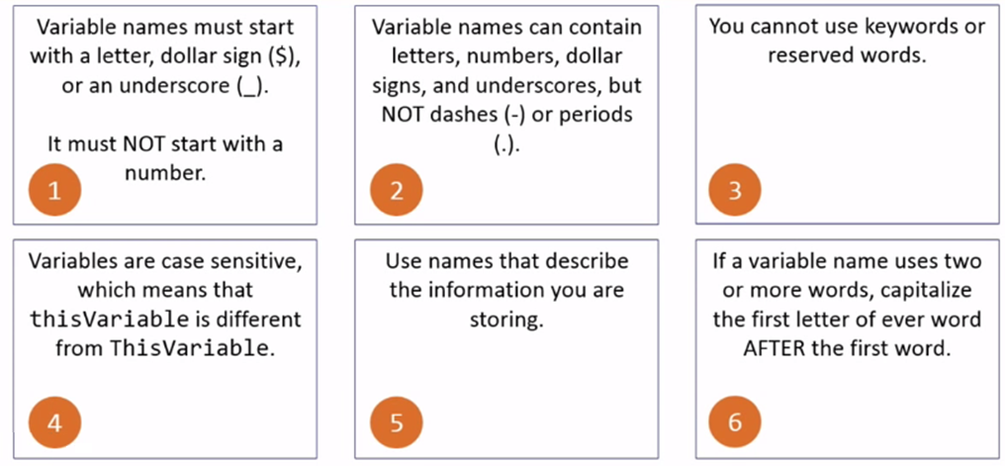
JavaScript Variables
Rules for naming variables
var, function etc

Slide 14
JavaScript Functions
JavaScript Functions
A Function is a group of statements that are combined to perform a given task (e.g. add two numbers)
A Statement is a line of code that performs a specific action.
In JavaScript, statements are ended with a semicolon (;) although even this is now optional!
<head>
<script>
// a named function
function onready() {
// a statement
alert("hello world");
}
</script>
</head>
<body>
<script>onready();</script>
</body>

Slide 15
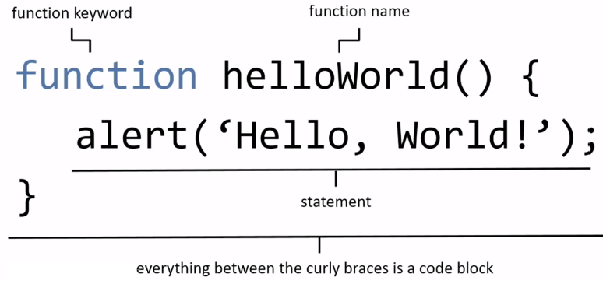
JavaScript Functions
JavaScript Functions

Slide 16
JavaScript Functions
JavaScript supports 1st Class Functions
Unlike modern programming languages, functions are equivalent to objects meaning they can be passed around, modified and have attributes added whenever!
This allows functions to be passed as variables to other functions/objects
Useful for “callbacks”
It uses a syntax very similar to Java, C# etc
Angle braces for code blocks
Square brackets for arrays of values
Semi colons for ends of statements
Variables declared in code blocks exist only in that block

Slide 17
JavaScript Functions
JavaScript supports 1st Class Functions
<head>
<script>
/* a named function */
function onready() {
alert(onready);
var myString = "hello world";
}
</script>
</head>
<body>
<script>onready();</script>
</body>
<head>
<script>
/* a function declared as a variable */
var onready = function() {
alert(onready);
var myString = "hello world";
}
</script>
</head>
<body>
<script>onready();</script>
</body>

Slide 18
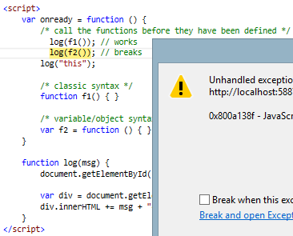
JavaScript Functions
JavaScript implements Hoisting
The compiler looks ahead and sees that there are functions defined later in the code after they have been used
If a function is used as a variable, it must be declared before it is used not after
F1 is declared using normal function syntax and so is hoisted (compiled ahead of time)
F2 is declared as a variable and so hasn’t been hoisted and thus had not been compiled yet
Notes:
In JavaScript functions are highly regarded!
JavaScript also allows Hoisting
Is where a function can be defined later in code than where it appears to be used
The compiler looks ahead and sees that there are functions defined later in the code and it considers that

Slide 19
JavaScript Functions
Variable Scope
Variables declared inside a function are not available outside the function
<head>
<script>
var x = 5
function someFunction() {
var localVal = 12;
return insideVal;
}
alert(x + localVal); // error
alert(x + someFunction()); // 17
</script>
</head>
Global Scope:
Variables declared outside a function exist for the whole page
Local Scope:
Variables declared inside a function exist only in the function
Automatically Global:
Variables declared inside a function without the var keyword are also global scope variables

Slide 20
JavaScript Functions
Executing a Function
<script>
function helloWorld() {
alert("helloWorld");
}
</script>
Function
Function Trigger using an Event Handler
<body>
<button onclick="helloWorld()">Click Me!</button>
<script>
helloWorld();
</script>
</body>

Slide 21
Topics
Querying the DOM
How to access a specific element(s)
Manipulating the DOM
Responding to Events
JQuery

Slide 22
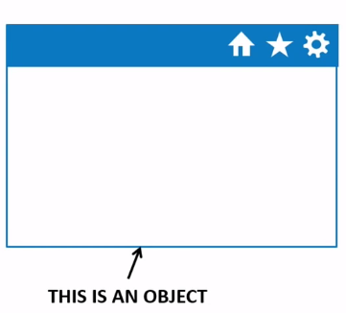
Document Object Model
Everything in html is an object to JavaScript
The window
The HTML document
All the HTML elements
The HTML page is parsed and a Document Object Model (DOM) created based on all of the element

Slide 23
The Window Object
The browser window is so important you rarely need to reference it directly
The following examples that trigger a popup window message are the same:
window.alert('You pushed me!');
alert('You pushed me!');
https://developer.mozilla.org/en-US/docs/Web/API/Window

Slide 24
The Window Object
The window object can also be used to get information about the current page location
The location is both readable and writable
<script>
alert(window.location) // shows the current url
alert(window.location.href)
</script>
<button onclick="window.location='http://www.unisa.edu.au'">Press</button><br />
<button onclick="location='http://www.unisa.edu.au'">Press</button>

Slide 25
The Document Object
The Document object reflects the HTML document
It has a lot more that can be done with it
A lot more methods. . .
<script>
alert(document.location) // shows the current url
alert(document.location.href)
</script>
<button onclick="document.location='http://www.unisa.edu.au'">Press</button><br />
<button onclick="document.location.href='http://www.unisa.edu.au'">Press</button>
The document location property is not writable in all browsers
https://developer.mozilla.org/en-US/docs/Web/API/Location

Slide 26

Document Object Model
Descendants
Parent
Ancestors
<!DOCTYPE html>
<html>
<head>
<title>My Title</title>
<meta charset="utf-8" />
</head>
<body>
<h1>My header</h1>
<a href="http://www.unisa.edu.au">My Link</a>
</body>
</html>
Child
< Siblings >
Notes:
The Document Object Model
Once an HTML page has been parsed and displayed it is structured as a document object according to the Document Object Model (DOM). So programming the HTML document can also be considered as manipulating an object that conforms to the DOM.

Slide 27
Document Object Model
The HTML DOM is a standard object model and programming interface for HTML
The browser builds a model of the HTML document which includes
The HTML elements as objects
Any attributes of the HTML elements (href, text etc)
Methods to access all of the HTML elements
Any events associated with the different HTML elements
The model defines how to get, change, add, or delete HTML elements and their attributes from the document

Slide 28
Querying the DOM - JavaScript
Navigating the DOM is complex so the standard allows any element to be accessed using one of several methods:
getElementById(“theID”)
Finds an element in the DOM by it’s ID
Remember an id should be unique for the entire document hence element
getElementsByTagName(“div”)
Note that this is elements because a document may have many of the same tag
querySelector(“#id”) //new
Finds the first occurrence of an element
querySelectorAll(“.className”) //new
Finds ALL occurrences of an element and returns them as a node list of elements
https://developer.mozilla.org/en-US/docs/Web/API/Document/querySelectorAll

Slide 29
Querying the DOM
To find an element by ID there are two common approaches:
The 2nd query uses a #id or .className as per CSS standards
The 2nd query selector can also be any other selector (eg a .class selector)
The querySelector will only return the first item if there are multiple matches
var x = document.getElementById("anyID");
// or
var x = document.querySelector("#anyID");

Slide 30
Querying the DOM
To find an element by class name or element
Use the querySelector if you know there is only one item that will be returned or you only want the first match.
Use the querySelectorAll if you want all the matches.
var x = document.querySelector(".item, li");
var list = document.querySelectorALL(".item, li");
var item = document.querySelectorAll(".item, li").item(0)
x.innerHtml = "Something New";

Slide 31
JavaScript Event Handlers
The DOM includes built in events that can be triggered
JavaScript includes event handlers and listeners that respond to specific events
Events | Event Handler | Event Listner
Form submission | onsubmit | submit
Keystrokes | onkeydown, onkeypress, onkeyup | keydown, keypress, keyup
Mouse/touchpad clicks | onclick, onmousedown, onmouseup, onmouseover, onmouseout | click, mousedown. . .
Item selection | onselect | select
Item changed | onchange | change
Page load complete | onload | load
Notes:
An event handler is assigned directly to a HTML element. For example: <button onclick=“somefunction” />
This has the disadvantage that only one function can be associated with that handler for that element. This means if you want two things to happen when the button is clicked you must add it to the somefunction code.
Alternatively, you can add as many event listeners for a element as you like. This is done independently of the element html tag (see following slide)

Slide 32
JavaScript Event Listeners
<script>
function toggleContent() {
var content = document.getElementById("content");
if (content.style.display == "none") {
content.style.display = "block";
}
else { content.style.display = "none"; }
} // end toggleContent
var button = document.getElementById("BClick");
button.addEventListener("click", toggleContent, false);
</script>
<button id="BClick">Click!</button>
<hr />
<div id="content" style="display:none">Show some content</div>
Notes:
Note that this is an EventListner as opposed to an EventHandler.
The difference is that an event handler would assign an event to the button:
button.onclick = toggleContent;
This is different because only one event can be assigned to the button. However, many event listeners can be assigned to the same button even if they overlap.
This function defines a variable called “content” which is based on the div id=content element (the div and all of the html it contains).
Now we are using the content div, checking its style properties for a display value. If the item is not visible (display == “none” then we set the display to “block” or visible.
If not, then set it to hidden (“display none”);
This function does nothing unless another event calls it. You can call it anything you want.
Thus javascript allows us to use HTML elements as objects and to read and or modify them.
Remember a function is a declaration of behaviour and does nothing until called.
The last statements find the button on the page, and add a click event listener to it. Clicking the button calls the “toggleContent” function.

Slide 33
JavaScript Other Functions
Confirm Dialogue
There’s also a prompt() but it’s crummy!
var reset = confirm("Are you sure you want to reset the page?");
if (reset) {
// do stuff
}

Slide 34
JQuery
JavaScript on steroids

Slide 35
JQuery Overview
JQuery is a library of JavaScript functions written to assist web developers with their work
It is extremely popular due to the css-style selectors and large number of plugins/additional libraries that can be added to a web project
Using CSS-style selectors for selecting elements and creating event listeners made it easy to use for web designers and enthusiasts
JQuery also overcomes some of the incompatibilities between browsers
It provides a common way of handling everything and works the same on all browsers (well… mostly)
Notes:
jQuery is designed to search the HTML document object quickly in a browser independent way.
It uses document.getElementById() and the query selectors to do this.
It takes all the standard Javascript methods and wraps them in more user-friendly functions.

Slide 36
What does jQuery do?
Simplified HTML document traversing
$("#id) vs document.getElementByID("id")
Common event handling for all browsers
button.on("click", toggleContent) vs
button.addEventListener("click", toggleContent, false);
Easy animation
Common Ajax interactions for all browsers
For a comprehensive tutorial example see: http://ejohn.org/apps/workshop/intro/

Slide 37
JQuery Vs JavaScript
Using the JavaScript querySelector and querySelectAll will only manipulate objects on a single item basis (using item(0)..)
JQuery enables multiple items to be modified at once
$("div").addClass("selected"); // change all divs
$("div").get(0).addClass("selected"); // change 1st div

Slide 38
JQuery Output
Not only does JQuery locate elements using CSS syntax, it provides clean methods for modifying their attributes
$("p").append("<span>This is new text</span>"); // add element after
$("p").html("<span>This is new text</span>"); // replace inner html
$("p").text("Just plain text"); // replace inner html text
$("input[type=text]").val("Some Text Entered"); // replace value
$("p").css("font-size", "2em"); // add a CSS style
$("input [type=text]").attr("required", ""); // add a new attribute
To get values, just leave the replacement value blank
var text = $("p").html();

Slide 39
JQuery Selectors
JQuery selectors use CSS styntax
$("p").append("<span>This is new text</span>"); // add element after
$("p").html("<span>This is new text</span>"); // replace inner html
$("p").text("Just plain text"); // replace inner html text
$("input[type=text]").val("Some Text Entered"); // replace value
$("p").css("font-size", "2em"); // add a CSS style
$("input [type=text]").attr("required", ""); // add a new attribute
To get values, just leave the replacement value blank
var text = $("p").html();

Slide 40
JQuery Event Listeners vs Delegates
JavaScript does not handle adding listeners to dynamically added elements very well (see http://jsfiddle.net/founddrama/ggMUn/)
JQuery handles adding events to existing and dynamic elements nicely
Listeners only work if the element was on the page when it loaded
Delegations work for all elements even if they were added dynamically after the page was loaded
https://learn.jquery.com/events/event-delegation/

Slide 41
JQuery Event Listeners vs Delegates
<ul>
<li>Item 1</li>
<li>Item 2</li>
</ul>
<button>Add Item</button>
<script>
$("button").on("click", function () {
var count = $("ul").find("li").length;
$("ul").append("<li>Item " + (count + 1) + "</li>");
});
$("li").on("click", function () {
alert($(this).text()); // listener doesn’t work for li3, 4...
});
$("ul").on("click", "li", function () {
alert($(this).text()); // delegate works for li3, 4, 5...
});
</script>
Alternative to this on next page

Slide 42
JQuery Event Listeners VS JavaScript
JQuery makes programming easier and quicker
<script>
$("button").click(function () { // $("button").on("click", function. . .
var count = $("ul").find("li").length; // or children("li")..
$("ul").append("<li>Item " + (count + 1) + "</li>");
}, false);
var btn = document.getElementById("btn");
btn.addEventListener("click", function () {
var count = document.querySelector("ul").childElementCount;
var li = document.createElement("li");
li.appendChild(document.createTextNode("Item " + (count + 1)));
document.querySelector("ul").appendChild(li);
});
</script>
<ul>
<li>Item 1</li>
<li>Item 2</li>
</ul>
<button>Add Item JQ</button>
<button id="btn">Add Item JS</button>

Slide 43
JQuery Method Chaining
JQuery supports method chaining which allows the output of one function to feed into another
$("body").append("<p style='display:none'>New text</p>").find("p").fadeIn();
// same as:
$("body")
.append("<p style='display:none'>New text</p>")
.find("p")
.fadeIn();

