Slide 1
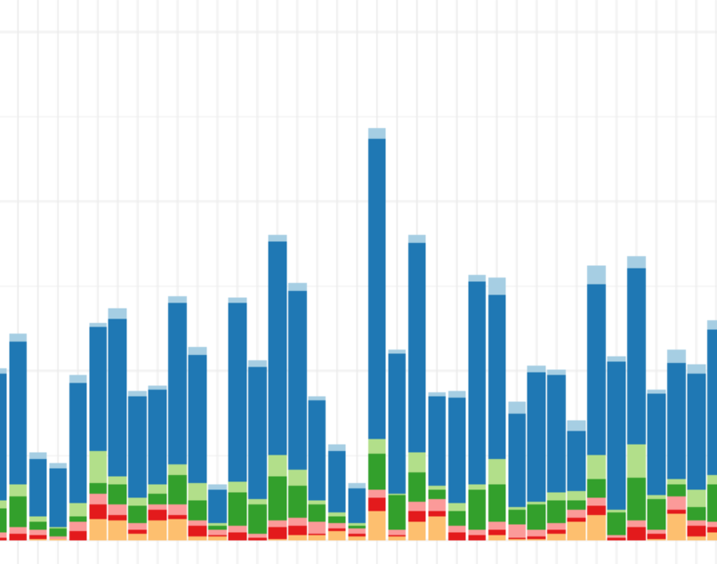
MMR Summary
Mumps – Measles - Rubella

Slide 2
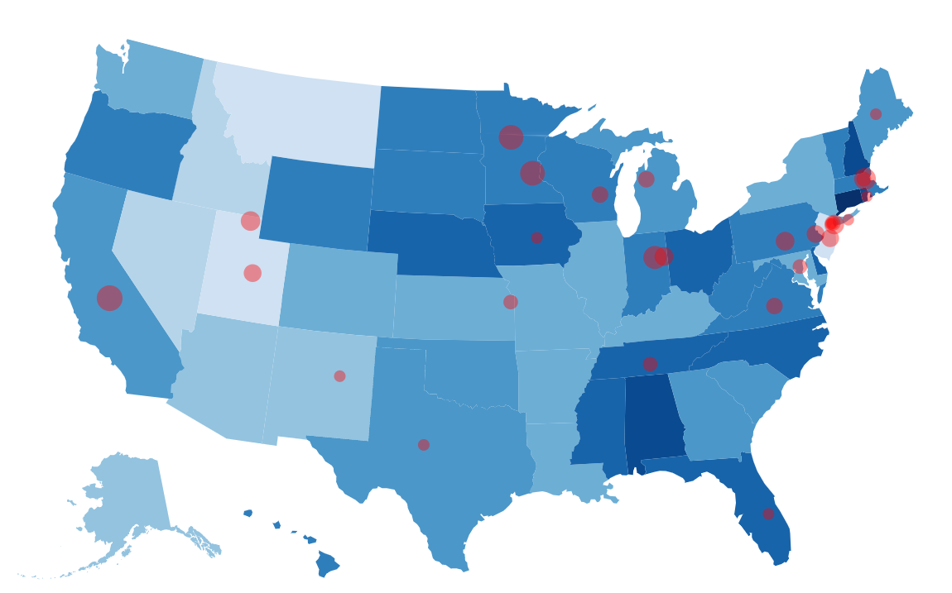
MMR Vaccination
Mumps – Measles - Rubella

Slide 3
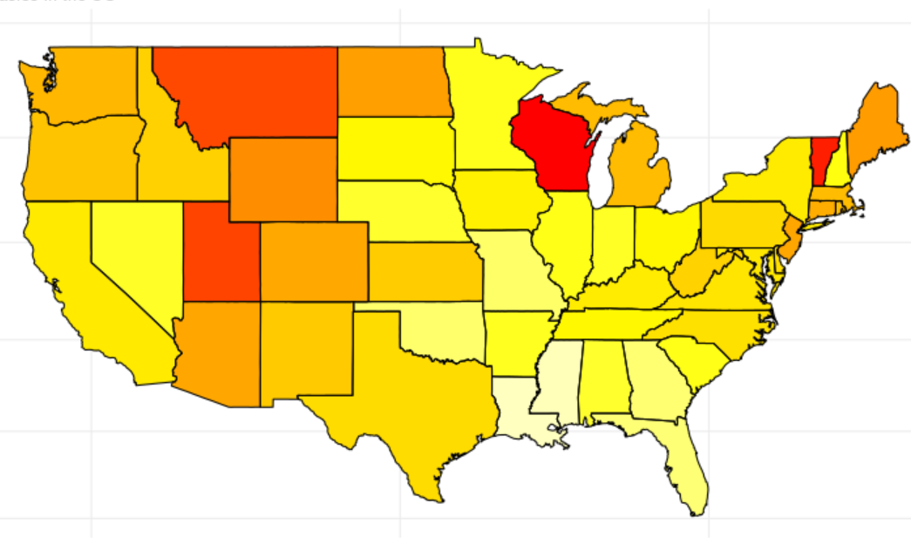
Diseases Correlation

Slide 4

ABOUT

