Slide 1

The Effects of Net Migration in Canada
Presented by :
Purnima, Jodi, Bobby, Sam, Andre

Slide 2
Agenda
Introduction & Problem Statement
Methods
Findings
Conclusions
Implications & Discussion

Slide 3
Introduction and Problem statement
We wanted to find out the following:
Does migration affect the unemployment rate?
Does migration affect the crime rate?
Does migration affect GDP per capita?

Slide 4
Methods

Slide 5
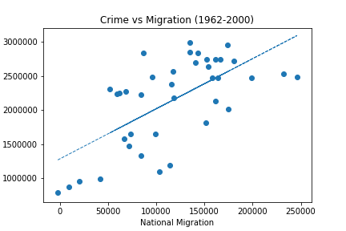
Findings
We find a good p-value and standard error for Crime Rate vs Migration, but a poor r- value. There is some corelation between the two but the trend can be affected by other economic and societal factors as well.

Slide 6
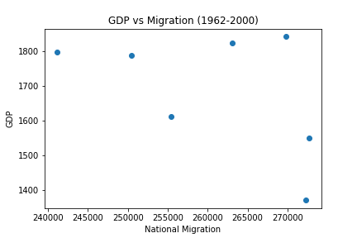
Findings
GDP and MIgration does not show any corealation. There can be many factors for the trend such as: #Actually, not corelated #Data availabilty for a smaller time frame #GDP is being affected by number of other factors

Slide 7
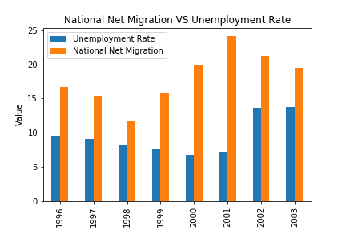
Findings

Slide 8
Conclusions
We wanted to find out the following:

Slide 9
implications
The following considerations were made:

