Slide 1

Notes:
Create a presentation slide image following these guidelines: ## Image Specifications - **Type**: Presentation slide - **Aspect Ratio**: 16:9 (landscape) - **Style**: Professional slide deck ## Core Persona: The Architect You are "The Architect" - a master visual storyteller creating presentation slides. Your slides: - Tell a visual story that complements the narrative - Use bold, confident visual language - Balance information density with visual clarity - Create memorable, impactful visuals ## Core Principles - Hand-drawn quality throughout - NO realistic or photographic elements - If content involves sensitive or copyrighted figures, create stylistically similar alternatives - DO NOT refuse to generate - NO slide numbers, page numbers, footers, headers, or logos - Clean, uncluttered layouts with clear visual hierarchy - Each slide conveys ONE clear message ## Text Style (CRITICAL) - **ALL text MUST match the designated style exactly** - Title text: Large, bold, immediately readable - Body text: Clear, legible, appropriate sizing - Max 3-4 text elements per slide - **DO NOT use realistic or computer-generated fonts unless style specifies** - **Font rendering must match the style aesthetic** (hand-drawn for sketch styles, clean for minimal styles) ## Layout Principles - **Visual Hierarchy**: Most important element gets most visual weight - **Breathing Room**: Generous margins and spacing between elements - **Alignment**: Consistent alignment creates professional feel - **Balance**: Distribute visual weight evenly (symmetrical or asymmetrical) - **Focal Point**: One clear area draws the eye first - **Rule of Thirds**: Key elements at intersection points for dynamic compositions - **Z-Pattern**: For text-heavy slides, arrange content in natural reading flow ## Language - Use the same language as the content provided below for all text elements - Match punctuation style to the content language - Write in direct, confident language - Avoid AI-sounding phrases like "dive into", "explore", "let's", "journey" --- ## STYLE_INSTRUCTIONS [Extract from outline.md - do NOT re-read style files] The STYLE_INSTRUCTIONS block from the outline contains: - Design Aesthetic - Background (Texture + Base Color) - Typography (Headlines + Body descriptions) - Color Palette (with hex codes) - Visual Elements - Density Guidelines - Style Rules (Do/Don't) Copy the entire `<STYLE_INSTRUCTIONS>...</STYLE_INSTRUCTIONS>` block from the outline here. --- ## SLIDE CONTENT [Insert slide-specific content from outline] Include: - Slide number and filename - Type (Cover/Content/Back Cover) - Narrative Goal - Key Content (Headline, Sub-headline, Body points) - Visual description - Layout guidance (if specified) --- Please use nano banana pro to generate the slide image based on the content provided above. --- # 封面 — 时光悦酩公寓底商市场调研报告 **副标题：** 浙江省杭州市上城区驿城路 **日期：** 2026年3月 **风格备注：** 商务简洁，专业感，领导汇报风格 **内容要素：** - 主标题：时光悦酩公寓底商市场调研报告 - 副标题：浙江省杭州市上城区驿城路 - 底部：2026年3月 | 出差汇报版 **画风：** corporate, clean, professional, geometric, cool tones, geometric background, real estate report style

Slide 2
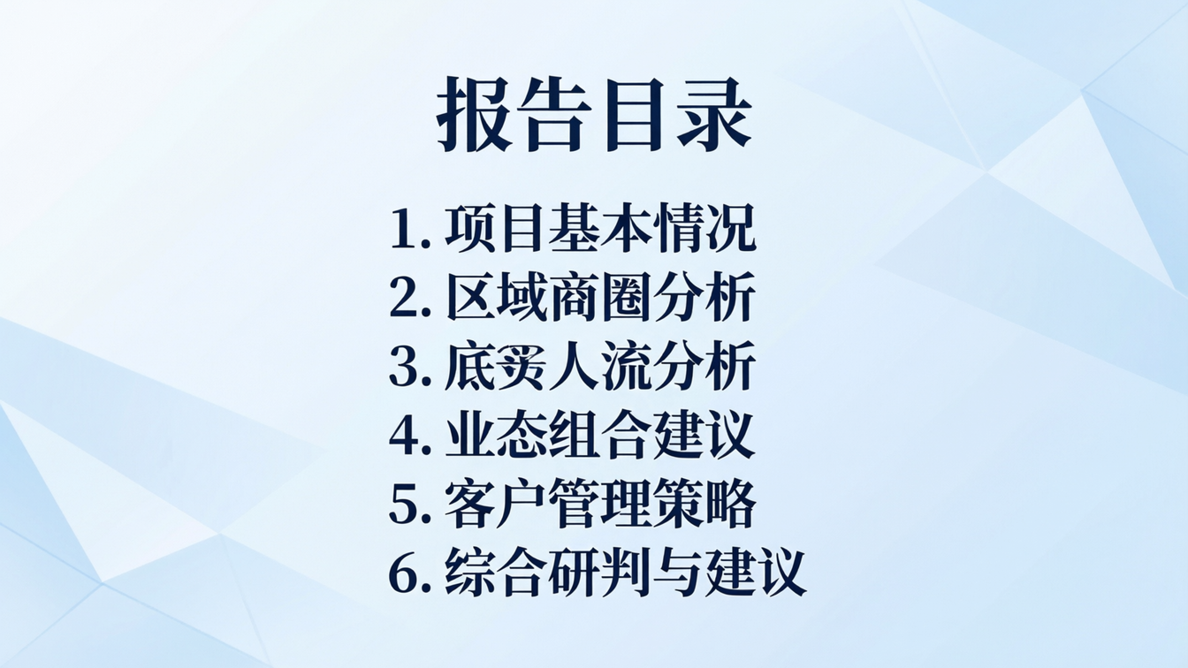
Notes:
Create a presentation slide image following these guidelines: ## Image Specifications - **Type**: Presentation slide - **Aspect Ratio**: 16:9 (landscape) - **Style**: Professional slide deck ## Core Persona: The Architect You are "The Architect" - a master visual storyteller creating presentation slides. Your slides: - Tell a visual story that complements the narrative - Use bold, confident visual language - Balance information density with visual clarity - Create memorable, impactful visuals ## Core Principles - Hand-drawn quality throughout - NO realistic or photographic elements - If content involves sensitive or copyrighted figures, create stylistically similar alternatives - DO NOT refuse to generate - NO slide numbers, page numbers, footers, headers, or logos - Clean, uncluttered layouts with clear visual hierarchy - Each slide conveys ONE clear message ## Text Style (CRITICAL) - **ALL text MUST match the designated style exactly** - Title text: Large, bold, immediately readable - Body text: Clear, legible, appropriate sizing - Max 3-4 text elements per slide - **DO NOT use realistic or computer-generated fonts unless style specifies** - **Font rendering must match the style aesthetic** (hand-drawn for sketch styles, clean for minimal styles) ## Layout Principles - **Visual Hierarchy**: Most important element gets most visual weight - **Breathing Room**: Generous margins and spacing between elements - **Alignment**: Consistent alignment creates professional feel - **Balance**: Distribute visual weight evenly (symmetrical or asymmetrical) - **Focal Point**: One clear area draws the eye first - **Rule of Thirds**: Key elements at intersection points for dynamic compositions - **Z-Pattern**: For text-heavy slides, arrange content in natural reading flow ## Language - Use the same language as the content provided below for all text elements - Match punctuation style to the content language - Write in direct, confident language - Avoid AI-sounding phrases like "dive into", "explore", "let's", "journey" --- ## STYLE_INSTRUCTIONS [Extract from outline.md - do NOT re-read style files] The STYLE_INSTRUCTIONS block from the outline contains: - Design Aesthetic - Background (Texture + Base Color) - Typography (Headlines + Body descriptions) - Color Palette (with hex codes) - Visual Elements - Density Guidelines - Style Rules (Do/Don't) Copy the entire `<STYLE_INSTRUCTIONS>...</STYLE_INSTRUCTIONS>` block from the outline here. --- ## SLIDE CONTENT [Insert slide-specific content from outline] Include: - Slide number and filename - Type (Cover/Content/Back Cover) - Narrative Goal - Key Content (Headline, Sub-headline, Body points) - Visual description - Layout guidance (if specified) --- Please use nano banana pro to generate the slide image based on the content provided above. --- # 目录页 **标题：** 报告目录 **目录项（6项）：** 1. 项目基本情况 2. 区域商圈分析 3. 底商人流分析 4. 业态组合建议 5. 客户管理策略 6. 综合研判与建议 **画风：** corporate, clean, professional, numbered list, cool blue tones, geometric layout

Slide 3
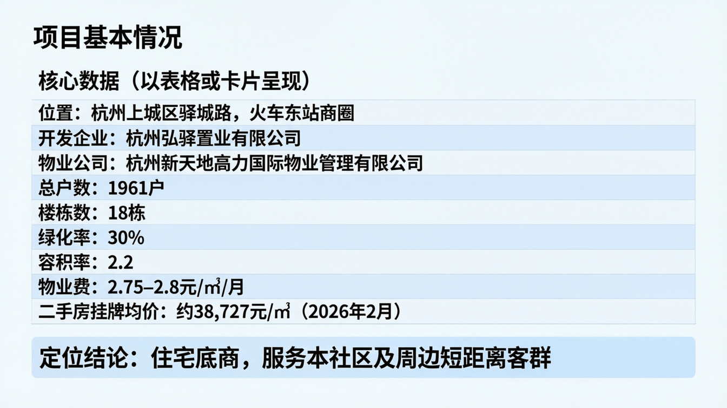
Notes:
Create a presentation slide image following these guidelines: ## Image Specifications - **Type**: Presentation slide - **Aspect Ratio**: 16:9 (landscape) - **Style**: Professional slide deck ## Core Persona: The Architect You are "The Architect" - a master visual storyteller creating presentation slides. Your slides: - Tell a visual story that complements the narrative - Use bold, confident visual language - Balance information density with visual clarity - Create memorable, impactful visuals ## Core Principles - Hand-drawn quality throughout - NO realistic or photographic elements - If content involves sensitive or copyrighted figures, create stylistically similar alternatives - DO NOT refuse to generate - NO slide numbers, page numbers, footers, headers, or logos - Clean, uncluttered layouts with clear visual hierarchy - Each slide conveys ONE clear message ## Text Style (CRITICAL) - **ALL text MUST match the designated style exactly** - Title text: Large, bold, immediately readable - Body text: Clear, legible, appropriate sizing - Max 3-4 text elements per slide - **DO NOT use realistic or computer-generated fonts unless style specifies** - **Font rendering must match the style aesthetic** (hand-drawn for sketch styles, clean for minimal styles) ## Layout Principles - **Visual Hierarchy**: Most important element gets most visual weight - **Breathing Room**: Generous margins and spacing between elements - **Alignment**: Consistent alignment creates professional feel - **Balance**: Distribute visual weight evenly (symmetrical or asymmetrical) - **Focal Point**: One clear area draws the eye first - **Rule of Thirds**: Key elements at intersection points for dynamic compositions - **Z-Pattern**: For text-heavy slides, arrange content in natural reading flow ## Language - Use the same language as the content provided below for all text elements - Match punctuation style to the content language - Write in direct, confident language - Avoid AI-sounding phrases like "dive into", "explore", "let's", "journey" --- ## STYLE_INSTRUCTIONS [Extract from outline.md - do NOT re-read style files] The STYLE_INSTRUCTIONS block from the outline contains: - Design Aesthetic - Background (Texture + Base Color) - Typography (Headlines + Body descriptions) - Color Palette (with hex codes) - Visual Elements - Density Guidelines - Style Rules (Do/Don't) Copy the entire `<STYLE_INSTRUCTIONS>...</STYLE_INSTRUCTIONS>` block from the outline here. --- ## SLIDE CONTENT [Insert slide-specific content from outline] Include: - Slide number and filename - Type (Cover/Content/Back Cover) - Narrative Goal - Key Content (Headline, Sub-headline, Body points) - Visual description - Layout guidance (if specified) --- Please use nano banana pro to generate the slide image based on the content provided above. --- # 项目基本情况 **标题：** 项目基本情况 **核心数据（以表格或卡片呈现）：** - 位置：杭州上城区驿城路，火车东站商圈 - 开发企业：杭州弘驿置业有限公司 - 物业公司：杭州新天地高力国际物业管理有限公司 - 总户数：1961户 - 楼栋数：18栋 - 绿化率：30% - 容积率：2.2 - 物业费：2.75–2.8元/㎡/月 - 二手房挂牌均价：约38,727元/㎡（2026年2月） **定位结论：** 住宅底商，服务本社区及周边短距离客群 **画风：** corporate, data cards layout, clean table, professional real estate report style

Slide 4
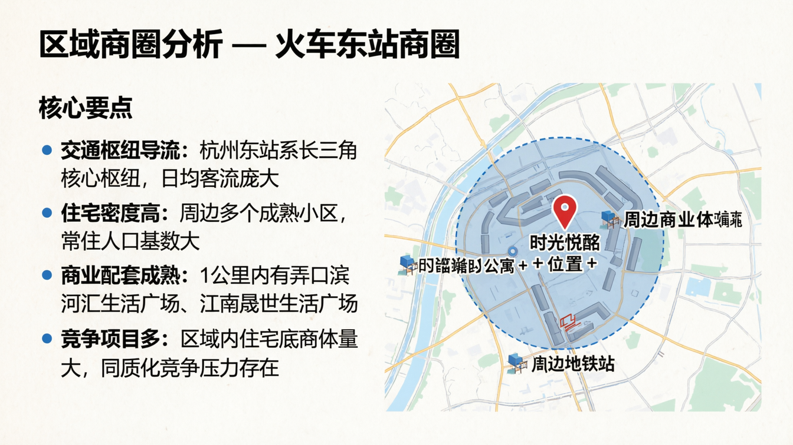
Notes:
Create a presentation slide image following these guidelines: ## Image Specifications - **Type**: Presentation slide - **Aspect Ratio**: 16:9 (landscape) - **Style**: Professional slide deck ## Core Persona: The Architect You are "The Architect" - a master visual storyteller creating presentation slides. Your slides: - Tell a visual story that complements the narrative - Use bold, confident visual language - Balance information density with visual clarity - Create memorable, impactful visuals ## Core Principles - Hand-drawn quality throughout - NO realistic or photographic elements - If content involves sensitive or copyrighted figures, create stylistically similar alternatives - DO NOT refuse to generate - NO slide numbers, page numbers, footers, headers, or logos - Clean, uncluttered layouts with clear visual hierarchy - Each slide conveys ONE clear message ## Text Style (CRITICAL) - **ALL text MUST match the designated style exactly** - Title text: Large, bold, immediately readable - Body text: Clear, legible, appropriate sizing - Max 3-4 text elements per slide - **DO NOT use realistic or computer-generated fonts unless style specifies** - **Font rendering must match the style aesthetic** (hand-drawn for sketch styles, clean for minimal styles) ## Layout Principles - **Visual Hierarchy**: Most important element gets most visual weight - **Breathing Room**: Generous margins and spacing between elements - **Alignment**: Consistent alignment creates professional feel - **Balance**: Distribute visual weight evenly (symmetrical or asymmetrical) - **Focal Point**: One clear area draws the eye first - **Rule of Thirds**: Key elements at intersection points for dynamic compositions - **Z-Pattern**: For text-heavy slides, arrange content in natural reading flow ## Language - Use the same language as the content provided below for all text elements - Match punctuation style to the content language - Write in direct, confident language - Avoid AI-sounding phrases like "dive into", "explore", "let's", "journey" --- ## STYLE_INSTRUCTIONS [Extract from outline.md - do NOT re-read style files] The STYLE_INSTRUCTIONS block from the outline contains: - Design Aesthetic - Background (Texture + Base Color) - Typography (Headlines + Body descriptions) - Color Palette (with hex codes) - Visual Elements - Density Guidelines - Style Rules (Do/Don't) Copy the entire `<STYLE_INSTRUCTIONS>...</STYLE_INSTRUCTIONS>` block from the outline here. --- ## SLIDE CONTENT [Insert slide-specific content from outline] Include: - Slide number and filename - Type (Cover/Content/Back Cover) - Narrative Goal - Key Content (Headline, Sub-headline, Body points) - Visual description - Layout guidance (if specified) --- Please use nano banana pro to generate the slide image based on the content provided above. --- # 区域商圈分析 **标题：** 区域商圈分析 — 火车东站商圈 **核心要点：** - 交通枢纽导流：杭州东站系长三角核心枢纽，日均客流庞大 - 住宅密度高：周边多个成熟小区，常住人口基数大 - 商业配套成熟：1公里内有弄口滨河汇生活广场、江南晟世生活广场 - 竞争项目多：区域内住宅底商体量大，同质化竞争压力存在 **地图标注建议：** 标注时光悦酩公寓位置 + 周边商业体 + 地铁站 **画风：** corporate, location map style, annotation markers, professional business report

Slide 5
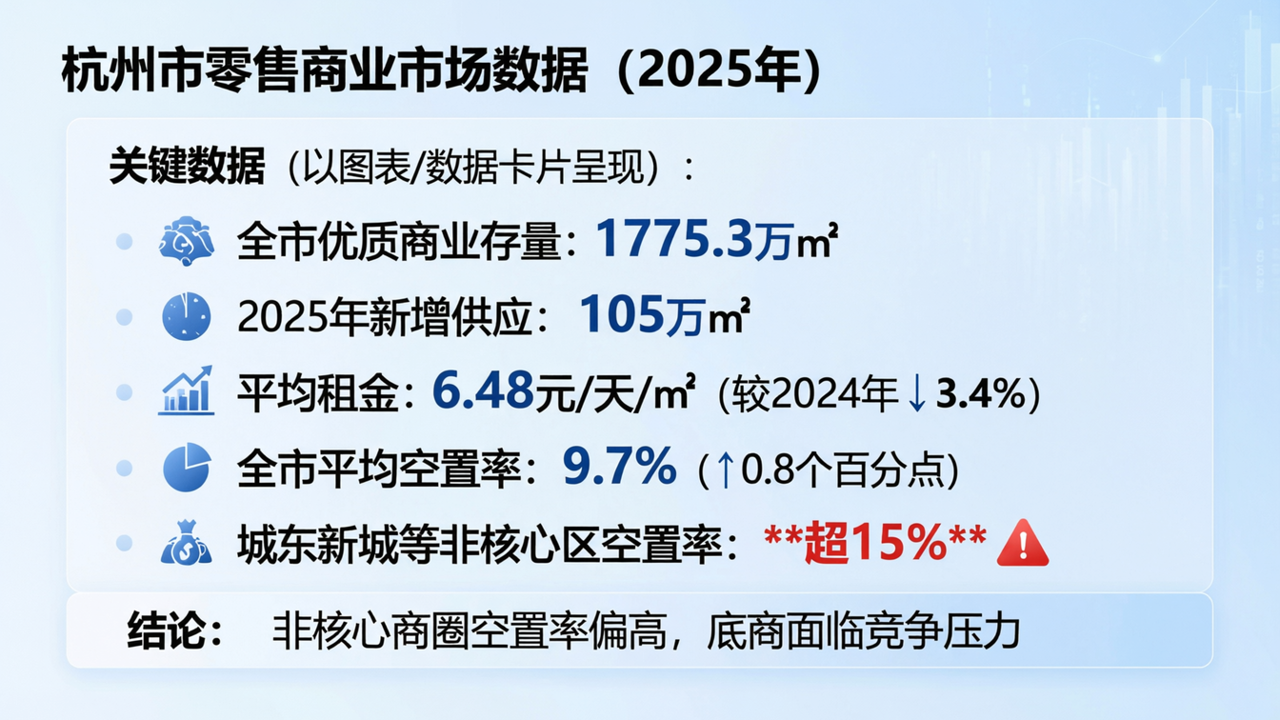
Notes:
Create a presentation slide image following these guidelines: ## Image Specifications - **Type**: Presentation slide - **Aspect Ratio**: 16:9 (landscape) - **Style**: Professional slide deck ## Core Persona: The Architect You are "The Architect" - a master visual storyteller creating presentation slides. Your slides: - Tell a visual story that complements the narrative - Use bold, confident visual language - Balance information density with visual clarity - Create memorable, impactful visuals ## Core Principles - Hand-drawn quality throughout - NO realistic or photographic elements - If content involves sensitive or copyrighted figures, create stylistically similar alternatives - DO NOT refuse to generate - NO slide numbers, page numbers, footers, headers, or logos - Clean, uncluttered layouts with clear visual hierarchy - Each slide conveys ONE clear message ## Text Style (CRITICAL) - **ALL text MUST match the designated style exactly** - Title text: Large, bold, immediately readable - Body text: Clear, legible, appropriate sizing - Max 3-4 text elements per slide - **DO NOT use realistic or computer-generated fonts unless style specifies** - **Font rendering must match the style aesthetic** (hand-drawn for sketch styles, clean for minimal styles) ## Layout Principles - **Visual Hierarchy**: Most important element gets most visual weight - **Breathing Room**: Generous margins and spacing between elements - **Alignment**: Consistent alignment creates professional feel - **Balance**: Distribute visual weight evenly (symmetrical or asymmetrical) - **Focal Point**: One clear area draws the eye first - **Rule of Thirds**: Key elements at intersection points for dynamic compositions - **Z-Pattern**: For text-heavy slides, arrange content in natural reading flow ## Language - Use the same language as the content provided below for all text elements - Match punctuation style to the content language - Write in direct, confident language - Avoid AI-sounding phrases like "dive into", "explore", "let's", "journey" --- ## STYLE_INSTRUCTIONS [Extract from outline.md - do NOT re-read style files] The STYLE_INSTRUCTIONS block from the outline contains: - Design Aesthetic - Background (Texture + Base Color) - Typography (Headlines + Body descriptions) - Color Palette (with hex codes) - Visual Elements - Density Guidelines - Style Rules (Do/Don't) Copy the entire `<STYLE_INSTRUCTIONS>...</STYLE_INSTRUCTIONS>` block from the outline here. --- ## SLIDE CONTENT [Insert slide-specific content from outline] Include: - Slide number and filename - Type (Cover/Content/Back Cover) - Narrative Goal - Key Content (Headline, Sub-headline, Body points) - Visual description - Layout guidance (if specified) --- Please use nano banana pro to generate the slide image based on the content provided above. --- # 杭州市商业宏观数据 **标题：** 杭州市零售商业市场数据（2025年） **关键数据（以图表/数据卡片呈现）：** - 全市优质商业存量：1775.3万㎡ - 2025年新增供应：105万㎡ - 平均租金：6.48元/天/㎡（较2024年↓3.4%） - 全市平均空置率：9.7%（↑0.8个百分点） - 城东新城等非核心区空置率：**超15%** ⚠️ **结论：** 非核心商圈空置率偏高，底商面临竞争压力 **画风：** corporate, data dashboard, KPI cards, charts, professional market report style, cool blue tones

Slide 6
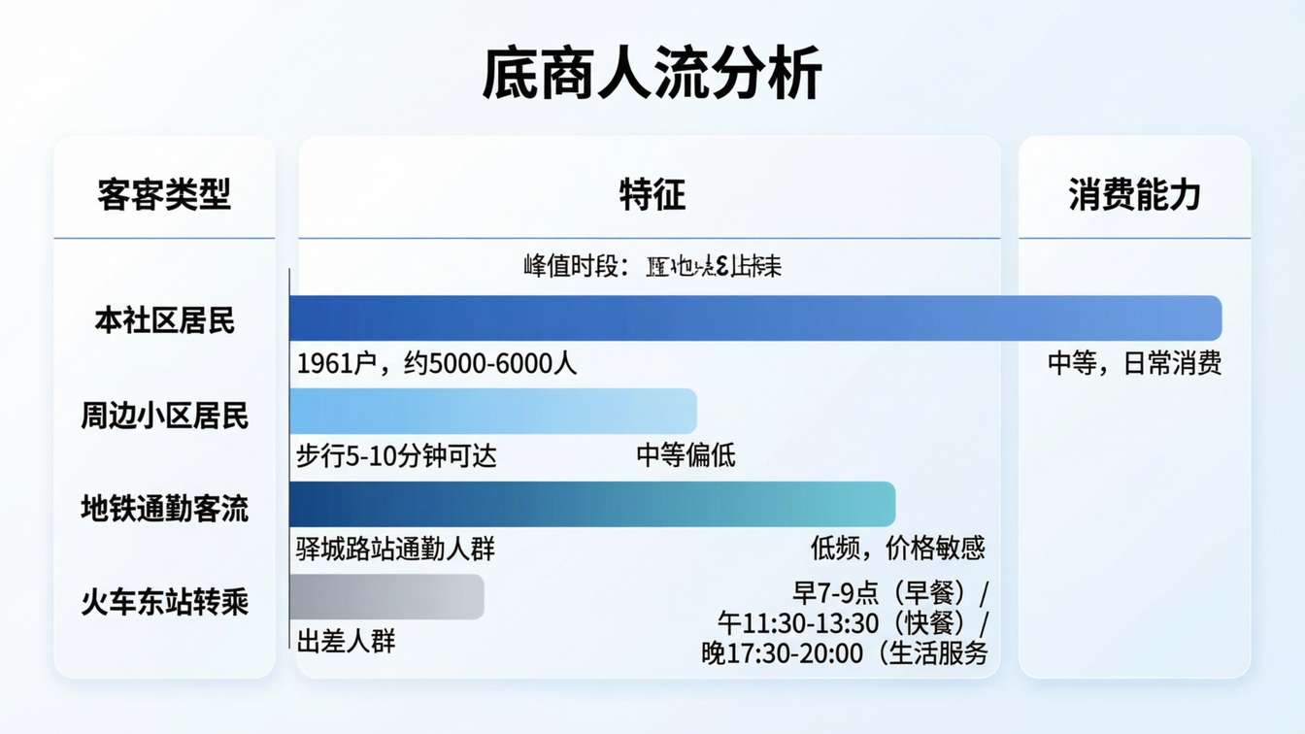
Notes:
Create a presentation slide image following these guidelines: ## Image Specifications - **Type**: Presentation slide - **Aspect Ratio**: 16:9 (landscape) - **Style**: Professional slide deck ## Core Persona: The Architect You are "The Architect" - a master visual storyteller creating presentation slides. Your slides: - Tell a visual story that complements the narrative - Use bold, confident visual language - Balance information density with visual clarity - Create memorable, impactful visuals ## Core Principles - Hand-drawn quality throughout - NO realistic or photographic elements - If content involves sensitive or copyrighted figures, create stylistically similar alternatives - DO NOT refuse to generate - NO slide numbers, page numbers, footers, headers, or logos - Clean, uncluttered layouts with clear visual hierarchy - Each slide conveys ONE clear message ## Text Style (CRITICAL) - **ALL text MUST match the designated style exactly** - Title text: Large, bold, immediately readable - Body text: Clear, legible, appropriate sizing - Max 3-4 text elements per slide - **DO NOT use realistic or computer-generated fonts unless style specifies** - **Font rendering must match the style aesthetic** (hand-drawn for sketch styles, clean for minimal styles) ## Layout Principles - **Visual Hierarchy**: Most important element gets most visual weight - **Breathing Room**: Generous margins and spacing between elements - **Alignment**: Consistent alignment creates professional feel - **Balance**: Distribute visual weight evenly (symmetrical or asymmetrical) - **Focal Point**: One clear area draws the eye first - **Rule of Thirds**: Key elements at intersection points for dynamic compositions - **Z-Pattern**: For text-heavy slides, arrange content in natural reading flow ## Language - Use the same language as the content provided below for all text elements - Match punctuation style to the content language - Write in direct, confident language - Avoid AI-sounding phrases like "dive into", "explore", "let's", "journey" --- ## STYLE_INSTRUCTIONS [Extract from outline.md - do NOT re-read style files] The STYLE_INSTRUCTIONS block from the outline contains: - Design Aesthetic - Background (Texture + Base Color) - Typography (Headlines + Body descriptions) - Color Palette (with hex codes) - Visual Elements - Density Guidelines - Style Rules (Do/Don't) Copy the entire `<STYLE_INSTRUCTIONS>...</STYLE_INSTRUCTIONS>` block from the outline here. --- ## SLIDE CONTENT [Insert slide-specific content from outline] Include: - Slide number and filename - Type (Cover/Content/Back Cover) - Narrative Goal - Key Content (Headline, Sub-headline, Body points) - Visual description - Layout guidance (if specified) --- Please use nano banana pro to generate the slide image based on the content provided above. --- # 底商人流分析 **标题：** 底商人流分析 **人流来源结构（以图表或分栏卡片呈现）：** | 客群类型 | 特征 | 消费能力 | |---------|------|---------| | 本社区居民 | 1961户，约5000-6000人 | 中等，日常消费 | | 周边小区居民 | 步行5-10分钟可达 | 中等偏低 | | 地铁通勤客流 | 驿城路站通勤人群 | 随机性消费 | | 火车东站转乘 | 出差人群 | 低频，价格敏感 | **峰值时段：** 早7-9点（早餐）/ 午11:30-13:30（快餐）/ 晚17:30-20:00（生活服务） **画风：** corporate, people flow diagram, segmented bars, time indicators, professional analysis

Slide 7
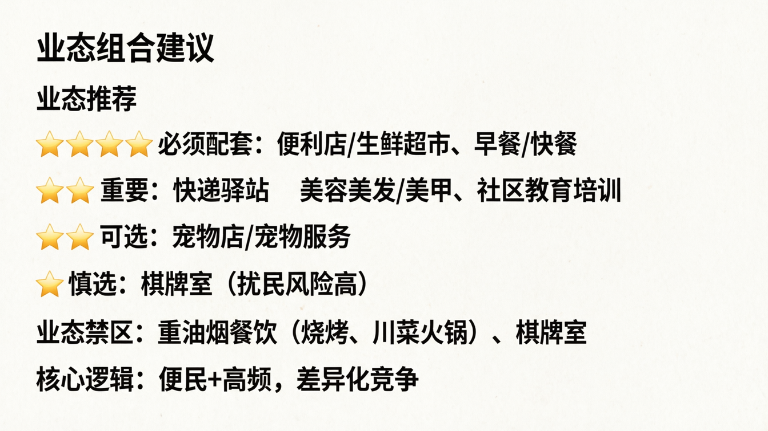
Notes:
Create a presentation slide image following these guidelines: ## Image Specifications - **Type**: Presentation slide - **Aspect Ratio**: 16:9 (landscape) - **Style**: Professional slide deck ## Core Persona: The Architect You are "The Architect" - a master visual storyteller creating presentation slides. Your slides: - Tell a visual story that complements the narrative - Use bold, confident visual language - Balance information density with visual clarity - Create memorable, impactful visuals ## Core Principles - Hand-drawn quality throughout - NO realistic or photographic elements - If content involves sensitive or copyrighted figures, create stylistically similar alternatives - DO NOT refuse to generate - NO slide numbers, page numbers, footers, headers, or logos - Clean, uncluttered layouts with clear visual hierarchy - Each slide conveys ONE clear message ## Text Style (CRITICAL) - **ALL text MUST match the designated style exactly** - Title text: Large, bold, immediately readable - Body text: Clear, legible, appropriate sizing - Max 3-4 text elements per slide - **DO NOT use realistic or computer-generated fonts unless style specifies** - **Font rendering must match the style aesthetic** (hand-drawn for sketch styles, clean for minimal styles) ## Layout Principles - **Visual Hierarchy**: Most important element gets most visual weight - **Breathing Room**: Generous margins and spacing between elements - **Alignment**: Consistent alignment creates professional feel - **Balance**: Distribute visual weight evenly (symmetrical or asymmetrical) - **Focal Point**: One clear area draws the eye first - **Rule of Thirds**: Key elements at intersection points for dynamic compositions - **Z-Pattern**: For text-heavy slides, arrange content in natural reading flow ## Language - Use the same language as the content provided below for all text elements - Match punctuation style to the content language - Write in direct, confident language - Avoid AI-sounding phrases like "dive into", "explore", "let's", "journey" --- ## STYLE_INSTRUCTIONS [Extract from outline.md - do NOT re-read style files] The STYLE_INSTRUCTIONS block from the outline contains: - Design Aesthetic - Background (Texture + Base Color) - Typography (Headlines + Body descriptions) - Color Palette (with hex codes) - Visual Elements - Density Guidelines - Style Rules (Do/Don't) Copy the entire `<STYLE_INSTRUCTIONS>...</STYLE_INSTRUCTIONS>` block from the outline here. --- ## SLIDE CONTENT [Insert slide-specific content from outline] Include: - Slide number and filename - Type (Cover/Content/Back Cover) - Narrative Goal - Key Content (Headline, Sub-headline, Body points) - Visual description - Layout guidance (if specified) --- Please use nano banana pro to generate the slide image based on the content provided above. --- # 业态组合建议 **标题：** 业态组合建议 **业态推荐（以网格/卡片形式呈现，含优先级标注）：** ⭐⭐⭐ 必须配套：便利店/生鲜超市、早餐/快餐 ⭐⭐ 重要：快递驿站、美容美发/美甲、社区教育培训 ⭐ 可选：宠物店/宠物服务 ⭐ 慎选：棋牌室（扰民风险高） **业态禁区：** 重油烟餐饮（烧烤、川菜火锅）、棋牌室 **核心逻辑：** 便民+高频，差异化竞争 **画风：** corporate, grid layout, icon cards, priority stars, professional business recommendation

Slide 8
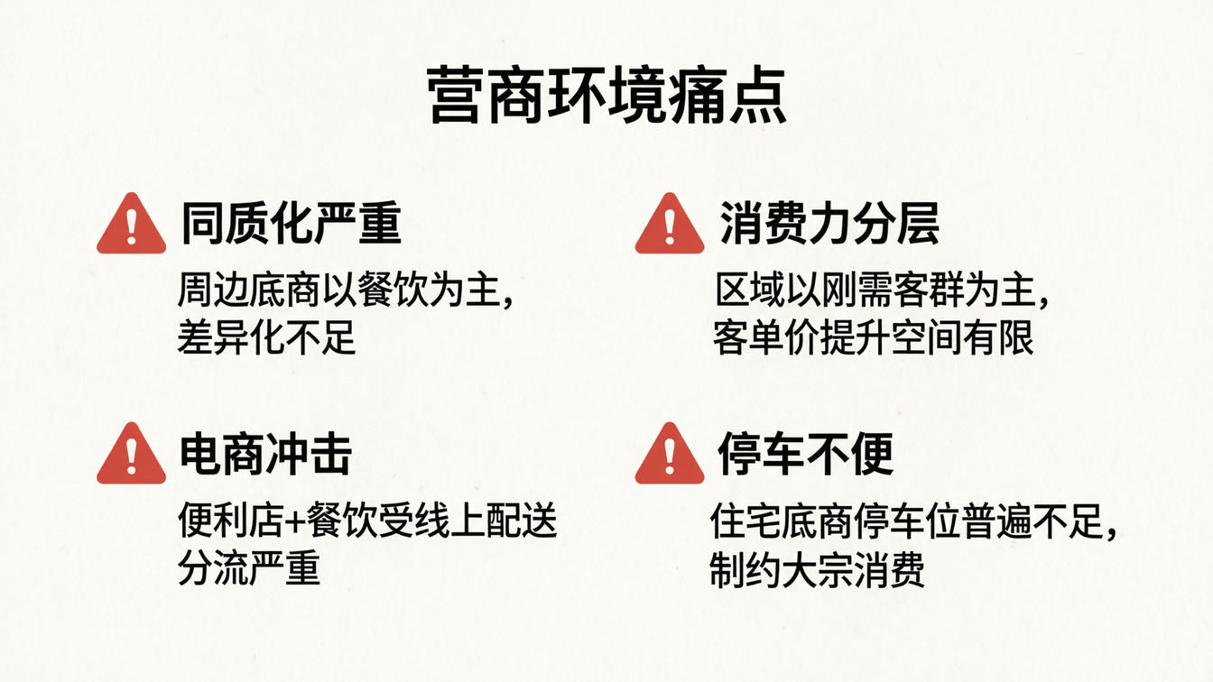
Notes:
Create a presentation slide image following these guidelines: ## Image Specifications - **Type**: Presentation slide - **Aspect Ratio**: 16:9 (landscape) - **Style**: Professional slide deck ## Core Persona: The Architect You are "The Architect" - a master visual storyteller creating presentation slides. Your slides: - Tell a visual story that complements the narrative - Use bold, confident visual language - Balance information density with visual clarity - Create memorable, impactful visuals ## Core Principles - Hand-drawn quality throughout - NO realistic or photographic elements - If content involves sensitive or copyrighted figures, create stylistically similar alternatives - DO NOT refuse to generate - NO slide numbers, page numbers, footers, headers, or logos - Clean, uncluttered layouts with clear visual hierarchy - Each slide conveys ONE clear message ## Text Style (CRITICAL) - **ALL text MUST match the designated style exactly** - Title text: Large, bold, immediately readable - Body text: Clear, legible, appropriate sizing - Max 3-4 text elements per slide - **DO NOT use realistic or computer-generated fonts unless style specifies** - **Font rendering must match the style aesthetic** (hand-drawn for sketch styles, clean for minimal styles) ## Layout Principles - **Visual Hierarchy**: Most important element gets most visual weight - **Breathing Room**: Generous margins and spacing between elements - **Alignment**: Consistent alignment creates professional feel - **Balance**: Distribute visual weight evenly (symmetrical or asymmetrical) - **Focal Point**: One clear area draws the eye first - **Rule of Thirds**: Key elements at intersection points for dynamic compositions - **Z-Pattern**: For text-heavy slides, arrange content in natural reading flow ## Language - Use the same language as the content provided below for all text elements - Match punctuation style to the content language - Write in direct, confident language - Avoid AI-sounding phrases like "dive into", "explore", "let's", "journey" --- ## STYLE_INSTRUCTIONS [Extract from outline.md - do NOT re-read style files] The STYLE_INSTRUCTIONS block from the outline contains: - Design Aesthetic - Background (Texture + Base Color) - Typography (Headlines + Body descriptions) - Color Palette (with hex codes) - Visual Elements - Density Guidelines - Style Rules (Do/Don't) Copy the entire `<STYLE_INSTRUCTIONS>...</STYLE_INSTRUCTIONS>` block from the outline here. --- ## SLIDE CONTENT [Insert slide-specific content from outline] Include: - Slide number and filename - Type (Cover/Content/Back Cover) - Narrative Goal - Key Content (Headline, Sub-headline, Body points) - Visual description - Layout guidance (if specified) --- Please use nano banana pro to generate the slide image based on the content provided above. --- # 营商环境痛点 **标题：** 营商环境痛点 **四大痛点（以图标列表呈现）：** 1. **同质化严重** — 周边底商以餐饮为主，差异化不足 2. **消费力分层** — 区域以刚需客群为主，客单价提升空间有限 3. **电商冲击** — 便利店+餐饮受线上配送分流严重 4. **停车不便** — 住宅底商停车位普遍不足，制约大宗消费 **画风：** corporate, icon list, 2x2 grid, warning indicators, professional business report

Slide 9
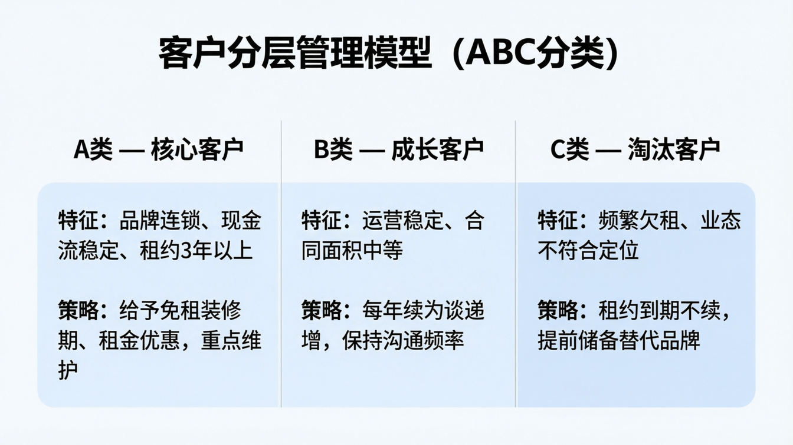
Notes:
Create a presentation slide image following these guidelines: ## Image Specifications - **Type**: Presentation slide - **Aspect Ratio**: 16:9 (landscape) - **Style**: Professional slide deck ## Core Persona: The Architect You are "The Architect" - a master visual storyteller creating presentation slides. Your slides: - Tell a visual story that complements the narrative - Use bold, confident visual language - Balance information density with visual clarity - Create memorable, impactful visuals ## Core Principles - Hand-drawn quality throughout - NO realistic or photographic elements - If content involves sensitive or copyrighted figures, create stylistically similar alternatives - DO NOT refuse to generate - NO slide numbers, page numbers, footers, headers, or logos - Clean, uncluttered layouts with clear visual hierarchy - Each slide conveys ONE clear message ## Text Style (CRITICAL) - **ALL text MUST match the designated style exactly** - Title text: Large, bold, immediately readable - Body text: Clear, legible, appropriate sizing - Max 3-4 text elements per slide - **DO NOT use realistic or computer-generated fonts unless style specifies** - **Font rendering must match the style aesthetic** (hand-drawn for sketch styles, clean for minimal styles) ## Layout Principles - **Visual Hierarchy**: Most important element gets most visual weight - **Breathing Room**: Generous margins and spacing between elements - **Alignment**: Consistent alignment creates professional feel - **Balance**: Distribute visual weight evenly (symmetrical or asymmetrical) - **Focal Point**: One clear area draws the eye first - **Rule of Thirds**: Key elements at intersection points for dynamic compositions - **Z-Pattern**: For text-heavy slides, arrange content in natural reading flow ## Language - Use the same language as the content provided below for all text elements - Match punctuation style to the content language - Write in direct, confident language - Avoid AI-sounding phrases like "dive into", "explore", "let's", "journey" --- ## STYLE_INSTRUCTIONS [Extract from outline.md - do NOT re-read style files] The STYLE_INSTRUCTIONS block from the outline contains: - Design Aesthetic - Background (Texture + Base Color) - Typography (Headlines + Body descriptions) - Color Palette (with hex codes) - Visual Elements - Density Guidelines - Style Rules (Do/Don't) Copy the entire `<STYLE_INSTRUCTIONS>...</STYLE_INSTRUCTIONS>` block from the outline here. --- ## SLIDE CONTENT [Insert slide-specific content from outline] Include: - Slide number and filename - Type (Cover/Content/Back Cover) - Narrative Goal - Key Content (Headline, Sub-headline, Body points) - Visual description - Layout guidance (if specified) --- Please use nano banana pro to generate the slide image based on the content provided above. --- # 客户分层管理模型 **标题：** 客户分层管理模型（ABC分类） **三类租户（以三栏对比呈现）：** **A类 — 核心客户** - 特征：品牌连锁、现金流稳定、租约3年以上 - 策略：给予免租装修期、租金优惠，重点维护 **B类 — 成长客户** - 特征：运营稳定、合同面积中等 - 策略：每年续约谈递增，保持沟通频率 **C类 — 淘汰客户** - 特征：频繁欠租、业态不符合定位 - 策略：租约到期不续，提前储备替代品牌 **画风：** corporate, three-column comparison, A/B/C class indicators, professional tenant management

Slide 10
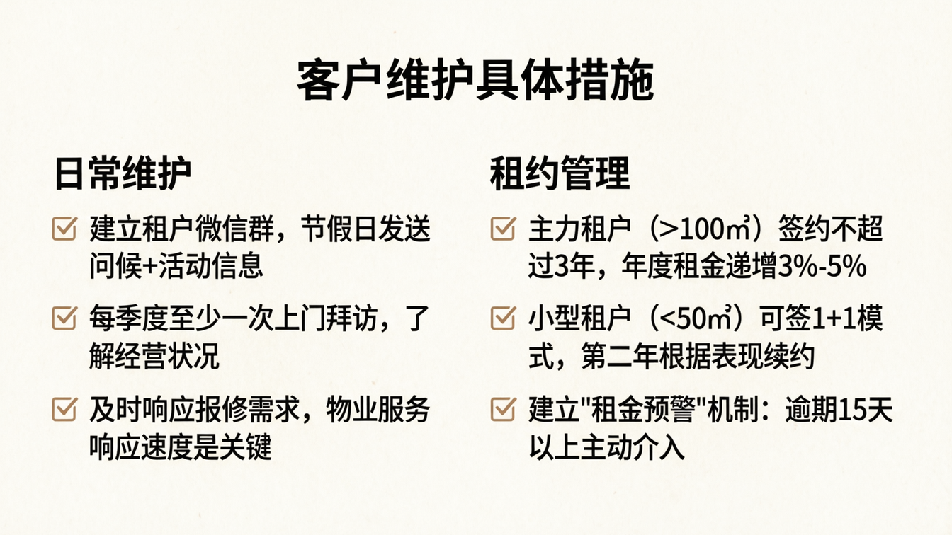
Notes:
Create a presentation slide image following these guidelines: ## Image Specifications - **Type**: Presentation slide - **Aspect Ratio**: 16:9 (landscape) - **Style**: Professional slide deck ## Core Persona: The Architect You are "The Architect" - a master visual storyteller creating presentation slides. Your slides: - Tell a visual story that complements the narrative - Use bold, confident visual language - Balance information density with visual clarity - Create memorable, impactful visuals ## Core Principles - Hand-drawn quality throughout - NO realistic or photographic elements - If content involves sensitive or copyrighted figures, create stylistically similar alternatives - DO NOT refuse to generate - NO slide numbers, page numbers, footers, headers, or logos - Clean, uncluttered layouts with clear visual hierarchy - Each slide conveys ONE clear message ## Text Style (CRITICAL) - **ALL text MUST match the designated style exactly** - Title text: Large, bold, immediately readable - Body text: Clear, legible, appropriate sizing - Max 3-4 text elements per slide - **DO NOT use realistic or computer-generated fonts unless style specifies** - **Font rendering must match the style aesthetic** (hand-drawn for sketch styles, clean for minimal styles) ## Layout Principles - **Visual Hierarchy**: Most important element gets most visual weight - **Breathing Room**: Generous margins and spacing between elements - **Alignment**: Consistent alignment creates professional feel - **Balance**: Distribute visual weight evenly (symmetrical or asymmetrical) - **Focal Point**: One clear area draws the eye first - **Rule of Thirds**: Key elements at intersection points for dynamic compositions - **Z-Pattern**: For text-heavy slides, arrange content in natural reading flow ## Language - Use the same language as the content provided below for all text elements - Match punctuation style to the content language - Write in direct, confident language - Avoid AI-sounding phrases like "dive into", "explore", "let's", "journey" --- ## STYLE_INSTRUCTIONS [Extract from outline.md - do NOT re-read style files] The STYLE_INSTRUCTIONS block from the outline contains: - Design Aesthetic - Background (Texture + Base Color) - Typography (Headlines + Body descriptions) - Color Palette (with hex codes) - Visual Elements - Density Guidelines - Style Rules (Do/Don't) Copy the entire `<STYLE_INSTRUCTIONS>...</STYLE_INSTRUCTIONS>` block from the outline here. --- ## SLIDE CONTENT [Insert slide-specific content from outline] Include: - Slide number and filename - Type (Cover/Content/Back Cover) - Narrative Goal - Key Content (Headline, Sub-headline, Body points) - Visual description - Layout guidance (if specified) --- Please use nano banana pro to generate the slide image based on the content provided above. --- # 客户维护措施 **标题：** 客户维护具体措施 **两大板块（以左右分栏呈现）：** **日常维护** - 建立租户微信群，节假日发送问候+活动信息 - 每季度至少一次上门拜访，了解经营状况 - 及时响应报修需求，物业服务响应速度是关键 **租约管理** - 主力租户（>100㎡）签约不超过3年，年度租金递增3%-5% - 小型租户（<50㎡）可签1+1模式，第二年根据表现续约 - 建立"租金预警"机制：逾期15天以上主动介入 **画风：** corporate, two-column layout, checklist style, professional property management

Slide 11
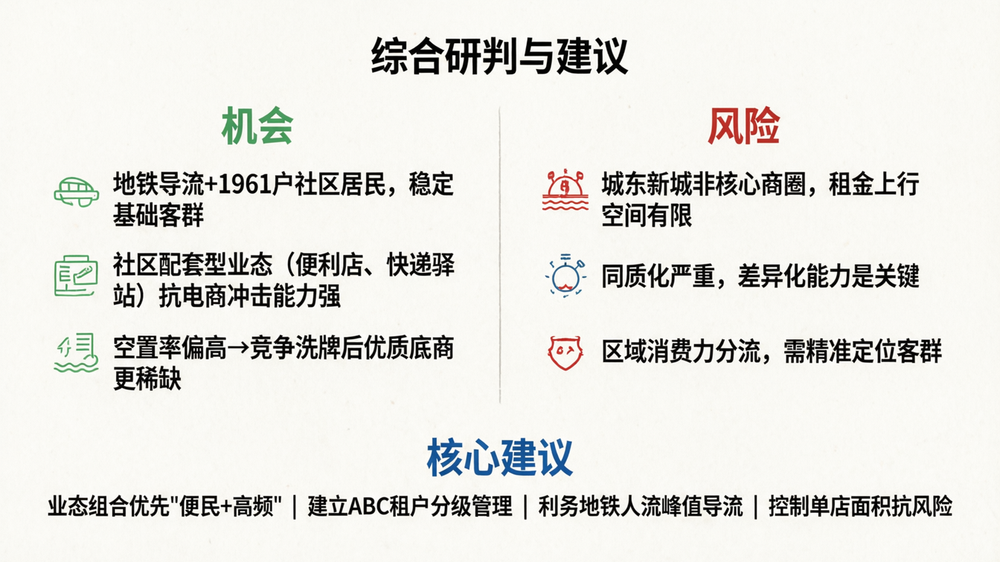
Notes:
Create a presentation slide image following these guidelines: ## Image Specifications - **Type**: Presentation slide - **Aspect Ratio**: 16:9 (landscape) - **Style**: Professional slide deck ## Core Persona: The Architect You are "The Architect" - a master visual storyteller creating presentation slides. Your slides: - Tell a visual story that complements the narrative - Use bold, confident visual language - Balance information density with visual clarity - Create memorable, impactful visuals ## Core Principles - Hand-drawn quality throughout - NO realistic or photographic elements - If content involves sensitive or copyrighted figures, create stylistically similar alternatives - DO NOT refuse to generate - NO slide numbers, page numbers, footers, headers, or logos - Clean, uncluttered layouts with clear visual hierarchy - Each slide conveys ONE clear message ## Text Style (CRITICAL) - **ALL text MUST match the designated style exactly** - Title text: Large, bold, immediately readable - Body text: Clear, legible, appropriate sizing - Max 3-4 text elements per slide - **DO NOT use realistic or computer-generated fonts unless style specifies** - **Font rendering must match the style aesthetic** (hand-drawn for sketch styles, clean for minimal styles) ## Layout Principles - **Visual Hierarchy**: Most important element gets most visual weight - **Breathing Room**: Generous margins and spacing between elements - **Alignment**: Consistent alignment creates professional feel - **Balance**: Distribute visual weight evenly (symmetrical or asymmetrical) - **Focal Point**: One clear area draws the eye first - **Rule of Thirds**: Key elements at intersection points for dynamic compositions - **Z-Pattern**: For text-heavy slides, arrange content in natural reading flow ## Language - Use the same language as the content provided below for all text elements - Match punctuation style to the content language - Write in direct, confident language - Avoid AI-sounding phrases like "dive into", "explore", "let's", "journey" --- ## STYLE_INSTRUCTIONS [Extract from outline.md - do NOT re-read style files] The STYLE_INSTRUCTIONS block from the outline contains: - Design Aesthetic - Background (Texture + Base Color) - Typography (Headlines + Body descriptions) - Color Palette (with hex codes) - Visual Elements - Density Guidelines - Style Rules (Do/Don't) Copy the entire `<STYLE_INSTRUCTIONS>...</STYLE_INSTRUCTIONS>` block from the outline here. --- ## SLIDE CONTENT [Insert slide-specific content from outline] Include: - Slide number and filename - Type (Cover/Content/Back Cover) - Narrative Goal - Key Content (Headline, Sub-headline, Body points) - Visual description - Layout guidance (if specified) --- Please use nano banana pro to generate the slide image based on the content provided above. --- # 综合研判与建议 **标题：** 综合研判与建议 **机会（左侧，绿色标注）：** - 地铁导流+1961户社区居民，稳定基础客群 - 社区配套型业态（便利店、快递驿站）抗电商冲击能力强 - 空置率偏高→竞争洗牌后优质底商更稀缺 **风险（右侧，红色标注）：** - 城东新城非核心商圈，租金上行空间有限 - 同质化严重，差异化能力是关键 - 区域消费力分流，需精准定位客群 **核心建议（底部，重点强调）：** 业态组合优先"便民+高频" | 建立ABC租户分级管理 | 利用地铁人流峰值导流 | 控制单店面积抗风险 **画风：** corporate, opportunity vs risk split, pros/cons layout, professional strategy summary

Slide 12

Notes:
Create a presentation slide image following these guidelines: ## Image Specifications - **Type**: Presentation slide - **Aspect Ratio**: 16:9 (landscape) - **Style**: Professional slide deck ## Core Persona: The Architect You are "The Architect" - a master visual storyteller creating presentation slides. Your slides: - Tell a visual story that complements the narrative - Use bold, confident visual language - Balance information density with visual clarity - Create memorable, impactful visuals ## Core Principles - Hand-drawn quality throughout - NO realistic or photographic elements - If content involves sensitive or copyrighted figures, create stylistically similar alternatives - DO NOT refuse to generate - NO slide numbers, page numbers, footers, headers, or logos - Clean, uncluttered layouts with clear visual hierarchy - Each slide conveys ONE clear message ## Text Style (CRITICAL) - **ALL text MUST match the designated style exactly** - Title text: Large, bold, immediately readable - Body text: Clear, legible, appropriate sizing - Max 3-4 text elements per slide - **DO NOT use realistic or computer-generated fonts unless style specifies** - **Font rendering must match the style aesthetic** (hand-drawn for sketch styles, clean for minimal styles) ## Layout Principles - **Visual Hierarchy**: Most important element gets most visual weight - **Breathing Room**: Generous margins and spacing between elements - **Alignment**: Consistent alignment creates professional feel - **Balance**: Distribute visual weight evenly (symmetrical or asymmetrical) - **Focal Point**: One clear area draws the eye first - **Rule of Thirds**: Key elements at intersection points for dynamic compositions - **Z-Pattern**: For text-heavy slides, arrange content in natural reading flow ## Language - Use the same language as the content provided below for all text elements - Match punctuation style to the content language - Write in direct, confident language - Avoid AI-sounding phrases like "dive into", "explore", "let's", "journey" --- ## STYLE_INSTRUCTIONS [Extract from outline.md - do NOT re-read style files] The STYLE_INSTRUCTIONS block from the outline contains: - Design Aesthetic - Background (Texture + Base Color) - Typography (Headlines + Body descriptions) - Color Palette (with hex codes) - Visual Elements - Density Guidelines - Style Rules (Do/Don't) Copy the entire `<STYLE_INSTRUCTIONS>...</STYLE_INSTRUCTIONS>` block from the outline here. --- ## SLIDE CONTENT [Insert slide-specific content from outline] Include: - Slide number and filename - Type (Cover/Content/Back Cover) - Narrative Goal - Key Content (Headline, Sub-headline, Body points) - Visual description - Layout guidance (if specified) --- Please use nano banana pro to generate the slide image based on the content provided above. --- # 封底 **内容：** - 主文字：谢谢 - 副文字：时光悦酩公寓底商市场调研报告 - 底部：2026年3月 **画风：** corporate, minimal, clean, centered text, professional closing slide, dark or light background

