Slide 1

Unit-16: E-commerce Technologies
Lecture-5:
E-Commerce Solutions
Dr M O Faruque Sarker
7 March 2011

Slide 2
Outline
E-commerce Solutions
A Case Study: Magento Architecture
E-commerce Solution Infrastructure
Cloud-based E-Commerce

Slide 3
Types of Solutions
Full featured e-commerce suite:
Magento www.magentocommerce.com/
IBM websphere
www.ibm.com/software/websphere/
Limited functionalities e-commerce suite
Zencart (www.zen-cart.com/ )
Solution provided by vendor
  Open source
  Proprietary
On-line Portal Store-fronts
  Ebay (Ebay.co.uk)
  Amazon
(http://webstore.amazon.com)
Cloud based Software-as-Service (SaaS)
Shopify www.shopify.com/

Slide 4
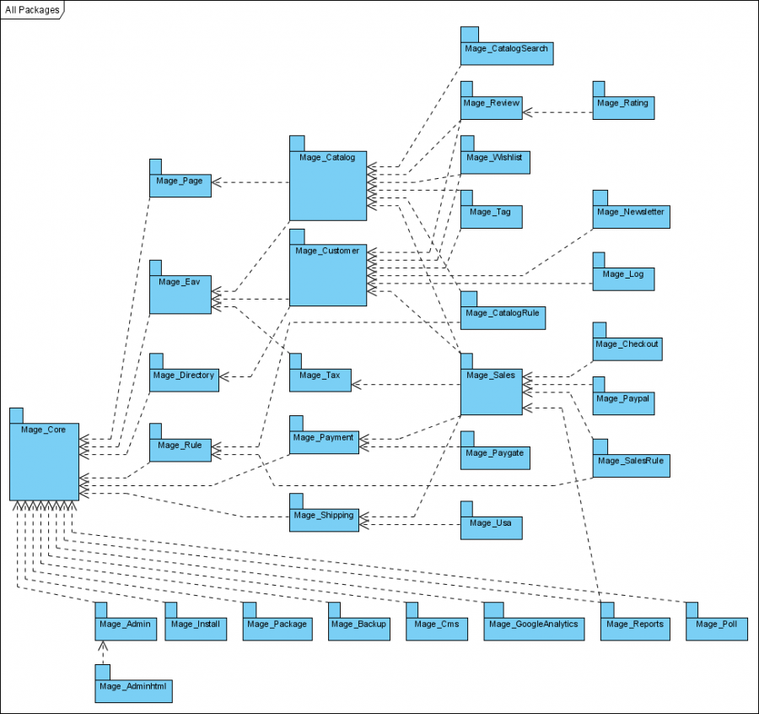
Magento Architecture

Slide 5
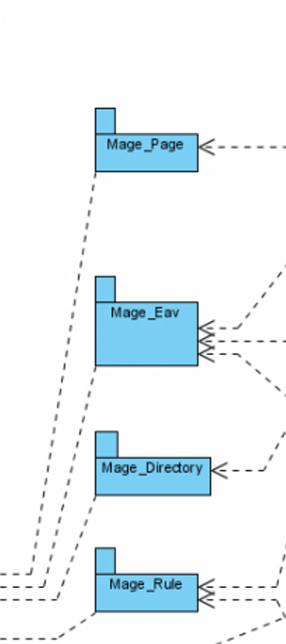
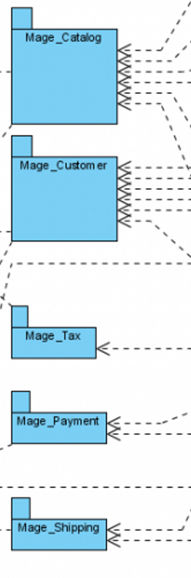

Slide 6
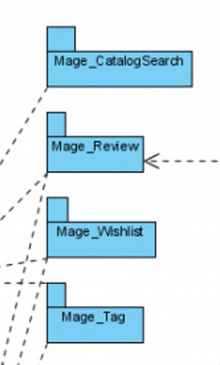
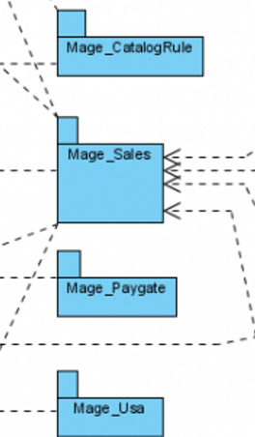
Catalog, Payment & Tax

Slide 7
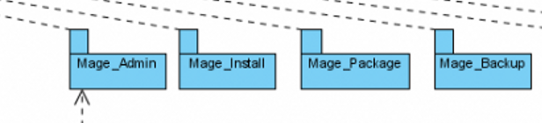
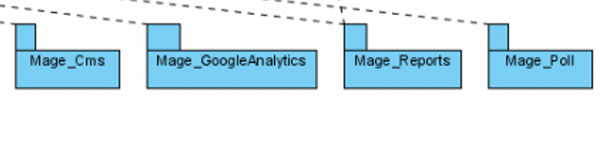
Admin

Slide 8
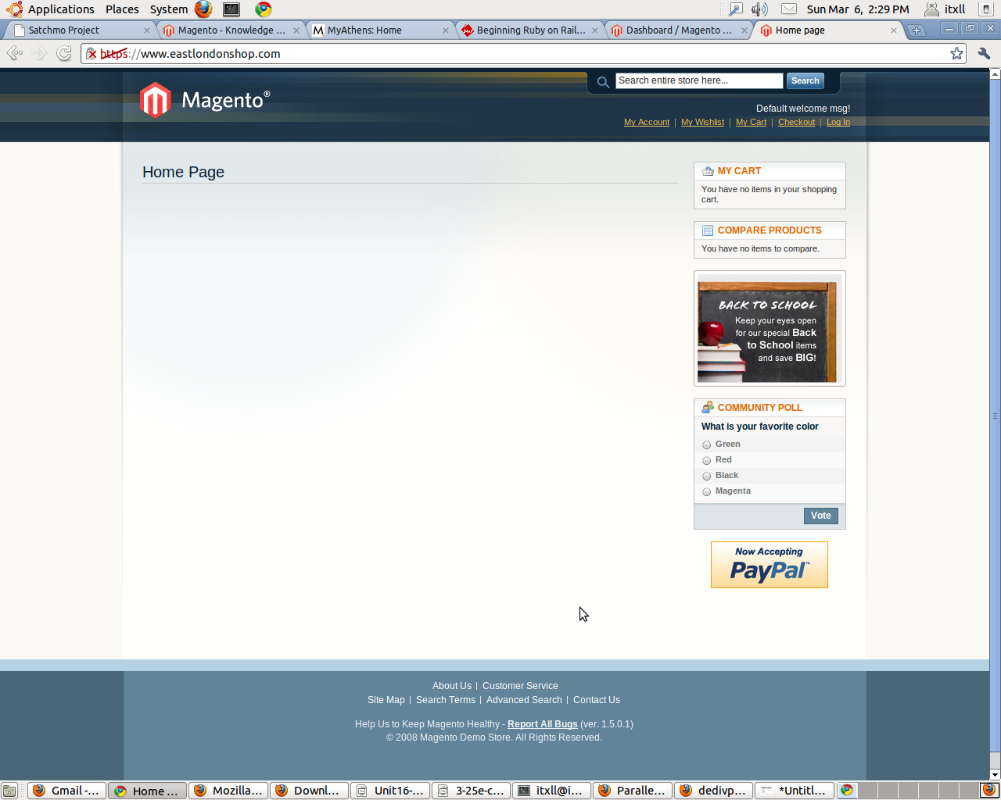
Front-end

Slide 9
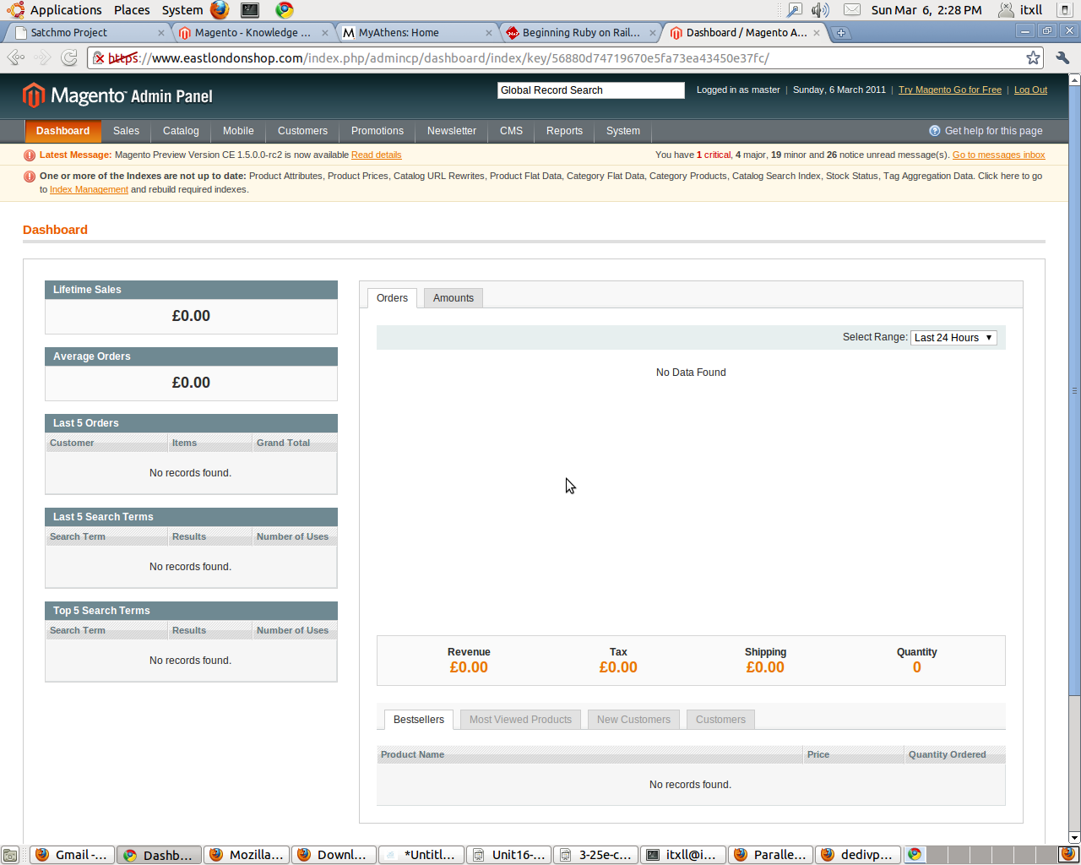
Backend

Slide 10


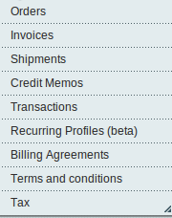
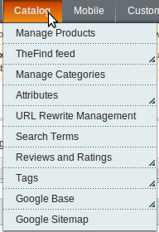

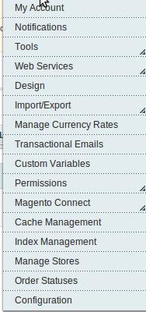
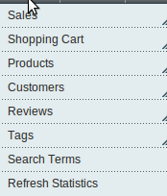
Admin options

Slide 11
Lots of activities under the hood
Customers
Traffic (page views)
Location
Server (hosting), cart
Draw the costumer
Marketing – PPC and SEO
Product to sell
Photos, Description
Store Design
Site Design (Skin)
Staff
Customer Care
Cash Register
Payment Gateway

Slide 12
IT Infrastructure
Sourcing
Payment Gateways
Logistics
Ecommerce is:
Website Infrastructure
Traffic
Marketing
Customer Care

Slide 13
Trust
What makes a sale
happen on the Internet?

Slide 14
Sourcing for eCommerce
Has to be repeatable and consistent
Has to be managed – ideally in real time avoid out of stock situation – otherwise high Customer Care Costs
Available for FAST shipment
Need to have minimum quantities – otherwise to expensive to photograph

Slide 15
Logistics
Label Printing
Tracking numbers – needs to integrate with website
Backorder Management
Invoice generation
Shipping Documents
Personalization – certificates, letters, VIP
Communicate back to the customer

Slide 16
Traffic Sources
Google
Yahoo
SEO
Blogs
Social Media
Repeat Business

Slide 17
Traffic
Use Google and Yahoo and others –
create landing pages to take customers
right where they want to buy –
its cheaper to advertise
Show up consistently,
build trust through predictability
Natural Search Engine results give credibility
BUT PPC and SEO buyers are
different segmented
SEO success does not mean PPC
can be stopped

Slide 18
Return Traffic
First time to acquire customer can be from £20 to £100.
2nd time – its £2-£3.
Methods to keep them coming back:
Loyalty programs
Newsletters
Social Marketing
Product rotation

Slide 19
Customer Care
Requires strong set of
Policies and Procedures
Phone support good for high ticket (VIP) customers – otherwise expensive
Email is very good – requires a strong Customer Care Ticket Management System
Knowledge Base – focus to reduce Customer Care costs by constant improvement on site and FAQ
Return Handling – easy,
traceable and care free

Slide 20
Customer Care
Online Chat is good – requires
higher Customer Care People
Outsourcing to other country – yes – but
need to be a big size

Slide 21
Marketing
OnSite Marketing - images
Traffic – getting people to visit
Pricing – compelling prices
Product Selection – sufficient not to loose traffic
Return per customer (loyalty)
Analytics - looking at the numbers to understand behavior

Slide 22
Marketing
Everything to do with user experience
Colors, photos, descriptions, specs, ease of use, etc.
Loyalty programs and CR% focus

Slide 23
Reporting Tools
Poor performing product identification
Total Sales
Sales by Category
ROAS (Return on Advertising Spent)
Cost per order
Profit Per Order
Historical performance – with tuning

Slide 24
Analytics
Core purpose: to allow you
to ‘see’ your site.
No true equivalent in “real world’
Your eyes and ears on a site
Primary tool for ‘tuning’ a website
Person ‘tuning’ a site begins
the site ‘through’ numbers

Slide 25
Analytics Examples
Google Analytics
Indextools (by Yahoo)
Omniture
Server Log Analysis Tools

Slide 26
Web Site (Cart)
Server – owned, hosted or cloud
Backup of server
Redundancy
Security Patches
Performance very important
Shopping Cart Software
1000’s to choose from
Choosing one depends on features,
cost, ease of maintenance

Slide 27
Payment
Need to be able to accept payment
Paypal
Google Checkout
Amazon Checkout
Many others
Require integration with Cart
Each payment method means higher Customer Care costs

Slide 28
Payment
Chargebacks –
fraudulent charges
Fraud Detection –
you are responsible
Banking to accept payment

Slide 29
In-house IT Infrastructure
Product Management
Order Fulfilment
Inventory Management
Reporting

Slide 30
Product Management
Product Management
Pricing tools
Image Management
Integration with Web Servers
Description management
Specification Management

Slide 31
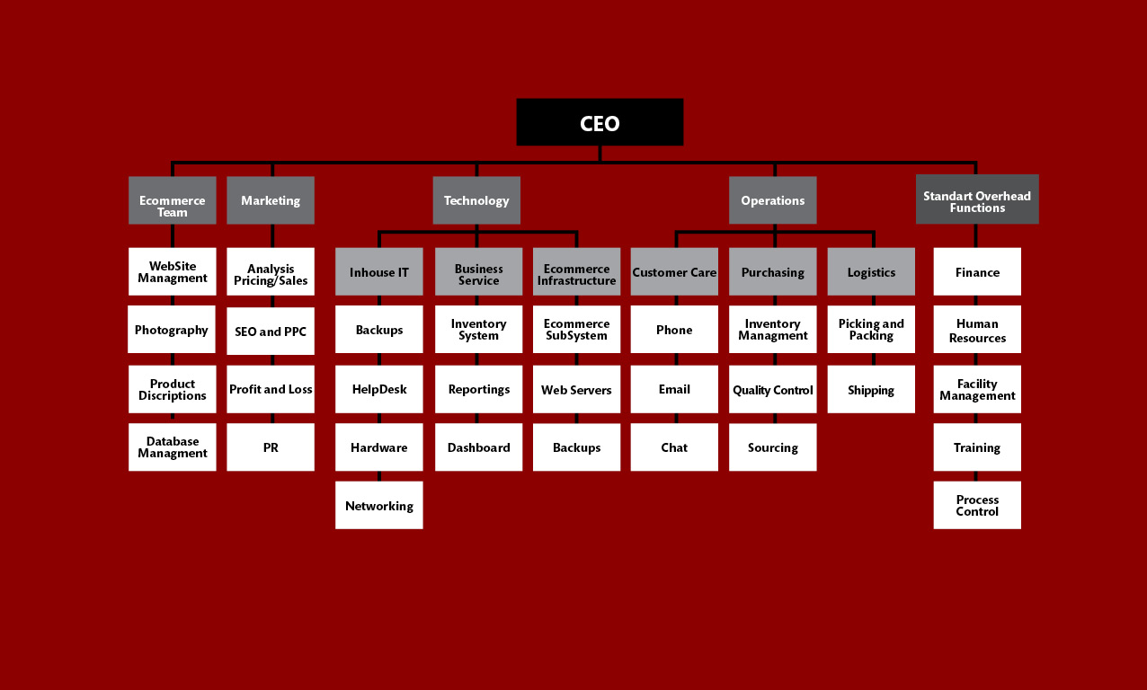

Slide 32
Physical vs. E-commerce
 | Physical Space | eCommerce
Sourcing | YES | YES
Store Design | Designer | Graphic Designer
Store Construction | Building Contractor | A whole team
Product Merchandising | Visual cues – use your eyes | Depend on analytics and numbers
Inventory Out of Stock | Not there – cannot sell it | Need to have good inventory management system
Photography | Not required | MUST – and must be good
Descriptions | Not required | MUST – and must be good
Specifications | Not required | MUST – and must be good

Slide 33
 | Physical Space | eCommerce
Staff | Yes – need training | Yes – need training – must be computer able
Store Security | Yes – physical | Yes – virtual – hackers
Payment | Yes – if cash low risk, credit card also lower risk | Yes – higher risk
Advertising | Just being there gets traffic. | If you don’t promote no chance for anyone to show up

Slide 34
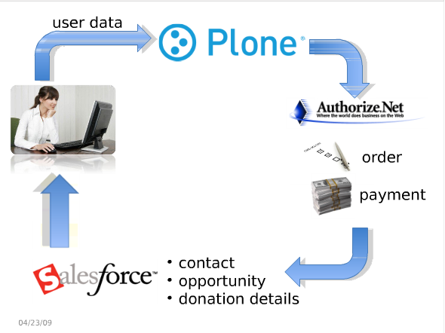
Cloud-based Solutions

Slide 35
Options to get started
Entry Level – Amazon Market Place, Ebay, PayPal, Amazon Shops,
other low cost carts. No identity
Mid-level – better carts – more features. Identity hard to establish
High level – Miva, open
source carts, etc.
Expert-level – grown your own
(Amazon level)

Slide 36
One Time Costs
 | Entry Level | Mid-Level | High-level
Cart Software | £0 | £500 | £200
Help Desk Software | £0 – email | £0 - email | £400
Order Tracking and Fulfillment | £0 – part of offering | £0 – spreadsheet, list, etc. | £5000
Site Design | £0 – minimal branding | £1000 | £20,000
Product Management Software | £0 – web based | £0 – web based | £5000
Customer Care Policies | £0 – wing it on a case by case | £0 – wing it on a case by case | £5000
Photography | £0 – do it with your own camera | £5/photo – £2500K | £7500
Descriptions | £0 – get creative | £5/photo – £2500K | £7500
Product Specifications | £0 – bring out the ruler and scale | £0 – do it yourself | £5000
Traffic – setup Google, Yahoo | Learn the basic in two weeks | Outsource to India - £500 | £5000
Stock | Product dependent - but need samples | Product Dependent – but need samples | Product Dependent – but need samples
Project Management | £0 -Its only you | £0 – Its still only you | £80K
Development Engineers | £0 – no need | £2000 – likely need some help | £100K
Total | £0 | £8500 | £325K
Expected Results | Don’t count on too much – price based marketing - £50K/year | £100K to £200K/year in sales possible | £1MM-£3MM/year possible
What you can handle | 5 – 10 orders a day | 10-20 orders | 400 order/day

Slide 37
Operating Costs
 | Entry Level | Mid-Level | High-level
WebMaster | £0 – no need | £500 | £5000
Customer Care Staff | £0 – its you | £1000 | £3000
Fulfillment Staff | £0 – its you | £1000 | £4000
Site Changes (Designer) | £0 – not really possible | £500 | £1000
Product Changes (DB Manager) | £0 – its you | £0 – its you | £1000
Reporting and Analysis | £0 – its you | £0 – its you | £1000
Photography | £0 – do it with your own camera | £5/photo – £200 | £500
Operations Manager | £0 – its you | £0 – its you | £3000
Marketing Spend | Learn the basic in two weeks | Outsource – 15% of spend - £500 | £4500
C | Product dependent | Product dependent | Product dependent
Shipping | Product dependent | Product dependent | Product dependent
Payment Processing | 3% = £100 | £3% – £500 | £1500
Total | £100 | £4200 | £25,000
Expected Results | 80-100 hour week | £100K to £200K/year in sales possible | £1MM-£3MM/year possible
What you can handle | 5 – 10 orders a day | 10-20 orders | 400 order/day

