Slide 1

E-Commerce Technologies
Dr. M O Faruque Sarker
London School of Commerce & IT
28 Feb 2011
Lecture 4: Software Infrastructure

Slide 2
Lecture outline
Operating System
Webserver
Log Analysis Tools
Database server

Slide 3
Unix
Unix is a multitasking, multi-user computer operating system originally developed in 1969 by a group of AT&T employees at Bell Labs
In 1994 Novell (who had acquired the UNIX systems business of AT&T/USL) transferred the rights to the UNIX trademark and the specification to The Open Group www.unix.org
Components: Kernel, Development Environment (e.g. cc, make),
Commands & utilities

Slide 4
Commercial Unix OS
IBM's AIX 7.1 (Advanced Interactive eXecutive)
  32bit 64 bit runs concurrently or cooperatively
Silicon Graphics (SGI) IRIX 6.5
  High performance graphics & scalable
Compaq/Hp Tru64
  64bit, web-based management interfaces
Solaris 9
  High security (IPSec) in OS level

Slide 5
Free Unix-like operating systems
Linux since 1991
Berkeley Software Distribution (BSD) family
  FreeBSD, a major open source effort focusing on performance and the x86 platform.
  NetBSD, an open source BSD with an emphasis on portability and clean design.
OpenSolaris from Sun Micro Systems

Slide 6

Linux
Refers to the family of Unix-like computer operating systems using the Linux kernel
Linux kernel was initially conceived and created by Finnish computer science student Linus Torvalds in 1991
The Linux kernel is released under the GNU General Public License version 2
Hundreds of Linux distributions give full OS packages in a bundle

Slide 7
Solaris
Solaris is a Unix operating system originally developed by Sun Microsystems.
Oracle Solaris, as it is now known, has been owned by Oracle Corporation since Oracle's acquisition of Sun in January 2010
Solaris uses a common code base for the platforms it supports: SPARC and i86pc

Slide 8
Windows
You all know what windows is!
Windows server family: Windows NT, server 2003, …, Windows Server 2008
Compare OSes before switch

Slide 9
Why Compare OSes
The operating system is a prevalent part of computing.
Layer of interaction between hardware and software.
Determines how effectively you can complete tasks you need to do.

Slide 10
Which Areas to Compare?
Hardware
Usability
Software
Networking
Security
Support

Slide 11
Windows Advantages
Very user friendly
Optimized for networking
Simple for collaborating

Slide 12
Linux Advantages
Flexible and adaptable
Best for Internet & networking environments
Allows you to install your preferred applications, programming, etc

Slide 13
Linux in Brief
Company / developer | Linus Torvalds and many others
Programmed in | Assembly language, C
OS family | Unix-like
Latest stable release | 2.6.37 (Feb 2011)
Latest unstable release | 2.6.38-rc6 (Feb 2011)
Supported platforms | IA-32, MIPS, x86-64, SPARC, DEC Alpha, Itanium, PowerPC, ARM, m68k, PA-RISC, s390, SuperH, M32R and more
Marketing target | Desktops, servers, embedded devices
Available language(s) | Multi-lingual

Slide 14
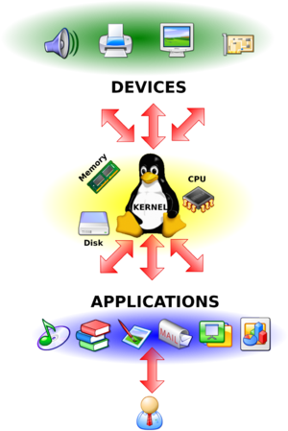
Linux Kernel

Slide 15
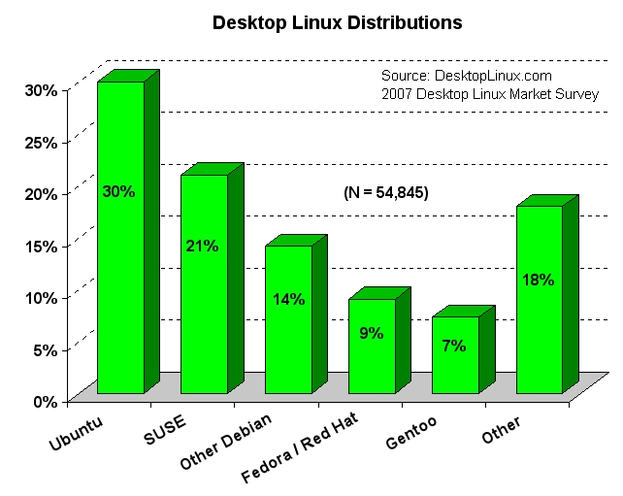
Too many Linux Distributions
A Linux distribution is a collection of software applications built on top of the Linux kernel and operating system. There are many variations between distributions, as each strives to provide a unique user experience.
There are, at last count, over 350 distinct distributions of Linux.

Slide 16
Where Linux is used?
Servers
Super computers
Desktop
Laptops
Televisions Samsung most models, LG some models
Digital Video Recorder
Set-top boxes
MP3 / Ogg portable players
Mobile phones
Handheld and portable
Internet Tablets
Gaming consoles
Toys

Slide 17
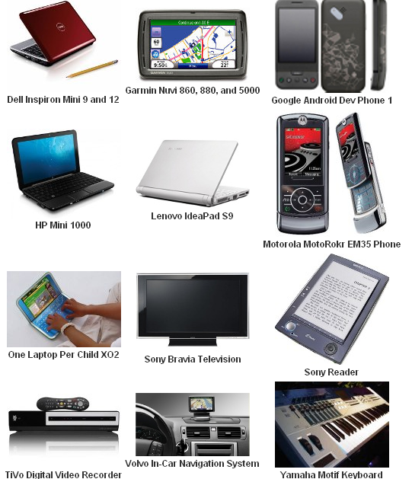

Slide 18
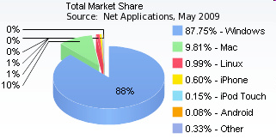
Market Share of Linux
In September 2008 Microsoft CEO Steve Ballmer admitted that 60% of web-servers run Linux versus 40% that run Windows Server.
90% of the supercomputers running on Linux. (e.g. Cray XT Jaguar)
Desktop market share of Linux range from less than 1% to 4.8%. In comparison, Microsoft operating systems hold more than 85%.

Slide 19
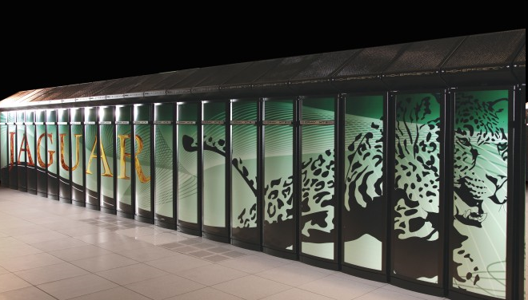
Cray XT Jaguar: The New World's Fastest Supercomputer
(1.64 quadrillion (1000000000000000 ) mathematical calculations per second )
45,000 quad-core AMD Opteron processors.
362 terabytes of memory.
Department of Energy's Oak Ridge National Laboratory

Slide 20
Applications for Linux
Office: Open office, Koffice .
Database: Oracle, MySQL.
Email: Evolution / Mozilla Thunderbird.
Audio/Video: MPlayer / VLC.
CD Burning: K3b.
Graphics: The Gimp / Photogenics.
Instant Messaging: Gaim.
Web Browsing: Mozilla Firefox
Antivirus: ClamAV
Application Sites:
http:// www.sourceforge.net
http://www.freshmeat.net

Slide 21
Partial list of Big and Famous Organizations using Linux
Google
Wikipedia
Yahoo
Amazon.com
Cisco
Novell
IBM
BMW
Audi
Tommy Hilfiger
Toyota Motor Sales, U.S.A.
Panasonic
All these organizations have admitted that they got not only economical advantage by using Linux but also got greater stability and security.

Slide 22
Advantages of Linux
It’s Free and open source.
Linux is portable to any hardware platform .
Linux requires minimal hardware configuration.
Linux continues work well even when the hard disk is almost full.
Linux can run almost forever without any reboot. It’s stable.

Slide 23
Advantages cont…
Linux operating system does not slow down with time.
Linux operating systems comes with some inbuilt softwares like open office for Word, Power-point, Excel, Firefox, CD/DVD burner etc.
Linux is one of the most secure operating systems.
The large number of Linux distributions gives you a choice.
The Linux OS and most Linux applications have very short debug-times.

Slide 24
Disadvantages
There’s no standard edition of Linux.
Linux has patchier support for drivers.
Linux is not very user friendly and confusing for beginners.
Fans of PC gaming may find Linux offers them a much more limited range.
Because Linux is a free, open source system, there are no legal comebacks if you find software isn’t up to scratch or if it causes a problem.

Slide 25
Interesting facts about Linux
A 21 year-old Finnish college student created the Linux kernel as a hobby.
As of today, only 2% of the Linux kernel has been written by Linus Torvalds.
Linux kernel 1.0.0 was released with 176,250 lines of code. The latest Linux kernel has over 10 million lines of code.
Linux has had about 60-100 viruses listed till date.
Linux currently has an estimated user figures ranging from 20 to 30 million. And growing!
80% web servers use linux.
The Linux kernel can be found on more than 90% of systems on the world's Top 500 supercomputers.

Slide 26
Linux or Windows?
Use Linux:-
If you are a experienced user of Windows.
If you are a curious programmer.
If you want to become a hacker.
If you want to experiment with OS.
Use Windows:-
If you have no experience with any OS.
If you are fond of PC Games.
If you have so lazy that you don’t want to use even a single command.

Slide 27
Different ways to use Linux
1.Installing Linux in system HDD. (Dangerous, you may loss your whole data)
Before taking risk please logon to this
www.linux.org/docs/beginner/install.html
2. Live cds ((Without actually installing in our system)
more info @ www.linux-live.org
3. Pen drive linux (Without actually installing in our system)
more info @ www.pendrivelinux.com
4. Using VMware or Virtual Box(Without actually installing in our system)

Slide 28

References
www.linux.org
www.linux.com
www.kernel.org
en.wikipedia.org/wiki/Linux
www.linuxjournal.com
www.linuxfoundation.org
www.li.org
www.whatislinux.net

Slide 29
Part-2
Web Server & DBMS

Slide 30
Web servers
What's an web server?
  A Web server is a computer program that delivers (serves) content, such as Web pages, using the Hypertext Transfer Protocol (HTTP), over the World …
E.g. The Apache HTTP Server Project is an effort to develop and maintain an open-source HTTP server for modern operating systems including UNIX and Windows NT.
Types:
  Commercial
  Free & Open-sources

Slide 31
History of WWW
1987: Larry Wall creates a programming language called
PERL widely used later for website applications
1989: Tim Berners Lee & Robert Calliliau proposed World
Wide Web based on ENQUIRE
1991: Paul Kunz installs _x000c_rst web server in US at Stanford
University
1993: Marc Andressen developed Mosaic as _x000c_rst graphical
web browser
1995: Robert McCool & Eric Bina developed NCSA HTTPd
1995: Apache webserver project commenced

Slide 32

Apache Features
Web publishing of static and dynamic content
Secure web interaction
Virtual Hosting [More about Virtual Hosting]
Proxy Server [Apache:As forward proxy server]
  acts as an intermediary for requests from clients seeking resources from other servers.
Reverse Proxy Server [Apache:As reverse proxy server]
  a type of proxy server that retrieves resources on behalf of a client from one or more servers.

Slide 33
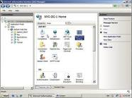
Nice look & feel with IIS 7.5
Internet Information Services (IIS) – formerly called Internet Information Server – is a web server application and set of feature extension modules created by Microsoft for use with Microsoft Windows
Features
  HTTP, Security, Contents, Compression, Caching, Logging modules.

Slide 34
Scalable: Zeus
Zeus Web Server is a proprietary web server for Unix and Unix-like platforms (currently Solaris, FreeBSD, HP-UX and Linux). Support for AIX, Tru64, and Mac OS X was dropped on 10 June 2008.
Zeus supports dynamic content via CGI, FastCGI, Apache JServ, and other FastCGI-like protocol.

Slide 35
CGI
CGI defines a standard way for a Web server to pass a Web user's request to an application program and to receive data back to forward to the user.
Some examples
  FastCGI
  SCGI
  Web Server Gateway Interface

Slide 36
Light-weight web servers
LightHttpd
Nginx

Slide 37
Web analysis
Web Analytics is a tool for measuring website traffic and lets you see real-time user behavior on your website. Off-site and on-site web analytics are the two categories of web analytics.
On-site analytics measures how visitors reached your site and how they interact with it. There are mainly two methods for data collection. Log file analysis and page tagging. Both collect data that can be processed to produce web traffic reports.

Slide 38
Log file Analysis
Log file analysis is the processing of web server log files that contain the information such as what files are accessed, when, and who or what accessed them. The main advantages of log files are search engine spider reporting, server error code reporting, and information regarding download data.

Slide 39
What is a Web server log file?
Records activity on a Web server
“Who” visited
What files were requested
What time/date site was visited
What page was visited first, last
Not “blogs” (Web logs)

Slide 40
Page Tagging Analytics
A page tag is a small JavaScript code located in each page of your website. Page tagging is one of the most effective method for collecting detailed data on website visitors. Page tagging records an event only if the page is successfully viewed by visitors.

Slide 41
Error Logging Levels
Level | Description | Example
emerg | Emergency conditions that render the system unusable | “No active child processes: shutting down.”
alert | Conditions that require immediate action | “Child 1234 returned a Fatal error. Apache is exiting!”
crit | Critical conditions | “Parent: Path to Apache process too long.”
error | Error conditions | “master_main: create child process failed. Exiting.”
warn | Warning conditions | “Child process 1234 did not exit; sending another SIGHUP.”
notice | Advisory conditions that do not indicate abnormal activity | “httpd: SIGUSR1 received. Doing graceful restart.”
info | Informational only | “Shutdown event signaled. Shutting the server down.”
debug | Messages displayed only when running in debug mode | “Loaded module mod_vhost.c.”

Slide 42
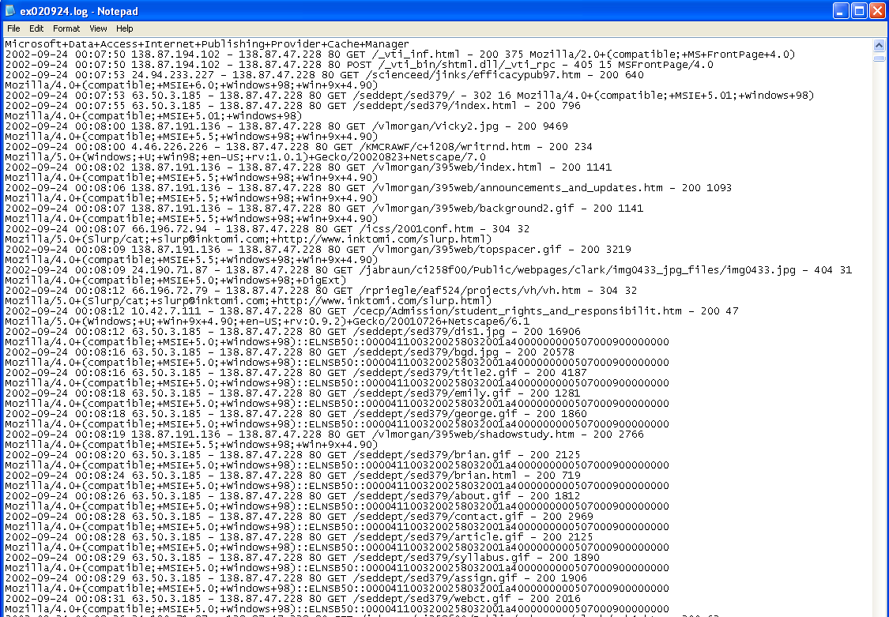
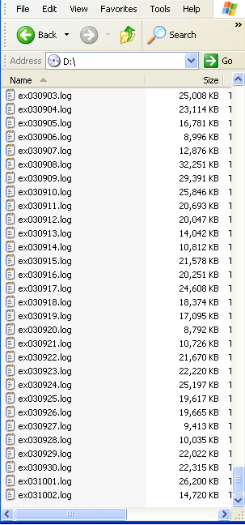
Using Log File Analysis to
Evaluate Instructional Design
Elements of a log file
  Simple text file
  Generated by
  Web server
  software
  Tracks visitors’
  activity on a
  Web site
  Example
  Difficult to read
  in raw format
  Controlled by
  server admin.

Slide 43
Traffic Reporting
That tracks and reports the number of visitors, requests and orders for any online advertising campaign you run
Commercial: 3Dstats
Free & OSS: AWStats

Slide 44
Part-3 Databases

Slide 45
What is a Database?
A data base is organized information.
A data base management system is a product that supports implementation & use of databases.
HOWEVER, generally, the term database is reserved for something using a standard DBMS product
DBMS is the product/tool:
MySQL,
Access,
Oracle
...

Slide 46
MySQL
The world's most popular open source database
Was developed to be fast and small, specifically for Web sites
Popular for use with Web sites that are coded in PHP scripting language
PHP and MySQL work well together.

Slide 47
How MySQL Works
The MySQL software consists of the MySQL server, several utility programs that assist in the administration of MySQL databases
The MySQL server is the manager of the database system. It handles all your database instructions
Before you can pass instructions to the MySQL server, it must be running and waiting for requests => Daemonization

Slide 48
PostgreSQL
PostgreSQL is one of the most popular open source SQL database implementations and has served as the foundation of several commercial products
It supports many database features commonly found in commercial databases,such as stored procedures, views, triggers, functions,
To access data, establish a connection with the database server, then send SQL commands to insert, delete, or update data in the database tables
The database server returns the result of the query (called a result set) to your program which extracts the individual record data.

Slide 49
Summary
E-commerce infrastructure software include: OS, web server, log analysis tools and DBMS
Both commercial and Open source software are used in real-world e-commerce sites
Some combinations of tools form a common framework: such as
  LAMP (Linux+Apache+MySQL+PHP) or
  LAPP (Linux+Apache+Perl/Python/PHP+PostgreSQL)

