Slide 1

Unit 48: Lecture 3
Security Risk Assessment
Dr M O Faruque Sarker
LSCI
28 Feb 2011

Slide 2
Outline
Security Baselines & Standards
Information Security Assessment: A Phased Approach

Slide 3
Security Baselines
To understand the level of risk that exists within the operating environment, periodic risk assessments need to be performed.
When a new system is implemented, a preliminary assessment called a security baseline needs to be performed.
Value of security becomes tangible and measurable only when an incident occurs that provides a monetary value to the loss.

Slide 4
Risk Assessments
Assessments are a mechanism to identify the strengths and implemented controls of a system, not just the weaknesses and risks.
Assessments should be combined with teaching and training sessions.

Slide 5
Information Security Assessment: A Phased Approach
High-level Security Assessment
Security Operations
Compliance with Legal and Regulatory Requirements
Computer Operations
Application Controls Assessments

Slide 6
(I) High-level Security Assessment
Assessing the Organization's Security Function
  How many staffs or administrators?
  Are security mission and charter documented and tied to each of the business units?
Assessing the Security Plan
  Who is responsible for its development, review, approval, and implementation?
Assessing Security Policies, Standards, and Procedures

Slide 7
...High-level Security Assessment
Assessing Risk-Related Programs:
Business impact analysis (BIA)
Incident response team (IRT): monitoring, investigation, and re-mediation
Emergency reporting and response (ERT)
Disaster recovery planning (DRP)
Business continuity planning (BCP)

Slide 8
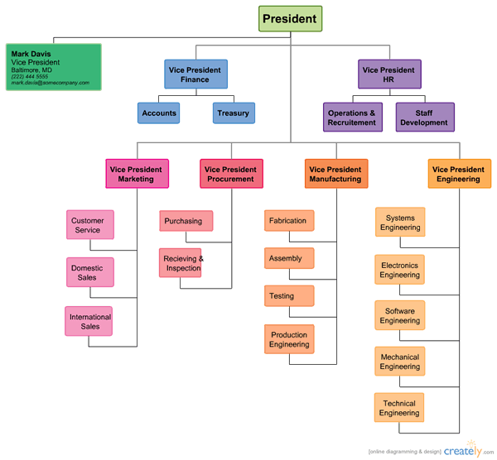
Assessment Document Checklist
Organizational chart

Slide 9
...Assessment Document Checklist
Organizational Policy Documents
- IT strategic plan
- Information security plan
- Security charter or mission statement
- Security policies, standards, and procedures

Slide 10
...Assessment Document Checklist
External documents:
- Confidentiality agreements/statements
- Regulatory policy documents
- Maintenance and service contracts with third-party service providers

Slide 11
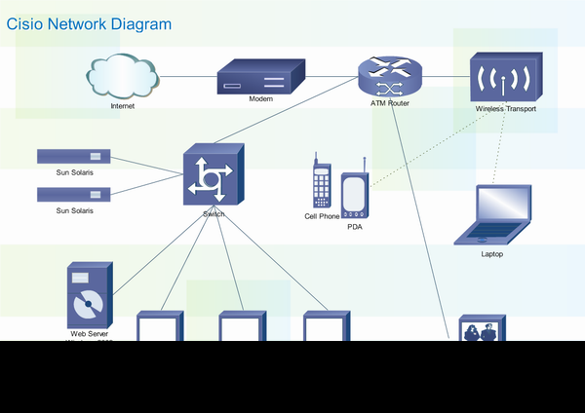
...Assessment Document Checklist
Network diagrams

Slide 12
...Assessment Document Checklist
Inventories:
- Hardware asset inventory
- Application inventory
- Database inventory
- Network management tools inventory
- Security assessment tools inventory

Slide 13
...Assessment Document Checklist
Methods, Reports and other checklists
- Data classification methodology
- Audit programs
- Compliance check-lists
- Security assessment reports
- Resource ownership matrix

Slide 14
(II) Security Operations
Security Monitoring
Daily review of remote access log-ins to identify failed access attempts
Review of system access logs for access to systems during non-work hours
Review of traffic on external gateways
Review of access to application system utilities and privileged user activities
Review of access to sensitive files or data

Slide 15
Computer Virus Controls
Download current definitions from the appropriate sources on a timely basis
Test virus software before distribution
Distribute and upload current definitions to all platforms (servers, mail servers, firewalls, and workstations)

Slide 16
...Computer Virus Controls
Validate that distribution of software and definition files is effective
Ensure compliance with all anti-virus software procedures
Assess the communications mechanism between administrators and users on potential viruses and the reporting of suspected viruses

Slide 17
Microcomputer Security
Monitoring licenses registered versus licenses used
Inventorying PC software
Defining and distributing approved software lists
Developing software usage policies

Slide 18
Microcomputer Security Actions
Prevent the use of unauthorized software
Provide training to all PC users
Ensure physical and logical security of PCs used for critical business operations
Ensure PC software development adherence to approved software development and maintenance methodologies

Slide 19
...Microcomputer Security
Provide adequate documentation of PC applications to users
Ensure the integrity of all data, applications, and information processed on the PC
Provide for backup and contingency plans for PC hardware, software, and peripherals

Slide 20
(III) Compliance with Legal and Regulatory Requirements
Guidelines on the retention, storage, and handling of regulated information
Appropriate protection of classified data
Compliance with regulatory requirements
Compliance with legislation protecting information

Slide 21
(III) Computer Operations
Physical Security
  Cypher or key pad locks
  Fencing/Guards
  Monitoring devices
  Maintaining authorized personnel access lists
  Limiting access to only essential personnel
  Maintaining sign-in logs
  Badges

Slide 22
Environmental controls include
Backup power (uninterruptible power systems Air conditioning
Fire suppression devices (fire extinguishers, halon, other)
Fire detection devices (sensors)
Heat detection devices
Alternative processing facilities
System and data backups

Slide 23
Problem Management
Reduction of failures to an acceptable level
Prevention of the re-occurrence of problems
Reduction of the impact on service

Slide 24
Problem resolution
Providing a centralized point of contact for problems
Logging problem calls
Resolution of problems quickly and efficiently
Transferring unresolved problems to more technically qualified personnel
Tracking and managing difficult problems

Slide 25
...Problem resolution
Identifying recurring problems, analyzing root causes, and do permanent resolution
Improving communication and training to end users
Reporting the status of issues to management, users, and departments
Evaluating vendor performance and service-level contracts based on the level of support provided in resolving issues

Slide 26
Application Controls Assessments
Application lockout after so many failed attempts to log on (e.g., three failed attempts)
Minimum password length (e.g., eight characters)
Specified password structure (e.g., a combination of alpha and numeric characters or the use of passphrases)
Password change frequency (e.g., every 30 days)

Slide 27
...Application Controls Assessments
Passwords must be unique
Passwords must be encrypted
Maintain encrypted password files
Maintain password history (e.g., last ten passwords cannot be reused)

Slide 28
...Application Controls Assessments
Establish password cycle time (e.g., minimum of five days before the password can be changed )
Non-displayed fields
Validation of password before passwords can be changed
Limitations on sharing passwords

Slide 29
Application Development and Implementation
Appropriate access to source libraries
The ability to audit access to source libraries
Integrity checks for the input of data to detect out-of-range values, invalid characters in data fields, incomplete data, upper and lower data volume limits, two character data ranges, and inconsistent control data

Slide 30
Application Development and Implementation
Session or batch controls to reconcile file balances after transaction updates
Balance controls to validate opening balances with previously closed balances, including run-to-run totals, file update totals, program-to-program totals, and hash totals on records and files
Management authorization for the initiation of application acquisition, development, and maintenance

Slide 31
...Application Development and Implementation
Change requests documents that record the reason for the amendment, date of amendment, and appropriate approvals
Separate test and production environments
Documented acceptance criteria for test plans
New programs and program changes are formally approved during appropriate phases of the development process and prior to implementation

Slide 32
...Application Development and Implementation
Formal sign-off and acceptance procedures
Cut-over procedures to move applications from the test to the production environment
Programmers are prevented from updating production programs
Programmers are restricted from adding programs to the production libraries

Slide 33
...Application Development and Implementation
Segregation of duties in programming and execution of programs
System and user documentation is updated to reflect all program and operations changes

Slide 34
...Application Development and Implementation
Emergency maintenance and temporary fixes to application and system software are covered by the same procedures applied to normal maintenance
Backup versions of software are maintained prior to making any changes to the code

Slide 35
Change Management
Ensure that all changes to production programs are implemented by library control administrators
Only the applications programmers involved in the changes have access to application programs under development
Only systems programmers have access to system programs under development
Only library administrators have write access to system and application libraries

Slide 36
Network Assessments
Check physical and logical configurations:
  Local area networks (LANs)
  Metropolitan area networks (MANs)
  Wide area networks (WANs)
  Gateways separating the corporate WAN and/or lines of business
  Internet gateways
  Virtual private networks (VPNs)
  Value-added networks (VANs)

Slide 37
Work-step 1: Understand Network Architecture
Review network diagrams and documentation
Interview data/voice/device network administrators
Review standards relating to networked systems
Review planned migration to new technologies
Review network hardware/ software inventory
Identify business functions utilizing the network

Slide 38
Work-step 2: Understand Network Management
Identify network management tools and other utility software used in managing the network
Identify how the network management tools are utilized
Identify the devices managed through network
Identify plans or changes to network managers

Slide 39
Work-step 3: Understand Network Security Administration
Identify policies, procedures, standards, and guidelines for network security administration
Identify responsibilities for network security administration
Identify monitoring capabilities and reports used in network security administration

Slide 40
Work-step 4: Understand New Technology Deployment
Identify:
  responsibilities for change control
  audit participation in new technology plans
  documentation of risks in new technologies
  general control strategy used in introduction of new technologies
  testing/acceptance methods used for new technologies
  review process for approval of new technology plans

Slide 41
Work-step 5: Understand outage response capabilities
Identify tools and approaches to reducing risks
Identify responsibility for emergency response
Identify tools/strategies for responding to emergency conditions
Identify threat incidents and priorities

Slide 42
Remote Access Activity 1:
Evaluate external connections
Identify external network service providers
Identify external network users (customers, business partners, employees, service providers)
Identify access methods
Identify frequency of access
Identify nature of access

Slide 43
...Remote Access Activity 1:
Evaluate external connections
Identify services used for access
Identify time-of-day access required
Identify services used when access granted

Slide 44
Remote Activity 2: Evaluate network security features:
Identify points of control for each access path
Identify points of control for each service accessed
Identify points of external control
Identify nature of control points (intended for authentication, monitoring, etc.)
Identify level of functionality for each control point
Identify responsibility for each control point

Slide 45
Remote Access Activity 3:
Develop access path schematic
Document access paths and control points
Report observations and recommendations

Slide 46
Internet Gateway Connectivity Assessment 1: Access
Identify authorization processes and controls
Identify authentication process and controls
Identify gateway monitoring and reporting controls
Identify incident response capabilities and responsibilities

Slide 47
Internet Gateway Connectivity Assessment 2: Maintenance
Identify responsibility for managing gateway
Identify management tools and software used
Identify accountability controls for gateway maintenance
Identify monitoring and reporting controls

Slide 48
Internet Gateway Connectivity Assessment 3: Threats
Identify potential threats to gateway integrity
Selectively test threats
Identify alternate access paths to gateway or across networks
Selectively test alternate access paths
Evaluate degree of risk for each threat and potential harm to the organization
Document approved and alternate paths and controls

Slide 49
Internet Gateway Connectivity Assessment 4: Control
Determine degree of risk from unauthorized access, monitoring, or modification of data
Determine potential liability to organization
Construct risk matrix

Slide 50
Internet Gateway Connectivity Assessment 5: Path Schematic
Document access paths and control points
Report observations and recommendations

Slide 51
Current and Future Internet Connections
Evaluate Internet controls:
  Identify Internet access points
  Identify Internet user characteristics
  Identify nature of Internet access
  Identify control implemented
  Evaluate consistency and effectiveness of control strategy
  Evaluate control strategy in light of future needs and requirements
Develop access path schematic

Slide 52
Electronic Mail and the Virtual Office
Identify special security requirements
Identify network resources used
Identify controls available to support security and confidentiality requirements
Identify other means available to support security requirements
Identify security products and services
Document analysis results

Slide 53
OS Security Assessment
Security policies
System configuration
System change control
Domains and trust relationships
Networking

Slide 54
...OS Security Assessment
Remote access
Physical access
Log-on and log-off controls
User management
Group management
Password management

Slide 55
...OS Security Assessment
Directory and file system security
System privileges and utilities
Maintenance and operations
Auditing, logging, and monitoring
Backup and recovery
Security administration

Slide 56
Telecommunications Assessments
An example assessment-
The number of individuals assigned to perform the job function is adequate.
Responsibilities are defined and documented.
Policies and standards related to the functional area are defined, documented, and in compliance.
Documentation of component configurations exists and is accurate.
The use of third-party vendors to perform management and security functions of the component may introduce security concerns.

Slide 57
Policies and standards related to telecommunications
A value statement regarding telecommunications assets
A policy objective statement
Employee access privileges keeping with their job assignment and responsibilities
Employees are responsible for knowing how to operate the system properly, identifying and reporting fraud, misuse, or system abuse

Slide 58
Summary
Assessments provide a snapshot of how the organization is positioned to protect itself
The high-level overview provides an understanding of the level of effort and priority that has been placed on security within the organization.
The more detailed assessments include a review of environment, OS, applications, databases, networks and telecommunications.

