Slide 1

Unit 16: E-Commerce Technologies
Lecture 1: Purpose of E-commerce Sites
Dr. M Omar Faruque Sarker
LSCI
14 Feb 2011

Slide 2
Lecture Outline
Motivations
Unit Overview
Lecture Plan
Introduction to E-commerce
Purpose of E-commerce Site
Lesson Summary

Slide 3
Motivations
Why Study E-commerce Technologies?
- Almost everybody is buying and selling over Internet. Why not you?
- Trading on eBay/Amazon etc.
- Porting existing business to Internet

Slide 4
Unit Overview
Unit Objectives:
1 Understand the functionality of commercial transactional websites
2 Understand the technologies involved in setting up commercial websites
3 Know how to address e-Commerce security issues
4 Be able to design e-Commerce technology solutions.

Slide 5
What is E-commerce
- Electronically mediated trading
- Buying and selling of products or services over electronic systems such as the Internet and other computer networks
- Involves: electronic funds transfer, supply chain management, Internet marketing, online transaction processing, electronic data interchange (EDI), inventory management systems, and automated data collection systems

Slide 6
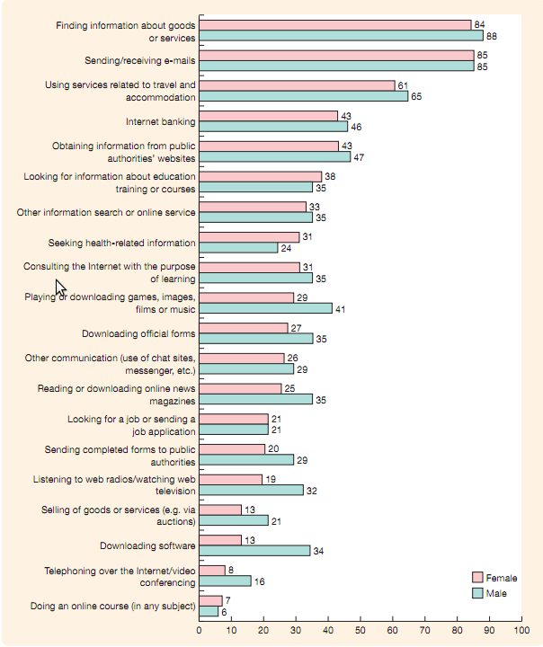

Slide 7
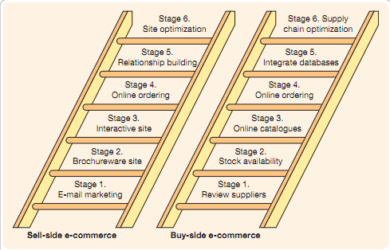
Buy-side & Sell-side

Slide 8
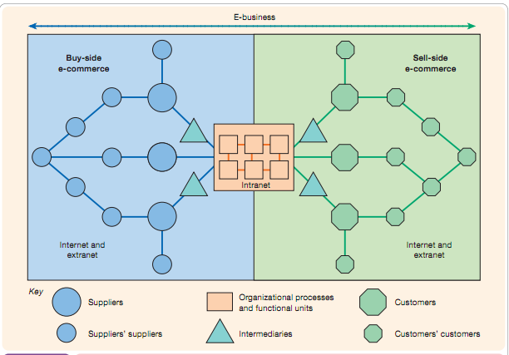

Slide 9
Why E-commerce?
Direct benefits of offering sevices online
  Low set-up cost
  Increased sales
  Reduced marketing cost
  Reduced supply chain cost
  Reduced administrative overhead
Indirect Benefits:
Branding, Rapid marketing, Customer feedback, Future trends

Slide 10
Aspects of an E-commerce Site
Site objectives
Goods and services offered
Product Information Provided
Payment transactions
Customer infomation storage/retrival
Customer authetication
Usability and accessibility
Serach Engine Optimization

Slide 11
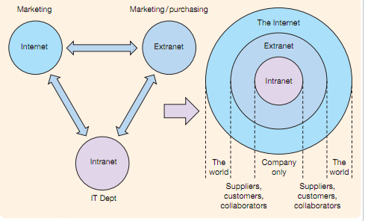

Slide 12
Types of sell-side sites
Transactional
Relationship-building
Brand-building
Portal, publisher, media sites

Slide 13
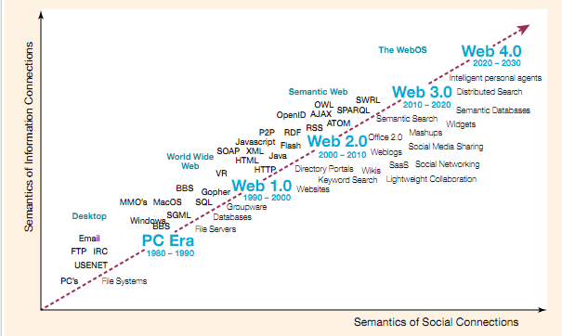

Slide 14
Transaction types
C2C
C2B/B2C
B2B
C2G/G2C
B2G/G2B
G2G

Slide 15
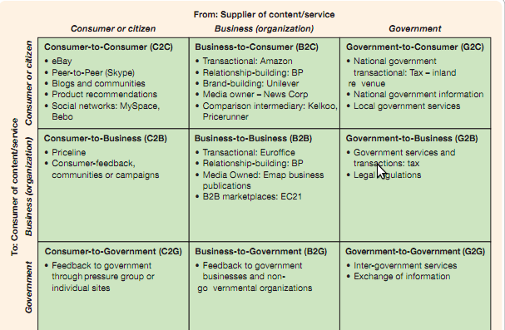

Slide 16
Internet Jargons
Social network
Blog
Rich media

Slide 17
E-commerce Sites
E-bay.com
Amazon.com
HSBC.com
Argos.co.uk

Slide 18
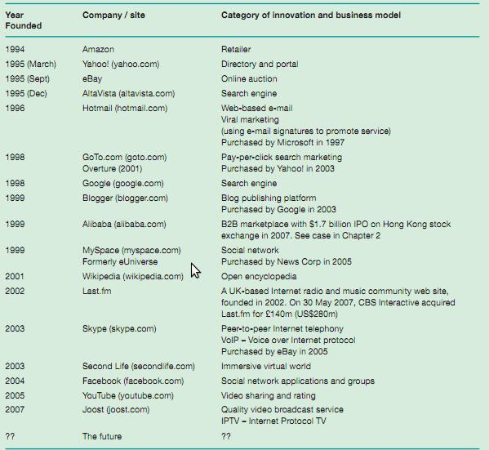
History of E-commerce Sites

Slide 19
Case study: E-bay (1)
- Pierre Omidyar, 28-old French software engineer coded 'AuctionWeb' for another company on Sep 1995 => renamed eBay 1997
- Built on commerce, sustained by trust, inspired by opportunity
- Revenue: eBay Market Place (70%), Paypal(25%), Skype(5%)
- Revenue model: Listing price, sale commission, advertising

Slide 20
Case study: E-bay (2)
- Online storefront: 532000 (2007)
- Software tools for automated selling: Turbo listing, calculator
- Risks: Fraud (1 in 10,000 reported by BBC in 2005)
- Customer feedback/ review based market place
- Competitors: Yahoo! And other online companies

Slide 21
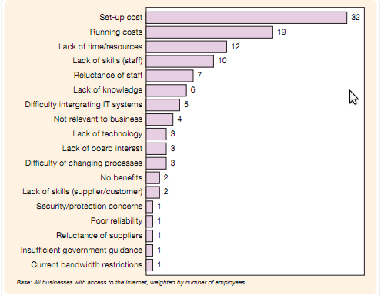
Barriers to E-commerce

Slide 22
Summary
E-commerce is one of the most growing areas in commerce & IT
E-commerce sites can be classified according to participating audiences and their purposes.
Successful dot-com companies like eBay, Amazon etc. have now been established and well matured in the e-commerce world.

