Slide 1
e-commerce:
From online stores to social networks

Slide 2
B2C E-Commerce: Overview
Online Stores
1
Advertising Networks
2
Social Networks
3
Notes:
This presentation is divided into three parts: The Past, Present, and Future trends of e-commerce. The presentation is a personal history of e-commerce, not necessarily an accurate historical account; it is my account based on my experiences from 1994 until the present.
The early history of Internet e-commerce began with online stores. I will discuss how the establishment of a security standard enabled online payment processing, and explain the infrastructure requirements of running an online store. I will also explain the various common alternatives for integrating online store software with payment processing services.
The availability of online stores contributed to the growth of the popularity of the Internet, and with the wide-spread acceptance of online retail selling came a growing trend towards online advertising. Current trends in e-commerce focus on generating revenue by serving ads, and also on using advertising to drive addition retail sales. I will demonstrate the process of buying online Ads and of making money by serving Ads (both using Google’s Ad Network).
Internet e-commerce leads to significant integration of advertising, shopping, and purchasing behaviour and the information about those activities. Since these activities all take place through interactions with webservers, which log ever transaction, there is significant information available about how people use information, how they shop, what they want, what they think etc. The current trend in e-commerce is something we can call “ecommerce 2.0” and seeks to leverage people’s participation in social networks to add value to commercial transactions. Commerce is seen as a “conversation” among participants that include customers and businesses. Greater participation increases the value of the products and services available on the Internet. I will show several interesting examples of how this works including how Amazon has leveraged participation, and how “professional blogging” has emerged on the back of advertising revenue and the “read/write” web.

Slide 3
Online Stores:
Components & Processes
Customer
a
Catalogue
1
Catalogue
List of Products
Descriptions
Prices
Options, size, etc.
Pictures
b
Shopping
Cart
2
Shopping Cart
A temporary list of item to be purchased
c
d
3
Checkout
Billing Info
Shipping Address
Shipping Cost
Record Order
Process Payment
Payment
Collection
Checkout
e-commerce - Michael McDonnell
Notes:
If you have ever purchased something online you are familiar with most of the parts involved in e-commerce. In general the process customers visit a merchants website where they browse a catalogue of goods. They select goods to purchase (usually be storing them in a virtual shopping cart) and at some point complete the purchase by providing payment information.
The information displayed in the catalogue is typically stored in a database and that database may be populated with information downloaded directly from B2B systems of suppliers. The database usually contains things like the list of available products, whether they are in stock or not, prices, descriptions, pictures, etc. The database might also contain information about customer accounts, and the contents of their virtual shopping carts.
The servers for the database and website are typically provided by a Internet Service Provider (ISP): a company that specializing is hosting websites. Something this might be a company that specializes in hosting e-commerce websites.
Payment processing is one of the more complicated parts of e-commerce. Customers typically pay with a credit-card and credit card payment processing is typically handled by special companies. Your website needs to be able to connect with the payment processors servers and there are a variety of ways in which this can be done. In some cases the web hosting company take care of this, in other cases, you have to buy special software for your website to be able to “talk” to the payment processing companies computers.
An online store consists of several obvious and well-define components. These components are typically implemented by one ore more pieces of software or as services hosted by some vendor.
First you, need a catalogue of your products. Websites are ideal for this. You can have web pages that list products and separate pages for product details. You also probably need something like a shopping cart so that as a customer looks over your catalogue, they can keep track of what they want to buy. Next, you need some kind of “checkout” system whereby the customer can place their final order. If you’ve got some kind of shopping cart, then the checkout process involves calculating the total cost of all the items in the shopping cart, calculating tax (and shipping costs), recording the order (so that it can be fulfilled).
Finally, you need some way to collect payment. This is where conducting retail sales over the Internet differs from other communications methods. With the Internet it is possible to have computer systems that communicate with each automatically. So there is no need for a person to record and manually process a credit card payment at a later time.
An online store consists of several obvious and well-define components. These components are typically implemented by one ore more pieces of software or as services hosted by some vendor.
First you, need a catalogue of your products. Websites are ideal for this. You can have web pages that list products and separate pages for product details.
You also probably need something like a shopping cart so that as a customer looks over your catalogue, they can keep track of what they want to buy.
Next, you need some kind of “checkout” system whereby the customer can place their final order. If you’ve got some kind of shopping cart, then the checkout process involves calculating the total cost of all the items in the shopping cart, calculating tax (and shipping costs), recording the order (so that it can be fulfilled).
Finally, you need some way to collect payment. This is where conducting retail sales over the Internet differs from other communications methods. With the Internet it is possible to have computer systems that communicate with each automatically. So there is no need for a person to record and manually process a credit card payment at a later time.

Slide 4
Online Stores:
Hardware Infrastructure
Web Server
Catalogue
Database Server
Software Programs
Catalogue
Shopping Cart
Checkout
Payment Processing
Static Data
  Images
  Web Pages
Data
Product Info
Shopping Cart Contents
Orders
Customer Account Info
Shopping
Cart
Checkout
Notes:
To run on online store you are going to potentially need a lot of things!
You need someone to host your website, or you need your own web server. You very likely also need a database server. Some web site hosting companies will provide you with a database. Your catalogue, if it is large will need a database. Many all-in-one online store packages require that you have a database. Order history, customer information, etc. will all be stored in the database.
You may need software to run your store. You might want a program that helps you build and manage your catalogue. You might want a program that acts as a shopping cart for your customers. You might want a program that manages customer accounts over time (for repeat business). You might want something to help you manage payments.
The process of setting yourself up to access payments is often the most challenging for businesses. At the very least you need a company to process your payments for you. Some services will do everything for you, accept payment from users, and send payment on to you. When this happens, the customer’s credit card does get billed by you. The customer will see another business’ name on their credit card bill. Not the best way to build customer confidence!
If you want to handle payment yourself, you will need an Internet Merchant Account at your bank. This will allow you to accept credit card payments from online sales. You will also need a Payment Gateway. A payment gateway is a service from a company that will process credit card payments, and ensure that your merchant account is credited with payment.
Your payment gateway service needs to be integrated with your online store software. There are several different degrees of integration.
Internet Merchant Account
an account with a bank that allows you to process credit cards online.
Payment Processing Gateway
connects your e-store and your internet merchant account

Slide 5

Online Stores
Customers
Banks
Products
Prices
Descriptions
Accounts
Your Website
Payment
Processor
Suppliers
Database
Web Hosting Company
Notes:
If you have ever purchased something online you are familiar with most of the parts involved in e-commerce. In general the process customers visit a merchants website where they browse a catalogue of goods. They select goods to purchase (usually be storing them in a virtual shopping cart) and at some point complete the purchase by providing payment information.
The information displayed in the catalogue is typically stored in a database and that database may be populated with information downloaded directly from B2B systems of suppliers. The database usually contains things like the list of available products, whether they are in stock or not, prices, descriptions, pictures, etc. The database might also contain information about customer accounts, and the contents of their virtual shopping carts.
The servers for the database and website are typically provided by a Internet Service Provider (ISP): a company that specializing is hosting websites. Something this might be a company that specializes in hosting e-commerce websites.
Payment processing is one of the more complicated parts of e-commerce. Customers typically pay with a credit-card and credit card payment processing is typically handled by special companies. Your website needs to be able to connect with the payment processors servers and there are a variety of ways in which this can be done. In some cases the web hosting company take care of this, in other cases, you have to buy special software for your website to be able to “talk” to the payment processing companies computers.

Slide 6
Online Store Example:
Bookstore
  Site sells books
  The website has an extensive catalogue
    BIG Database
    All “e-commerce” is handled “on-site”
    Shopping cart
    Checkout
    Payment processing (with the exception of payment clearing)

Slide 7
Online Store Example:
Soap Seller
  Site sells soaps and candles
  The website is just a catalogue
    No database at all
    Just “flat” files stored on the web server
  All “e-commerce” is handled by the 3rd party
    Shopping cart
    Checkout
    Payment processing

Slide 8
3rd Party Hosted Shopping and Payment
Customer
1
Catalogue
2
Online Store
Shopping
Cart
Payment
Processing
Company
3
Checkout
4
Payment
Collection
Notes:
The simple way to setup a store involves getting a place to host a website and build a catalogue with simply HTML. You would use a payment processing service that handles everything for you: payment collection, processing, and paying you! Pay-pal for example. The advantage is that this is very easy to setup. The disadvantage is that your customer has to visit the payment processors website for a lot of the process, and you have little control over how friendly the process is.
Paypal offers this type of service and it is very popular. My sister-in-law has a site that works this way http://www.bubblehut.ca/

Slide 9
3rd Party Payment Only
Customer
1
Catalogue
Online
Store
Website
2
Shopping
Cart
Payment
Processing
Company
3
Checkout
4
Payment
Collection
Notes:
The next simplest way is to buy an all-in-one online store program, and rely on a 3rd party only for payment processing.
In this type of setup, the customer uses your website for everything, until they need to enter their credit card information. You do not collect credit card information from them, the payment processor will do that. The credit card processor will let you know if payment was successful or not.
You can use this type of setup with or without having your own merchant account.
Software like “shopshite” is well known for this type of thing. I have worked with Shopsite Pro many times. Some web site hosting companies specialize in hosting shopsite, and can have you setup REALLY fast and cheap.
This type of setup is very popular because the store own doesn’t need to know anything about the technical details of payment processing. The payment collection is integrated with payment processing. It works if you have a merchant account, it works if don’t but you don’t need to know the details either way.
However, the customer still has to visit the payment processors website… so there is the perception that you do not have a complete web presence. It looks a bit unprofessional.

Slide 10
Payment Processing Hidden From User
Customer
1
Catalogue
Online
Store
Website
2
Shopping
Cart
Payment
Processing
Company
3
Checkout
4
Payment
Collection
5
Payment
Gateway
Notes:
Finally, the most professional and complete way to setup an online store is to handle ALL interaction with the customer yourself. The customer never leaves your website at all, even for credit card collection.
You still need a payment gateway to process payment, but the customer never interacts with them. Your software will collect the credit card info and then, in the background, communicate with the payment gateway. The gateway will let you know if payment is successful or not.
This is the way all the big retailers do things. If you order something from http://www.chapters.ca/ this is the model that they use.
The advantage is that you can offer far more features to your customers and encourage return business. You can keep the customer credit card on file (for security), you can give them a history of their past orders, you can offer them the opportunity to automatically issue periodic orders.

Slide 11
Payment Process:
Internet Merchant Account
Customer
a
Store
Website
b
Charge
Credit Card
c
d
Pay the
Merchant
Payment
Gateway
Notes:
There are two types of payment model (generally and commonly). The first is/was the most common: The Merchant Account. If you have a store and you want to account payment by credit card you need a merchant account at your bank. This will allow you to accept credit-cards. The bank provides you with the slips and machines to process the cards, and you periodically submit payment slips and you bank makes sure you get your money. Internet Merchant Accounts are just like this but apply to online orders (slightly different rules because of different risk perception). When someone places an order on your website, they submit their credit card information to you (via the website). Your web server makes a connection in the background to a Payment Gateway. The Payment Gateway’s job is to make sure the credit card is valid and has enough credit and to make sure money gets put in your bank account. The Payment Gateway is a 3rd party company.

Slide 12
Payment Process:
PayPal Account
Customer
a
PayPal
b
c
Charge
Credit Card
Pay the
Merchant
Notes:
PayPal markets its payment system as being extremely secure because the vendor never get ANY information about you. They get payment, from PayPal, but they never even get your credit card number. PayPal receives that information but does not share it with the vendor. They charge your credit card themselves, and then transfer money to the vendor for you. They act as a middle-man. As long as you can trust PayPal with your credit-card info then your more safe.
Of course, you still have to share your contact information with the vendor or they will not be able to ship your product to you. So they cannot act completely as a middle-man.
It is interesting to note that PayPal is also now the biggest payment gateway having bought out Verisign (which owned Soltrus in Canada). Ebay used to have its own payment system, but bought out PayPal. Since then, many others have gone out of business (Yahoo! had one, western union had one, etc. The list goes on).
See http://computer.howstuffworks.com/paypal.htm for more details.

Slide 13
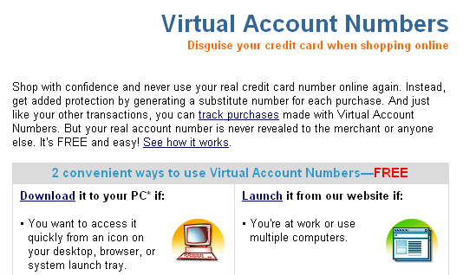
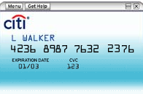
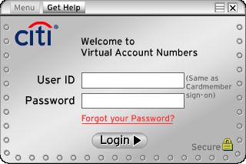
Payment Security:
Virtual Accounts at Citi Bank
Notes:
From: http://www.citicards.com/cards/wv/detail.do?screenID=700
Virtual Account Numbers1
With this service for Citi cardmembers, you never have to give out your real credit card number online. View the Virtual Account Numbers animation to learn more.
With one click, you can generate a random credit card number and make it virtually impossible for anyone to steal your account number while shopping online. Then, you enter this number into the merchant's form and complete your purchase without revealing your real card number. View cards with this feature.
It's safe and easy. Register or sign on for Account Online to get Virtual Account Numbers.
Note: Virtual Account Numbers cannot be used for purchases that require you to show your credit card at time of pick-up (e.g., movie tickets, etc.), because the account numbers will not match.

Slide 14
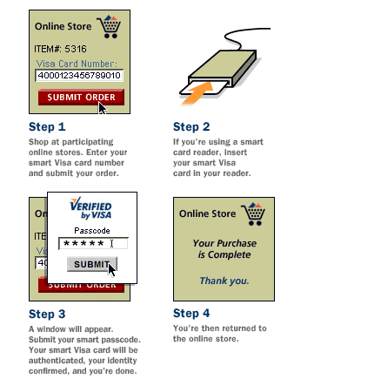
Payment Secutiy:
Visa Chip Cards
A typical plastic card with an embedded computer chip and microcomputer.
  Enables encryption of confidential information and personalization of usage limits.
A card reader reads the encrypted data, and password authentication is used to verify users.
e-commerce - Michael McDonnell
Notes:
From: http://www.visacemea.com/wv/chip_cards.jsp
Chip—or smart—cards are the 21st-century update of conventional cards. They have many advantages, including:
Increased security – chip cards are virtually impossible to counterfeit and powerful encryption prevents unauthorised access to information stored on the microchip, making electronic payments safer than ever before.
Additional features – a single smart card has the potential to perform a variety of functions. As well as payments, your card’s chip could be programmed to incorporate extra features and services from other organisations, such as a loyalty scheme, transport ticketing or identity documentation.
Greater convenience – their memory capacity means that chip cards can be used safely in remote locations where telecommunications are unreliable or prohibitively expensive. Chip cards contain a number of checks and balances that are set up by your issuing bank, which means that your card can make an informed decision at every transaction.
Until every market has completed the move to smart technology, Visa chip cards will also carry a magnetic stripe. This means that you will be able to use your chip card wherever you are.
From: http://www.visa.ca/chip/inaction.cfm (download 2007-03-12)
Challenge
High levels of credit card fraud and counterfeit cards plagued France during the 1980s and early 1990s. The monetary loss to all payment industry stakeholders in France totalled hundreds of millions of dollars.
Solution
The French national bank card association, Cartes Bancaires and Carte Bleue, Visa's group member in France, decided to address the problem. As the cost for microchips fell and their increase in technological power rose, the decision to distribute chip cards was made. After a small test pilot in 1990 that included 220 merchants and 5,000 cards, chip cards were introduced throughout France.
Result
1993 was the first full year in which every Visa card issued in France contained a chip. The success of the chip card in preventing fraud loss was outstanding:
Total fraud losses were halved in 1993
Losses on domestic counterfeit fell by 78 percent in 1993
Overall between 1991 and 1998, savings on fraud losses were estimated at $750 million ($150 million in 1998 alone).
France's successful experience has led to a global migration to replace the magnetic stripe with the more efficient, secure and versatile chip card technology.

Slide 15
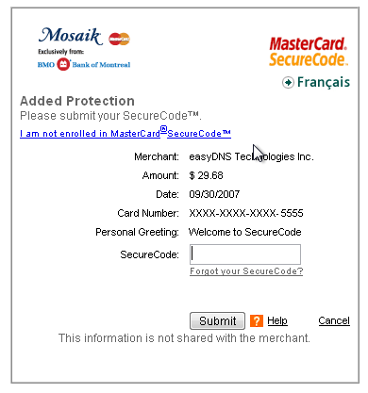
Payment Security:
Mastercard SecureCode
Notes:
Mastercard’s has a solution like Visa’s but without the smartcard option (as if anyone really has a smartcard reader at home anyways!). When you pay for something with Mastercard, you fill in your credit-card information normally ON THE VENDOR WEBSITE. But when you submit that information, you are redirected to a MASTERCARD WEBSITE that asks you to prove your identity. If you have already have a SecureCode, you enter it. If you do not, or if you have forgotten it, you have to enter several pieces of detailed personal information. The information you provide is NOT shared with the Merchant. Thus Mastercard has verified that you are who you say your are without compromising that information by sharing it will the vendor.

Slide 16
Online Purchase Behaviour
Most Purchased
Least Purchased
Computers & Software
Travel
Gift Cards
Toys
Videogames
== “Commodity” Items
Food
Cars & Car Parts
Pet Supplies
Appliances and tools
Health & Beauty Products
== “High Touch” Items
Digital Products – Ideal for Online Sale
Commodity-like
Mass-customizable
Delivered by download
No need for intermediary
Global in reach
Examples:
Tickets (travel, events)
Music, Images, Video
Books, News, other info.
Software
Source: Shop.org; Forrester Research
Notes:
Most Purchased is ranked by percentage of consumer reporting that they bought that type.
People tend to be more comfortable buying items on the Internet that are commodity like, that is, don’t really matter whether they are purchased in stores or online.
Books, computers, toys, videogames, etc.
People tend to be less comfortable buying “high touch” items on the Internet such as:
Furniture, automobiles, clothing, groceries, pets, etc.

Slide 17
Advertising Networks
  Online stores are now common
    Internet used to increase sales
    not just to facilitate sales
  Advertising is now big business
    US$7.9 BILLION in 1st Q 2006
    37% higher than 1st Q 2005
  Web Analytics is growing
    Analyze web data to convert visitors into buyers
Notes:
Buying stuff on the Internet is now very common and widely accepted. Now that people are buying things from online stores, the emphasis has shifted on finding ways to use the Internet to INCREASE sales regardless of the where the sale takes place (online or offline).
Advertising has become a big business.
$7.9 billion was spent on web ads in the first quarter of 2006 (http://www.clickz.com/showPage.html?page=3623521)
Why is advertising important: For example, ¼ of all electronic purchases are researched online (http://www.clickz.com/showPage.html?page=3623767). Who cares if they buy online or not… the “online store” is as much about advertising, research, and good information as it is about payment processing.
The Internet offers a great deal of integration between marketing, shopping, and purchasing. That integration makes more information available for analysis. “Web analytics” is the process of analyzing data from web sites in support of trying to convert website visitors in buyers. The goal of this process is often called “sales conversion.” However, there is a broader trend of using analytics to improve communication and improve usability. Web analytics can be applied outside of a sales context.
This is much more sophisticated than paying for Ads on TV or in magazines, with the analysis growing in sophistication.

Slide 18
Example:
Google AdWords
Pay-per-click
  Price set by bid
  Pay when user clicks
Ads appear on
  Search results
  Related Website
  Other places
Targeted by keyword
  Select keywords
  Set maximum price for add to appear with that keyword
Ad Position
  Determine by competition based on bids
http://adwords.google.com/
Notes:
In the 1990’s the biggest seller of Ads was DoubleClick. They had a horribly bad reputation, and their conduct resulted in government hearings, lawsuits (that they lost) and a general mistrust in web technologies (cookies!). The Ads they sold were “targeted” but generally aimed at gathering profile data about individual and aggregates of consumers.
Google, searching for a saleable product, applied its search technology to targeting ads. Google profiles content to target Ads. That is they assume that if you are visiting a website about hotrods, that the “best” Ads for that site would be related to cars. In this case “best” means that the Ads will be more likely to be clicked on because the audience viewing them are likely to be interested in cars, and “best” because the audience will be less distracted and annoyed because the Ads relate to the content they were looking for at the website, and “best” for the website owner because the Ads related to his content and may “add value” to his website (hmmm… dubious).
This can be done without profiling individuals! It is done by profiling the content on pages. Website owners don’t need to tell Google their website is about hotrods… google already knows that because of their search technology! Google gets “ad targeting” for free because of their search technology.
AdWords is the service google uses to let you buy Ads in its network.
[DEMONSTRATION HERE]
Also see http://www.google.com/domainpark/ which is Google’s program for typosquatters (they call them ‘domainers’ or “domain parkers”). These are people who buy up domains hoping that you’ll type them in by accident and then all you see is a site full of google ads. You might click one just to get to someplace else (maybe your lost).

Slide 19
Example:
Google AdSense
Display Ads
  Get paid!
Pay-per-click
  Paid when user clicks
Pay-per-impression
  Paid when is displayed 1000 times
Targeted by keyword
  Ad keywords match content of your webpage
  Ad are relevant to your audience
Ad Appearance
  You determine size, and appearance of ads
http://www.google.com/adsense/
Notes:
Google charges advertisers for Ads, and it pays website owners to display those Ads.
AdSense is the service (or “ad network”) that google offers by which website owners can get paid for hosting Ads.
It is not hard to make money with ads. Some people claim to make thousand of dollars a day. I do not doubt this claim.
[DEMONSTRATION HERE]
Note: PORN Ads are big business. One of the largest (historically) hosts of banner and porn Ads is in Edmonton! Google won’t host porn ads. Porn ads are very different in how they work than other ad networks. There is lots of fraud and a completely different “conversion” dynamic: people will click on ads but rarely buy the product! With regular products, people will generally click on ads for products that they are likely to buy.

Slide 20
E-commerce 2.0
  Important Cliches
    The Tipping Point (viral marketing)
    The Long Tail (social networks)
    The Market as “conversation”
  Examples
    Amazon
    E-bay
    “Professional” Bloggers
    My Space / Facebook
Notes:
“The Tipping Point” is an often used term in relationship to marketing, and today “viral marketing.” The idea is that phenomena tend to build-up in a steady fashion to a “tipping point” where they tend to grow exponentionally in magnitude. This is the “snow ball effect” where as you roll a snow ball down a hill it gathers more snow and gets bigger, and faster, and the bigger it gets the faster it goes, making it gather snow faster making it grow bigger faster and faster and bigger...
Marketers hope that by allowing customer participation in their services, that it will attract more attention, that more users will participate. They assume there is a feedback system where more participants will attract more participants until they reach “the tipping point” and they will have most or all of the market. Hotmail is frequently cited as the first example of viral marketing.
“The Long Tail” refers to retail sales where most of the money is made by selling a few copies of MANY MANY different items. It contrasts with traditional retail sales goals. Traditional retails want to make money by selling a LOT of just a few popular products. Traditionalists assume that a strong brand will attract a “tipping point” where they are more recognized than anyone else and there product will be purchased by everyone.
In contrast “long tail” retailers sill make a lot of money off of a few items, but they make MOST of their money off of a huge number of items that only sell a few copies.
Music is an excellent example. Online music retailers (sellers of both MP3 music and CDs) claim that they don’t make much off of the big hits. Sure, a lot of people by the new CDs of popular artists, but the real money is in selling a few copies of thousands and thousands and thousands of less popular titles.
Interestingly, this is the exact same pattern that libraries have always seen. The majority of library book checkouts are for titles that will only be checked out a few times.
“The market as conversation” was popularized by Seth Godin. The notion is that the true nature of Internet markets is that they represent dynamic relationship between businesses and customers and customer with each other, NOT a well-defined exchange of resources (money for goods). The conversation is a negotiation but it is also a system that adds extra value to the products and services being bought and sold. Without the “conversation” there is much less value and customers go elsewhere. The more conversation there is, the more business there is!
We will see some of these ideas in the examples I will cover.

Slide 21
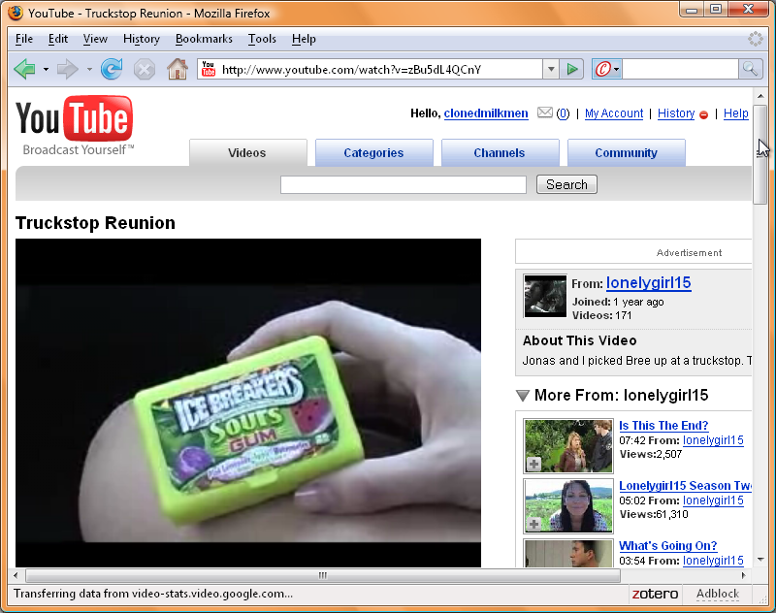
Example:
YouTube
Customers
distribute
the ads
  http://www.youtube.com/watch?v=zBu5dL4QCnY
Notes:
lonelygirl15 was a series of hoax videos some of which contain product placements
http://www.youtube.com/watch?v=zBu5dL4QCnY
3 minutes 30 seconds into the video is a placement for gum.
Now promotes music sales for Amie Street (online music store)
But YouTube videos are easily posted to your own blog, or myspace page, or facebook account. You just cut-and-paste the “embed” video link, and you are not distributing the video. The video is designed to be interesting and remarkable and not seem like an ad at all… which is why you would share it and post it to your own site. But it IS an advertisement. Instead of spending millions on TV ad time, the customers do the work but spreading it “virally” (like a virus) all over the web.

Slide 22
Example:
Amazon
“user generated content”
  Reviews
  Ratings
  Buying Patterns
    “People who bought this book also bought…”
Online Bookstore or Online Community?
More participation = More value
Notes:
Amazon is a book seller right? Are you sure?
There are things you get when shopping with Amazon that you do not get from a regular book store. You get book reviews from “official” sources and from other readers. You get ratings from people who read the books. You also get information about what other people have purchased, giving you a sense of what various books are like.
These information is collected from users, either directly or by observing the patterns of their behaviour. The more participation there is from customers, the more value customers can derive from the system. The more value they get, the more they will buy… or they more they will be satisified with their purchases.

Slide 23
Example:
E-bay
Customer-to-Customer (C2C) Sales
Customer Participation IS the business
  Reputation Ratings
  Payment Processing
More participation = More value
Notes:
Another way to sell is through an auction
Traditional pricing model represents a fixed price, take it or shop elsewhere.
Sell used books to the bookstore? Buy CD’s at Superstore?
Ebay also exploits user participation but more directly. Ebay doesn’t sell anything… they help you sell stuff. Originally they were an online auction but now they also help people setup online stores (of a sort).
Like Amazon they create extra value by allowing customer participation. Customers provide ratings of each other: they develop reputations as good or bad sellers and good or bad buyers.
Ebay takes a percentage of the sales that are made. You sell off your old comic books, and they take a cut. The more volume of sales that are made, the more money they make.
So they provide ways for customer to contribute ratings etc. so that people feel safe selling and buying.
This is also called a “reputation economy” (a key resource being developed is “reputation”)

Slide 24
Example:
Professional Bloggers
FREE Content
PAID for Advertisements
Goal: attract an ATTENTION
Goal: find an AUDIENCE
Audience Participation
  Builds COMMUNITY
More participation = More value (to community)
Notes:
Journalists and TV personalities have been making money for a long time. Newspapers and magazines make money by selling advertisement space. They pay their writers.
The Internet has allowed the middle man (the magazine owner) to be cut out of the picture. There are now so-called “professional bloggers” who make money by writing and charging for ad space on their blogs. Some of them make a lot of money: tens of thousands of dollars per month.
If a blogger can attract attention he can get a lot of traffic to his site. He can make money from pay-per-impression ads. If the ads are well targeted for his audience he might make money on pay-per-click. This can work in the short term.
If the blogger is good, that attention will result in attracting a regular audience. This can result in regular ongong revenue from ads… A STEADY PAYCHEQUE! All for blogging!
The real money however comes from building a community. If your blog allows people to make comments, and to discuss what you write about, you may find that your audience begins to participate, and your blog becomes much more than a magazine. It becomes the center of a community. And communities will tend to attract new members. If you hit that ‘Tipping point” your popularity could explode… as will your ad revenue!
Bloggers have to be popular and relevant. If they are excellent at facilitating community participation, they can get paid a lot. Participation == VALUE.

