Slide 1

E-Commerce Technologies
Lecture 3: Hardware & Data Backup
Dr. M O Faruque Sarker
London School of Commerce & IT
21 Feb 2011

Slide 2
Lecture outline
Hardware Terminology
Server Architecture
Back-up technology
Summary

Slide 3
PC Hardware
Temporary Data Holding
Memory
Data
Input
Data
Processor
Data
Output
Data
Data
Storage
Flash memory
CD or DVD
Hard disk

Slide 4
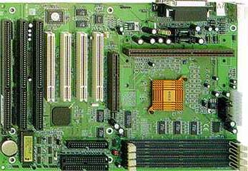
Motherboard
slots for
RAM chips
slots for
adapter cards
CPU
ROM chip

Slide 5
Processing Overview
Central Processing Unit
Processing
Data into
Information
Control
Unit
Arithmetic-
Logic
Unit
Input
Devices
Output
Devices
Primary Storage
Unit
Keyboard
Mouse
Touch Screen
Voice...
Monitor
Printer
Disks, Tapes, Optical Disks
Secondary Storage Devices

Slide 6
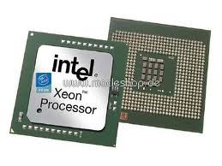
CPU
Central Processing Unit
Computation Engine
On a single Chip

Slide 7
Programming Languages
Generation | Language Type | Example Content
1 | Machine language | 010101000001001
2 | Assembly language | SUB a, b
3 | Procedure languages: C, Basic | float a, b, result; result = (a – b);
4 | Object oriented languages: C++, Java | Class Result() ... float R = Result(); R.substract( a, b);
5 | Dynamic languages: Python, Ruby etc. | result = (a – b);

Slide 8
Microprocessor's Duty
A microprocessor executes a collection of machine instructions that tell the processor what to do.
Using its ALU a microprocessor can perform mathematical operations like addition, subtraction, multiplication and division.
A microprocessor can move data from one memory location to another.
A microprocessor can make decisions and jump to a new set of instructions based on those decisions.

Slide 9
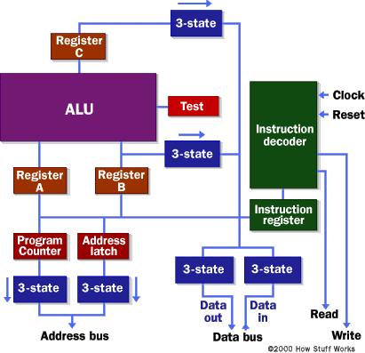
BLOCK DIAGRAM

Slide 10
Microprocessor in brief
A basic microprocessor system consists of the microprocessor core, memory, input/output modules, and a system bus connecting these modules.
The memory system usually consists of Read Only Memory (ROM) for boot information, and Random Access Memory (RAM) organized in a hierarchy of main memory and multilevel cache memory.
Typically, the cache memory is implemented as level 1 cache closely coupled to the microprocessor core, and level 2 cache accessible over the system bus.

Slide 11
Type Of Microprocessors
Computers based on a CPU with a complex instruction set known as CISC (Complex Instruction Set Computer) microprocessor.
  Example: Intel Pentium, Intel Xeon with SMBus
A RISC (Reduced Instruction Set Computer) has limited set of instructions that it can perform quickly.
  Example: AMD
Sun Micro Systems' UltraSPARC (Scalable Processor ARChitecture) is an open RISC platform which is used in today's robust ISPs.
Other Processor Families: IBM, HP, Motorolla, MIPS Technologies

Slide 12
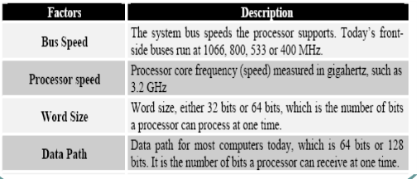
Key Features...

Slide 13
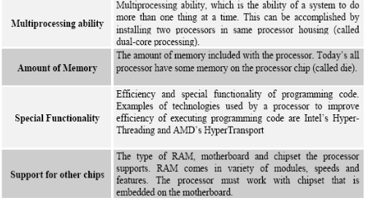
Key Features...

Slide 14
Key Features in Brief
Performance: How fast?
  In MHz or GHz?
  In MIPS: (million instructions per second)
Addressable Memory
  Xeon can address 64bit memory
Scalability
Enhanced Multi-media instructions:
  Intel MMX

Slide 15
Scalability of Resources
Clusters
Load Balancing Switches and Routers
Rack Units
Multiple CPU servers
Server Cabinets

Slide 16
Two Types of Processing
Parallel vs. Distributed Processing
  Parallel computing can mean multiple CPUs in a single computer
  Distributed computing is multiple CPUs across many computers over the network

Slide 17
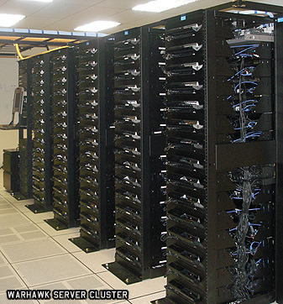
Server Clusters
A group of linked computers, working together closely thus in many respects forming a single computer.

Slide 18
Benefits of Clustering
Load balancing
High Availability
High Performance Computing
Grid Computing

Slide 19
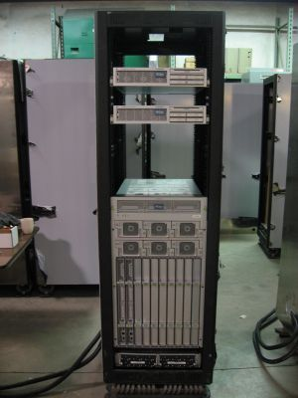
Rack units
A rack unit or U is a unit of measure used to describe the height of equipment intended for mounting in a 19 or 23-inch rack
one rack unit is "1U", 2 rack units as "2U" and so on.

Slide 20
Part-2:
Backup Technologies

Slide 21
Types of Backup
Power Supply Backup
Data Backup in HardDisk: RAID (Redundant Array of Independant Disks)
Backup services or Standby Servers

Slide 22
Power Supply Backup
Types of UPS
  Standby
  Hybrid
  True UPS
All E-commerce sites should use ”True” UPS

Slide 23
Types of Data Backup
Full Backup
Differtial Backup
Incremental Backup

Slide 24
What is RAID
Multiple small,inexpensive physical disks are combined in to an array that would function as a single logical drive,but provide better performance and higher data availability than single large expensive disk drive.

Slide 25
Why RAID?
Intelligently manages drives in unison performing data read/write algorithms across drives delivering
High levels of protection against downtime and data loss (mirroring)
Larger storage volumes achievable
Improved performance (striping)

Slide 26
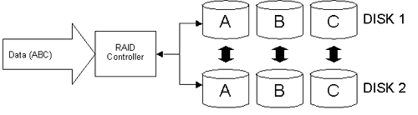
RAID Technique: (1) Mirroring

Slide 27
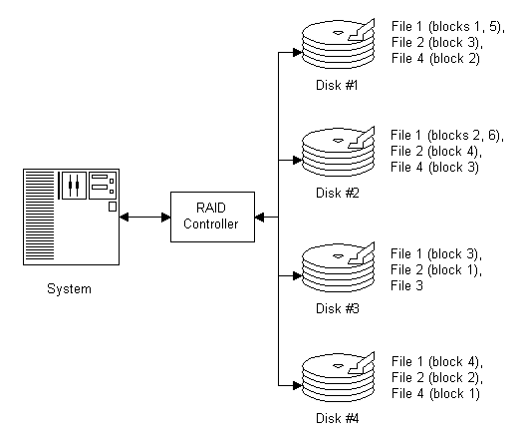
RAID Technique: (2) Stripping

Slide 28
RAID Technique:
(3) Parity Checking
A technique used to detect memory or data communication errors.
Parity-checking schemes work by storing a one-bit digit (0 or 1) that indicates whether the sum of the bits in a data item is odd or even
In even parity, the parity bit is set to 1 if the number of ones in a given set of bits (not including the parity bit) is odd, making the entire set of bits (including parity bit) even.

Slide 29
Use of Parity
Parity data is used by some RAID levels to achieve redundancy.
If a drive in the array fails, remaining data on the other drives can be combined with the parity data (using the Boolean XOR function) to reconstruct the missing data.

Slide 30
What is XOR
An exclusive disjunction is a logical operation on two logical values that produces a value of true only in cases where the truth value of the operands differ.
"one or the other but not both."
Input A | Input B | Output XOR
0 | 0 | 0
1 | 0 | 1
0 | 1 | 1
1 | 1 | 0

Slide 31
Parity in action (1/3)
Drive 1: 01101101
Drive 2: 11010100
To calculate parity data for the two drives, an XOR is performed on their data:
01101101
XOR 11010100
_____________
10111001
The resulting parity data, 10111001, is then stored on Drive 3.

Slide 32
Parity in Action (2/3)
If Drive 2 were to fail, its data could be rebuilt using the XOR results of the contents of the two remaining drives, Drive 1 and Drive 3:
Drive 1: 01101101
Drive 3: 10111001
as follows:
10111001
XOR 01101101
_____________
11010100

Slide 33
Parity in Action (3/3)
The result of that XOR calculation yields Drive 2's contents. 11010100 is then stored on Drive 2, fully repairing the array.

Slide 34
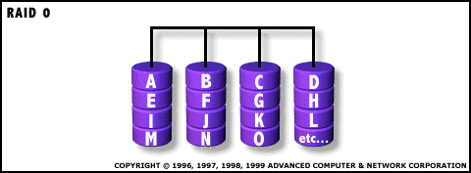
RAID 0
Uses striping
  I/O performance gain
  No Data redundancy
Not fault tolerant
Not considered “true” RAID

Slide 35
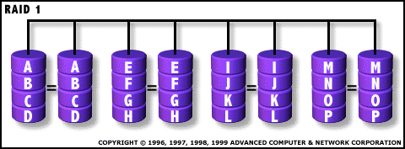
RAID 1
Uses mirroring
  Also known as duplexing
Fault tolerant
High Disk overhead
  Mirroring typically handled system software
Simplest RAID design

Slide 36
RAID 2
Error Detection and Correction
Parity and Hamming Code
  Used to identify and correct errors
Hamming Code
  Uses parity bits to verify data integrity
    Parity bits signify oddness of data bits
  ECC (Error Correction Code)

Slide 37
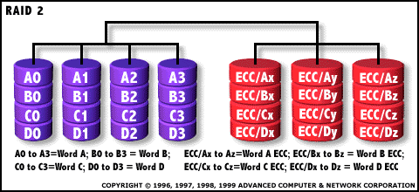
RAID 2
Characterized by:
  “On the fly” data correction
  High Ratio of Data disks to ECC disks
  Not a commercially viable solution
  High Costs Involved

Slide 38
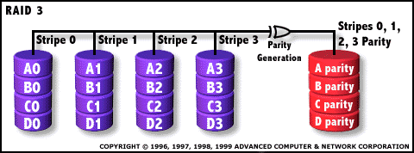
RAID 3
Advantages:
High Read/Write Transfer Rates
Disk failures don’t slow the system
Low Ratio of Data Disks to Parity Disks
Disadvantages:
Transaction rate slowed by Parity Disk
Complex Controller Design
Software Implementation
  Resource Intensive

Slide 39
RAID 3: Uses
Video Production
High-end Video and Image Editing
Other uses that require high throughput of data

Slide 40
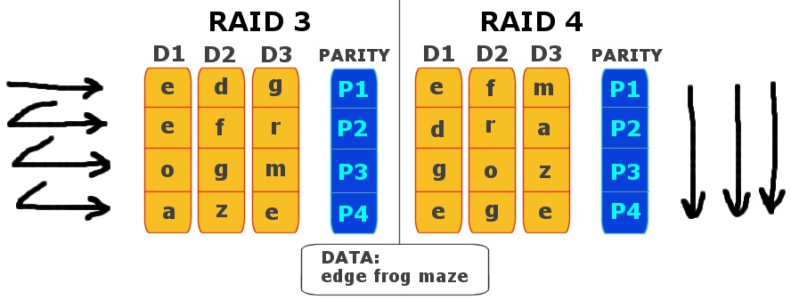
RAID 4
It uses large stripes which mean we can
read record s from any single drive.

Slide 41
RAID 4
Advantages:
Very high read rates
  Multiple files read at once
Uses:
Web Servers, and other high read, low write situations
Disadvantages:
Very slow write rates
  Even small writes fill up parity write queue
Inefficient data recovery
Even more Complex Controller Design than RAID 3

Slide 42
RAID 5
RAID 5 uses a parity data formula to create fault tolerance.
In RAID5 each block of data stripe
contains parity data that is calculated for the
other data blocks in that strip.
The blocks of parity data are distributed over the physical disks that make up the logical drive with each physical disk containing only one block of parity data
It is referred to as data guarding

Slide 43
RAID 5
Advantages
High read performance
No loss of data if one physical disk fails
More usable disk capacity
Disadvantages
Relatively low write performance
Data loss occurs if a second disk fails before
data from the first failed disk is rebuilt

Slide 44
RAID 6
RAID advanced data guarding sometimes referred to as RAID 6,is similar to RAID 5 in that parity data is generated and stored to protect against data loss caused by physical disk failure
Advantages
High read performance
High data availability
More usable disk capacity

Slide 45
RAID 7
This type includes a real time embedded
operating system as a controller caching
via a high speed bus and other characteristics
of stand alone computer
Characteristics
.Extremely high cost per MB
.Fast access times
.Improved write performance with increasing number of drives

Slide 46
RAID 10
Combining RAID 0 and RAID 1 is often referred
to as RAID 10 which offers higher performance
Than RAID 1 but at much higher cost
Uses multiple (mirrored) RAID 1 in a single array
Data striped across all mirrored sets
Very high fault tolerance
High performance rate

Slide 47
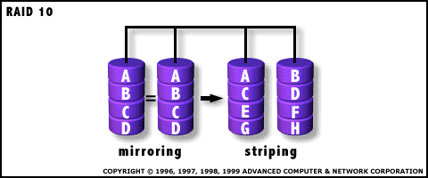
RAID 10
Characterized by:
- each drive duplicated
- high implementation cost

Slide 48
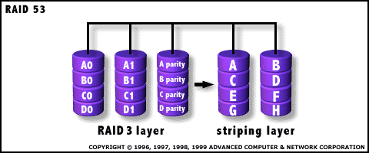
RAID 53
This type uses striping for RAID 3’s virtual
disk blocks
Consists of a striped array made up of RAID 3 segments
Very expensive
Achieves high rate of I/O

Slide 49
RAID 0+1
RAID 1+0 requires an array with four or more
physical disks. The disks are mirrored in pairs
and data blocks are striped across the mirrored
pairs
Advantages
Highest read and write performance
No loss of data as long as no failed disks are mirrored to
any other failed disk
Disadvantages
Expensive and Low disk capacity

Slide 50
RAID Level Summary...
RAID 0: Fastest and most efficient level but offers no fault tolerance
RAID 1: Performance-critical, fault tolerant environments, but requires 2X storage
RAID 5: Best choice for multi-user environments which are not write performance sensitive
RAID 10: Ideal for environments that require 100% redundancy with enhanced I/O performance of stripping and can afford such an investment

Slide 51
RAID Level Summary...
RAID 50: Works best when used with data that requires high reliability, high request rates, and high data transfer rates
RAID 0+1: Optimal for applications needing both fault tolerance and performance. Provides excellent but additional capacity investment
RAID 1E: Great choice for small databases or any other environment that need fault tolerance but have small capacity requirements
RAID 6: Ideal for organizations of all sizes requiring data redundancy, high read rates, and good performance

Slide 52
Now Verify a Server Farm's Claim!
Our web hosting is provided by our cloud hosting platform, which ensures your website receives 99.99% uptime.
Based in our highly resilient datacenter using our fast network we can offer truly unlimited web site hosting.

Slide 53
Lesson Summary
All e-commerce sites should select appropriate hardware and back-up technologies to maximize uptime and reliability
Selection of power and data backup depends on e-commerce site application
Different data backup technologies can be combied to fullfil custom needs.

