Slide 1

Unit 48: IT Security Management
Lecture 1: IT Security Concepts and Risks
Dr. M O Faruque Sarker
LSCI
14 Feb 2011

Slide 2
Lecture Outline
Motivations
Unit Overview
Lecture Plan
Introduction to IT Security
Security Risks
Lesson Summary

Slide 3
Motivations
Why IT Security Management?
- Securing an organization's IT infrastructure
  - Physical device
  - Sensitive Data
  - Communication
- Securing E-commerce Transactions
- Protecting users
- Be prepared for a disaster

Slide 4
Career in IT Security
Main career: IT Security Expert
Associate/Enhancement: Adding value with state-of-the-art knowledge

Slide 5
(ISC)2 Concentration Areas
International Information Systems Security Certification Consortium areas of concerns:
Access Control
Application Development Security
Business Continuity and Disaster Recovery Planning
Cryptography
Information Security Governance and Risk Management

Slide 6
(ISC)2 Concentration Areas
Legal, Regulations, Investigations and Compliance
Operations Security
Physical (Environmental) Security
Security Architecture and Design
Telecommunications and Network Security

Slide 7
Certifications
BCS
- Information Security Management Foundation & Practitioner
(ISC)2
SSCP – Systems Security Certified Practitioner
CAP – Certified Authorization Professional
CSSL – Certified Secure Software Lifecycle Professional
CISSP – Certified Information Systems Security Professional

Slide 8
Unit Overview
Learning outcomes:
1 Understand risks to IT security
2 Understand mechanisms to control organizational IT security
3 Be able to manage organizational security.

Slide 9
References
1. Alexander D et al – Information Security Management Principles (BCS, 2008) ISBN-13: 978-1902505909
2. Beekman G – Computer Confluence Complete: and Student CD (Prentice Hall, 2005) ISBN 1405835796
3. Tipton H – Information Security Management Handbook: v. 4 (Auerbach Pubs, 2010) ISBN-10: 1439819025
4. Foundations of Security: What Every Programmer Needs To Know by Neil Daswani, Christoph Kern, and Anita Kesavan

Slide 10
Some Categories of IT Security
Physical Security
Technological Security
  Application Security
  Operating System Security
  Network Security
  Database Security
Policies & Procedures
All Three Required

Slide 11
Physical Security
Asset theft and unauthorized entry
Information leakage and document theft
Types
  Non-destructive
  Destructive

Slide 12
Application Security
No flaws in identity verification process
Configure server correctly
  local files
  database content
Interpret data robustly

Slide 13
OS, Network & Database Security
Apps (e.g. servers) use OS for many functions
OS code likely contains vulnerabilities
  Regularly download patches to eliminate
  (e.g. Windows Update for critical patches)
Network Security: mitigate malicious traffic
Tools: Firewalls & Intrusion Detection Systems

Slide 14
Security Concept: Authentication
Identity Verification
Three General Ways:
  Something you know (i.e., Passwords)
  Something you have (i.e., Tokens)
  Something you are (i.e., Biometrics)

Slide 15
Security Concept: Authorization
Checking whether a user has permission to conduct some action
Identity vs. Authority
Is a “subject” (person) allowed to access an “object” (open a file)?
Access Control List: mechanism used by many operating systems to determine whether users are authorized to conduct different actions

Slide 16
Access Control Lists (ACLs)
Set of three-tuples
  <User, Resource, Privilege>
  Specifies which users are allowed to access which resources with which privileges
Privileges can be assigned based on roles (e.g. admin)
User | Resource | Privilege
ABC | /home/ABC/* | Read, write, execute
XYZ | /home/XYZ /* | Read, write, execute

Slide 17
Security Concept: Confidentiality
Goal: Keep the contents of communication or data on storage secret
Example: Person A & B want their communications to be secret from person E
Key – a secret shared between person A & B
Sometimes accomplished with
  Cryptography, Access Controls, Database Views

Slide 18
Security Concept: Message/Data Integrity
Data Integrity = No Corruption
Man in the middle attack: Has C tampered with the message that A sends to B?
Integrity Check: Add redundancy to data/messages

Slide 19
Security Concept: Accountability
Able to determine the attacker or principal
Logging & Audit Trails
Requirements:
  Secure Timestamping (OS vs. Network)
  Data integrity in logs & audit trails, must not be able to change trails, or be able to detect changes to logs
  Otherwise attacker can cover their tracks

Slide 20
Security Concept: Availability
Uptime, Free Storage
  Ex. Dial tone availability, System downtime limit, Web server response time
Goal of DoS (Denial of Service) attacks are to reduce availability
  Malware used to send excessive traffic to victim site
  Overwhelmed servers can’t process legitimate traffic

Slide 21
Security Concept: Non-Repudiation
Undeniability of a transaction
Generate evidence / receipts (digitally signed statements)
Often not implemented in practice, credit-card companies become de facto third-party verifiers

Slide 22
Part-2
Security Risks

Slide 23
Security Risks: Attacks
Brute-force and dictionary attacks
Denial-of-service (DoS) attacks
Spoofing
Man-in-the-middle attacks
Spamming
Sniffers

Slide 24
Brute-force and dictionary attacks
An attempt to discover passwords for user accounts by systematically attempting every possible combination of letters, numbers, and symbols.
A dictionary attack is an attempt to discover passwords by attempting to use every possible password from a predefined list of common or expected passwords.

Slide 25
Denial-of-service (DoS) attacks
Denial-of-service (DoS) are attacks that prevent the system from processing or responding to legitimate traffic or requests for resources and objects.
A distributed denial of service (DDoS) occurs when the attacker compromises several systems and uses them as launching platforms against one or more victims.

Slide 26
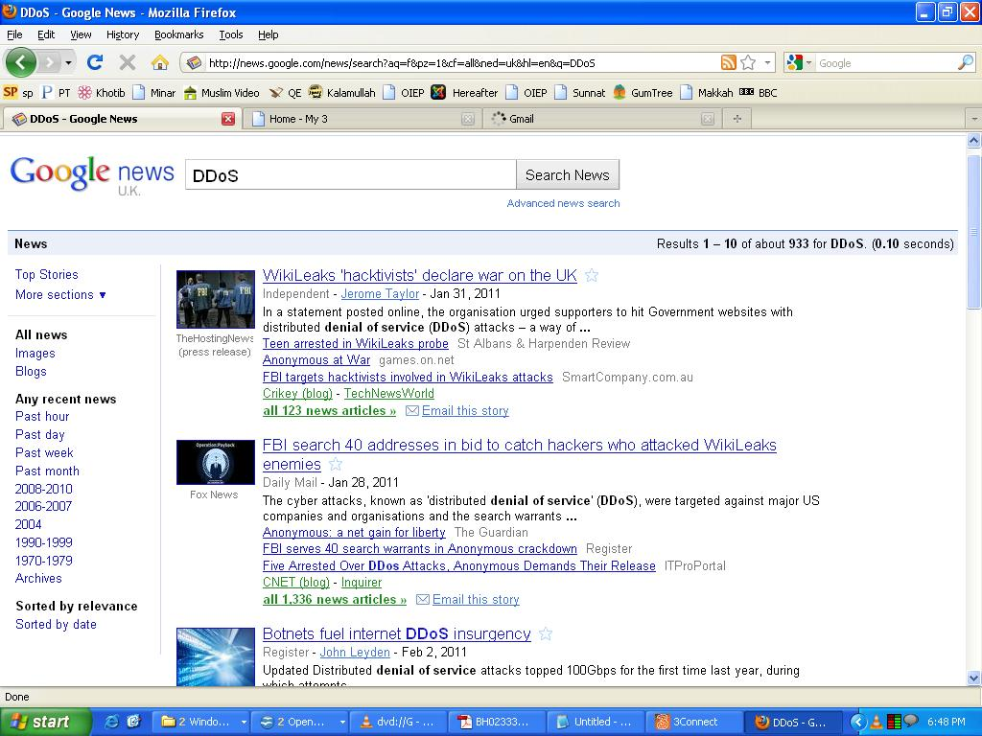

Slide 27
Spoofing
Spoofing is the art of pretending to be something other than what you are. Spoofing attacks consist of replacing the valid source and/or destination IP address and node numbers with false ones.
Examples of spoofing attacks are
(1) impersonation
  Capture of authentication traffic and the replay of that traffic
(2) masquerading
  Uses previously stolen account credentials to log on

Slide 28
Man-in-the-middle attacks
A man-in-the-middle attack occurs when a malicious user is able to gain a position between the two endpoints of an ongoing communication.
There are two types of man-in-the-middle attacks.
  One involves copying or sniffing the traffic between two parties; this is basically a sniffer attack.
  Other involves attackers positioning themselves in the line of communication where they act as a store-and-forward or proxy mechanism

Slide 29
Sniffer Attacks
A sniffer attack (also known as a snooping attack) is any activity that results in a malicious user obtaining information about a network or the traffic over that network.

Slide 30
Spamming Attacks
Spamming attacks are directed floods of unwanted messages to a victim’s email inbox or other messaging system. Such attacks cause DoS issues by filling up storage space and preventing legitimate messages from being delivered.

Slide 31
Web Application Security Issues
Worms and Other Malware
Buffer Overflows
Client-State Manipulation
SQL Injection
Password Security
Cross-Domain Security in Web Applications

Slide 32
Worms and Other Malware
Worms spreading across Internet through vulnerabilities in software
Virus: program that copies itself into other programs
  Could be transferred through infected disks
  Rate dependent on human use
Worm: a virus that uses the network to copy itself onto other computers
Worms propagate faster than viruses
  Large # of computers to infect
  Connecting is fast (milliseconds)

Slide 33
Rootkits, Botnets & Spyware
Rootkits: imposter OS tools used by attacker to hide his tracks
Botnets: network of software robots attacker uses to control many machines at once to launch attacks (e.g. DDoS through packet flooding, click fraud)
Spyware: software that monitors activity of a system or its users without their consent

Slide 34
Buffer overflows
Buffer: memory used to store user input, has fixed maximum size
Buffer overflow: when user input exceeds max buffer size
  Extra input goes into unexpected memory locations
Buffer overflows most common security threat!
  Used in many worms such as Morris Worm
Attacker can run desired code, hijack program

Slide 35
Client-State Manipulation
Web application – collection of programs used by server to reply to client (browser) requests
Often accept user input: don’t trust, validate!
HTTP is stateless, servers don’t keep state
To conduct transactions, web apps have state
State info may be sent to client who echoes it back in future requests
Example Exploit: “Hidden” parameters in HTML are not really hidden, can be manipulated

Slide 36
SQL Injection
Command injection vulnerability - untrusted input inserted into query or command
Attack string alters intended semantics of command
Ex: SQL Injection - unsanitized data used in query to back-end database (DB)
CardSystems, credit card payment processing Ruined by SQL Injection attack in June 2005
  263,000 credit cards stolen from its DB stored unencrypted, 40 million exposed
Awareness Increasing: # of reported SQL injection vulnerabilities tripled from 2004 to 2005

Slide 37
Password Hacking
Password systems ubiquitous, vulnerable
Early password security studies (1979) - Morris, Thompson: 86% of passwords can be cracked
Threats: Online & Offline Dictionary Attacks

Slide 38
Lesson Summary
IT security management is a challenging task with a great rewarding career options.
IT Security spans over multiple areas: Physical, OS, Database, Network and Applications
Key security concepts include: authentication, authorization, confidentiality data integrity, availability, accountability
Security threats to organizations are increasing over time.

