Slide 1

INTRODUCTION
My name is Habib Shittu, a junior data analyst at ChatData.
This is a short presentation on steps involved in data analysis process and project review.

Slide 2
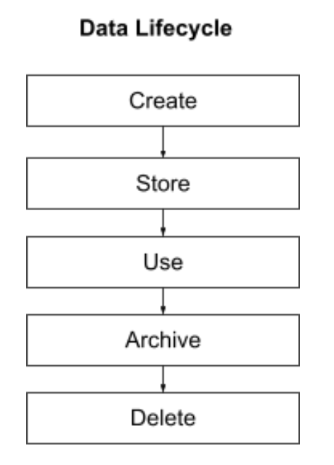
Data lifecycle
Stages of Data lifecycle for this project includes: Create, Store, Analyse and Archive.
The Data used for this project was acquired (Create) using Python Jupyter Notebook from the following data sources; i. Users: This is a table of users on the ChatData website. This is a csv file. ii. Posts: This is a table of posts on the ChatData website. This is a csv file. iii. Comments: This is a table of comments on the ChatData website. This is a csv file. *All the three files were imported into Python Jupyter Notebook to create a database using SQLite.

Slide 3
Pre Analysis Activities Understanding the Data Sources. Data Quality Assessment. Data Cleaning and Preprocessing. Exploratory Data Analysis (EDA). Data Integration and Database Creation. Database Schema Design. ETL (Extract, Transform, Load) Process. Data Versioning and Backup. Data Security and Access Control. Data Privacy and Compliance. Documentation. Data Dictionary. Testing and Validation. By following these steps, this will ensure that you have a clean, well-organized dataset stored in an SQLite database, ready for analysis.

Slide 4
By following these steps, you will create a robust and maintain the solution for updating and analysing data; Automate Data Retrieval and Processing. Implement data cleaning and transformation steps in your Python script. Automate Database Update. Implement logging and error handling in your script. Version Control. Documentation. Testing and Validation. Scalability and Performance. Team Collaboration. This Project fits into create, store, Analyse (use) and Archive in a broader data lifecycle

Slide 5
Tools Requirements
Using SQLite in Python Jupyter Notebook is highly effective for this task and project. Python is a versatile programming language suitable for a wide range of tasks, including data manipulation, analysis, and scripting. It vast ecosystem of libraries and packages, including data manipulation (Pandas), and working with databases (SQLite, SQLAlchemy).
Jupyter Notebook provides an interactive environment where you can write and execute code in cells. This is particularly useful for exploratory data analysis and sharing insights. Also good for documentation, presentation and for easy iteration, making it easy to test and modify code snippets.
SQLite is well-suited for small to medium-sized projects where the simplicity, serverless, and file-based database engine with low configuration overhead .

Slide 6
Requirements
Due to the notes provided and template developed by Oliver the analysis requirement is well spelt out and simplify. However, the rating of some columns is not clear, such as Score and Reputation. The analysis was carried by careful study of the data and developing a relationship among the three provided CSV files using the Entity Relationship Diagram method.

Slide 7
Why SQLite over PostgreSQL
Simplicity and Lightweight.
Low Resource Consumption. Embedded Applications. Portability. Small to Medium Sized Projects. Low Configuration Overhead.

Slide 8
Benefits of Relational database technologies for an IT Organisation
Structured Data Management. Data Integrity and Consistency. Data Security. Data Scalability. Data Retrieval and Query Optimization. Data Integrity and Redundancy. Data Backup and Recovery. Data Reporting and Analysis. Compliance and Regulation. Ease of Maintenance. Community and Support.

Slide 9
Organisation of the Data Source
Overall, the organization of the source data greatly is clean. A well-structured source dataset with clear relationships and consistent data quality makes the process of designing the database schema much smoother. It was a natural mapping from the CSV files to the database tables due to; Consistency. Data Integrity. Data Granularity. Relationships. Data Normalization. Data Transformation. Data Documentation.

Slide 10
Data Quality
Overall, the data is consistent due to cleaning and pre processing by Oliver and this help in producing quality results. The definitions of the data could be improved by creation of Data Dictionary. This will assist in understanding different variable column in the data for better analysis. The quality of the data could be improved by developing a company policy (Data governance) on Data format, structure, or semantics.

Slide 11
Security, ethics and legislation The data was masked but the present of columns such as Location of the users, DisplayName column also shows some users real name, AboutMe, ProfileImageUrl could present personal data. Ethical considerations that should be considered include whose data is captured, where, target use, where is the data coming from and stored. How is it stored in a secured manner. Some possible techniques (e.g.statistics) that could unmask the participants in this data includes; NLP and Sentiment Analysis (AboutMe), Geospatial Analysis (Location), Profile Picture Analysis (ProfileImageUrl). The use of this data is covered by UK GDPR, EU GDPR legislation and Consumer privacy Act in some states in the united states.

