Slide 1

INTRODUCTION
My name is Habib Shittu, a data analyst at DataSpace
This is a short presentation to introduce AusEnergy to different data management tools we use at DataSpace and we believe would help AusEnergy to maximise their data lifecycle to improve their decision and meet personalised business needs

Slide 2
PYTHON
Python is a general-purpose, open source programming language for data analysis that is easy to learn and use. It has a large community of users and developers. Benefits of using Python for data analysis:
Efficiency Flexibility
Community Open source
How Python can be used for data analysis:
Data wrangling: Python can be used to clean and prepare data for analysis.
Data analysis: Python can be used to perform statistical analysis on data.
Machine learning: Python can be used to build machine learning models.
Data visualization: Python can be used to create interactive visualizations of data.
Notes:
Python is a general-purpose, open source programming language for data analysis that is easy to learn and use. It has a large community of users and developers.
Benefits of using Python for data analysis:
Efficiency: Python is a very efficient language, which means that it can be used to process large datasets quickly and easily.
Flexibility: Python is a very flexible language, which means that it can be used for a variety of data analysis tasks.
Community: Python has a large and active community of users and developers, which means that there are many resources available to help data analysts learn and use the language.
Open source: Python is an open source language, which means that it is free to use and modify. This makes it a very cost-effective option for data analysts.
Examples of how Python is used for data analysis:
Data wrangling: Python can be used to clean and prepare data for analysis.
Data analysis: Python can be used to perform statistical analysis on data.
Machine learning: Python can be used to build machine learning models.
Data visualization: Python can be used to create interactive visualizations of data.

Slide 3

Tableau is a powerful and intuitive tool that allows users to create interactive dashboards and visualizations from data. It is a popular tool for data analysts because it is easy to use, even for those with no programming experience.
Tableau also offers a wide range of features that make it well-suited for data analysis, such as:
Data blending d. Filters and parameters
Calculated fields e. Tooltips and annotations
Sharing:
Examples of how Tableau is used for data analysis:
Dashboards Report
Presentations Machine learning
Notes:
Tableau is a data visualization software platform that allows users to create interactive dashboards and visualizations from data.
It is a popular tool for data analysts because it is easy to use, even for those with no programming experience.
Tableau also offers a wide range of features that make it well-suited for data analysis, such as:
Data blending: Tableau allows users to blend data from multiple sources into a single view.
Filters and parameters: Tableau allows users to filter and parameterize data to create customized views.
Calculated fields: Tableau allows users to create calculated fields to add new dimensions and metrics to data.
Tooltips and annotations: Tableau allows users to add tooltips and annotations to visualizations to provide additional context.
Sharing: Tableau allows users to share dashboards and visualizations with others.
Benefits of using Tableau for data analysis:
Ease of use: Tableau is a very easy-to-use tool that can be used by data analysts with no programming experience.
Powerful features: Tableau offers a wide range of features that make it well-suited for data analysis, such as data blending, filters and parameters, calculated fields, tooltips and annotations, and sharing.
Visualization capabilities: Tableau is a powerful data visualization tool that can create interactive and engaging visualizations that help data analysts communicate their findings to others.
Industry adoption: Tableau is a widely adopted tool by businesses of all sizes, which means that there are many resources available to help data analysts learn and use the software.
Examples of how Tableau is used for data analysis:
Dashboards: Tableau is often used to create dashboards that provide a single view of key metrics and trends.
Reports: Tableau can also be used to create reports that present data in a more structured format.
Presentations: Tableau can be used to create presentations that visually communicate data to others.
Machine learning: Tableau can be used to build machine learning models that can be used to predict future outcomes.
Conclusion:
Tableau is a powerful and versatile tool that can be used for a variety of data analysis tasks. It is easy to use, has a wide range of features, and is widely adopted by businesses of all sizes. These factors make it a great choice for data analysts who need to be able to quickly and easily create interactive and engaging visualizations of data.

Slide 4
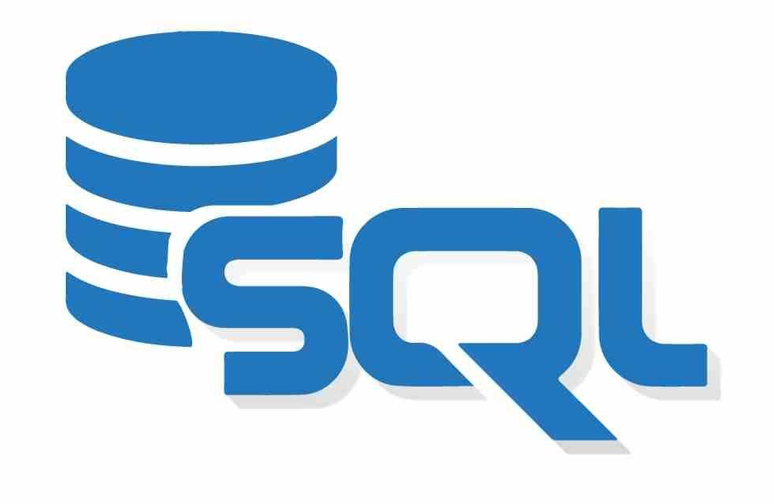
SQL and Databases
SQL (Structured Query Language) is a programming language that is used to manage data in relational databases.
Databases are a collection of data that is organized in a way that makes it easy to access and use.
Benefits of using SQL and databases for data analysis:
Powerful querying capabilities
Scalability
Security
Cost-effectiveness
Notes:
SQL and Databases for Data Analysts
Subtitle: A powerful duo for storing, querying, and analyzing data
Body:
SQL (Structured Query Language) is a programming language that is used to manage data in relational databases.
Databases are a collection of data that is organized in a way that makes it easy to access and use.
Data analysts use SQL and databases to store, query, and analyze data.
Benefits of using SQL and databases for data analysis:
Powerful querying capabilities: SQL provides a wide range of commands that can be used to query data in databases. This makes it possible to quickly and easily extract the data that you need for analysis.
Scalability: Databases can be scaled to store large amounts of data. This makes them a good choice for data analysts who need to work with large datasets.
Security: Databases can be secured to protect data from unauthorized access. This is important for data analysts who work with sensitive data.
Cost-effectiveness: Databases can be a cost-effective way to store and manage data. This is important for data analysts who need to work with large datasets on a budget.
Examples of how SQL and databases are used for data analysis:
Data cleaning: SQL can be used to clean data in databases. This involves removing errors, duplicates, and missing values from data.
Data analysis: SQL can be used to analyze data in databases. This involves running queries to extract data, performing statistical analysis, and creating visualizations.
Machine learning: SQL can be used to build machine learning models. This involves extracting data from databases, training models, and making predictions.
Conclusion:
SQL and databases are powerful tools that can be used for a variety of data analysis tasks. They are easy to learn and use, scalable, secure, and cost-effective. These factors make them a great choice for data analysts who need to store, query, and analyze data.

Slide 5
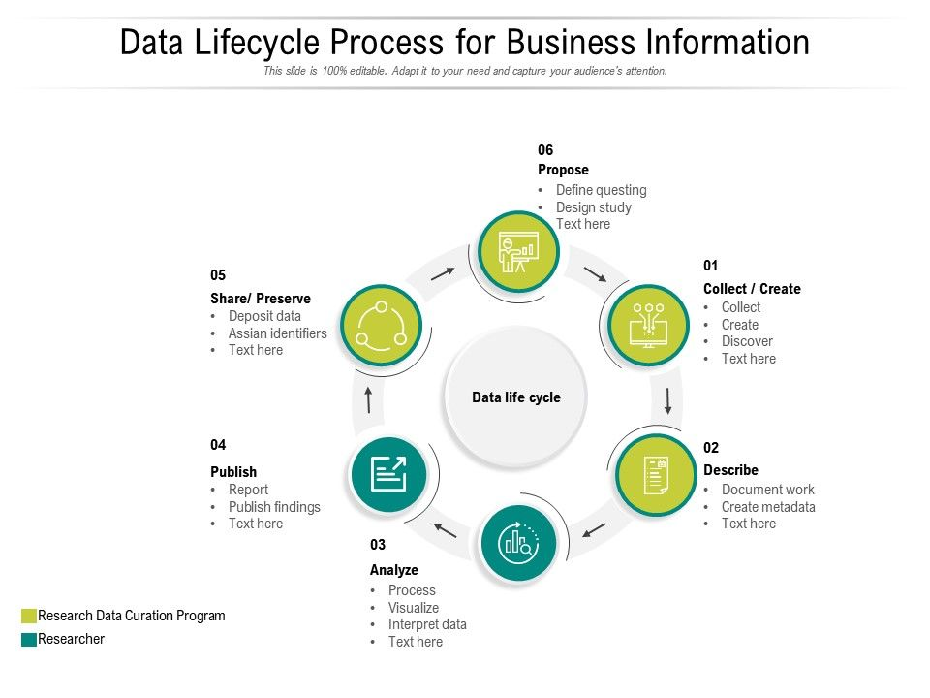
Data lifecycle
Planning: Identify data needs, develop data management plan
Collection: Gather data from a variety of sources
Storage: Organize and store data in a secure and accessible way
Management: Protect data from unauthorized access, ensure data quality, comply with regulations
Use: Analyze data to generate insights, make decisions
Disposal: Delete data that is no longer needed
Notes:
Title: The Data Lifecycle
Subtitle: An overview of the key phases of data management
Body:
The data lifecycle is the process of collecting, storing, managing, and using data. It is a continuous process that begins with the identification of data needs and ends with the disposal of data.
The key phases of the data lifecycle are:
Planning: This phase involves identifying the data needs of the organization and developing a data management plan.
Collection: This phase involves gathering data from a variety of sources, such as surveys, transactions, and sensors.
Storage: This phase involves organizing and storing data in a secure and accessible way.
Management: This phase involves protecting data from unauthorized access, ensuring data quality, and complying with regulations.
Use: This phase involves analyzing data to generate insights and make decisions.
Disposal: This phase involves deleting data that is no longer needed.
Excel spreadsheets can be used in all phases of the data lifecycle.
In the planning phase, Excel spreadsheets can be used to document data needs and requirements. In the collection phase, Excel spreadsheets can be used to collect data from surveys, transactions, and other sources. In the storage phase, Excel spreadsheets can be used to store small amounts of data. In the management phase, Excel spreadsheets can be used to protect data from unauthorized access, ensure data quality, and comply with regulations. In the use phase, Excel spreadsheets can be used to analyze data and generate insights. In the disposal phase, Excel spreadsheets can be used to delete data that is no longer needed.
Conclusion:
The data lifecycle is a continuous process that is essential for any organization that collects and uses data. Excel spreadsheets can be used in all phases of the data lifecycle to make the process more efficient and effective.
Here is another slide that you can use to explain the data lifecycle:
Data Lifecycle
Planning: Identify data needs, develop data management plan
Collection: Gather data from a variety of sources
Storage: Organize and store data in a secure and accessible way
Management: Protect data from unauthorized access, ensure data quality, comply with regulations
Use: Analyze data to generate insights, make decisions
Disposal: Delete data that is no longer needed
Excel Spreadsheets
Planning: Document data needs and requirements
Collection: Collect data from surveys, transactions, and other sources
Storage: Store small amounts of data
Management: Protect data from unauthorized access, ensure data quality, comply with regulations
Use: Analyze data and generate insights
Disposal: Delete data that is no longer needed

Slide 6
Spreadsheets can be used to achieve the following lifecycle phases;
planning phase, collection phase, storage phase, management phase, use phase, disposal phase.
However, Spreadsheet also has some limitations and challenges that may affect its suitability for certain phases of the data lifecycle. Such as; large volumes of data, security and integrity, regulatory and ethical standards, quality and consistency of data over time. It is advisable to use other tools or platforms that are more suitable for specific phases or purposes of the data lifecycle.
However, DataSpace could help AusEnergy with their expertise to carry out the full Data lifecycle phases Energy Demand analysis for AusEnergy, Dashboard could be included for publication to stakeholders presentation to better communicate their findings.
AusEnergy Demand Analysis Report
Notes:
In the planning phase, Excel spreadsheets can be used to document data needs and requirements. In the collection phase, Excel spreadsheets can be used to collect data from surveys, transactions, and other sources. In the storage phase, Excel spreadsheets can be used to store small amounts of data. In the management phase, Excel spreadsheets can be used to protect data from unauthorized access, ensure data quality, and comply with regulations. In the use phase, Excel spreadsheets can be used to analyze data and generate insights. In the disposal phase, Excel spreadsheets can be used to delete data that is no longer needed
However, Spreadsheet also has some limitations and challenges that may affect its suitability for certain phases of the data lifecycle. For example:
- Excel spreadsheet may not be able to handle large volumes of data efficiently, as it has a maximum limit of rows and columns per worksheet.
- Excel spreadsheet may not be able to ensure the security and integrity of data effectively, as it can be easily modified or corrupted by unauthorized users or malware.
- Excel spreadsheet may not be able to comply with the regulatory and ethical standards of data sharing, as it may contain sensitive or personal information that requires encryption or anonymization.
- Excel spreadsheet may not be able to preserve the quality and consistency of data over time, as it may suffer from errors, inconsistencies, or outdatedness due to manual entry or manipulation.
Therefore, Excel spreadsheet should be used with caution and care when dealing with different phases of the data lifecycle. It may be advisable to use other tools or platforms that are more suitable for specific phases or purposes of the data lifecycle.

