Slide 1

INTRODUCTION
My name is Habib Shittu, a junior data analyst at London Borough of Camden Council.
This is a short presentation on steps involed in data analysis process and project review.

Slide 2
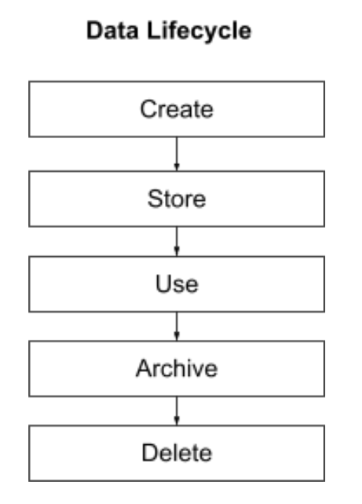
Data lifecycle
Stages of Data lifecycle for this project includes: Create, Store, Use.
The used for this project was acquired (Create) from the following sources; i. Trees Data: Website download from Camden Council. This is an Excel file ii. Common Names Data: Web scrapping using API, scraping of third-party website (a horticultural organization) This is in json format. iii. Environmental Data: This is an extract gotten by querying the Camden council assets database. This is a csv file. *All the three files were combined in Python Jupyter Notebook in preparation for analysis.

Slide 3
Data lifecycle
Updating the original data at its source, sensitivity and ownership scenarios.
For Trees Data and Environmental Data: The analysis carried out has identified errors and ways to improve its quality, this can be updated in the original data source after data cleaning and upon approval from appropriate department(data team coordinator) in the council. Common Names Data is from a third-party website and cannot be updated at source due ownership and other GDPR legislations.

Slide 4
Data lifecycle
Updating the original data at its source, sensitivity and ownership scenarios.
Common Names Data is owned by a third-party, the sensitivity can be assumed to be public since it readily available on their website, however care should be taken in aspects of use and copyrights. The Council might need to contact the organisation on issues of ownership and use of their data, security, ethics and legislation
The impacts of different sensitivity boarders around the intended audience that the primary data source is to be used for, Public Tree Data and Tree Walks Brochures projects are for general public therefore internal data such Environmental should be used with caution. The Council owns Trees Data and Environmental Data, this eliminate risks of ownership issues including security, ethics and legislation.

Slide 5
Requirements
Public Tree Data Project: Trees data and common data combined will provide list of all trees in the borough, this will serve the “opendata” initiative of the borough without exposing any sensitive or internal data. The columns are properly label to identify qualitative/ quantitative variables, binary/ nominal/ ordinal, discrete/ continuous variables, they contained required data needed for the project.
Tree Walks Brochures Project: Trees data and common names data combined will enable the public access all the trees in the borough. The common names column will help the public for easy identification while the Trees data will make easy location of any particular tree of interest.
Environment Report project: Environmental data combined with Trees data will help Camden council to achieve the objective of showing information about trees removed, trees planted and the net carbon and pollution impact on their website.

Slide 6
Requirements
Limitations in data: The common name data file does not contain all the common names for every scientific name and not all scientific name is in the file. In the Environmental Data under ‘Removal reason’ column, nan was used where there is data, this could have been properly labelled.
Classifying the data columns: After careful study of the string and numeric columns using value counts and descriptive stats classification of the columns become clearer and easier, for example ‘Number of trees’ column is in float instead of integer because a tree can only in whole but after using descriptive stats its confirm that the null values was responsible for it being categorise as floats which could make it quantitive continuous when it actually discrete variable. Date is qualitative ordinal by standard this was clarified by further online research.

Slide 7
Quality
Approach to data quality and issues identified: Define the data quality dimension and metrics; define the acceptable percentage of missing values, duplicates data, relevance, completeness. Metrics for working with missing data could be i. Deleting rows(less than 5%), ii. Mean|Median|Mode imputation (5-25%), iii. Regression imputation, iv. Deleting variable ( When a variable is missing most of its data e.g. ‘Removal reason’ column has 99% nan values). Also, Report on data quality issues and their severity.
Data quality impact on council’s ability to meet the requirements of the initiatives: i. Inaccurate results. The outliers in some columns will give inaccurate results ii. Working data outside the geolocation of the council. iii. Incomplete common names to the scientific names of trees in the council

Slide 8
Quality
Risks to the council of having poor quality data: i. Increased costs: more time and resources to clean and validate the data ii. Reduced productivity: difficult to find and use the information that is needed iii. Damage to reputation: having trees outside the Council geolocation in her brochure iv. Poor quality data means poor quality analysis. Garbage in garbage out.

Slide 9
Challenges and risks working with data from multiple sources
i. Data inconsistency: inconsistent in terms of its format, structure, or semantics. ii. Data quality: different sources may have different quality levels. iii. Data integration: Integrating data from multiple sources can be a complex and time-consuming process. iv. Data governance: Ensuring that the data is secure, accessible, and compliant with regulations can be challenging. v. Data privacy: data from multiple sources can raise privacy concerns.

