Slide 1

INTRODUCTION
My name is Habib Shittu, a data analyst at Dental pharma inc.
This is a short presentation on steps involed in data analysis process and stages of data lifecycle.

Slide 2
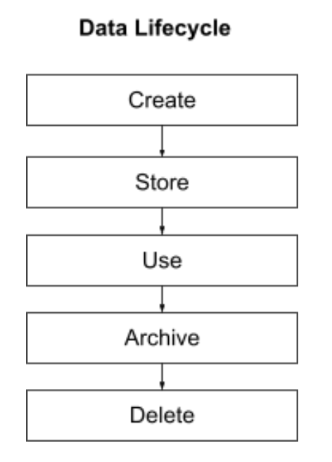
Data lifecycle
Stages of Data lifecycle: Create, Store, Use, Archive, Delete.
Ensure you check the Requirements (Business) Security, Ethics, Legislation, Tools, Quality.
Ensure the integrity of the new data by fulfiling all the supporting disciplines as highlighted above before carrying out the analysis
Data analysis lifecycle stages: Acquire(extract), Transform(Clean), organise(Structure), Analyse (Summarise, calculate metrics) and communicate (Dashboard report).
This project fits into create, store and use blocks in a broader data lifecycle.
Notes:
Title: The Data Lifecycle
Subtitle: An overview of the key phases of data management
Body:
The data lifecycle is the process of collecting, storing, managing, and using data. It is a continuous process that begins with the identification of data needs and ends with the disposal of data.
The key phases of the data lifecycle are:
Planning: This phase involves identifying the data needs of the organization and developing a data management plan.
Collection: This phase involves gathering data from a variety of sources, such as surveys, transactions, and sensors.
Storage: This phase involves organizing and storing data in a secure and accessible way.
Management: This phase involves protecting data from unauthorized access, ensuring data quality, and complying with regulations.
Use: This phase involves analyzing data to generate insights and make decisions.
Disposal: This phase involves deleting data that is no longer needed.
Excel spreadsheets can be used in all phases of the data lifecycle.
In the planning phase, Excel spreadsheets can be used to document data needs and requirements. In the collection phase, Excel spreadsheets can be used to collect data from surveys, transactions, and other sources. In the storage phase, Excel spreadsheets can be used to store small amounts of data. In the management phase, Excel spreadsheets can be used to protect data from unauthorized access, ensure data quality, and comply with regulations. In the use phase, Excel spreadsheets can be used to analyze data and generate insights. In the disposal phase, Excel spreadsheets can be used to delete data that is no longer needed.
Conclusion:
The data lifecycle is a continuous process that is essential for any organization that collects and uses data. Excel spreadsheets can be used in all phases of the data lifecycle to make the process more efficient and effective.
Here is another slide that you can use to explain the data lifecycle:
Data Lifecycle
Planning: Identify data needs, develop data management plan
Collection: Gather data from a variety of sources
Storage: Organize and store data in a secure and accessible way
Management: Protect data from unauthorized access, ensure data quality, comply with regulations
Use: Analyze data to generate insights, make decisions
Disposal: Delete data that is no longer needed

Slide 3
Identify stakeholder’s requirements: several users with different needs and responsibility derived from meeting notes. Then, followed the guidance template given by senior colleague Creating dashboard blueprints: This is based on business requirements, user needs, specific metrics and type of visualization. Mockup designs: Use of grid layout, clear and concise labels, using visuals to tell a story, consistent formatting. This will help create a professional and polished look.
Dashboard Requirement
Notes:
1.
Several users with different levels of responsibility and needs: The General Managers, who decide whether to halt or proceed with projects. To do this, they need to be alerted when there are significant performance gaps for projects. They also need to be able to monitor the overall performance of all projects. ○ Regional Managers who intervene with Country Managers in their region if there are performance gaps on projects. They need to be alerted regarding projects in their regions, and need to be able to monitor them. ○ Country Managers who take corrective action for projects falling under their responsibility. To do this, they need to be able to view indicators for projects in their country. ● Activity is guided by three key “Project Portfolio” indicators: ○ Actual project cost vs planned cost (i.e. meeting project budgets) ○ Actual duration vs planned duration (i.e. meeting project deadlines) ○ Project deliverables actually produced vs. those forecast
2.
Dashboard Blueprint
The table below captures the essential details that are needed for the dashboard.
Business Requirements: This was already completed at the end of the meeting with Sophie.
User Needs: This briefly describes the interactions the users will have with the data for this requirement (e.g., what filters are needed).
Specific Metrics to Use: This lists the metrics and any calculated metrics that will be used for this requirement (e.g. Actual Cost).
Visualization: The type of visualization that could be used for this requirement (e.g. Bar Chart).
3
Use a grid layout. A grid layout helps to create a sense of order and consistency on the dashboard. It also makes it easier for users to scan the dashboard and find the information they are looking for.
Use clear and concise labels. The labels on your dashboard should be clear and concise, so that users know what they are looking at. Avoid using jargon or technical terms that your users may not understand.
Use consistent colors and fonts. Using consistent colors and fonts throughout your dashboard will help to create a cohesive look and feel. It will also make it easier for users to scan the dashboard and find the information they are looking for.
Use white space. White space is important for creating a clear and uncluttered dashboard. Don't be afraid to leave some blank space around your visualizations and text.
Use filters and drill-down capabilities. Filters and drill-down capabilities allow users to explore the data in more detail. This can be helpful for users who want to get a deeper understanding of the data.
Test your dashboard with users. Once you have designed your dashboard, it is important to test it with users to get their feedback. This will help you to identify any areas that are unclear or confusing.
Here are some additional tips for making your Tableau dashboards clear and effective:
Focus on the most important information. Not all of the information in your data is going to be relevant to your users. Focus on the most important information and make sure that it is presented in a clear and concise way.
Use visuals to tell a story. Data visualizations can be a powerful way to tell a story with your data. Use visuals to help users understand the data and see the trends and patterns.
Keep it simple. Don't overload your dashboard with too much information. A simple dashboard is often more effective than a complex one.
Use consistent formatting. Use consistent formatting throughout your dashboard, such as font size, font style, and color scheme. This will help to create a professional and polished look.

