Slide 1
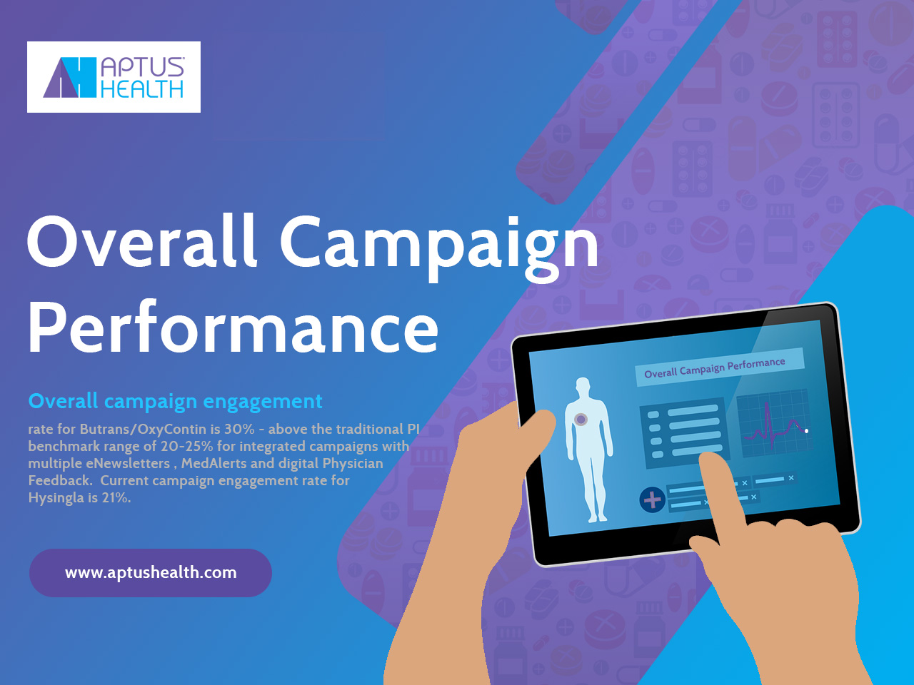

Slide 2


The Aptus Health Approach
Think Different About MCM
Trust is key … every audience, HCP or HCC, has a multitude of online destinations to choose from, and like all consumers of digital media, they simplify their lives by choosing a small handful and sticking with them. Better to use a channel that is already trusted than to create one and build the trust.
Every space is a digital space … MCM is not simply a substitute for face to face marketing—it is the de facto standard for modern marketing.
Integration is the name of the MCM game … it is critical to leverage your assets through an integrated, collaborative architecture, enabling a true integrated partnership model that provides flexibility of multiple channel levers to adjust as engagement occurs.
Death by a thousand cuts tactics… It is equally critical to avoid an unplanned, scattered approach that results in a ‘clunky’ model that creates a slow flow of engagement metrics to respond to, and multiple partners vying to increase their respective footprint.
Go big or go home… Take a bold approach to integrated MCM engagement design, not a full reliance on a fragmented approach to destinations
Be partners… one of the key benefits of MCM is its inherent measurability. Focus partnership on outcome alignment, and partner within a performance based construct that enables a self-funding model. Partners win or lose together.
Make it Biogen’s… Begin with the end in mind and design the program to capture learning that will inform Biogen’s MCM investment forward.

Slide 3





Strong results and learning's
on how GPs interact with hcv patients
GPs expressed considerable interest
> 80% interacted with the MCQs* in the eLearning modules
> 50% of all participants completed the quiz at the end of the program

Slide 4


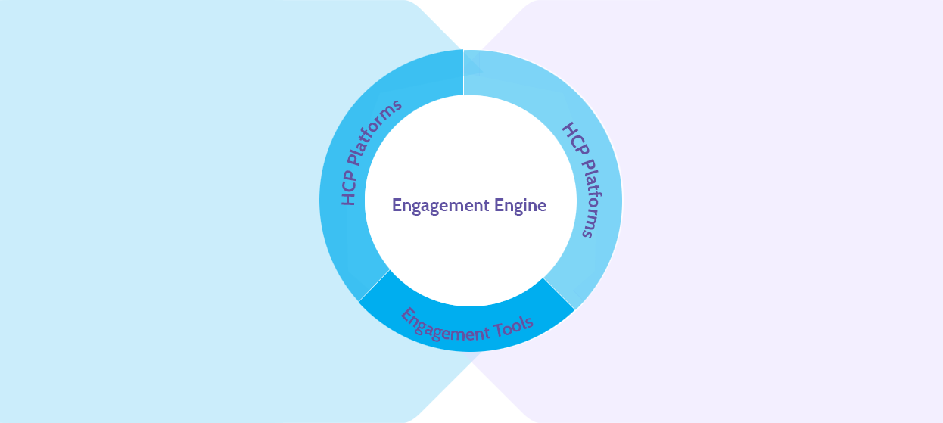
Adaptive Engagement
Engine Drives Enterprise Level Efforts
The art and science of synthesizing insights and
data into a dynamic blueprint
Blueprint
Data Analytics
> Messages
> Audiences
> Timing
> Channels
> Reception
> Segments
> Activity
> Affinity
Insight
Analytics
Objectives
Impact

Slide 5


Campaign Findings
Campaign Findings
Overall campaign engagement rate for Butrans/OxyContin is 30% - above the traditional PI benchmark range of 20-25% for integrated campaigns with multiple eNewsletters , MedAlerts and digital Physician Feedback. Current campaign engagement rate for Hysingla is 21%.
Engagement rate: % of unique targets engaged with the campaign and exposed to messaging.
Separately, OxyContin engagement rate is 25% and Butrans engagement rate is 20%.
PI benchmark: 20-25%.
For Butrans and OxyContin, the overall eNewsletter open rate is 8% and the current open rate for Hysingla is 7%.
Engagement rate: % of unique targets engaged with the campaign and exposed to messaging.
Separately, OxyContin engagement rate is 25% and Butrans engagement rate is 20%.
PI benchmark: 20-25%.
For the MedAlert, all three brands – Butrans, OxyContin and Hysingla – have 10% open rates within the benchmark range of 8-10%.
OxyContin MedAlert 1 had a 14% open rate with the following subject line: “Review abuse-deterrence studies of an extended-release opioid”.
The Butrans MedAlert with the highest open rate (13%) referred to the 12-week clinical study up front: “12-week clinical study of chronic pain patients”.
For Hysingla, use of “Learn about pharmacokinetics” worked well along with “abuse-deterrent properties”.
PI benchmark 8-10%

Slide 6
Campaign Findings
Campaign Findings
Overall campaign engagement rate for Butrans/OxyContin is 30% - above the traditional PI benchmark range of 20-25% for integrated campaigns with multiple eNewsletters , MedAlerts and digital Physician Feedback. Current campaign engagement rate for Hysingla is 21%.
Engagement rate: % of unique targets engaged with the campaign and exposed to messaging.
Separately, OxyContin engagement rate is 25% and Butrans engagement rate is 20%.
PI benchmark: 20-25%.
For Butrans and OxyContin, the overall eNewsletter open rate is 8% and the current open rate for Hysingla is 7%.
Engagement rate: % of unique targets engaged with the campaign and exposed to messaging.
Separately, OxyContin engagement rate is 25% and Butrans engagement rate is 20%.
PI benchmark: 20-25%.
For the MedAlert, all three brands – Butrans, OxyContin and Hysingla – have 10% open rates within the benchmark range of 8-10%.
OxyContin MedAlert 1 had a 14% open rate with the following subject line: “Review abuse-deterrence studies of an extended-release opioid”.
The Butrans MedAlert with the highest open rate (13%) referred to the 12-week clinical study up front: “12-week clinical study of chronic pain patients”.
For Hysingla, use of “Learn about pharmacokinetics” worked well along with “abuse-deterrent properties”.
PI benchmark 8-10%

