Slide 1


Saksham
CSO
Address Update
Customer

Slide 2
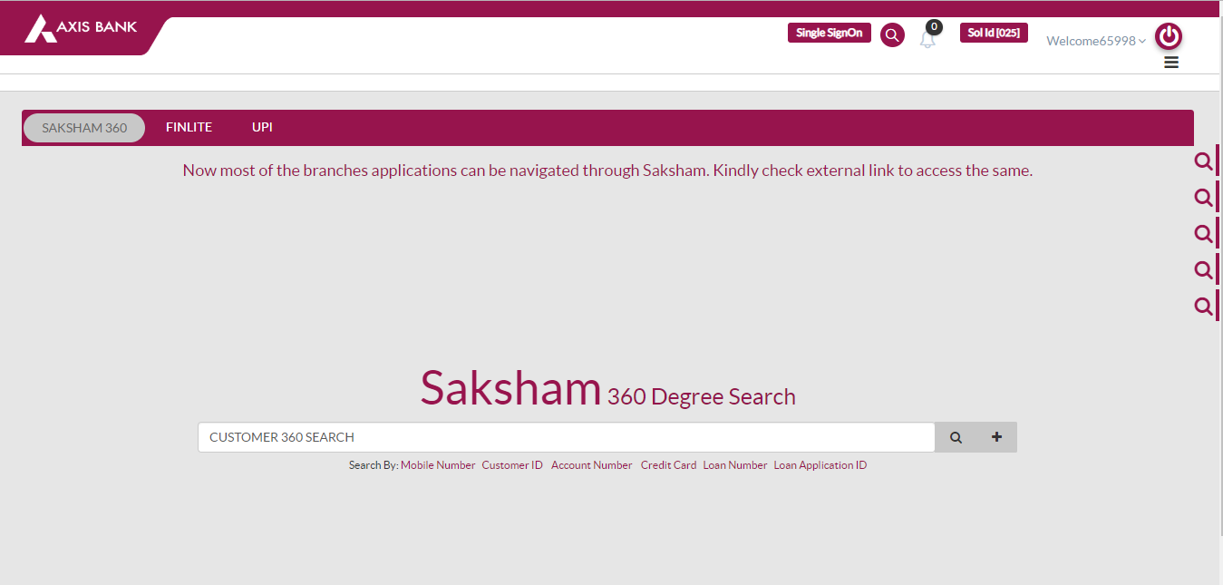
SAKSHAM HOME PAGE
CSO enters
Mobile No.
Cust ID
Account Number
Credit Card No
Loan No.
Loan Appli ID
Customer clicks
Search
What does that + button do?

Slide 3
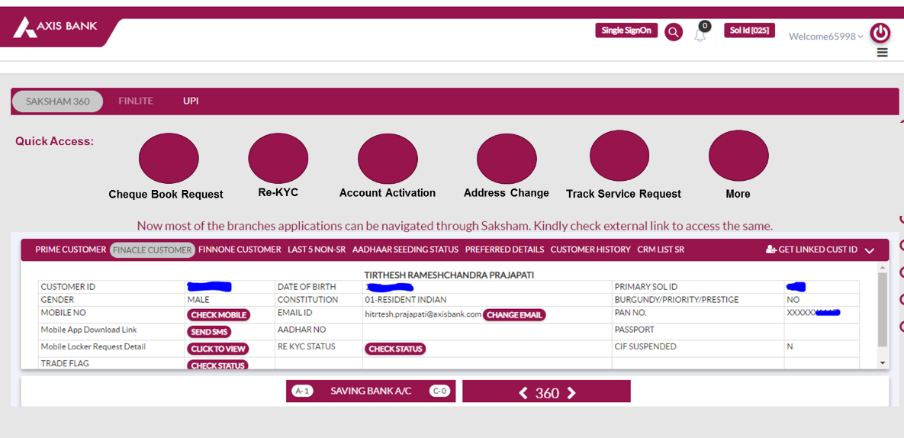
Customer clicks
Search on previous page and lands here
SAKSHAM
HOME PAGE
Quick Access to make?

Slide 4
How do I select a service in Saksham?
ON SAKSHAM HOME PAGE
2 Options
Option 1:
QUICK ACCESS
Option 2:
SAVINGS BANK ACCOUNT
CSO
Select Account
Account A
Account B
Account C
Option 1:
Cheque Book Request
Re-KYC
Account Activation
Address Change
What do those A-1 and C-0 stand for??
Track Request
Option 2:

Slide 5
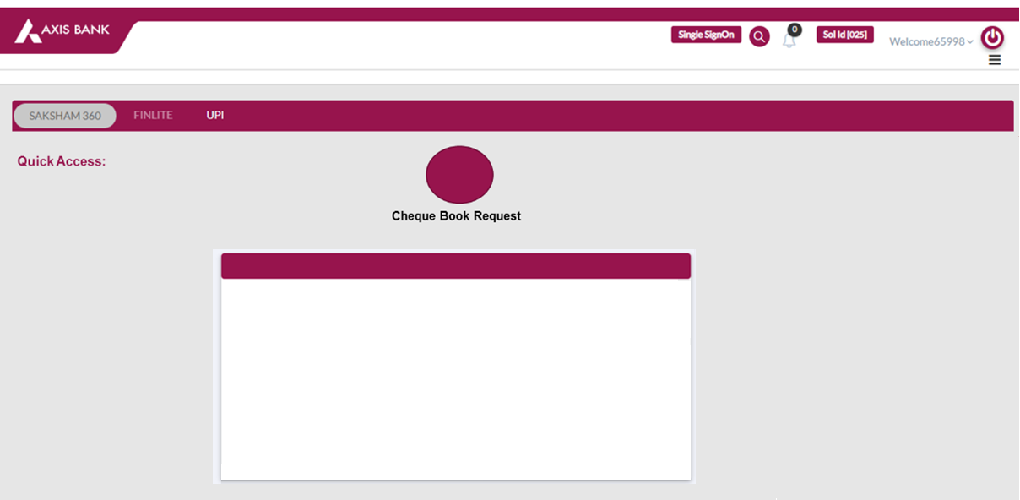
MOCK
It says these options will be there in Cheque Book Request Screen.
We don’t know if the screen needs to be designed by us? Or is it already existing with all these buttons.
EXISTING?
SR/NSR Raise ( disable)
Send Link
Missed Call Auth STP
Assisted by CSO
Link Based Auth STP
CRF/Request Letter
Maker-Check STP
Biometric Auth STP
DISABLE - For these FOUR processes (Account Activation, Address Change, Cheque book Request, Re-KYC), option to raise SR/NSR using the Raise SR/NSR tab in Saksham to be disabled

Slide 6
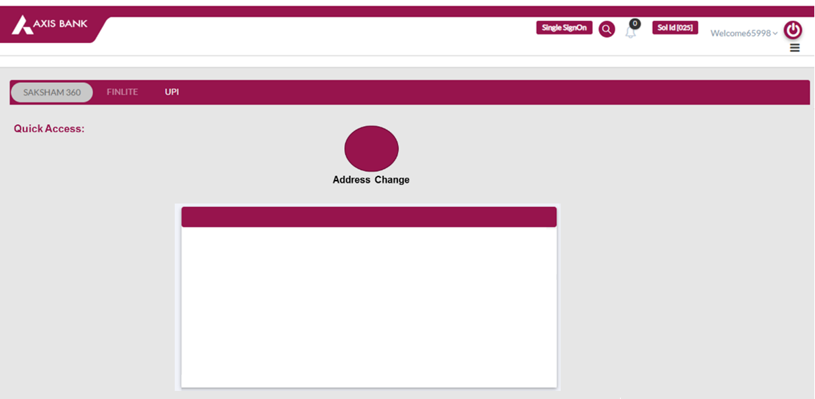
MOCK
It says these options will be there in Address Change Screen.
We don’t know if the screen needs to be designed by us? Or is it already existing with all these buttons.
EXISTING?
SR/NSR Raise ( disable)
Send Link
Biometric Auth STP + Maker Checker STP
Assisted by CSO
Missed Call Auth STP + Maker Checker STP
CRF/Request Letter
Link Based Auth STP + Maker Checker STP

Slide 7

MOCK
It says these options will be there in Re-KYC Screen.
We don’t know if the screen needs to be designed by us? Or is it already existing with all these buttons.
EXISTING?
SR/NSR Raise ( disable)
Send Link
Assisted by CSO
CRF/Request Letter
Biometric Auth STP

Slide 8

MOCK
It says these options will be there in Account Activation Screen.
No clear if the screen needs to be designed by us? Or is it already existing with all these buttons.
SR/NSR Raise ( disable)
Assisted by CSO
CRF/Request Letter

Slide 9
How do I select a service in Saksham?
ON SAKSHAM HOME PAGE
2 Options
Option 1:
QUICK ACCESS
Option 2:
SAVINGS BANK ACCOUNT
CSO
Select Account
NEXT PAGE SHOWS will show what happens when Savings Bank Button is clicked and Account is selected
Account A
Account B
Account C
Option 1:
Cheque Book Request
Re-KYC
Account Activation
Address Change
What do those A-1 and C-0 stand for??
Track Request
Option 2:

Slide 10
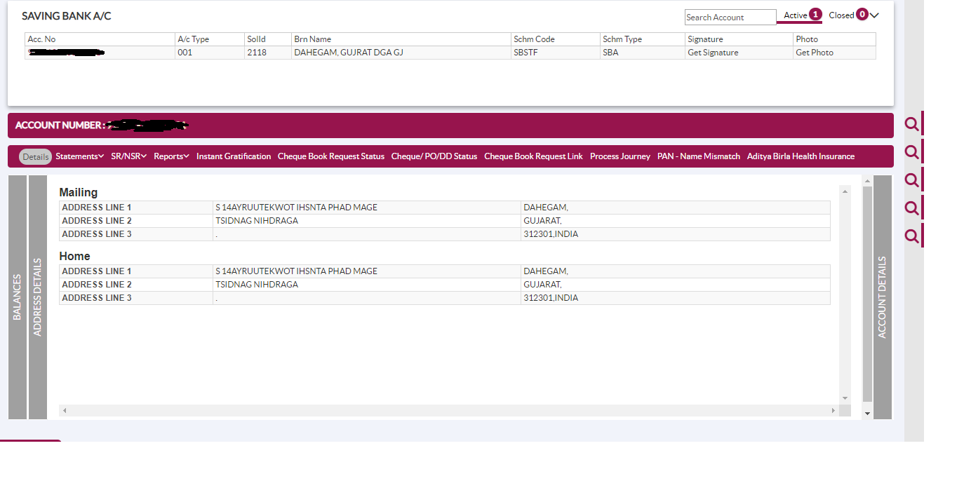
Click Saving Bank Account → Select Account from linked account? → Display page below
What do these search/ magnifying lenses do? Will they impact the screen in the center?
CSO Selects Account? WHERE?
As per USER STORY 2 in address update
CSO selects relationship ‘Savings Account’ and selects the account from linked accounts.

Slide 11
Instant Gratification to be replaced by
Instant Gratification Services

Slide 12
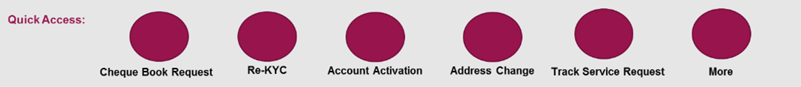
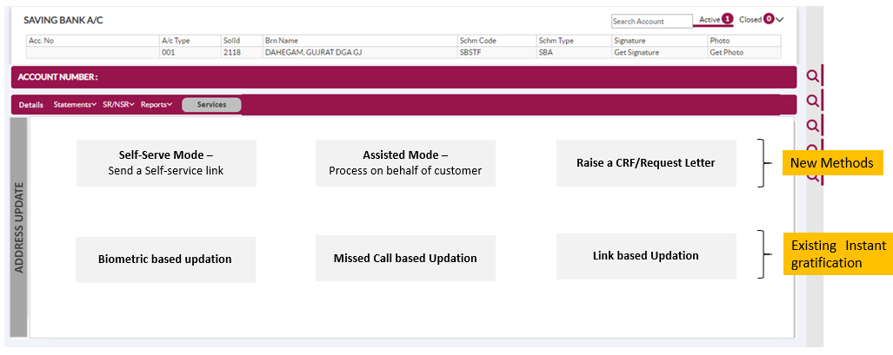
1
QUICK ACCESS – Has these options
OR
2
Click Saving Bank Account →Select Account→ from linked account? →Select Services → Display page below
CSO
Cheque Book Request
Address Update
Re-KYC
In Option 2, track request and more are not there?
They only appear in Quick links.
Also naming is different in Quick Links versus Services Section
Account Activation

Slide 13
ON SAKSHAM HOME PAGE
2 Options
Option 1:
QUICK ACCESS
Option 2:
SAVINGS BANK ACCOUNT
When is account selection happening? In Quick access scenario
Select Account
Account A
Account B
Account C
Cheque Book Request
Re-KYC
Account Activation
Address Change
Track Request

Slide 14
Address Change Landing Page
MOCK
It says these options will be there in Address Change Screen.
We don’t know if the screen needs to be designed by us? Or is it already existing with all these buttons.
EXISTING?
SR/NSR Raise ( disable)
Send Link
Biometric Auth STP + Maker Checker STP
Assisted by CSO
Missed Call Auth STP + Maker Checker STP
CRF/Request Letter
Link Based Auth STP + Maker Checker STP

Slide 15
Address Change Landing Page
MOCK
SR/NSR Raise ( disable)
Send Link
Biometric Auth STP + Maker Checker STP
EXISTING?
Assisted by CSO
Missed Call Auth STP + Maker Checker STP
CSO
CRF/Request Letter
Link Based Auth STP + Maker Checker STP

Slide 16


User Story 2 CSO Clicks?→Address Change → Assisted by CSO
Clicks
Assisted by CSO
What test is run to determine if he is eligible or not? What parameters to check.
CSO
Background
Verification
ELIGIBLE
For
Self Serve / Assisted flow?
NOT ELIGIBLE
For Self Serve / Assisted flow
RUN BACKGROUND VALIDATIONS
(LEVEL 0 TO LEVEL 3)
Error: The customer is not eligible for Self-serve link and assisted flows, please proceed with CRF/Request letter flow

Slide 17
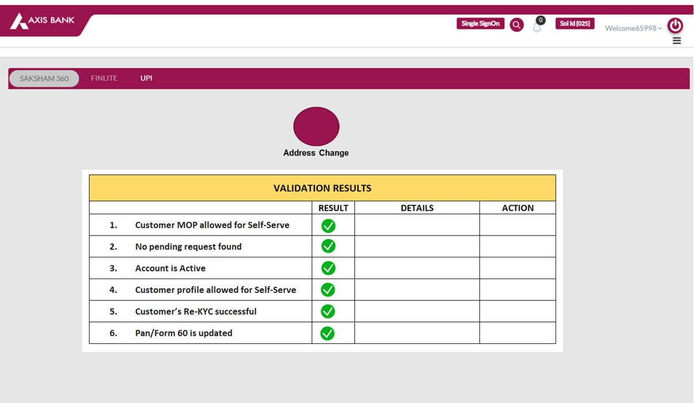
Need to create
A new screen
CAN PROCEED ONLY IF ALL GREEN
PROCEED

Slide 18
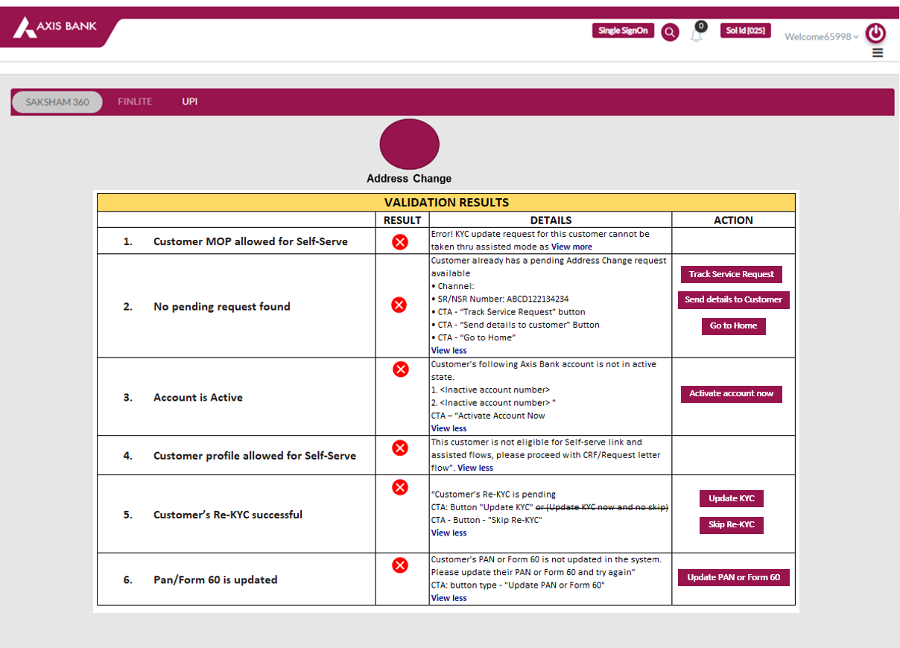
Need to create
A new screen
CANNOT PROCEED UNLESS :
Red crosses turn green
PROCEED

Slide 19
THE END (Do not refer to screens after this page) They are drafts/ components for re-use instead of recreating them

Slide 20
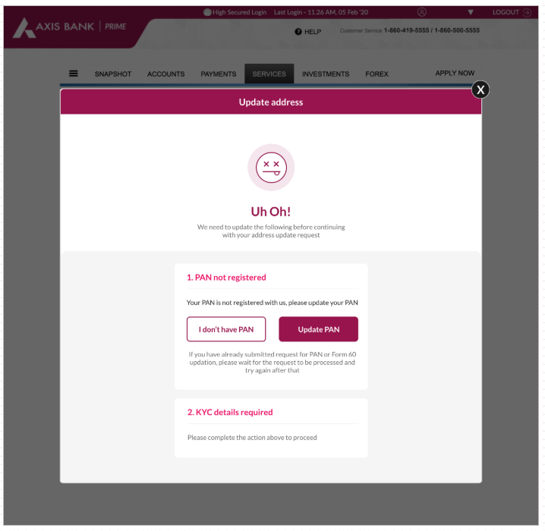

Slide 21
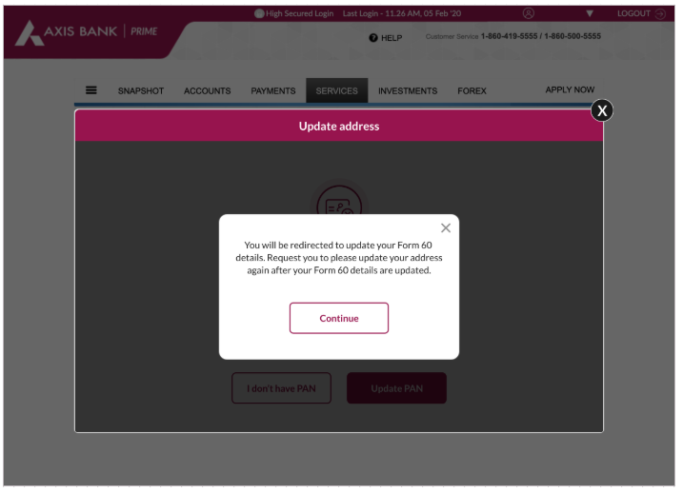

Slide 22
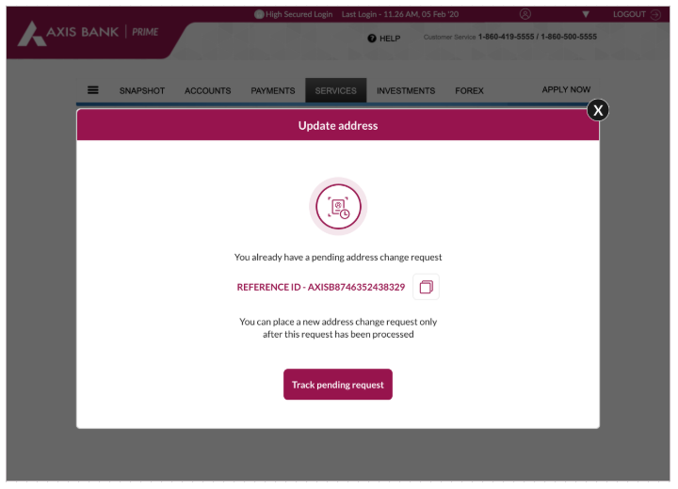

Slide 23
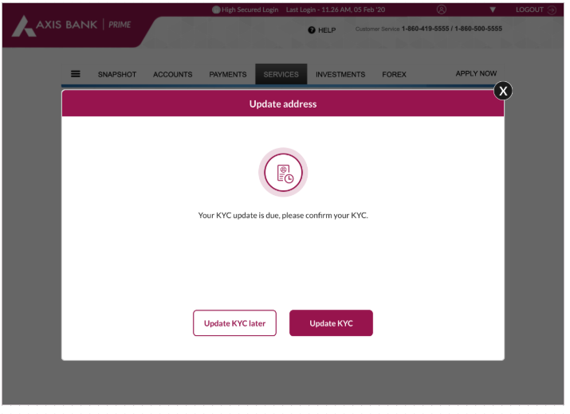

Slide 24
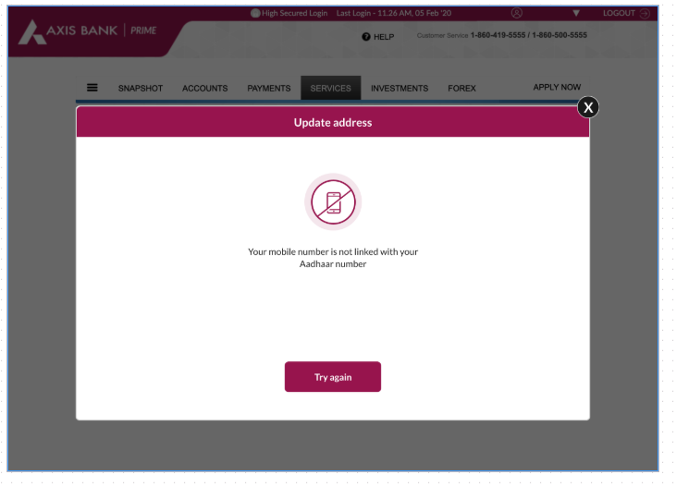

Slide 25
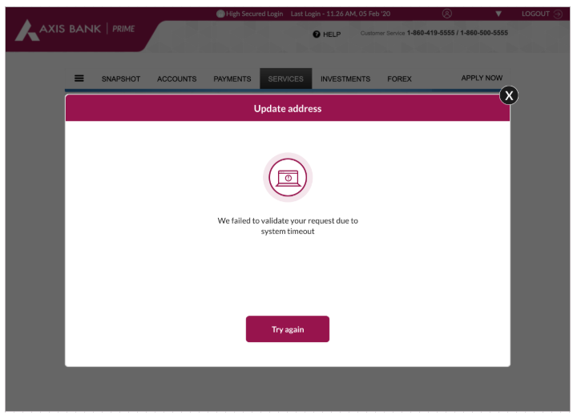

Slide 26
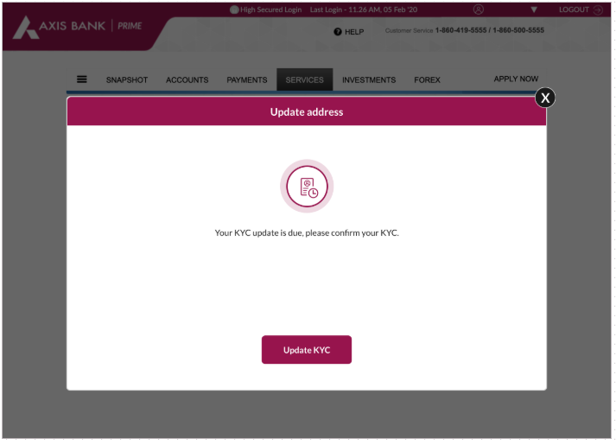

Slide 27
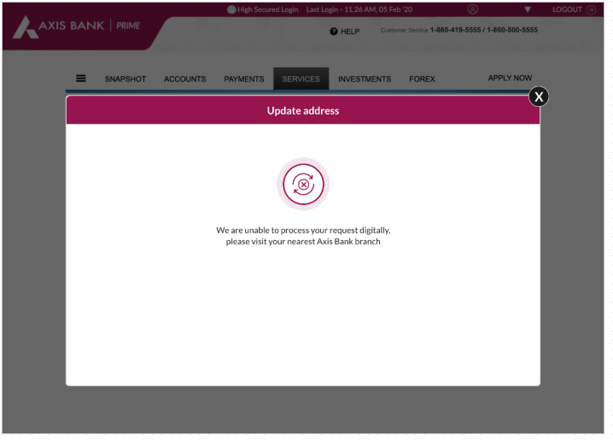

Slide 28
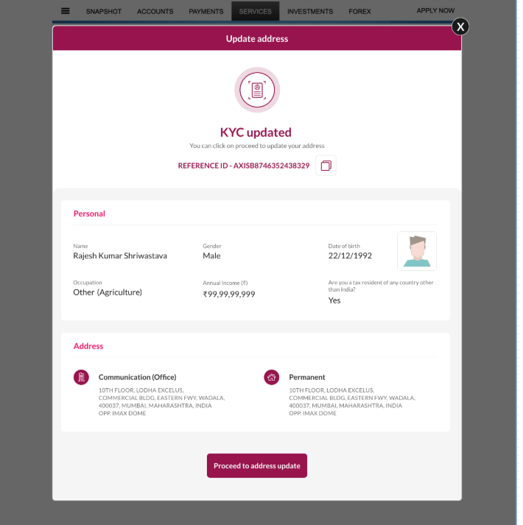

Slide 29
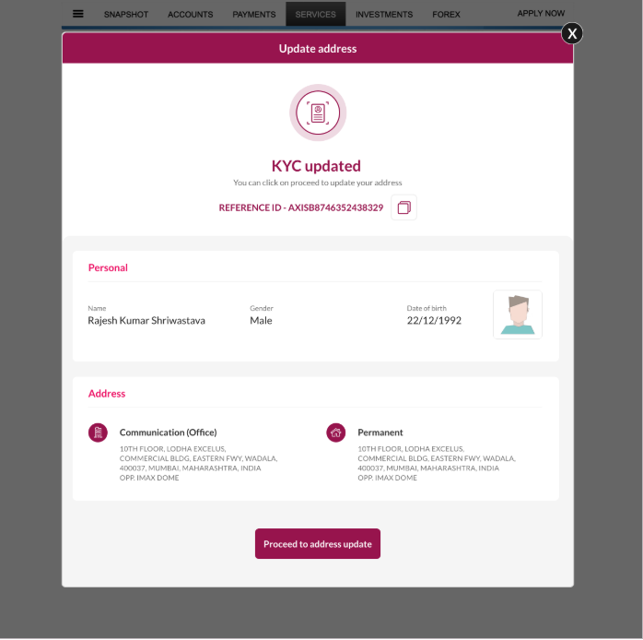

Slide 30
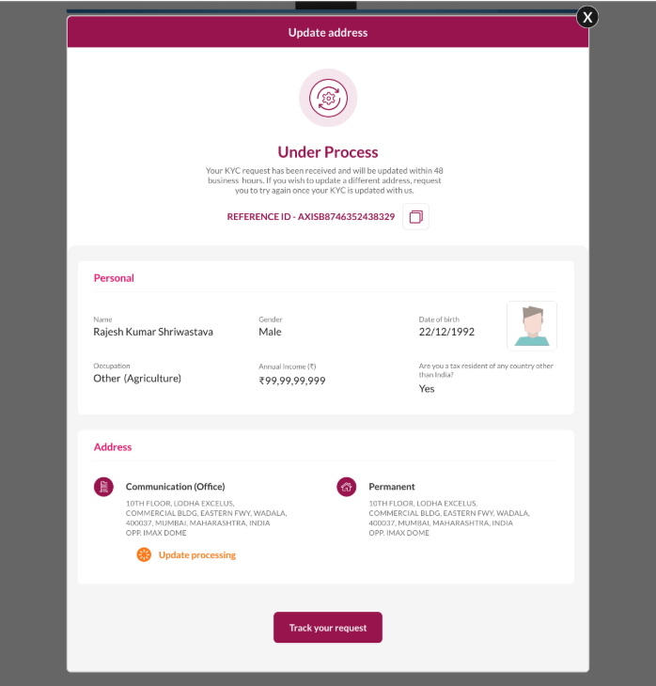

Slide 31
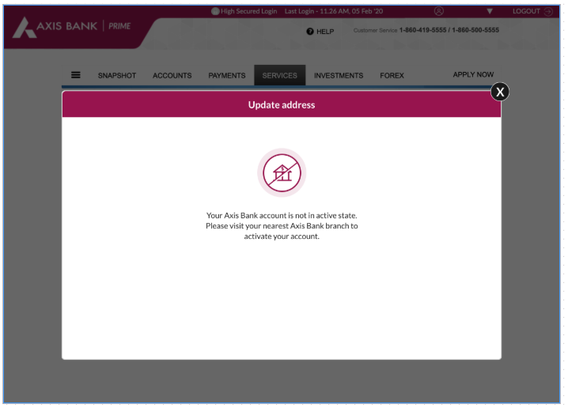

Slide 32
ADDRESS UPDATE FLOW

Slide 33
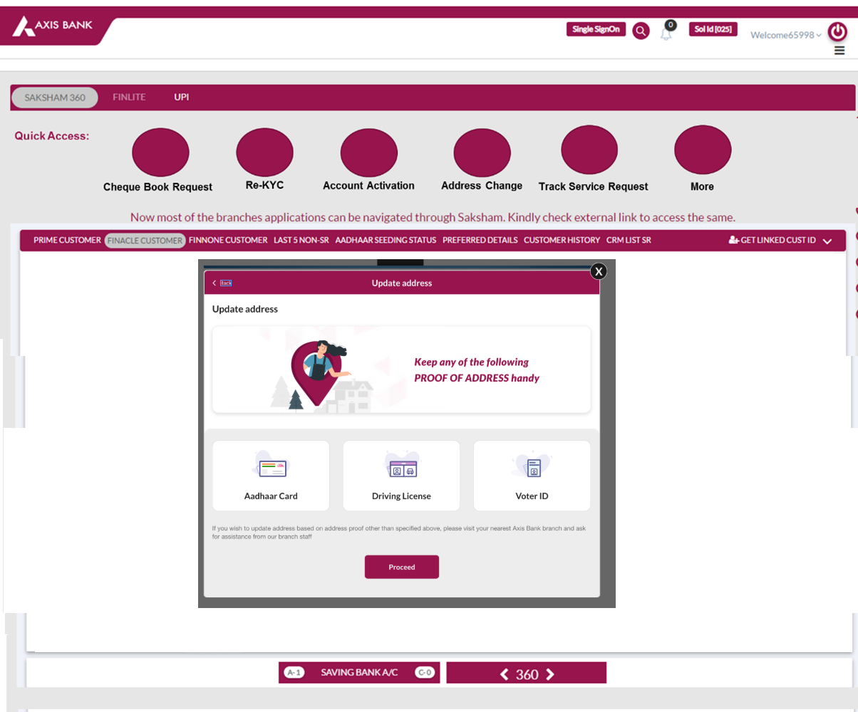
USER STORY 4

Slide 34
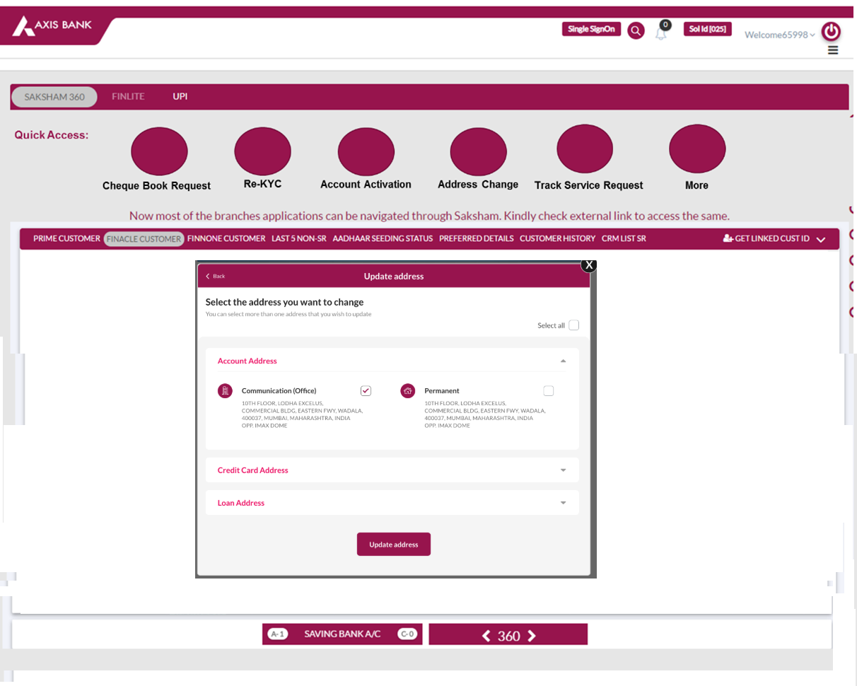
USER STORY 4

Slide 35
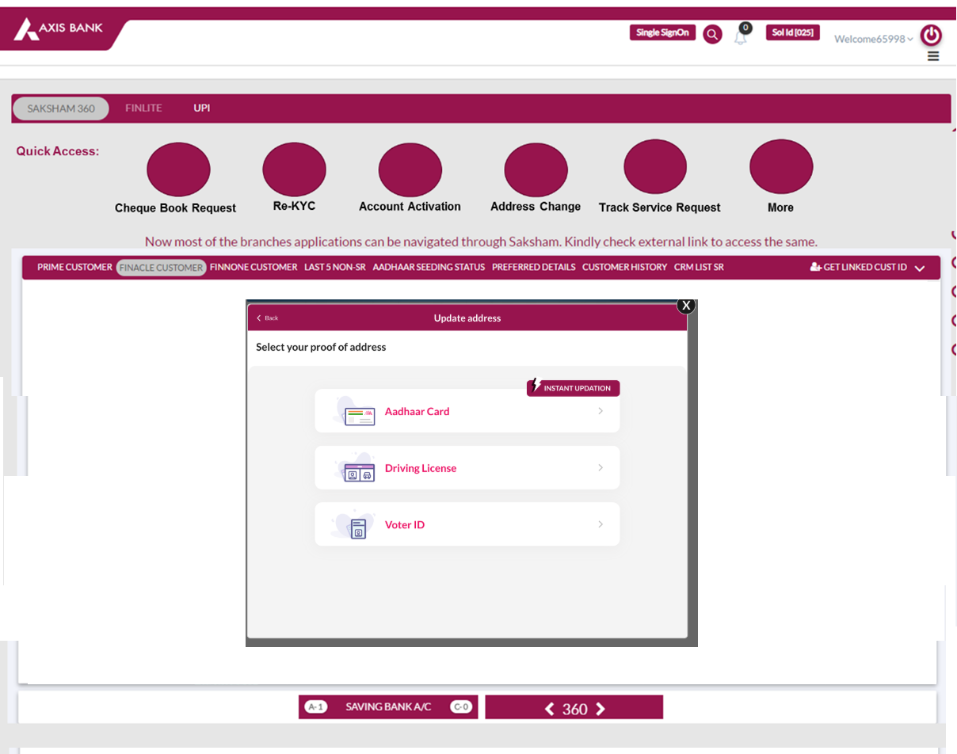
USER STORY 5

Slide 36
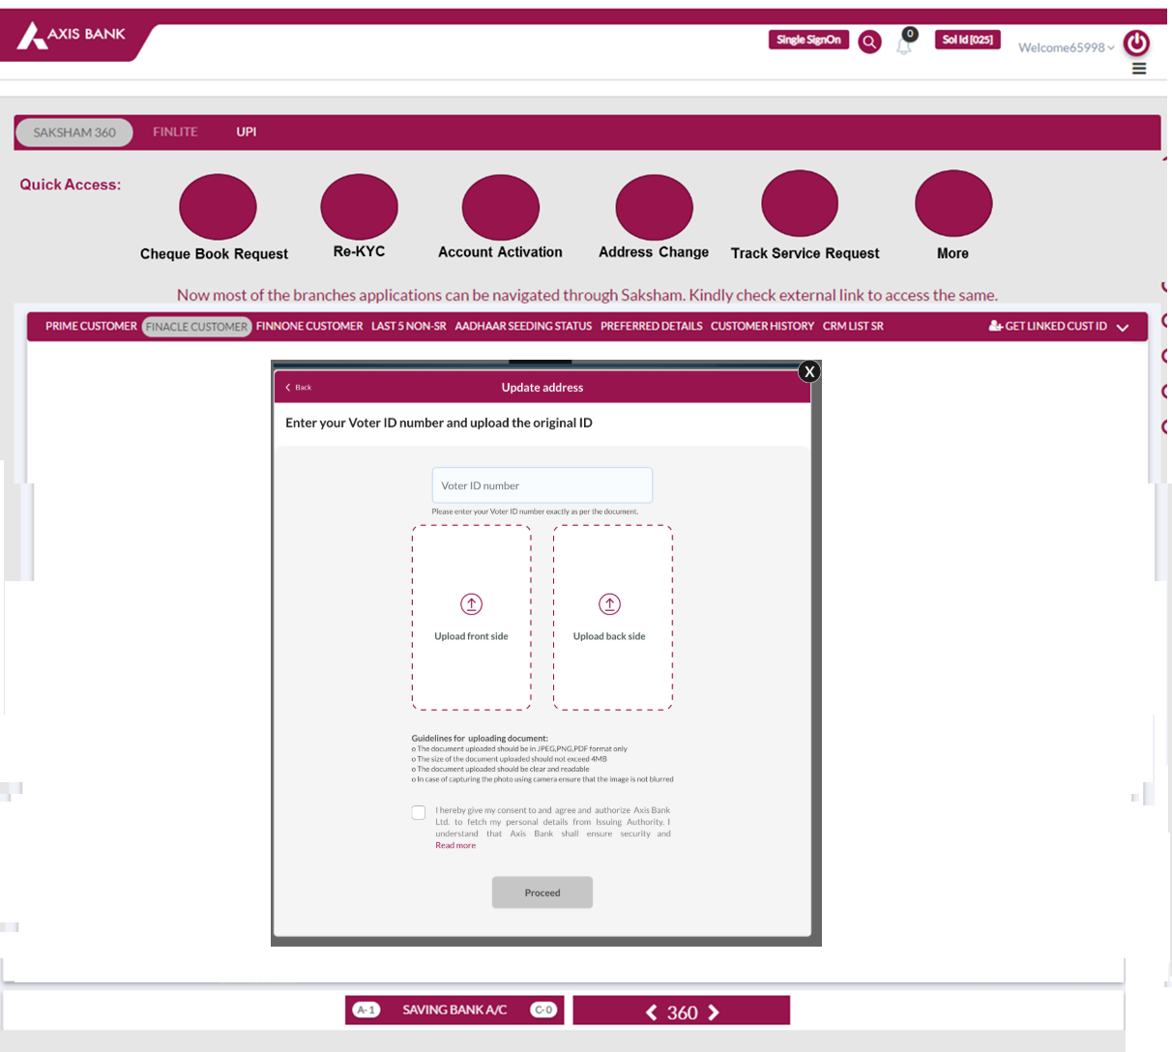

Slide 37
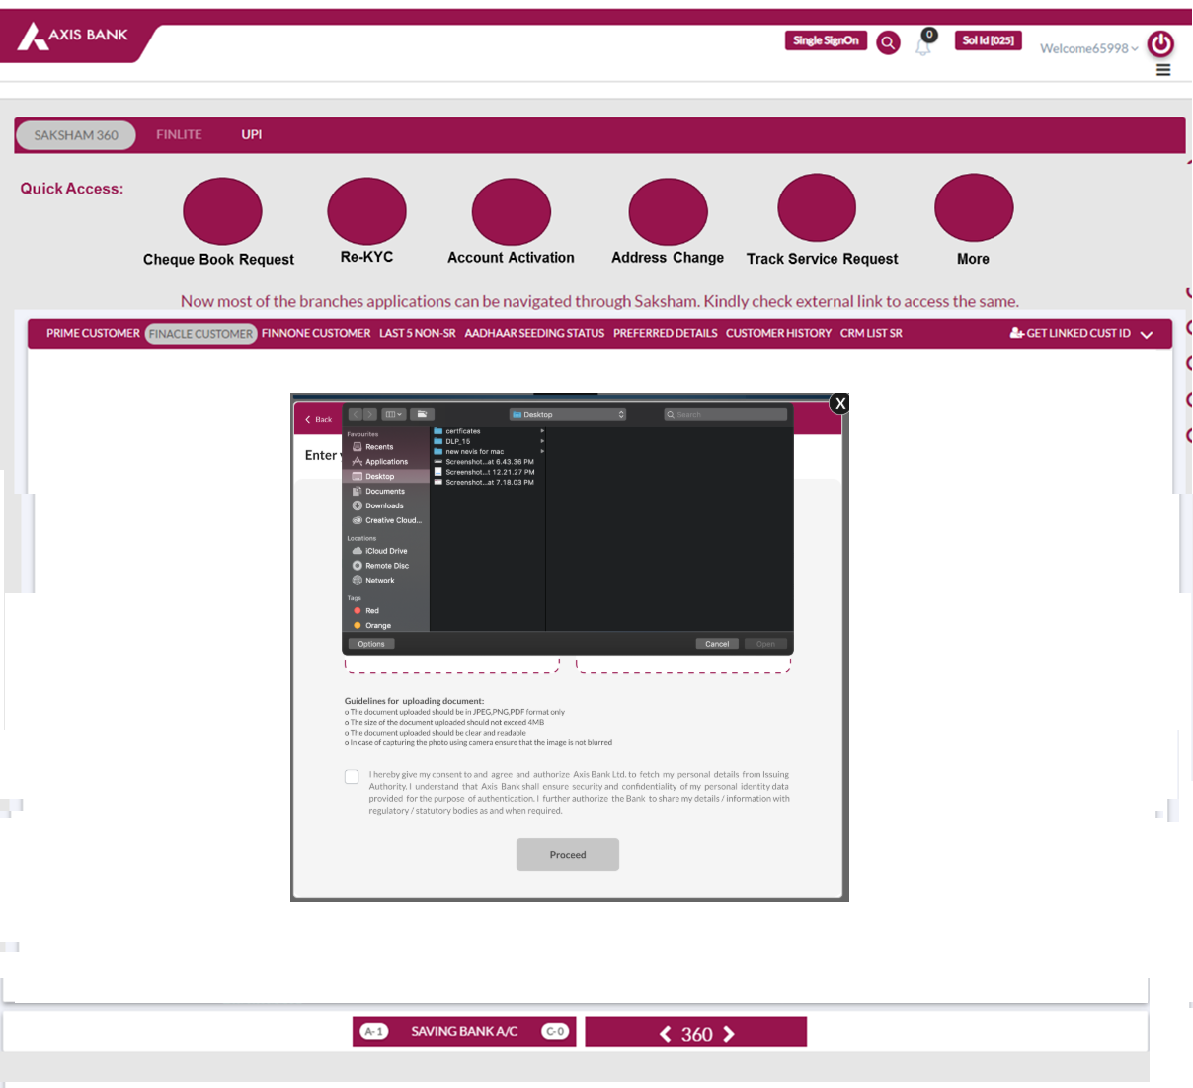

Slide 38
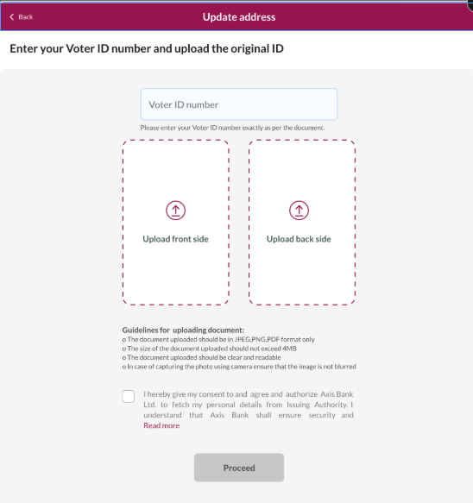
This is our present screen in IB/MB

Slide 39
SAKSHAM APPLICATION
Enter VOTER ID Number
PROCEED
NEXT

Slide 40
1. Generating Temporary ID…..
2. Upload the document in One Axis Bank against the received Temporary service Number
OK

Slide 41
Please Open One Axis App..

Slide 42
Meanwhile…. CSO is uploading doc in One Axis against Temporary ID

Slide 43
ONE AXIS AP
Capture both side of the document and ensure that the captured image is not blurred
Capture

Slide 44
ONE AXIS AP
Capture both side of the document and ensure that the captured image is not blurred
FRONT
BACK
SUBMIT
CAPTURE

Slide 45
ONE AXIS AP
Document uploaded successfully!

Slide 46
After seeing success screen on One Axis…. CSO comes back to Saksham

Slide 47
Please Open One Axis App..

Slide 48
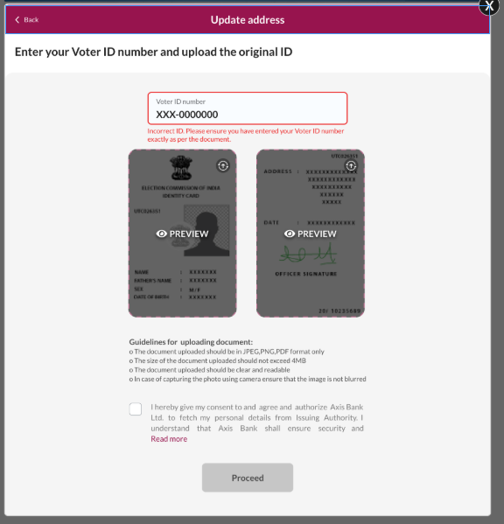
Self-Declaration: (Customized for CSO)
Content:
I hereby declare the below:
I have seen and verified all original documents provided by the customer
Proper due diligence has been done
The declaration here is customized to CSO

Slide 49
This is our present screen in IB/MB

Slide 50
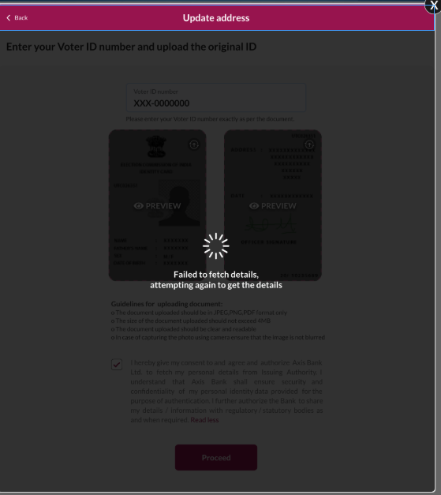
Hold On! We are fetching details from Issuing Authority.. (Voters)

Slide 52
Assisted Flow - Aadhaar
CSO Selected Aadhar Button
Cso to ENTER AADHAAR/ VIRTUAL ID
CHECK BOX- Consent / Declaration
I hereby give my consent to and agree and authorize Axis Bank Ltd. to fetch my personal details from UIDAI. I hereby state that I have no objection in authenticating myself with Aadhaar based authentication system and I voluntarily consent to providing my Aadhaar number / VID number, Biometric information and/or One Time Pin(OTP) data (and/or any similar authentication data) for the purposes of establishing my identity or for seeding my new account with NPCI mapper to enable me to receive Direct Benefit Transfer (DBT) including LPG Subsidy from Govt. of India (GOI) or relevant State Government(s) in my new account. I understand that the biometric and/or OTP and/or any other authentication data I may provide for authentication shall be used only for authenticating my identity through the Aadhaar authentication system for the specific transaction or as per requirement of law and for no other purposes. I confirm that I have been informed about the alternatives to submission of identity information and I have agreed to authenticate myself through Aadhaar based authentication system with full understanding of alternatives to submission of identity information. I understand that Axis Bank shall ensure security and confidentiality of my personal identity data provided for the purpose of Aadhaar based authentication. I authorize Axis Bank to verify and authenticate my Aadhaar during processing my application for legitimate business purposes. I further authorize the Bank to share my Aadhaar related details / information with regulatory /statutory bodies as and when required
Enter Aadhaar / Virtual
SUBMIT

Slide 53
Option to choose OTP or Biometric

Slide 54
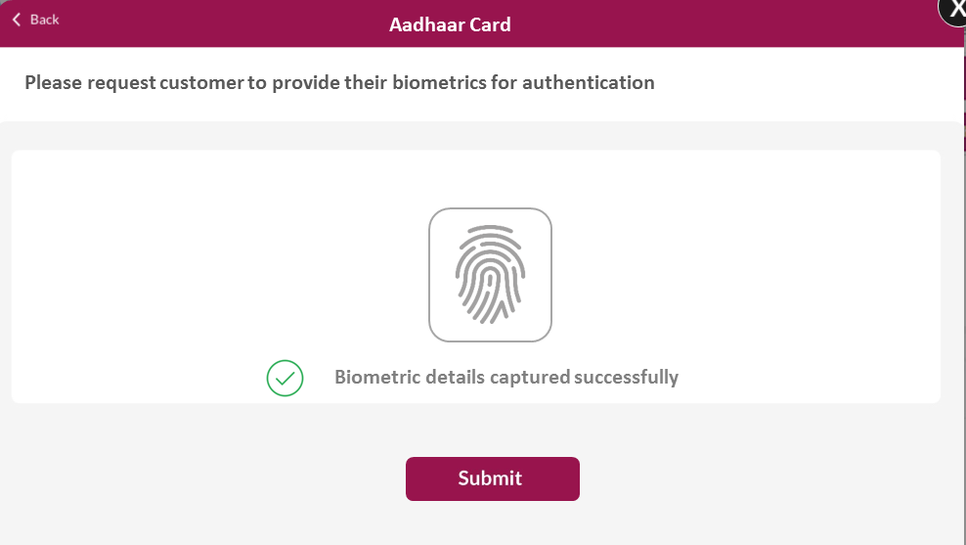
Customer to Provide Biometric

Slide 55
(Loader icon)….
Please request customer to provide their biometrics for authentication

Slide 56
BIOMETRIC
MEANWHILE BACKEND
UNABLE
to verify
ABLE
to Verify
Customer LOCKED Biometric
Technical Reason
Verification Fails
Try Again
3 Attempts – “Your request to Update Address is failed”
Verification Successful
FETCH DETAILS UIDAI

Slide 57
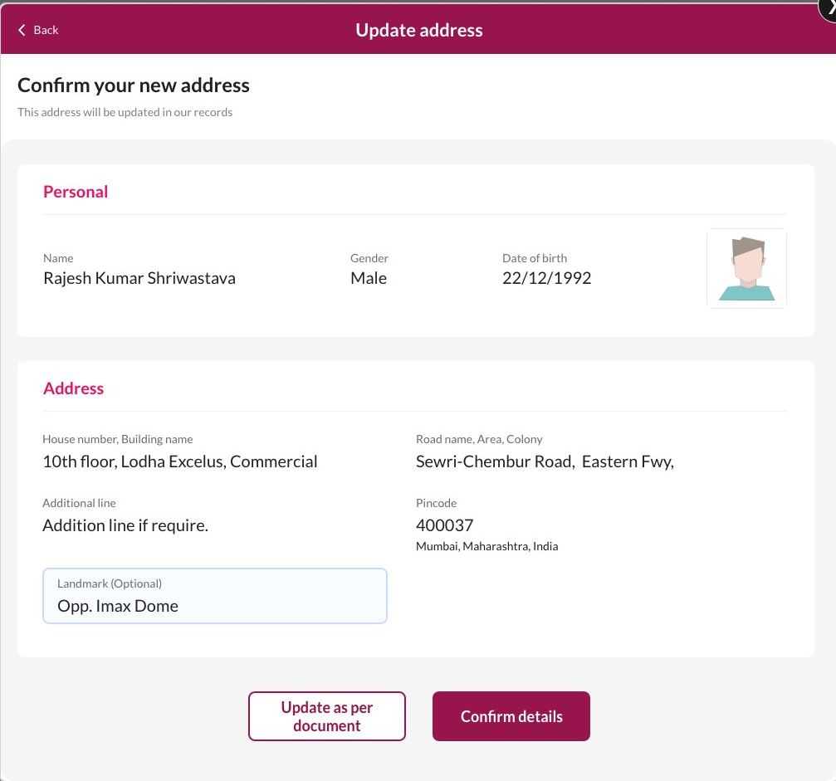
From Fetch Details to Displaying Confirmation page everything is same as current functionality in IB/MB already implemented
FETCH DETAILS UIDAI
Display Confirmation page
CANCEL
CONFIRM

Slide 58

CANCEL
CONFIRM
End Journey
SELF DELCARATION CHECKBOX:
I hereby declare the following:
Adfdasjfasdjfsdalkfasdfkasdjfkasdjfkjsdafjasdfjasdl;fjasdfjdaslkjfasdklfjasdl;fkjasdlfkasdjfsdajfasdlfjl;asdkjf asdjf asdjf lkasdjf ;lkasdfj sdakfj sdafj asdfj a.
SUBMIT

Slide 59
SUBMIT
Request will move to customer authentication flow
After successful verification of Address, CSO initiates verification flow for customer to confirm address
Biometric for Aadhaar Card
Missed Call
Link Based

Slide 60
After successful verification of Address, CSO initiates verification flow for customer to confirm address
Biometric for Aadhaar Card
Missed Call
Link Based
MEANWHILE BACKEND
UNABLE
to verify
ABLE
to Verify
Customer LOCKED Biometric
Technical Reason
Verification Fails
Try Again
3 Attempts
Verification Successful
CSO Views Success
Customer Gets SMS

