Slide 1
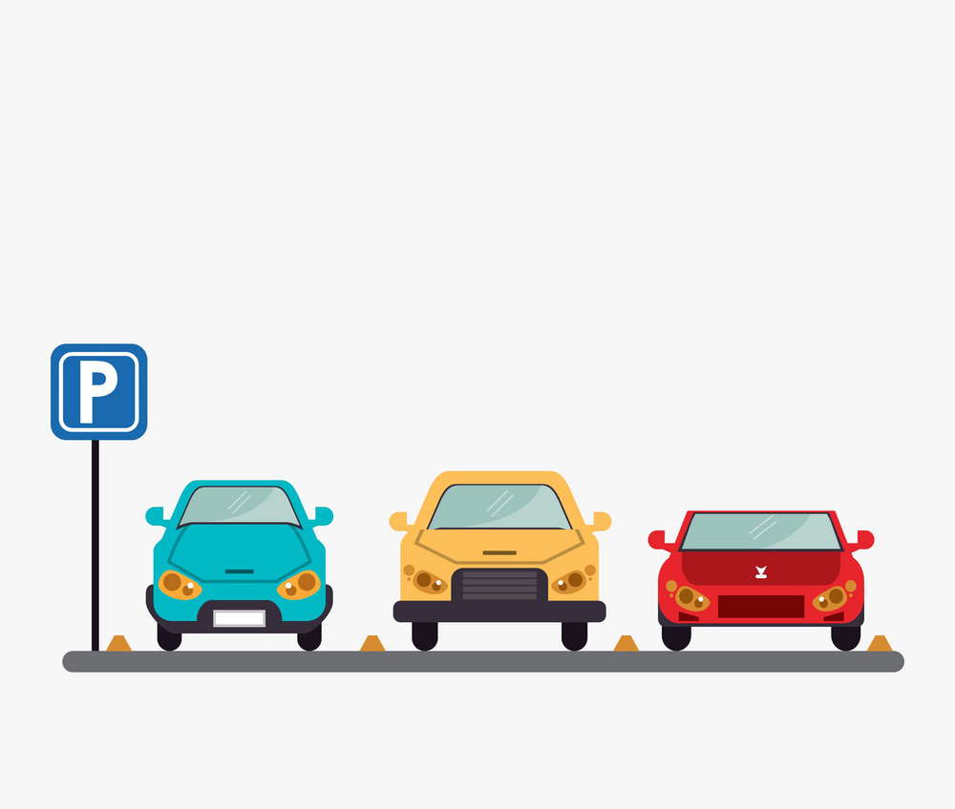
CAR PARKING
PROBLEM IN MUMBAI

Slide 2
Project Brief
Problem Statement:
Finding a parking space in most metro cities is an uphill task. Some people thus prefer to take cabs, instead of their own vehicles, to avoid the hassle of searching for a parking spot and then possibly running late. Also, parking at street corners leaves vehicles unguarded from potential damage by miscreants or natural causes. Parked aims to solve this pain point through a mobile app.

Slide 3
Product Research
The initial research was done about the different technologies that are used for tracking and monitoring your vehicle.
Geographic Information Systems(GIS):
For large scale location tracking systems, it is necessary to capture and store geographic information. Geographic information systems can capture, store, analyze and report geographic information.
Global Positioning System (GPS):
A constellation of 27 Earth-orbiting satellites. A GPS receiver, like the one in you mobile phone, can locate four or more of these satellites, figure out the distance to each, and deduce your location hrough trilateration. GPS is ideal for outdoor positioning, such as surveying, farming, transportation or military use.
Radio Frequency Identification (RFID):
Small, battery less microchips that can be attached to consumer goods, cattle, vehicles and other objects to track their movements. RFID tags are passive and only transmit data if prompted by a reader. The reader transmits radio waves that active the RFID tag. The tag then transmits information via a pre determined radio frequency. This information is captured and transmitted to a central database.

Slide 4
Wireless Local Area Network (WLAN):
Network of devices that connect via radio frequency such as 802.11b. These devices pass data over radio waves and provide users with a network with a range of 70-300
feet(21.3 to 91.4 meters)
Any location tracking or location based service system will use one or a combination of these technologies.

Slide 5
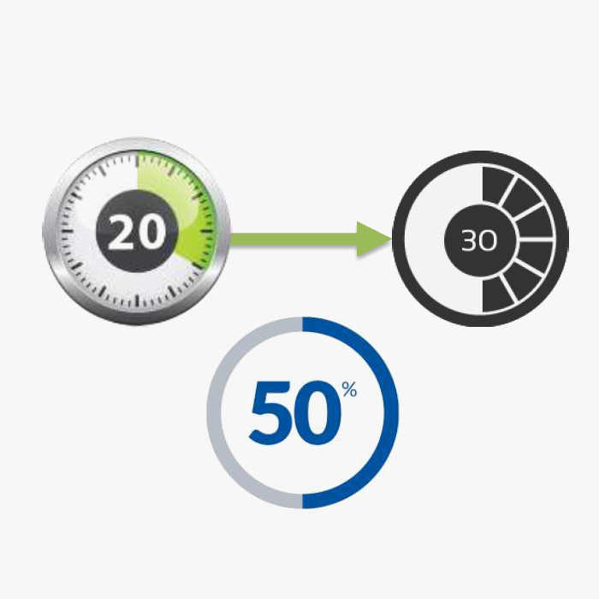
Web Survey
Online Survey: Online research stats about parking a car.
.The average time spent on finding a parking spot in Mumbai is around 20-30 minutes.
. Average of 50% of people drive away without parking.
. Also people are possessive about their cars in India
and wont hand it over unless we guarantee safety.

Slide 6
Reasons For Valet Parking
Extra help for
guests
Return to drop position
Reasons
More
spare time
Reasons Extra convenience
Spot
efficiency
Guests and car safety

Slide 7



User Scenario
Going to a movie:
Varun is a professional employee who is going to a movie with his friends on a weekend. He has arrived the theatre a bit late due to this varun and his friends are getting late for the movie so they can book a valet service on the go by using the parked app. Our valet driver will be waiting for them as soon as they come so and park their car and hand them the vehicle as soon as they come out.
Going for shopping:
Abhay is a married man who is going with his wife for shopping with his wife on a weekend. The entire shopping mall is filled with vehicles and they have to get back home cause they have a daughter and their Nanny has to leave a bit early that day so they doesn’t have to waste time for parking rather than that he can use parked app and book a valet service.
Going for dinner:
Robin is a college student who is going on a date with his girl friend and they both has went to a hangout place they had laughs, fun etc. When they came out the whole place became crowded they cant get their car out so they use parked app and call for valet services and get their vehicle earlier and get back to their homes.

Slide 8










Feature List
Save your time
Save your gas
Save Your money
See real time info on exactly
how many parking spots are
open.
Check daily and monthly
parking rates
View informative maps of
parking lots
See prices laid out and
compare costs
Find, book and pay for
parking in seconds
Navigate straight to your
booking space
Locate your parked vehicle

Slide 9
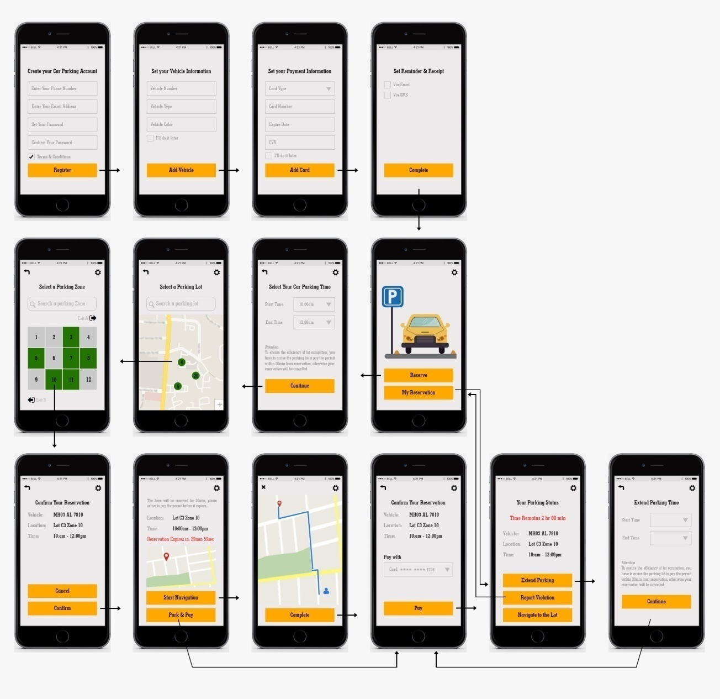
VISUAL DESIGN

Slide 10
Design Solution
Business Goals:
Parked is an valet parking service that aims to optimize the process of parking cars.
Through the app, a user can request a valet to come to a designated spot(with in their service location), take their vehicle, and park it in an enclosed space till the patron needs it again.
Solution:
Parked acts as a valet solution provider for high street retail outlets and also restaurants. We also offer on demand parking for the general public

Slide 11
THANK YOU SABIR SHAIKH

