Slide 1
AppW Archive Architecture Overall View and Strategy
1. Technology Stack Overview
2. Container solution(OpenShift) vs Lambda vs Container + Lambda and Data Flow
3. Networking – DNS/Load Balancer/VPC/Cluster/Service Discovery
4. Creating and Managing Persistent Storage for database/Health Status/Message Passing
5 CI/CD pipeline
6. AWS Service CloudFormation/ECS/ECR/Fargate/Credential/Autoscaling

Slide 2
1. Technology Stacks
Microservices architecture built on top of the Spring Boot Framework
Frontend: We can either choose one of the followings: (Preferably React)
AngularJS with templates, components, services and HTTP client making rest call to the backend
React with UI components, Redux, Flux, Routing, Immutable.js, and Relay that makes REST calls to the backend

Slide 3
1. Technology Stack
Backend:
Spring Boot Microservices on Red Hat Openshift Container Platform
Spring Stack
Spring MVC is built on the Servlet API and uses a synchronous blocking I/O architecture with a one-request-per-thread model (not consider using Spring WebFlux non blocking web framework built from the ground up to take advantage of multi-core, next generation processors and handle massive numbers of concurrent connections)
Servlet Containers
Servlet API
Spring Security (LDAP auth Server/OAuth2)
Spring MVC
Spring Data Repositories: JDBC, JPA
Red Hat Openshift Stack (integration of client library and service in cloud deployment with Spring in three major components : Service Registry, Load Balancer and Circuit Breaker)
Tomcat server support well Spring Boot framework
Kubernetes service (internal load balancer)
Service Registry
Eureka (REST) in AWS cloud for locating services/load balancing and failover
Consul (discovering and configuring services)
Zookeeper (for configuration, naming and synchronization)
OpenShift cluster resolves the IP address for load balancer
Hystrix for Circuit breaker that stop cascading failure and provide resilience
Zuul for proxy/ dynamic routing
External Configuration
Spring Cloud Config
Openshift configMaps

Slide 4
1. Technology Stack
AWS:
Installing a OpenShift Cluster with Containers
We will add service to the Redhat Openshift service catalog that can provision/deprovision via AWS Service Broker, which in turn create/delete a collection of AWS service/PostgreSQL using cloudFormation.

Slide 5
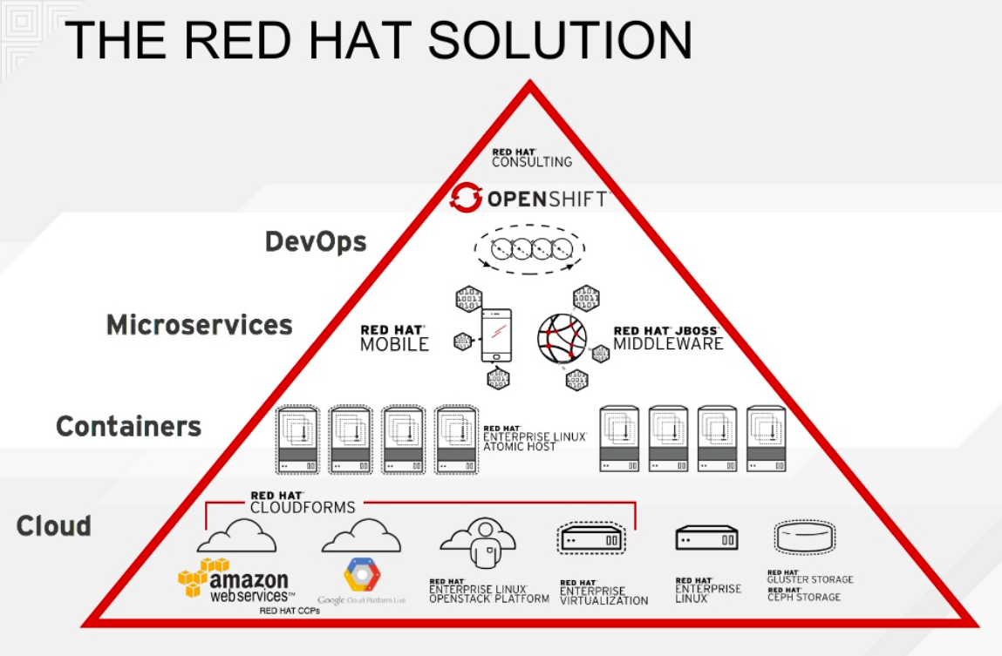
2. Container solution(OpenShift) vs Lambda vs Container + Lambda with Data Flow

Slide 6
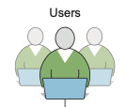


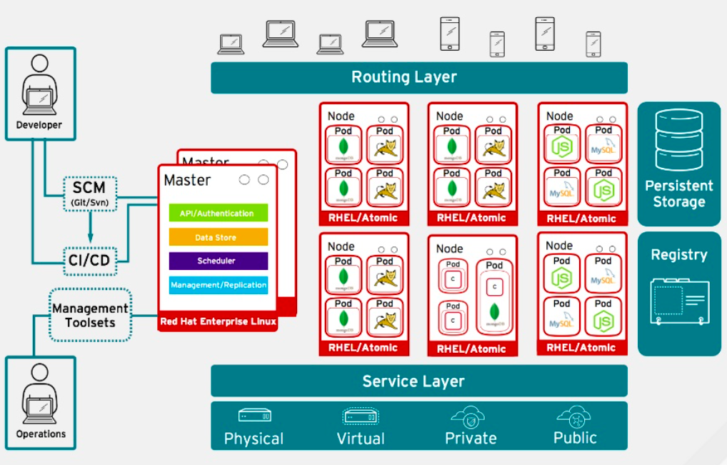





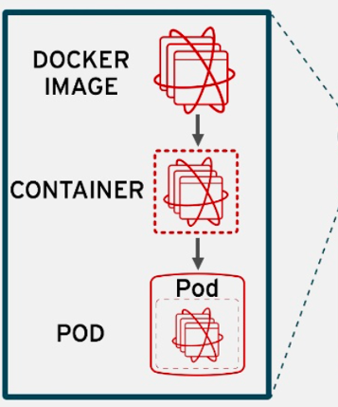
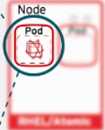



Routing Layer – provides easy DNS access and a consistent endpoint for all application in VPC
Register - provides container images to build and deploy application on the node
Service Layer – encapsulates the application’s business logic and coordinating responses
Eureka Server
Config Server
Single SignOn
ACL
Zuul
Bitbucket
PostgreSQL Database
Image
CONSUL

Slide 7
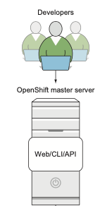
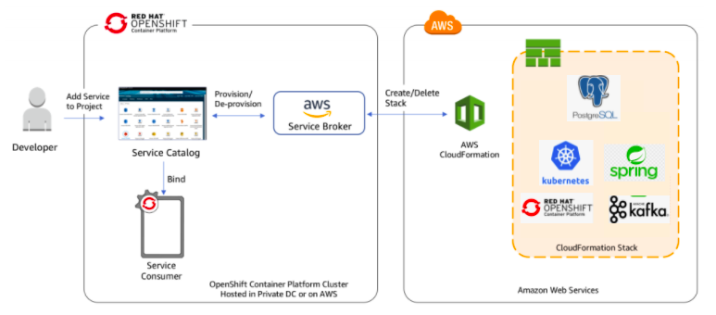
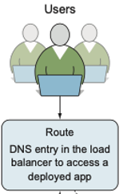



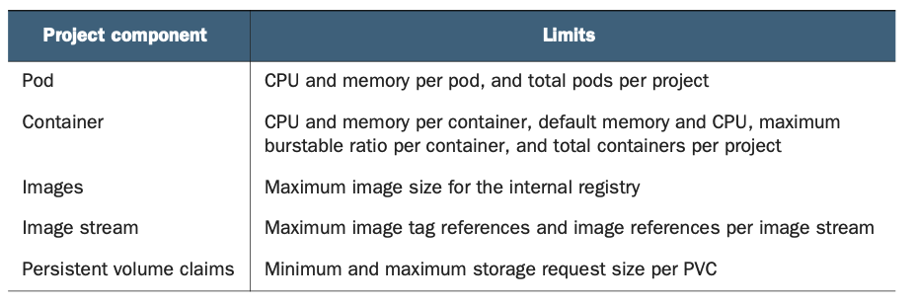
Setting up VPC endpoints for AWS CloudFormation
A route is created in the software load balancer to provide consistent application access using DNS
All of the Pods are proxied through the service, which allows for easier pod scaling
Designing cluster networks 1. Understanding network traffic flow in OpenShift
2. Configuring Open vSwitch 3. Configuring OpenShift network plugins 4. Using DNS in OpenShift

Slide 8
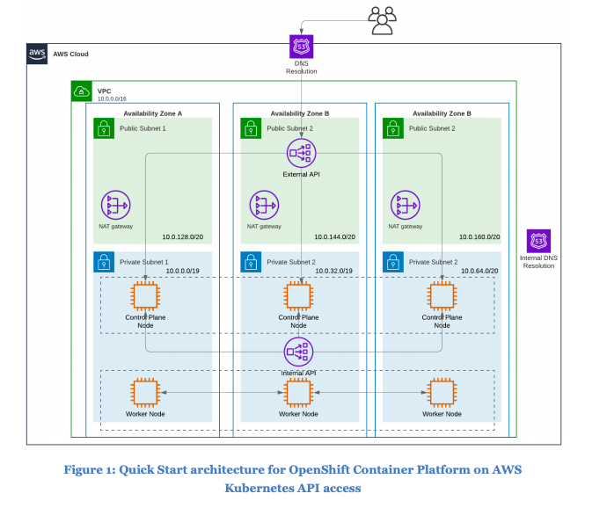
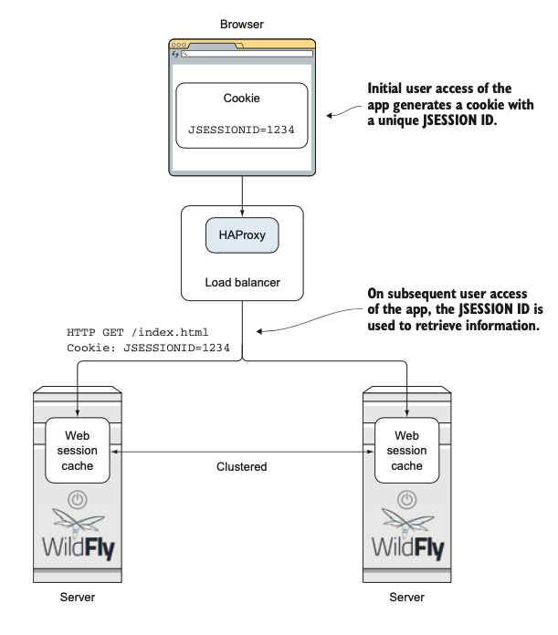
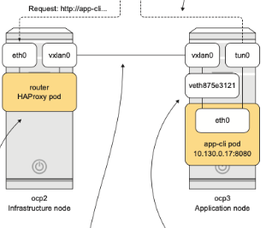
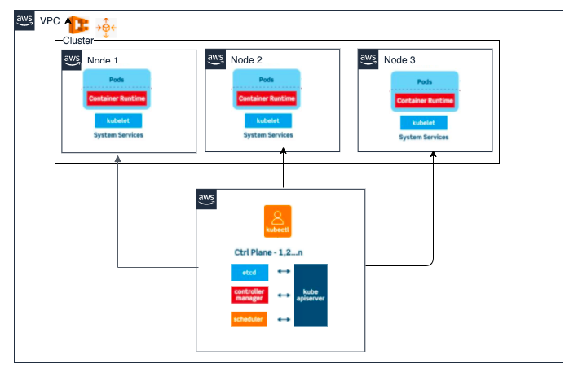
https://aws-quickstart.s3.amazonaws.com/quickstart-redhat-openshift/doc/red-hat-openshift-on-the-aws-cloud.pdf

Slide 9
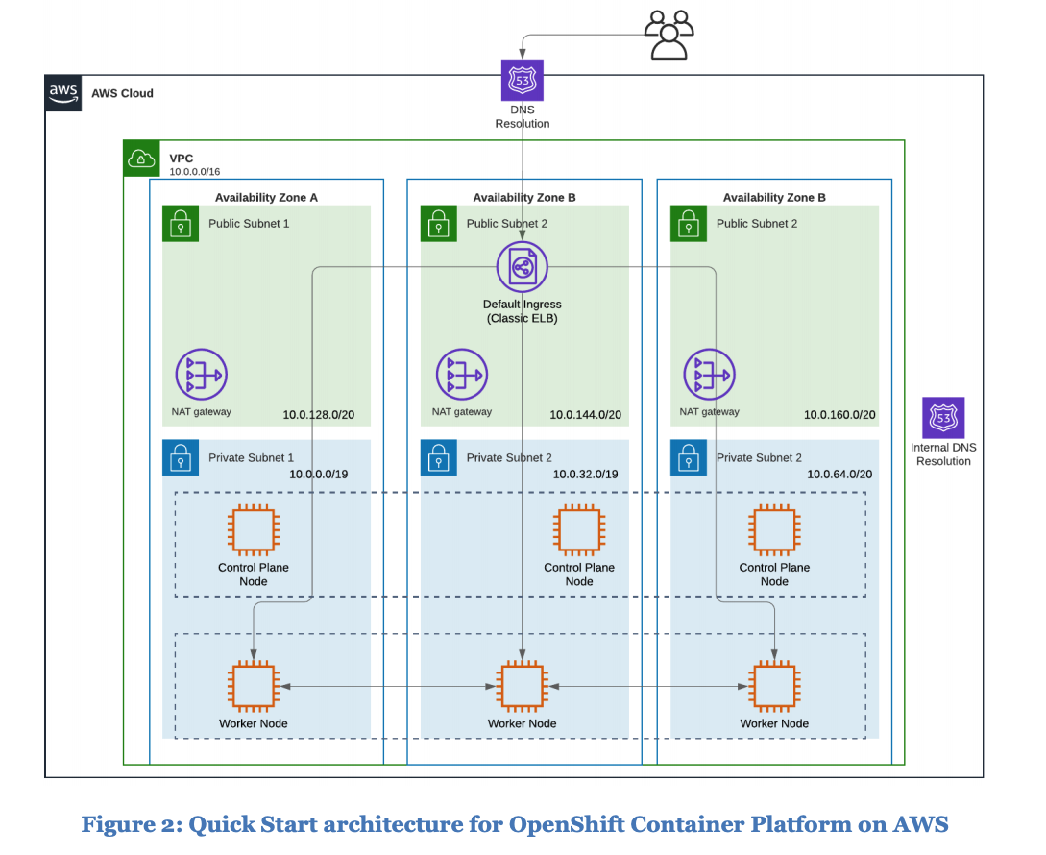
The Quick Start sets up the following:
1) A single virtual private cloud (VPC) that spans three Availability Zones, with one private and one public subnet in each Availability Zone.
2) An internet gateway to provide internet access to each subnet.*
3) A public, external Network Load Balancer for access to the OpenShift API.
4) A private, internal Network Load Balancer for access to the OpenShift API.
5) In the private subnets: – Three OpenShift master instances. – A variable number of OpenShift node instances.

Slide 10
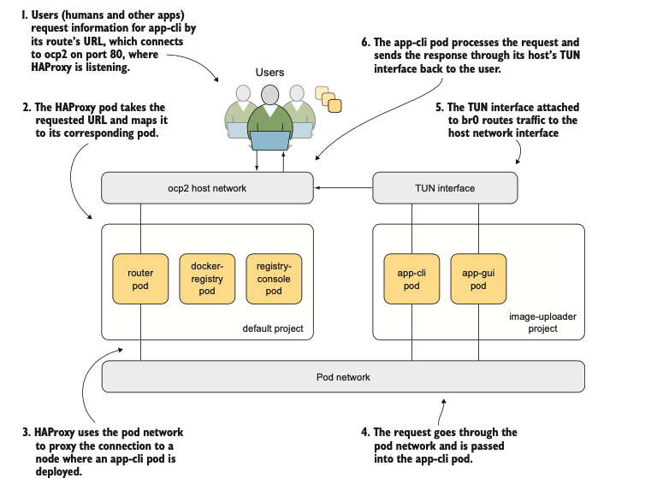
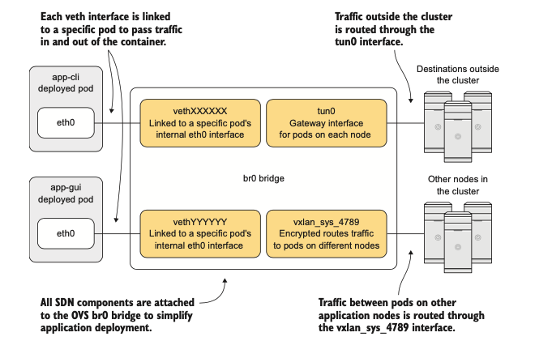
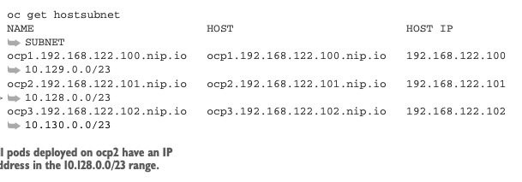

3. Network Interface
br0—An OVS bridge all OpenShift SDN interfaces are associated with. OVS creates this interface when the node is added to the OpenShift cluster.
tun0—Attached to br0. Acts as the default gateway for each node. Traffic in and out of your OpenShift cluster is routed through this interface.
vxlan_sys_4789—Also attached to br0. This virtual extensible local area net- work (VXLAN) is encrypted and used to route traffic to containers on other nodes in your cluster. It connects the nodes in your OpenShift cluster to create your pod network.

Slide 11
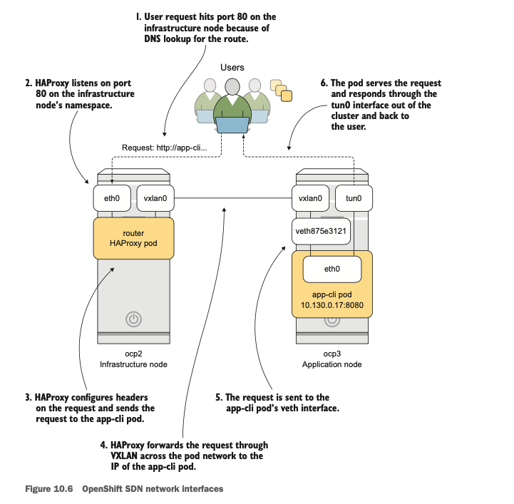
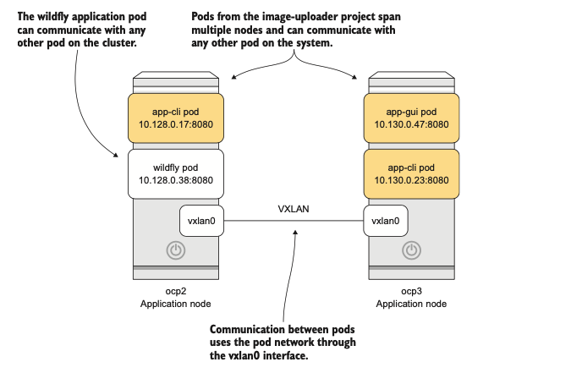
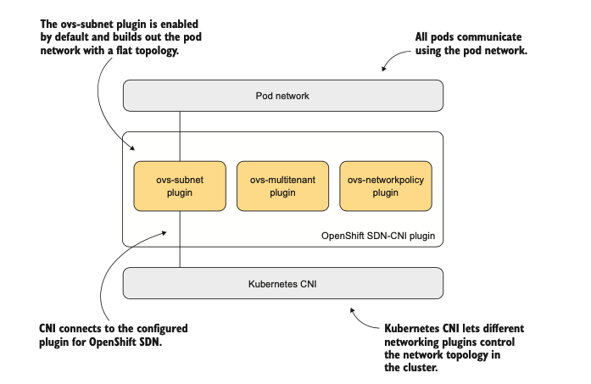
3. Network Interface
# ip a | egrep '^[0-9].*:' | awk '{ print $1 $2}'
1:lo:
2:eth0:
3:ovs-system:
6:br0:
7:docker0:
8:vxlan_sys_4789:
9:tun0:
10:veth68d047ad@if3:
11:veth875e3121@if3:
12:vethb7bbb4d5@if3:
13:vethd7768410@if3:
14:veth8f8e1db6@if3:
15:veth334d0271@if3:

Slide 12
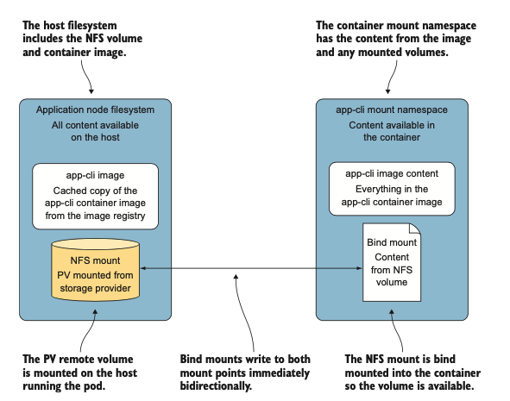
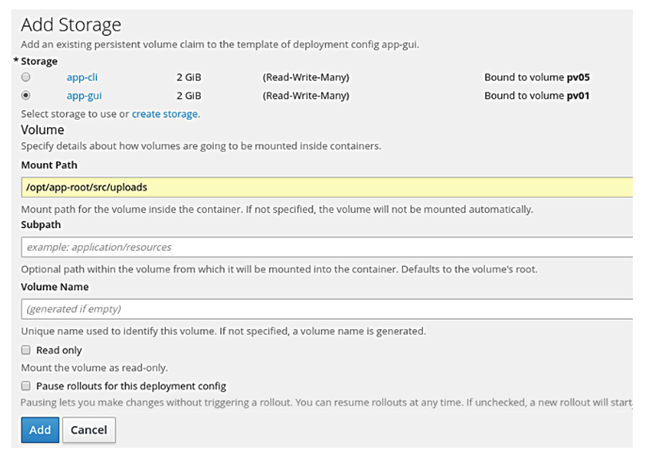
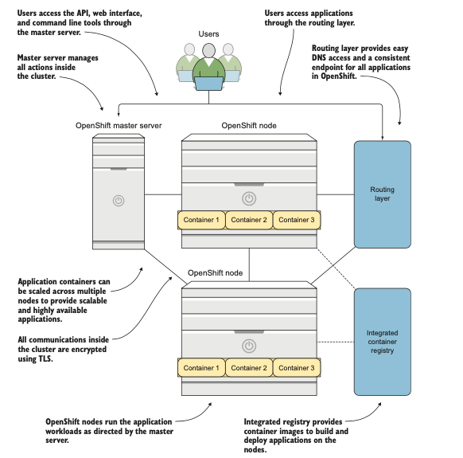



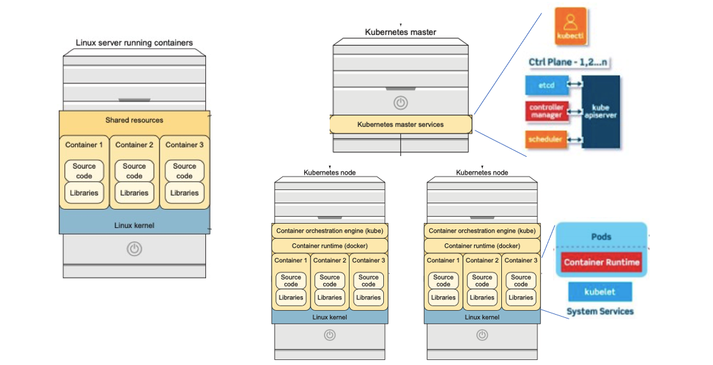
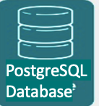
Creating and Managing Persistent Storage for database/Health Status/Message Passing

Slide 13
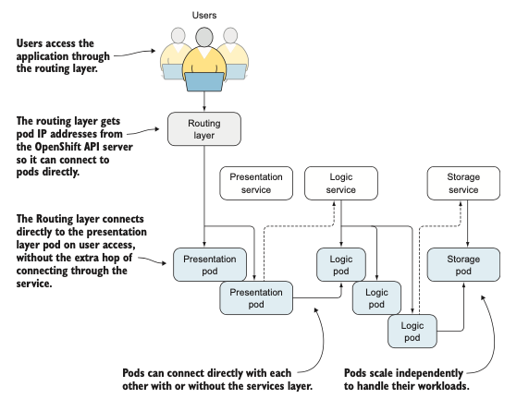
Creating and Managing Persistent Storage for database/Health Status/Message Passing

Slide 14
Creating and Managing Persistent database
OpenShift can use multiple network storage services, including NFS, to provide persistent storage for applications.
When using persistent storage, applications in OpenShift can share data and provide data across upgrades, upgrades, and container replacement.
OpenShift uses persistent volumes to represent available network storage volumes.
Persistent volume claims are associated with a project and match criteria such as capacity needed and access mode to bind to and reserve a persistent volume. Persistent volume claims can be mounted into OpenShift applications as vol- umes, mounting the network storage into the container’s filesystem in the desired location.
OpenShift manages the persistent volume using the proper network storage protocol and uses bind mounts to present the remote volumes in application containers.

Slide 15
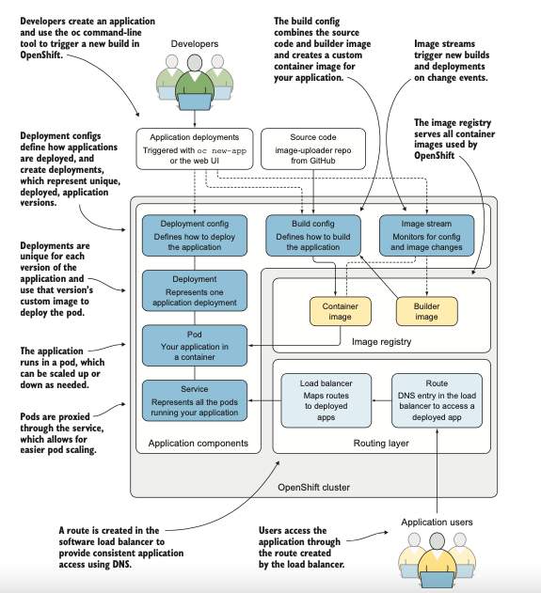
CI/CD pipeline

Slide 16
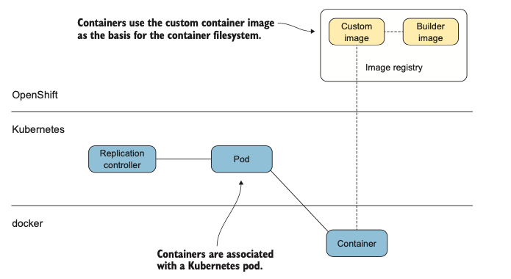
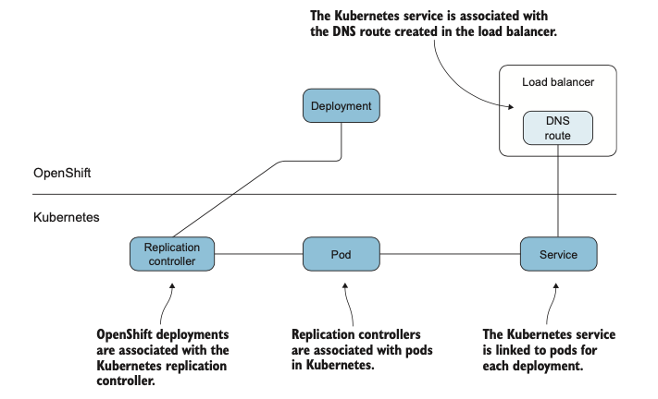
CI/CD pipeline

Slide 17
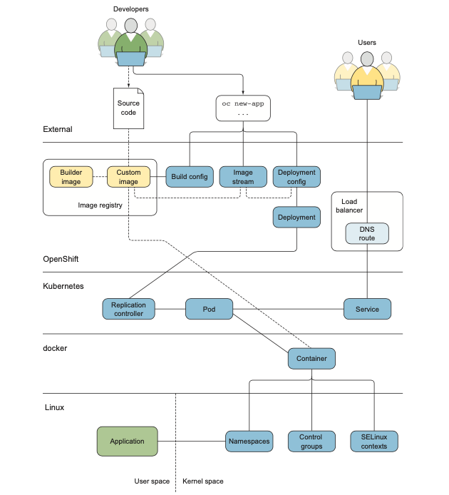
Summary

Slide 19
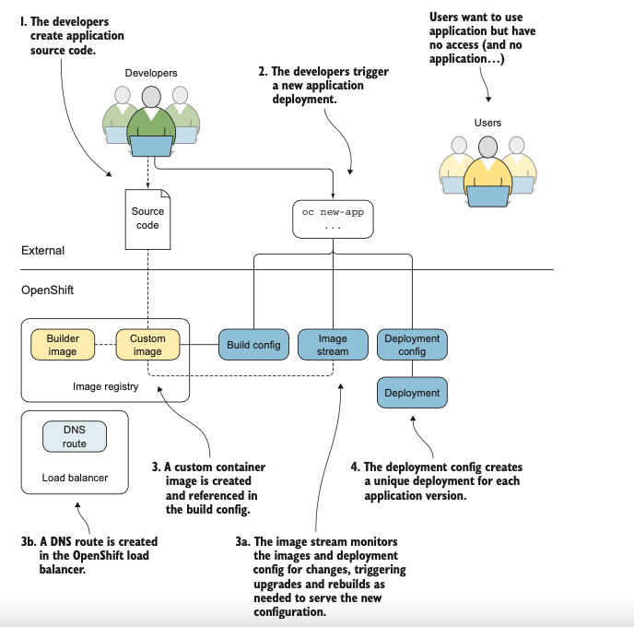

Slide 20
